Slide 1
First…
ArcMap is really picky
If you’re having problems with a CSV:
  Check the file in NotePad or NotePad++
    Excel will hide characters and reformat your data!
  Header names must be 10 letters or less, no punctuation or spaces
  No special characters in cells
  BlueSpray and QGIS are less picky

Slide 2
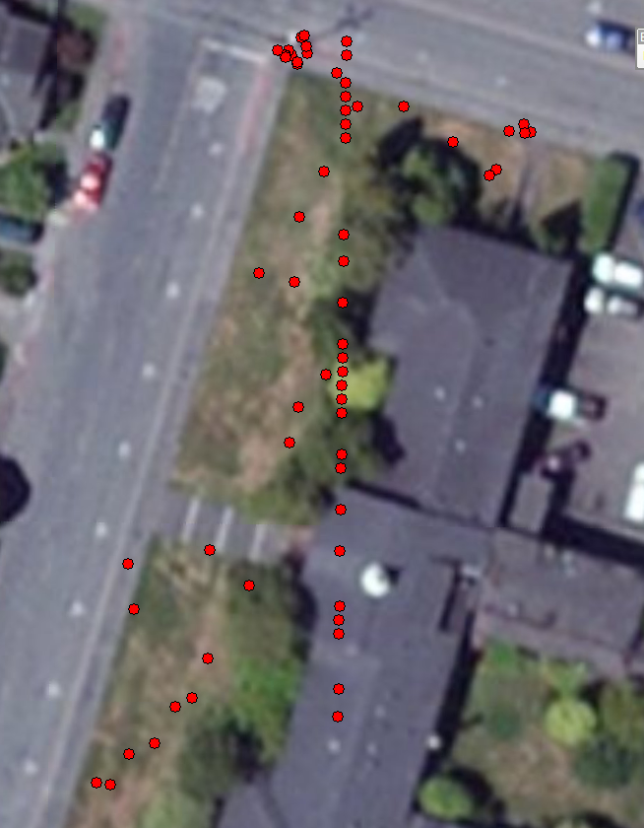

Slide 3
What happened?
Group | Benchmark Location | NAME | Latitude | Longitude | y_proj | x_proj
 |  | 2 | 40.871813 | -124.080055 | 40.871813 | -124.080055
 |  | 3 | 40.871803 | -124.080047 | 40.871803 | -124.080047
 |  | 4 | 40.871804 | -124.080047 | 40.871804 | -124.080047
 |  | 5 | 40.871809 | -124.080058 | 40.871809 | -124.080058
 |  | 6 | 40.871809 | -124.080059 | 40.871809 | -124.080059
 |  | 7 | 40.871809 | -124.080059 | 40.871809 | -124.080059
 |  | 8 | 40.871809 | -124.080059 | 40.871809 | -124.080059
 |  | 9 | 40.871808 | -124.080058 | 40.871808 | -124.080058
 |  | 10 | 40.871808 | -124.080058 | 40.871808 | -124.080058
 |  | 11 | 40.871773 | -124.079989 | 40.871773 | -124.079989
 |  | 12 | 40.871773 | -124.079944 | 40.871773 | -124.079944
 |  | 13 | 40.871813 | -124.080066 | 40.871813 | -124.080066
 |  | 14 | 40.871651 | -124.080081 | 40.871651 | -124.080081
 |  | 15 | 40.871554 | -124.080042 | 40.871554 | -124.080042
 |  | 16 | 40.871822 | -124.080043 | 40.871822 | -124.080043
 |  | 17 | 40.871371 | -124.080125 | 40.871371 | -124.080125
 |  | 18 | 40.87128 | -124.08023 | 40.87128 | -124.08023
 |  | 19 | 40.871824 | -124.08004 | 40.871824 | -124.08004
 |  | 3 | 40.87155 | -124.08 | 4525059 | 408982.7
 |  | 4 | 40.8716 | -124.08 | 4525065 | 408983.3
 |  | 5 | 40.87145 | -124.08 | 4525048 | 408979.6
 |  | 6 | 40.87141 | -124.08 | 4525044 | 408980.5
 |  | 7 | 40.87135 | -124.08 | 4525037 | 408977.8
 |  | 8 | 40.87139 | -124.08 | 4525041 | 408976.2
 | South Stairs | B01 | 40.87148 | -124.08 | 4525052 | 408979.4
 | South Stairs | B02 | 40.87148 | -124.08 | 4525052 | 408979.8
 | South Stairs | B03 | 40.87148 | -124.08 | 4525051 | 408979.4

Slide 4
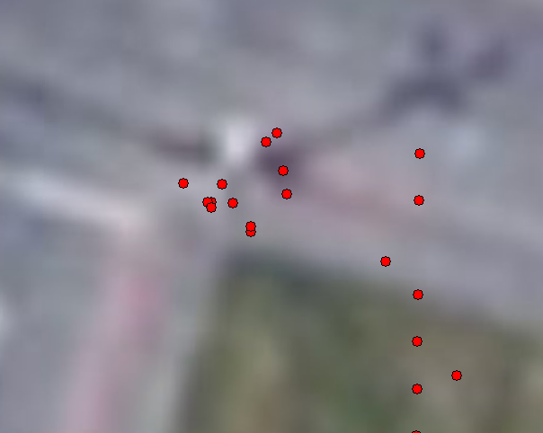
What happened?

Slide 5
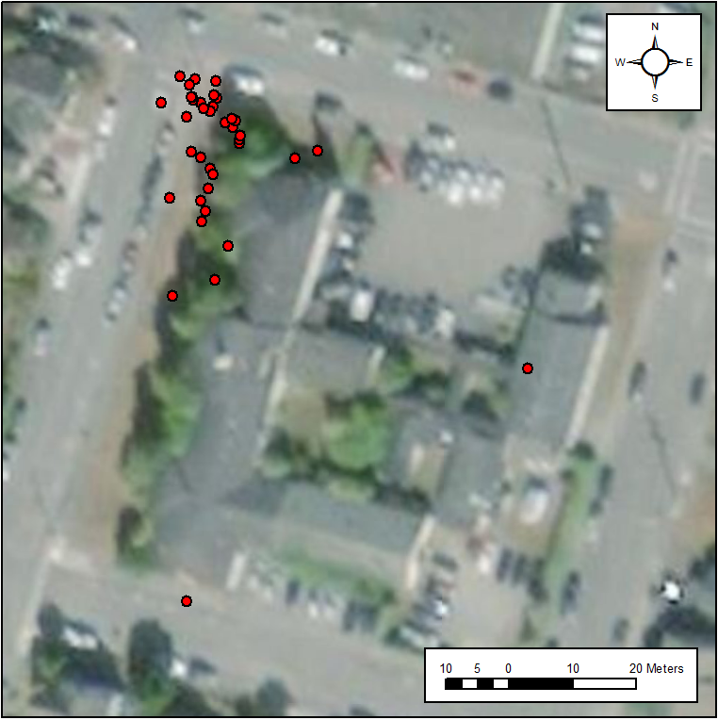
How did we do?
Notes:
Results from GSP 510, Fall 2018

Slide 6
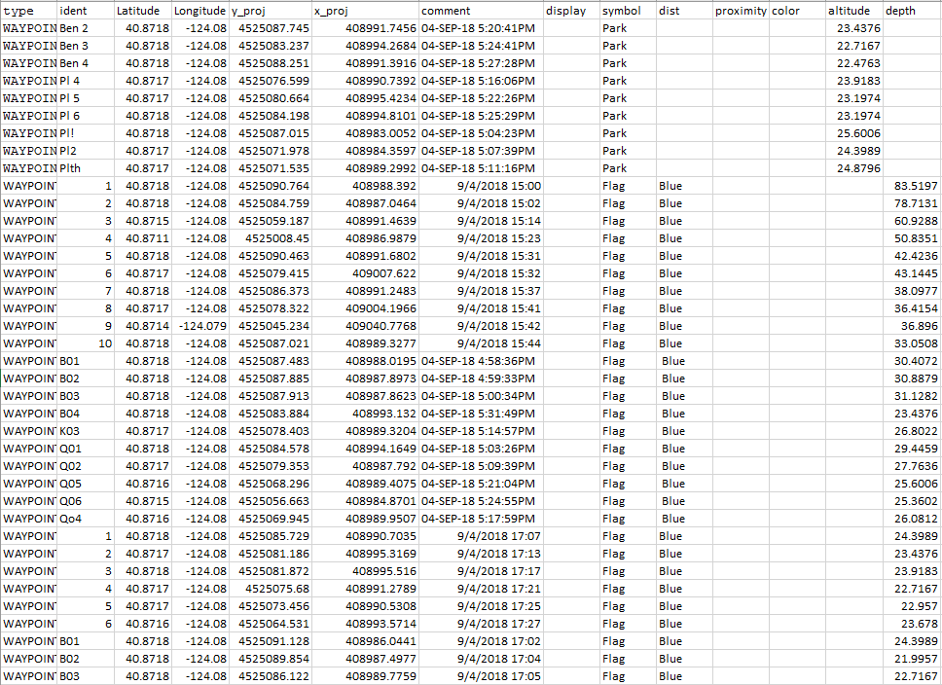
Notes:
Results from GSP 510, Fall 2018

