Slide 1
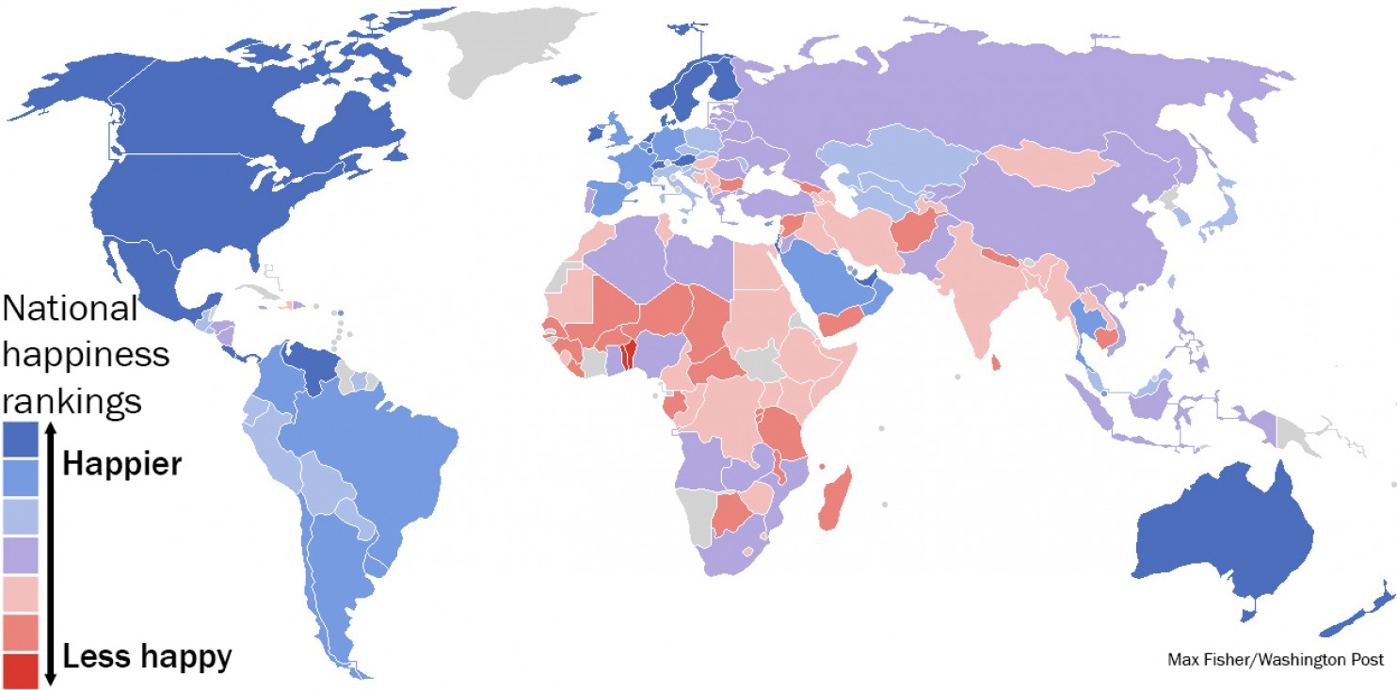
World Happiness Map
The results of Columbia University's World Happiness Report, mapped. (Max Fisher/The Washington Post)
The United States ranks 17th of the 156 ranked countries, behind Mexico (16) and Panama (15).
Notes:
One of my goals is to help increase human happiness, now and in the future.

Slide 2

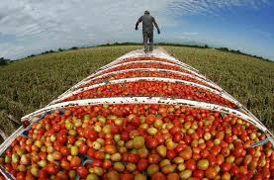
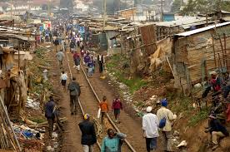
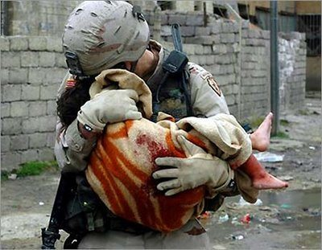
Human Happiness
Humans Need:
Risks:
Safe homes
Clean water
Good food
Socialization
Freedom
War/Armed Conflict
Natural Disasters
Totalitarian Governments
Disease
Famine
Drought
Clean water council
NPR

Slide 3
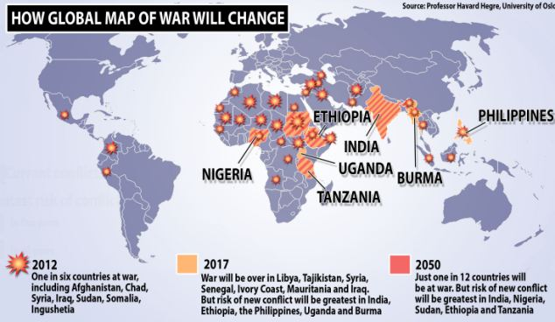
Armed Conflict to Drop to 1 in 12 countries by 2050
Higher education, lower infant mortality and lower population growth are reasons why the world can expect a more peaceful future

Slide 4
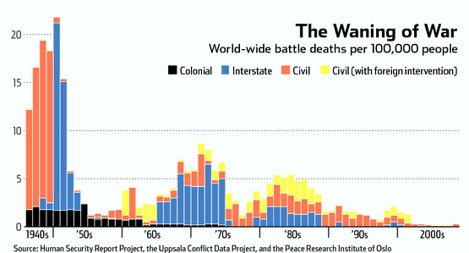
Armed Conflict
Notes:
The number of deaths from conflict have dramatically decreased in the last 70 years.

Slide 5
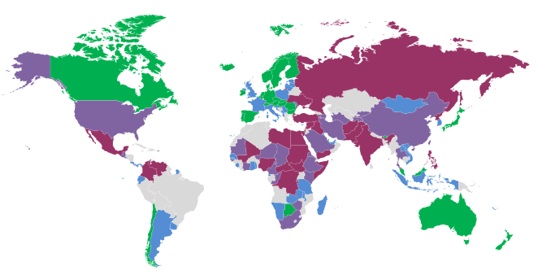
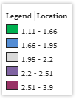
Global Peace Index
Global Peace Index Interactive Map

Slide 6
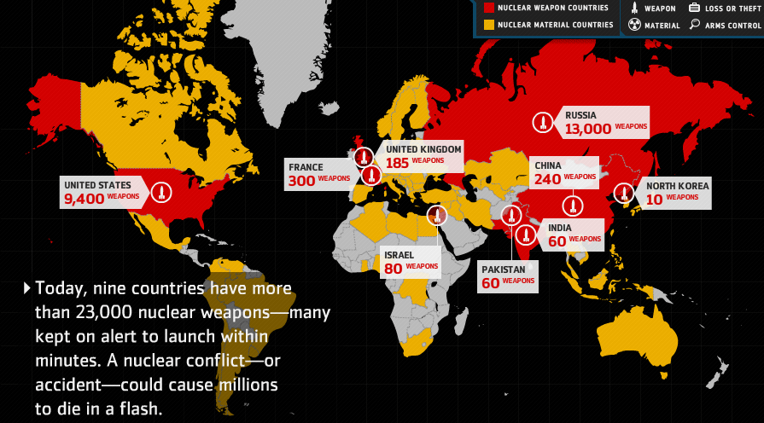
Nuclear Arsenal
$1,000 Billion to be spend in modernization in the next decade, Financial Times
Notes:
We continue to maintain a huge number of nuclear weapons which most folks do not think about today but this is still a major threat to happiness.

Slide 7
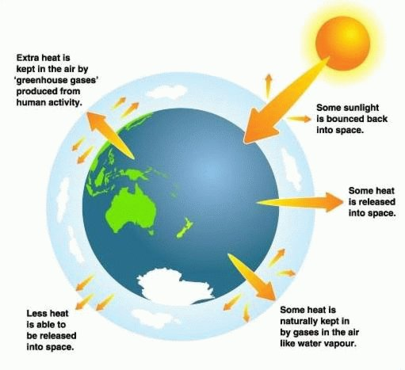
Greenhouse Gasses
http://interculturalclimateaction.wordpress.com

Slide 8
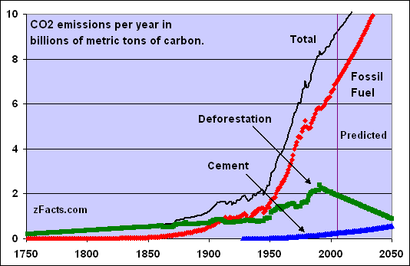
Carbon Dioxide Output
U.S. Dept. Of Energy

Slide 9
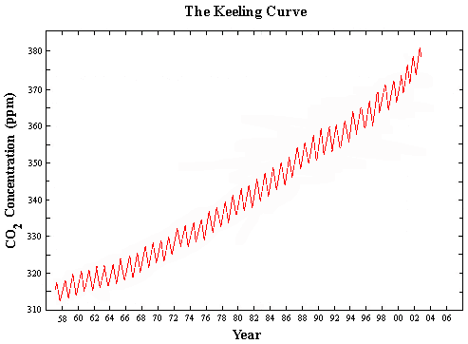
Atmospheric CO2

Slide 10
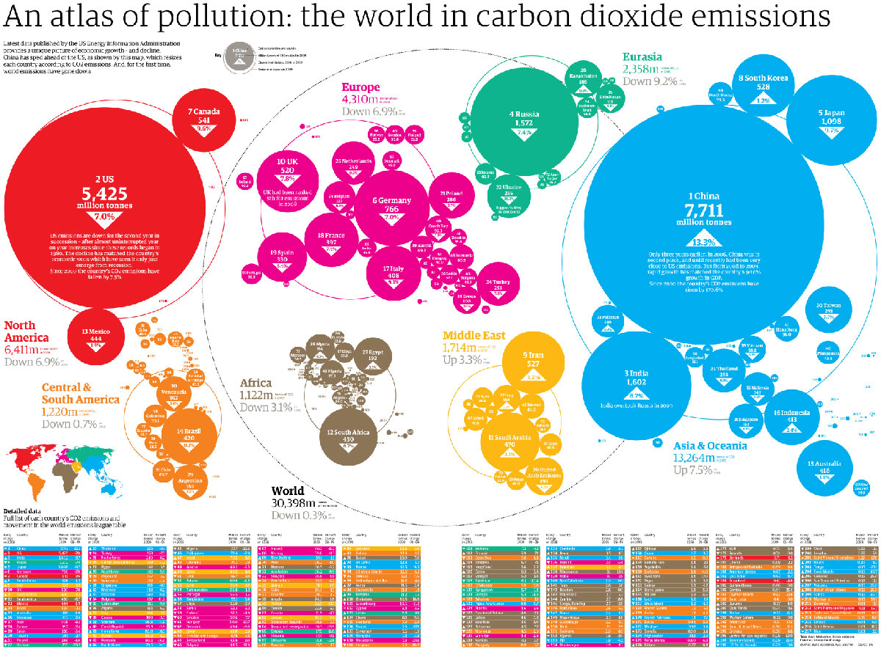

Slide 11
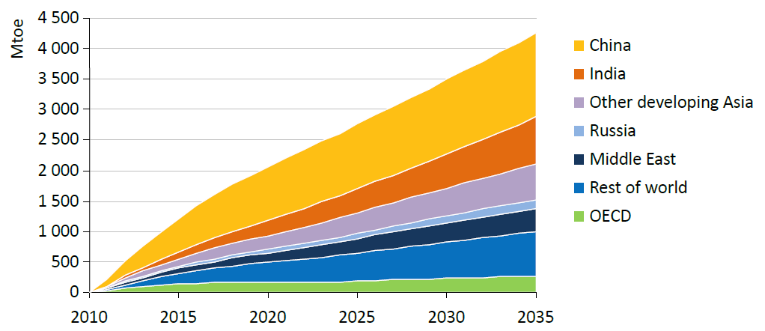
Increase in Energy Demand
International Energy Agency
Notes:
Demand for energy continues to grow.

Slide 12
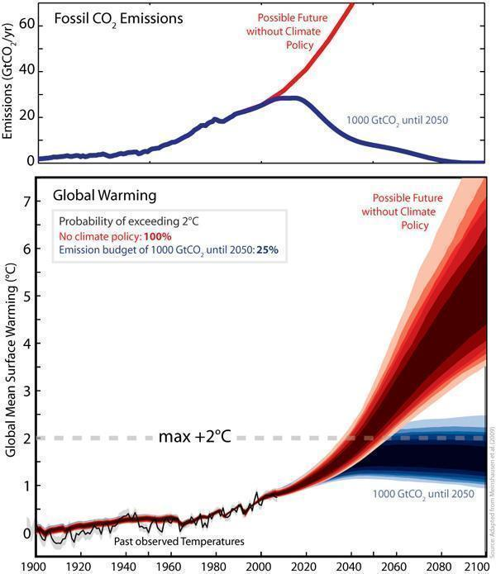
http://www.sciencedaily.com
Notes:
Global CO₂ emissions and warming compared to pre-industrial times for a scenario without climate policy (red) and a scenario in which the emissions are restricted to 1000 billion tonnes of CO₂ (blue) from 2000 to 2050. The intervention can limit the probability of exceeding the 2°C threshold to 25%. (Credit: Image courtesy of ETH Zurich)

Slide 13
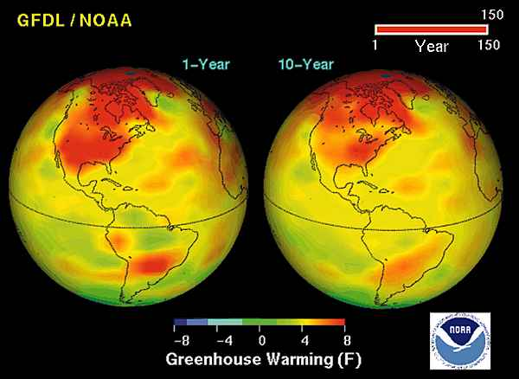
Global Warming
Notes:
Global warming is happening primarily in the northern latitudes and is rapidly changing ecosystems in the arctic.

Slide 14
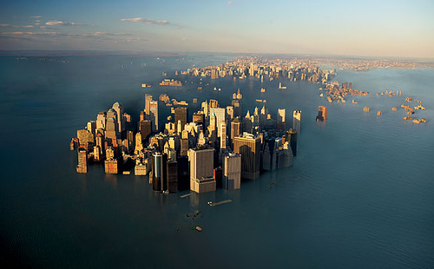
Sea Level Rise
If Greenland ice cap melts:
  7 meter sea level rise
If Antarctic ice cap melts:
  60 meter sea level rise (about 240 feet!)
See: http://geology.com/sea-level-rise/
wordpress.com
Notes:
It will probably take a long time for a 60 meter sea level rise to occur, potentially thousands of years.

Slide 15
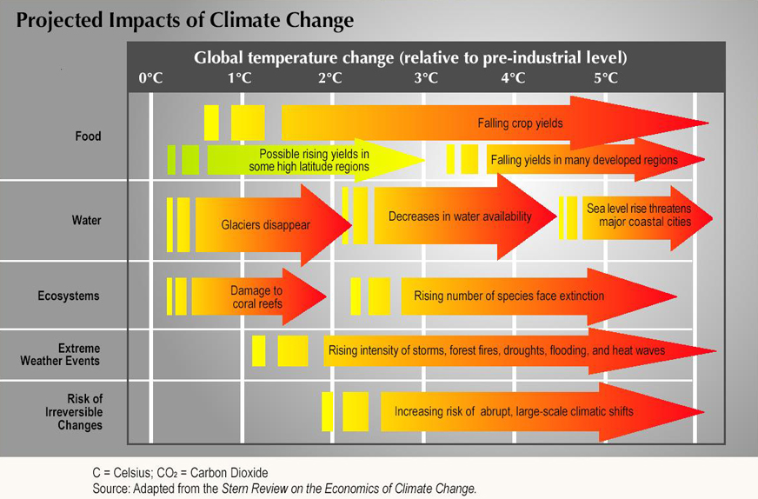
Notes:
Atlantic THC
The real concern with climate change is the increase in temperature causing decreases in food production and water availability.

Slide 16
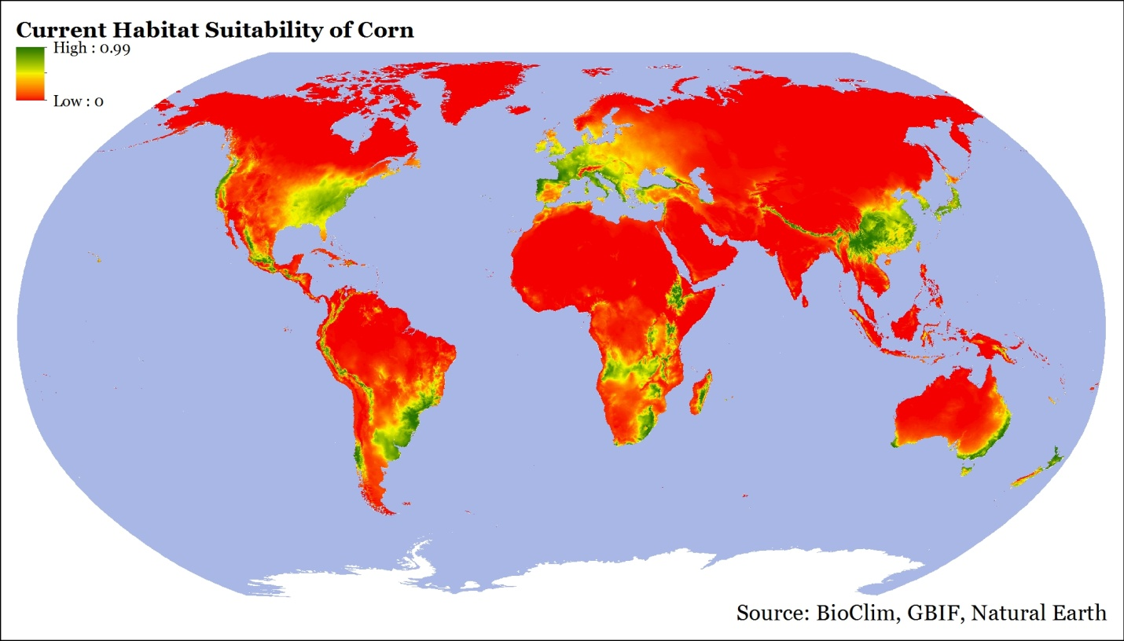
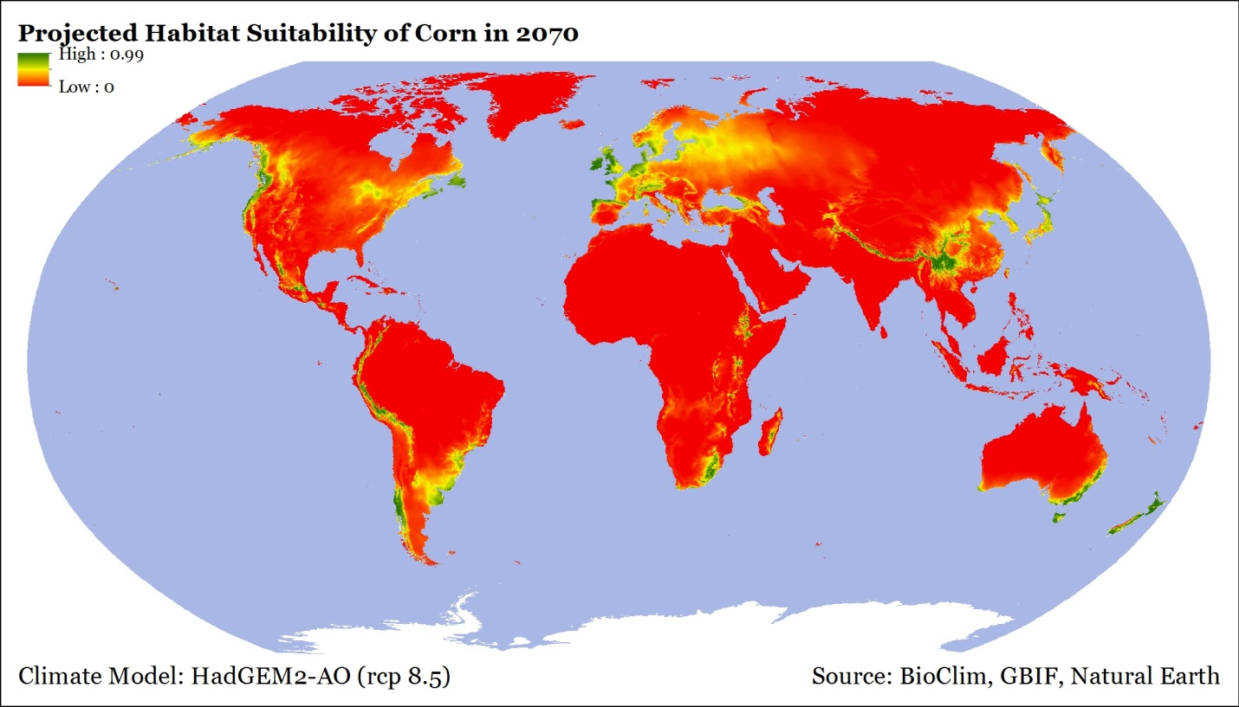
Corn
Habitat

Slide 17
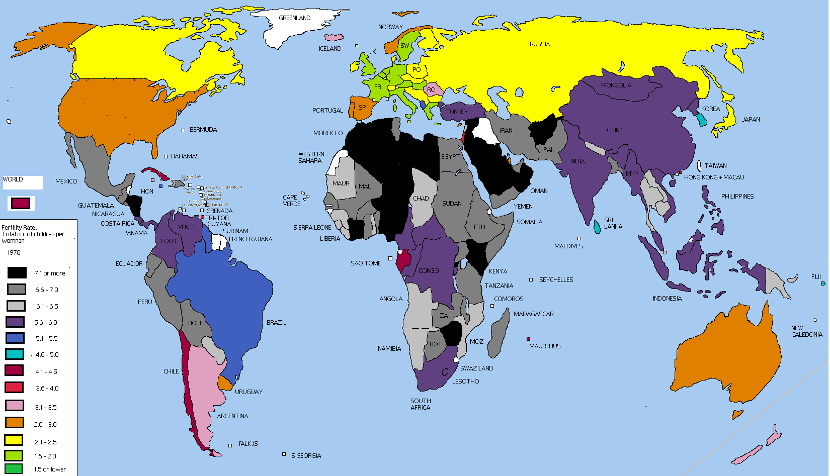
Fertility Rate: 1970
http://www.fooddeserts.org
Notes:
Fertility rates used to be well above replacement (2) so there was rapid population growth.

Slide 18
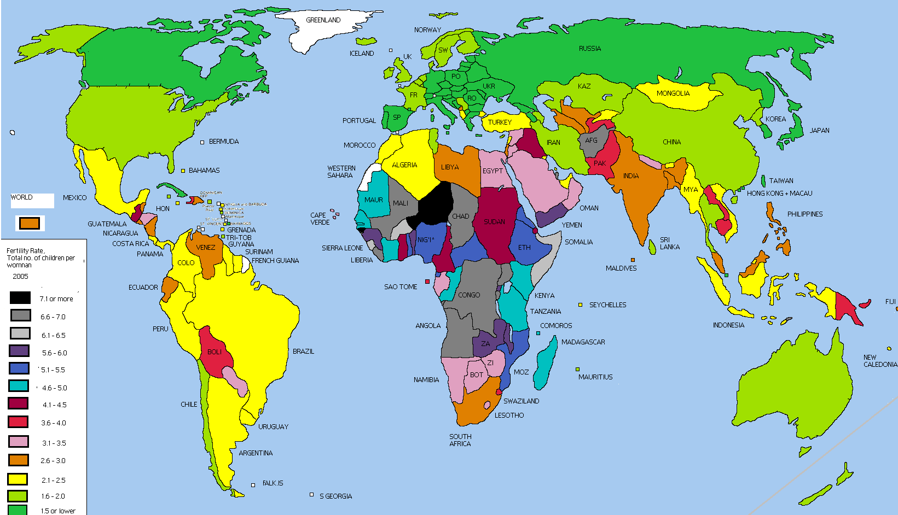
Fertility Rate: 2005
http://www.fooddeserts.org
Notes:
Fertility rates have dropped to near replacement for most of the world, except Africa.

Slide 19
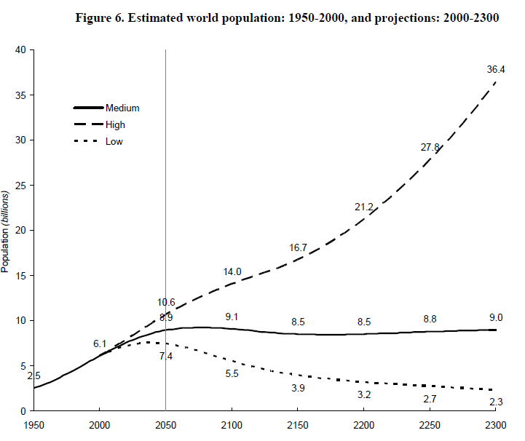
Estimated World Population
WORLD POPULATION TO 2300 - United Nations
Notes:
The UN has esimated that world population may peak at about 2050.

Slide 20
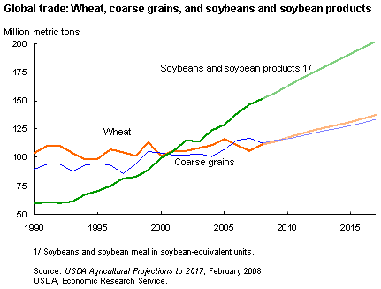
Food Production in Increasing
Notes:
At the same time, world food production has increased steadily but partly because of the use of fertilizers and industrial agricultural equipment.

Slide 21
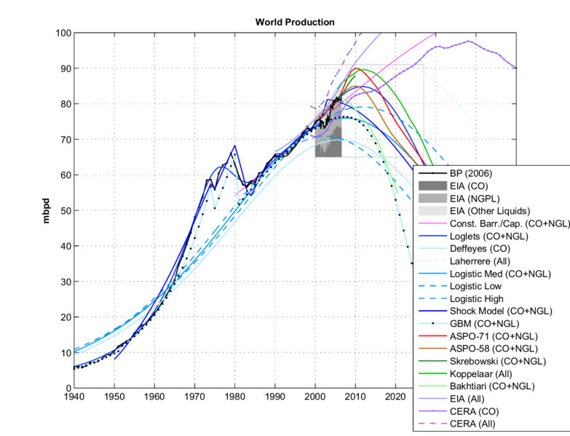
Peak Oil?
www.greatdreams.com
Notes:
Everyone agrees that we will run out of fossil fuels in the future but there is little agreement on when. This will cause oil to steadily increase in cost and eventually case oil scarcity.

Slide 22
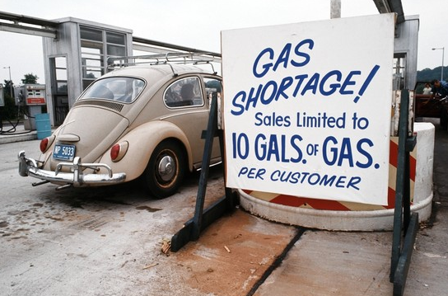
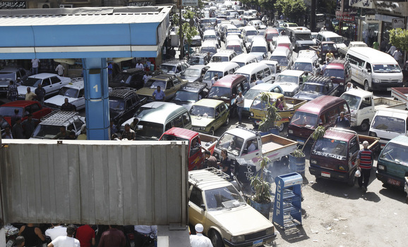
Oil Shortages
OPEC Oil Embargo in 1973
Wall Street Journal
Shortage in Cairo
dailyimpact.net
Notes:
A fuel shortage in June clogs the streets of Cairo with gas lines. Egypt’s oil production has peaked, and now so has the patience of its people.
http://www.dailyimpact.net/2013/07/11/the-arab-winter-stalks-egypt-whos-next/

Slide 23
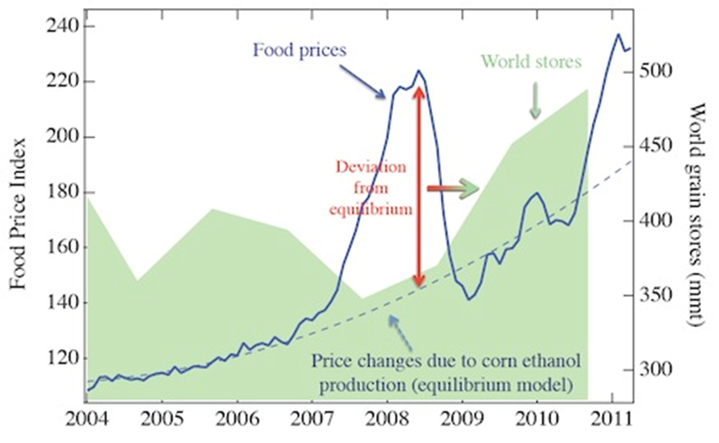
Ethanol Food Connection
2011, Johson, EM, Commodity Traitors: Financial Speculation on Commodities Fuels Global Insecurity,
Scientific American Blog.
Notes:
The price of oil is tied directly to food production because as soon as the price of gasoline reaches about $4 per gallon, farms switch swelling corn for food and large quantities are sold for ethanol production.

Slide 24
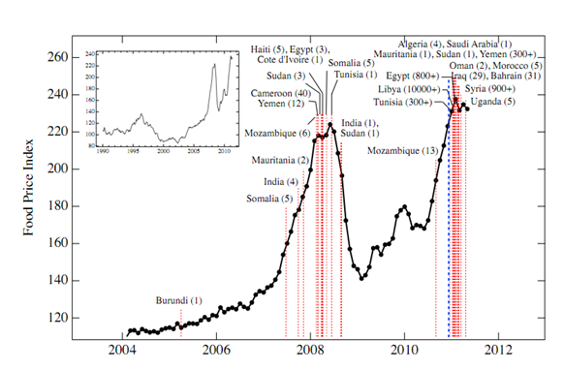
Food Riots
Technology Review, MIT, http://www.technologyreview.com/blog/arxiv/27083/
Notes:
This has caused food riots in areas far from the US.

Slide 25
Drought
Increasing
Population
Invasive
Species
Climate
Warming
Sea
Level Rise
Greenhouse
Gases
Marine
Acidification
Over-fishing
Decrease
in Food Availability
Pollution
Fertilizers
Reduced
Phosphorus
Shortage
Oil
“Scarcity”
Biofuels
Increase
Famine
Disease
Death

Slide 26
Drought
Climate
Warming
Sea
Level Rise
Greenhouse
Gases
Marine
Acidification
Decrease
in Food Availability
Burning Oil, Coal, and Natural Gas
Pollution
Oil
“Scarcity”
Biofuels
Increase
Famine
Disease
Death

Slide 27
Why not Nuclear?
Potential for disasters
Limited supply of fuel
No plan to store the waste
  Estimates for the time required to store nuclear waste range from 1000 to 100,000 years.
Oldest stable government in the world is Iceland at about 800 years.
  The US is second at about 240!
Notes:
Oldest stable government is Iceland

Slide 28
All we have to do is:
Stop burning fossil fuels!
  Including uranium.
Switch to sustainable, clean solutions
Conserve energy
Have fewer children
It’s probably too late to avoid major problems but the sooner we get started, the less problems we will have

Slide 29
Providing all global energy with clean renewable power
3,800,000 5MW wind turbines,
49,000 300MW concentrated solar plants
40,000 300 Mw solar PV power plants
1.7 billion 3kW roof top PV systems
5350 100MW geothermal power plants
270 new 1300MW hydroelectric power plants
720,0000 75MW wave devices
490,000 1MW tidal turbines
Jacobson M. Z., M. A. Delucchi, 2011, Providing all global energy with wind, water, and solar power, Part I:
Technologies, energy resources, quantities and areas of infrastructure. Energy Policy
Notes:
By 2030

Slide 30

Short-Term Thinking Leads to Long-Term Disasters
Notes:
At no other point in history has a species had the knowledge to prevent it’s own demise, and continued on a path of destruction.

Slide 31
Short term thinking leads to long-term disasters
Companies report earnings and profit every 3 months
The primary measure of success in the US is:
  National: Gross National Product
  Personal: Annual salary and wealth
  “He who dies with the most toys wins”
    His children do not.

Slide 32
The Risk
 | Do Nothing | Take Action
Global Change is not happening | No effect | Cleaner environment for everyone Economic impacts?
Global Change is happening | Billions starve Most major cities have to move Island cultures relocated Low-lying countries inundated 20-50% species lost | Less starve Less impact on cities Less impact on island cultures Less impact on low-lying countries Less species loss
Adapted from YouTube video: The most terrifying video you'll ever see
Notes:
How about we stop arguing about if and why and start taking action to mitigate the potential problems?

Slide 33
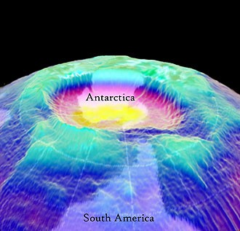
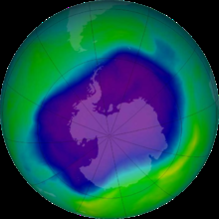
What does this have to do with GIS?
NASA
Wikipedia

Slide 34
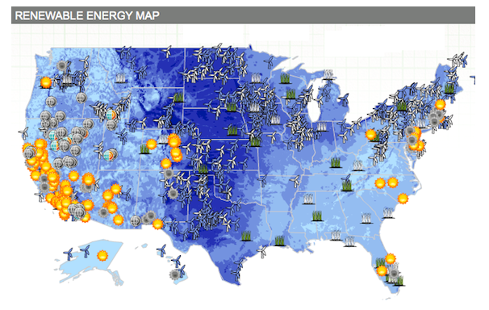
US Renewable Energy
http://thinkprogress.org/climate/2011/11/03/360531/getting-clean-energy-economy-facts/?mobile=nc

Slide 35
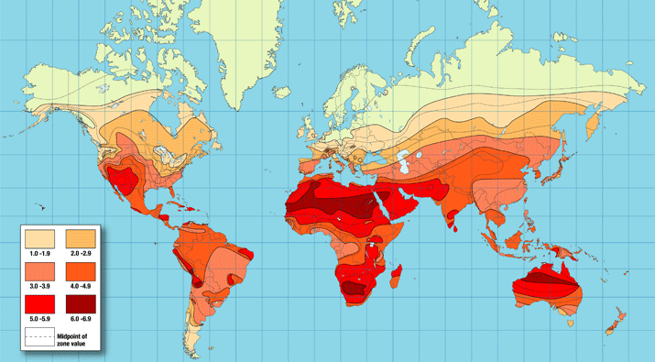
Solar Engery
http://www.exploregreenenergy.com

Slide 36
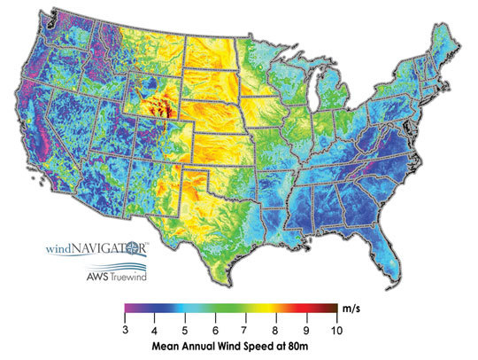
Mean Annual Wind Speed
http://myweb.unomaha.edu/~gpagett/CartGIS/gallery.htm

Slide 37
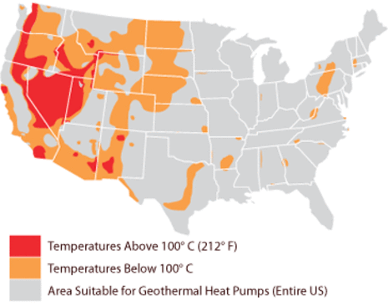
Geothermal

Slide 38
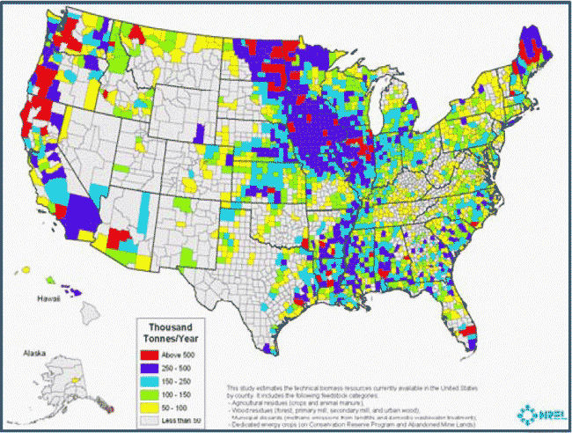
Biofuel

Slide 39
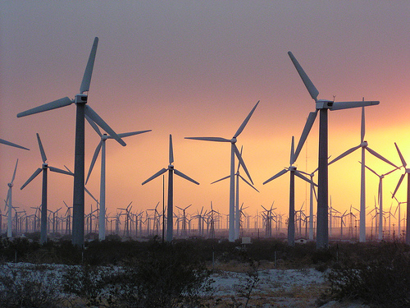
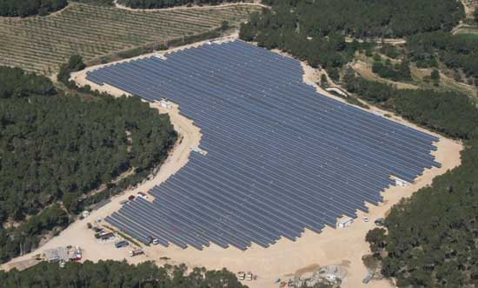
Pressure on Critical Land
Food
Energy
Biodiversity
Water

Slide 40
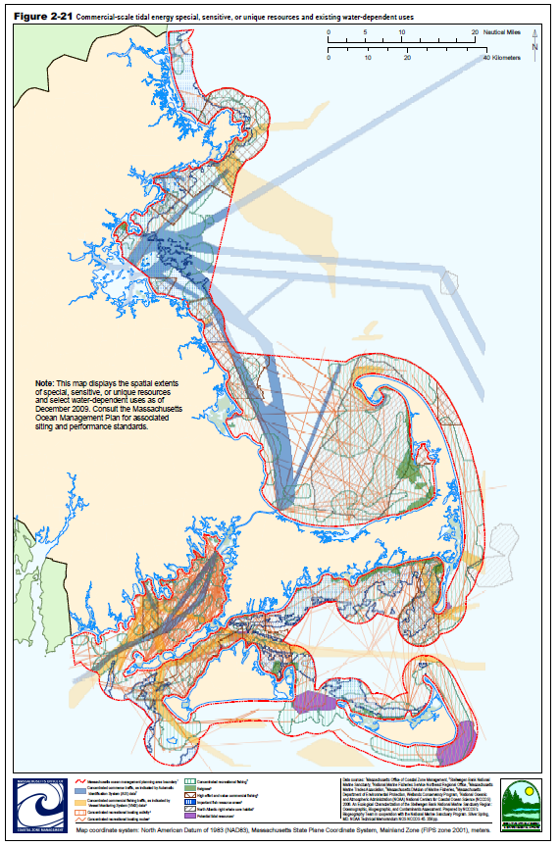
MSP
Marine Spatial Planning
Mass. Ocean Management Plan

Slide 41
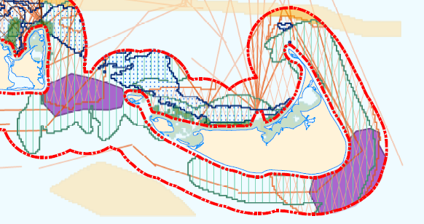
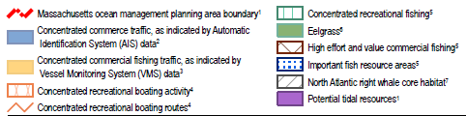
Nantucket Island

Slide 42
What can we do?
Listen, then define and describe the issue
Collect and qualify data
Analyze, model, map, and write
Convey results, with uncertinaties, to all interested parties
Learn and educate
Maps can make a difference, locally or globally

Slide 43
Additional Slides

Slide 44
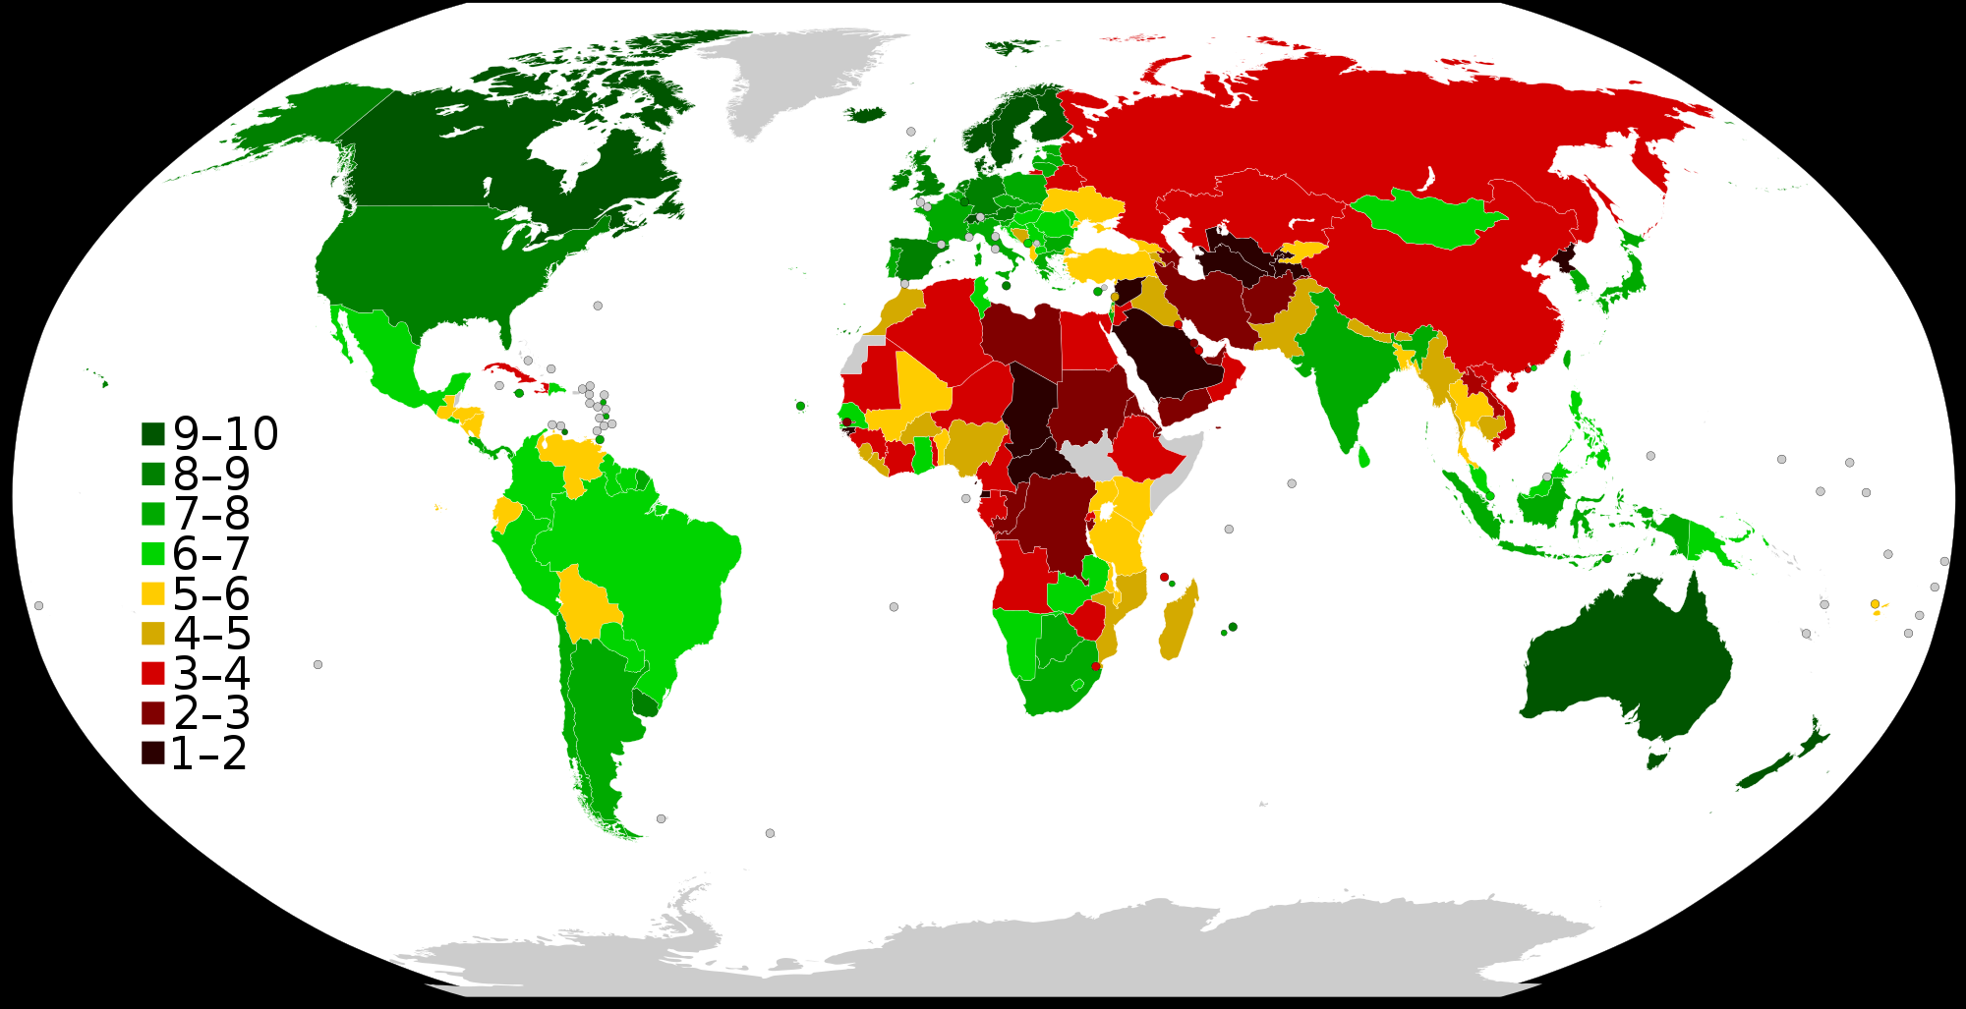
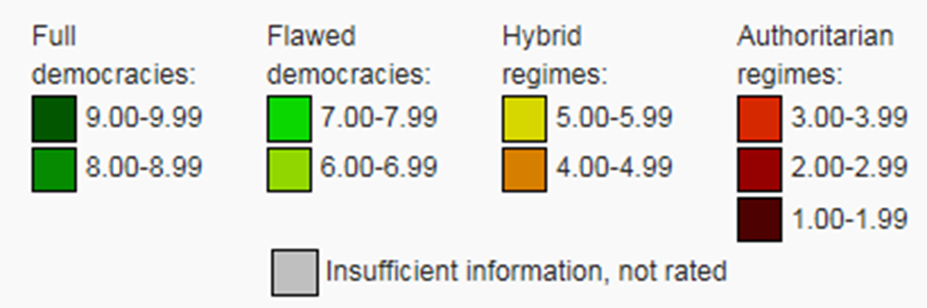
Economist Intelligence Unit Democracy Index Map for 2014
https://en.wikipedia.org/wiki/Democracy_Index

Slide 45
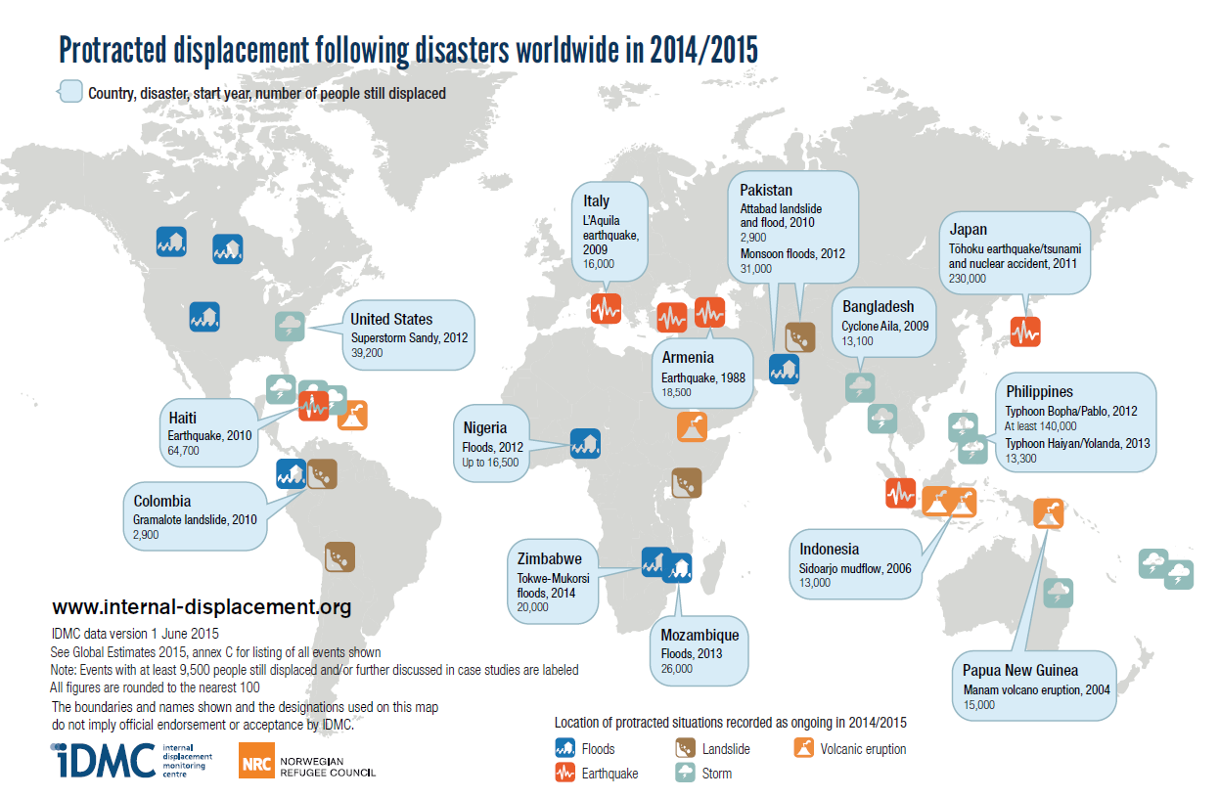

Slide 46
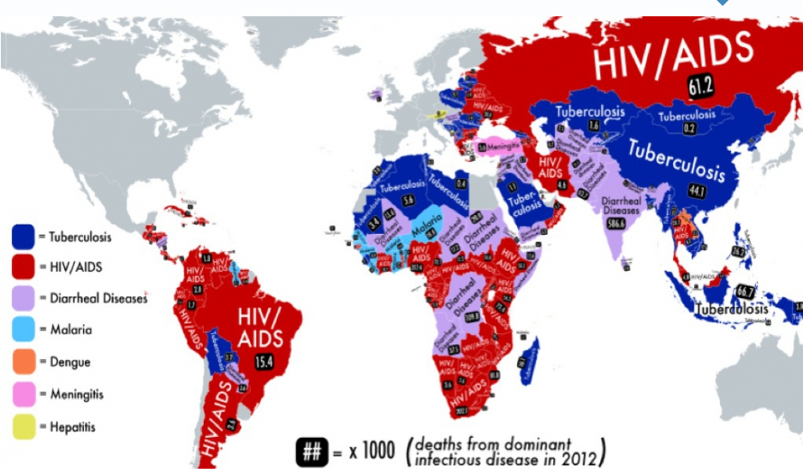
Which is the deadliest infectious disease where you live?
http://www.pri.org/stories/2014-10-27/map-shows-which-deadliest-infectious-disease-where-you-live

Slide 47
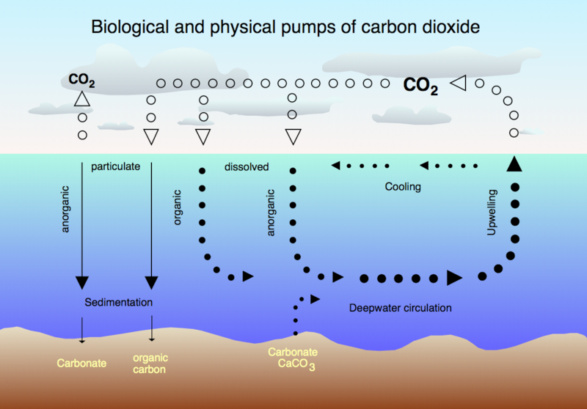
Ocean Acidification
Notes:
Another effect of atmospheric CO2 is that the ocean becomes more acidic as it absorbs CO2.

Slide 48
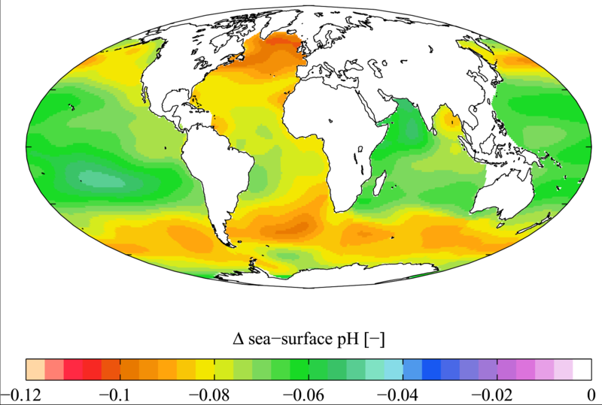
Increase in pH Since 1700s
Notes:
This has caused a global increase in pH and recently caused oyster failures because the small oysters could not form their shells. This has the potentially to cause collapses in major fisheries.

Slide 49
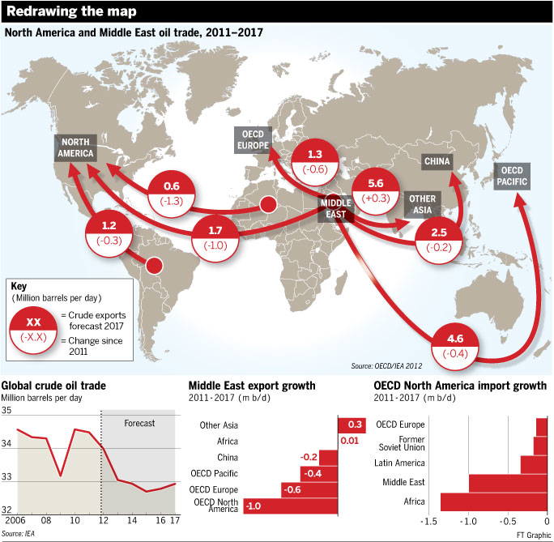
Notes:
Oil goes for btween 65 to 90 dollars a barrel, 1 million a day = 65 million to 90 million a day, 24 to 32 billion (about 30 billion a year)

Slide 50
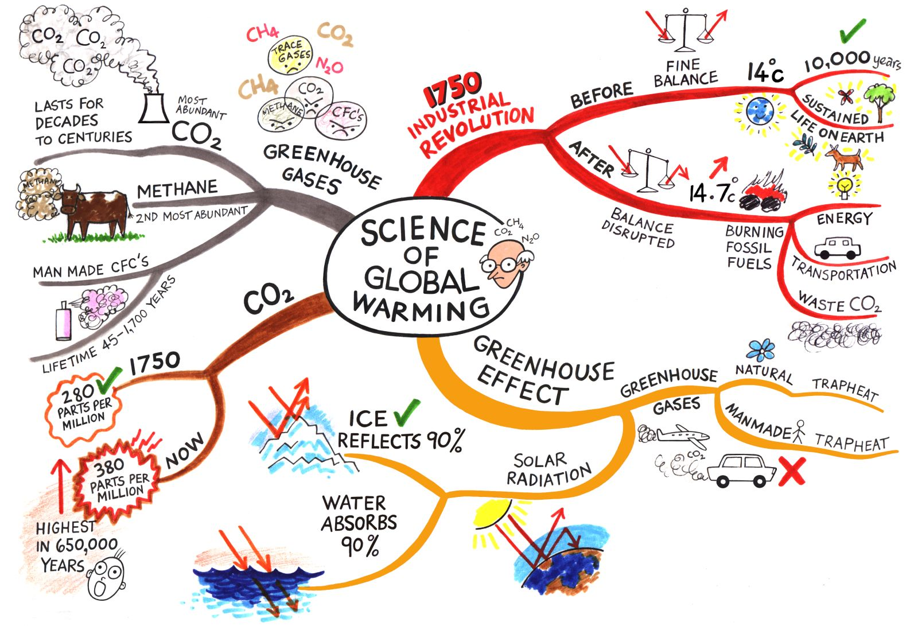
sparkaction.org

Slide 51
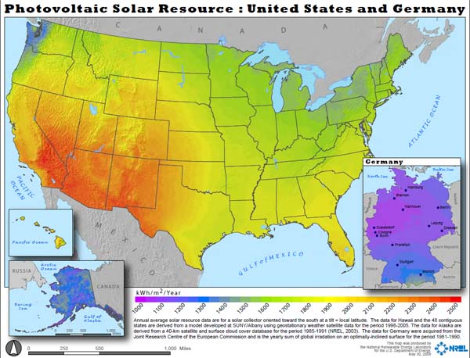
Solar in the US

Slide 52
Spatial-Tempral Planning
Disease Outbreaks
Safety/Emergency services
Recreation
Economics
Fish & Wildlife
Agriculture
Cultural Resources
Energy Production
Legal Issues
Ownership

Slide 53
Impacted by Ocean Acidification
Coccolithophores & Foraminifera: Plankton
  > ?
Corals:
  > huge variety of fish
Echinoderms: star fish, echinoderms
  > Mammals
Crustaceans: Shrimp, crabs, lobsters
  > birds, mammals, fish, and humans
Molluscs: Snails
  > birds, others

Slide 54


Australian Fire Storms
ksj.mit.edu

Slide 55


Slide 56
Food Security?
Demand for energy is increasing
  We will run out of fossil fuels
  Switch to biofuel will reduce food production
Population is increasing
  But the rate of increase is slowing
Food consumption is increasing
  Food production is increasing
  But we are running out of phosphorus

Slide 57

Interconnected World
http://www.pikeresearch.com/tag/biofuels

Slide 58



Slide 59

Climate Change
Caption: Figure 1. Rainfall deciles across Australia for 1 January 1997 to 31 December 2009; deciles based on climatology from 1900 to 2009 (Bureau of Meteorology)

Slide 60

Increasing Food Consumption

Slide 61


Coral Reef Bleaching
http://www.duke.edu

Slide 62


Threats to Biodiversity
Biodiversity Threat: riverthreat.net

Slide 63

Human Water Security
Human Water Security Threat: riverthreat.net

Slide 64



Slide 65

Predicted Temperature Increase
Degrees F
Year
http://www.dailytemperaturecycle.com/fossilfuellifetime.htm

Slide 66


Slide 67

Food Stocks are Low

Slide 68

Peak Phosphorus
Figure 1: Peak phosphorus ‘Hubbert’ curve, indicating that production will eventually reach a maximum, after which it will decline (source: Cordell, Drangert and White, 2009) ^{i}

Slide 69

Ice Cover in Arctic

Slide 70
Grand Challenges
Eradicate extreme poverty and hunger
Achieve universal primary education
Promote gender equality
Reduce child mortality
Improve maternal health
Combat diseases
Ensure environmental stability
Develop Global Partnership for Development
United Nations Millennium Development Goals

Slide 71


sparkaction.org

Slide 72
“Renewable, Clean, Energy”
Solar: requires trace minerals
Wind: minerals and species impacts
Wave/tidal: minerals and species impacts
Geothermal: limited availability?
Hydroelectric: limited locations, sediment
Biofuel: Deforestation, food -> fuel, marginal in the US
Nuclear: impacts, danger, storage
Conservation?

Slide 73

US Energy Sources
http://www.instituteforenergyresearch.org

Slide 74

US Renewable Energy
http://www.instituteforenergyresearch.org
Notes:
- Biomass and hydro is down because of draughts, solar increasing but still small

Slide 75

Increased CO2 -> Warming

Slide 76



China Renewable Energy Center

Slide 77

Energy Emissions
Stern Review

Slide 78

Energy Usage In New York

Slide 79

Global Potential Energy

Slide 80


Military
Expenditures
Notes:
A the same time, military expenditures in the US remain high. The map on the bottom uses a special approach that makes a polygon the size of an attribute, either increasing or decreasing it based on the value. This map shows how the US dominates world military spending while the Russian Federation actually spends very little.

Slide 81
Nuclear Arsenal
Imagine, a room, awash in gasoline. And there are two implacable enemies in that room. One of them has 9,000 matches. The other has 7,000 matches. Each of them is concerned about who’s ahead, who’s stronger. Well, that's the kind of situation we are actually in.
  Carl Segan

Slide 82

Arctic Ice Extent 2010
Magenta line indicates median ice extent for 1979-2000, NOAA
Notes:
For the first time in human history, there is a “northwest passage” open during the summer.

Slide 83


Greenland Ice Melt
NASA
Notes:
The entire ice cap of Greenland was defrosting in July of 2012, this is unprecidented in at least 150 years

Slide 84

World Phosphorus Reserves
http://www.thebrokeronline.eu/en/Articles/Peak-phosphorus
Notes:
Another threat to food production is that we have a limited supply of phosphorus, an important fertilizer.

Slide 85

Notes:
Countries that have strong economies are also investing in other countries and purchasing land to produce food for export. This could reduce local production capacity.

Slide 86

Notes:
The highest number of undernourished people are in Africa.

Slide 87

Change in Cereal Production
Gornall, Implications of climate change for agricultural productivity in the early twenty-first century,
The Royal Society, Biological Sciences
Notes:
Shows the predicted change in cereal production yield based on climate change scenarios.
Notice that there is actually a potential increase at first in the northern latitudes but then a uniform negative trend in output.

Slide 88


Slide 89

Global Armed Conflict
International Institute for Strategic Studies (IISS) Armed Conflict Database
Notes:
There are still armed conflicts but they are relegated to increasingly smaller areas of the globe.

