Slide 1
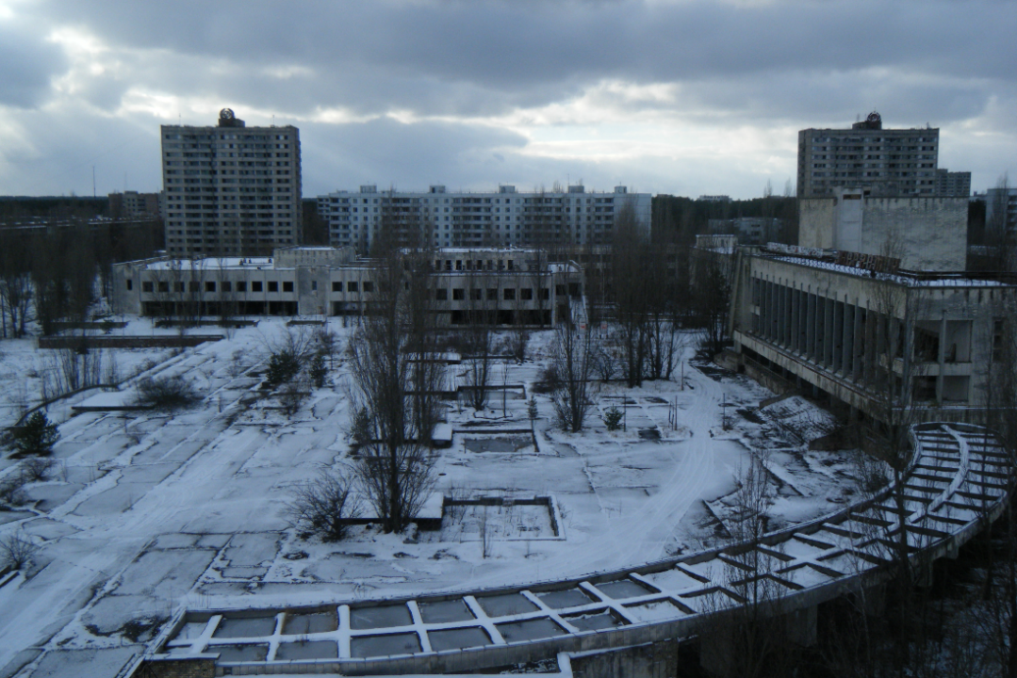
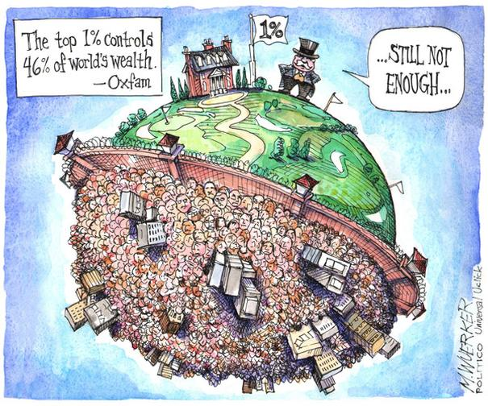
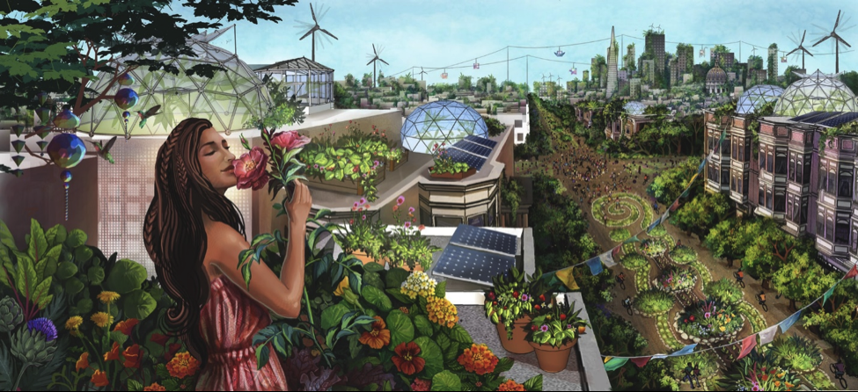
What will the world look like in 2100?
Nuclear Winter
Chernobyl in Winter
www.oxfam.ca
Orwell’s 1984
thebluereview.org
Ecotopia
Notes:
https://thebluereview.org/utopian-writers-american-west/

Slide 2
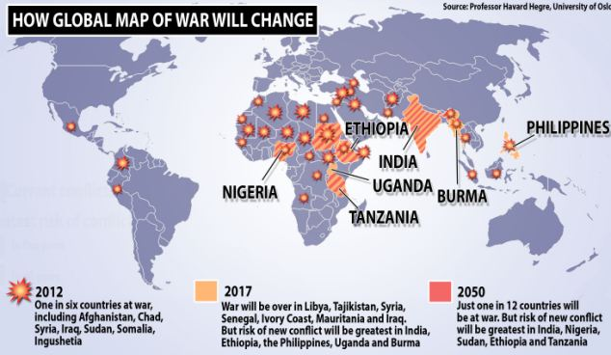
Armed Conflict to Drop to 1 in 12 countries by 2050
Higher education, lower infant mortality and lower population growth are reasons why the world can expect a more peaceful future

Slide 3
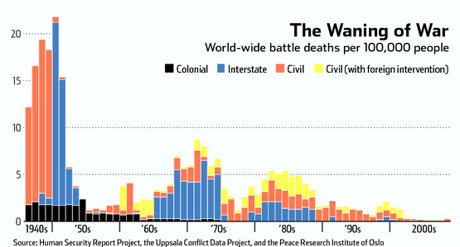
Armed Conflict
Notes:
The number of deaths from conflict have dramatically decreased in the last 70 years.

Slide 4
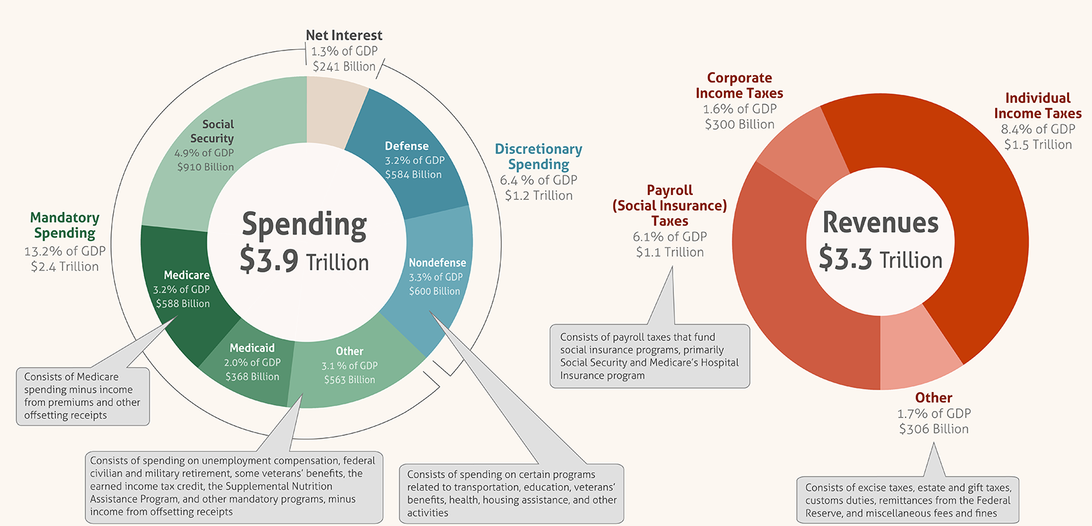
US Federal Budget
122 million taxpayers, average of $12,300 per taxpayer

Slide 5
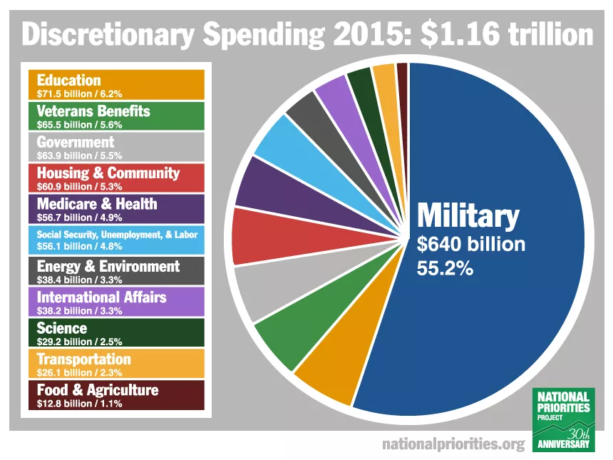

Slide 6
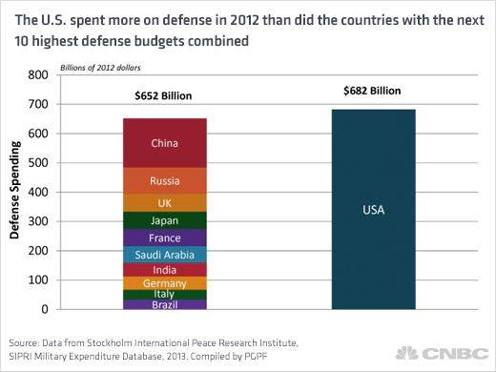

Slide 7
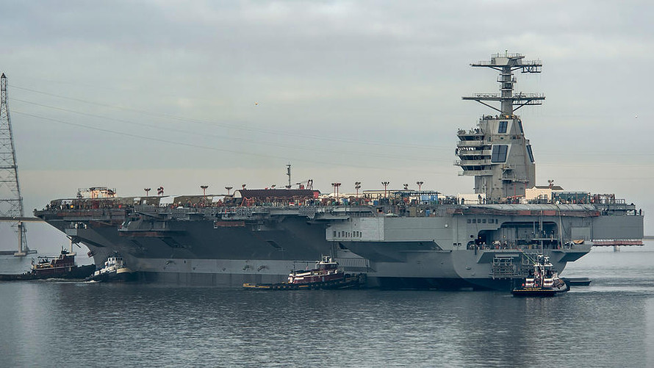
New $13 Billion Aircraft Carrier
Notes:
http://www.marketwatch.com/story/the-us-navys-new-13-billion-aircraft-carrier-will-dominate-the-seas-2016-03-09
House 4500 people, 90,000 ton weight

Slide 8
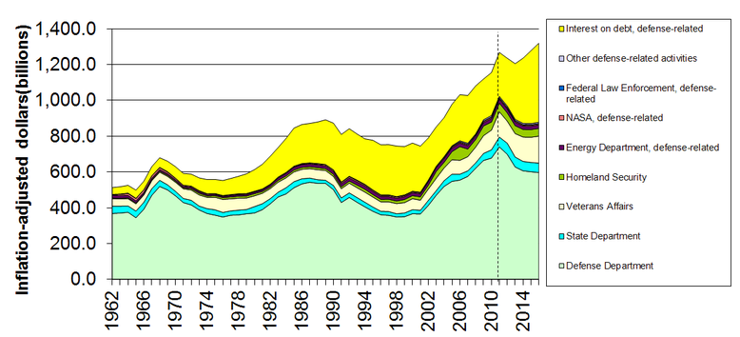
Military-Related Spending
https://en.wikipedia.org/wiki/Military_budget_of_the_United_States

Slide 9
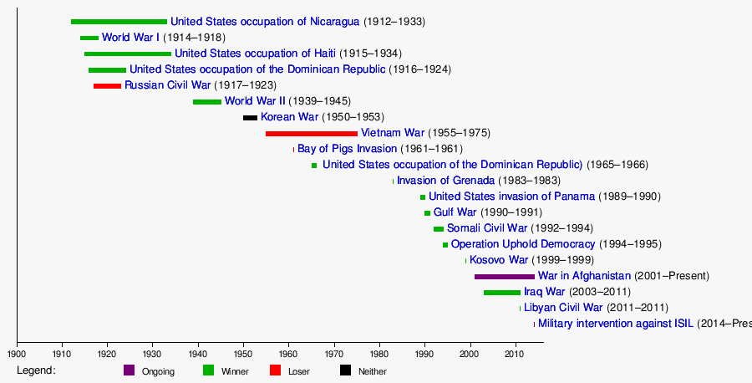
In 239 years, 222 years at war
https://www.quora.com/Why-has-America-waged-so-many-wars

Slide 10
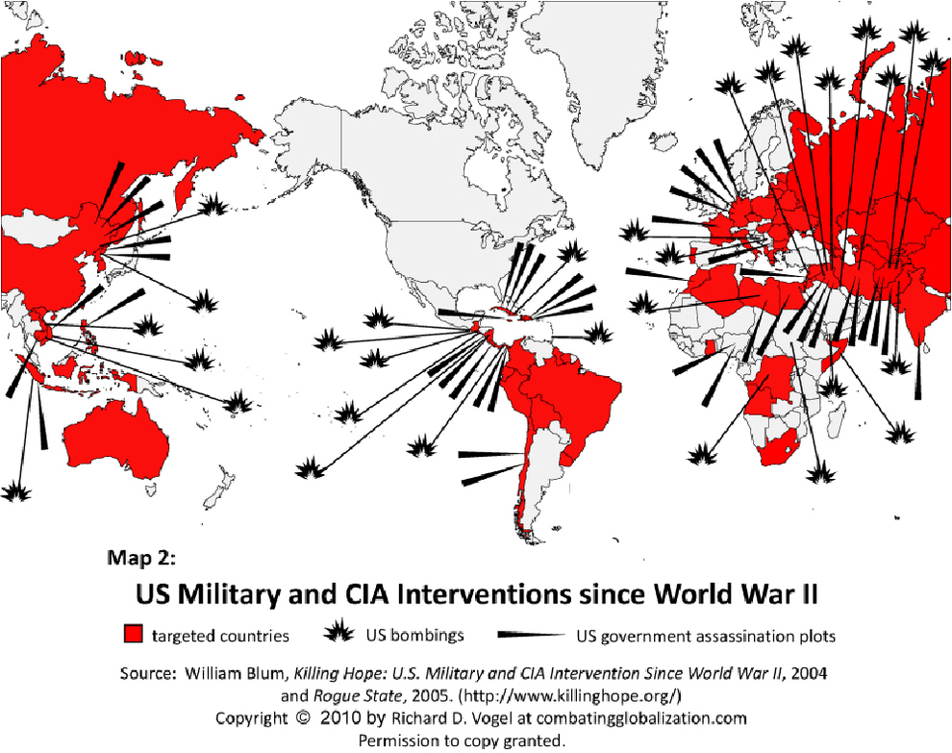
Notes:
US overturned a democratically elected government in Chile when they threatened to nationalize the mines. The government was replaced by a military dictatorship.
US overturned the government of Iran when they threatened to nationalize the oil fields, the government was replaced by the Shah, a ruthless dictator that tortured and willed 200,000 of his own people. Ayatollah Khomeini led a revolution against the Shah and today Iran's government is elected but our enemy.
https://www.youtube.com/watch?v=-2d-yXtm2ME

Slide 11
US Allies
US Enemies
E. U., Britain (democracies)
North Korea (dictatorship)
Saudi Arabia (monarchy)
Iran (constitutional monarchy)
1953
Iran (The Shah)
1979
Iran (Islamic democracy)
Iraq (Saddam Hussein)
1990
Iraq (Saddam Hussein)
2003
Iraq (Islamic democracy)
1973
Chile (Allende)
Chile (Pinochet)
Notes:
A form of government in which power is explicitly vested in the people, who in turn exercise their power through elected representatives. Today, the terms republic and democracy are virtually interchangeable, but historically the two differed.
Iran became our enemy in 1941 when the prime minister nationalized the oil fields
Shah of Iran: https://en.wikipedia.org/wiki/Mohammad_Reza_Pahlavi

Slide 12
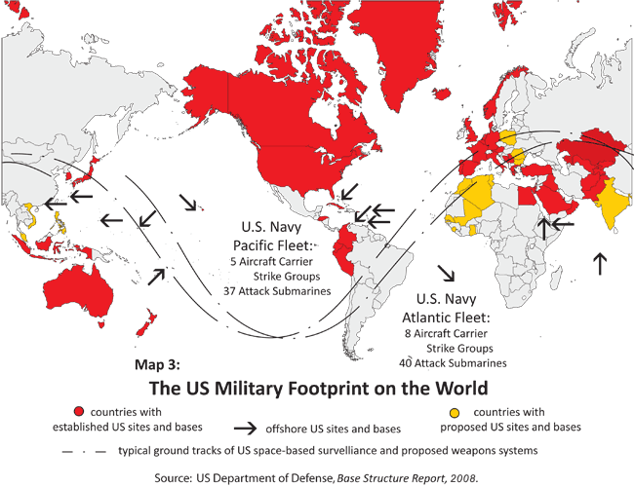

Slide 13
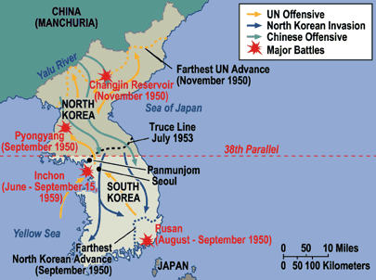
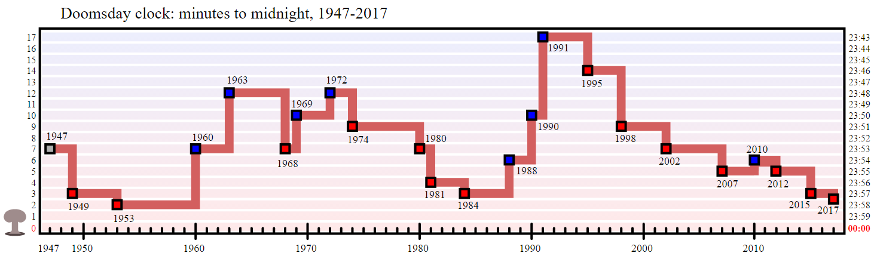
http://unit8juliahalexisp10.wikispaces.com
Korean War
1 Million People Killed

Slide 14

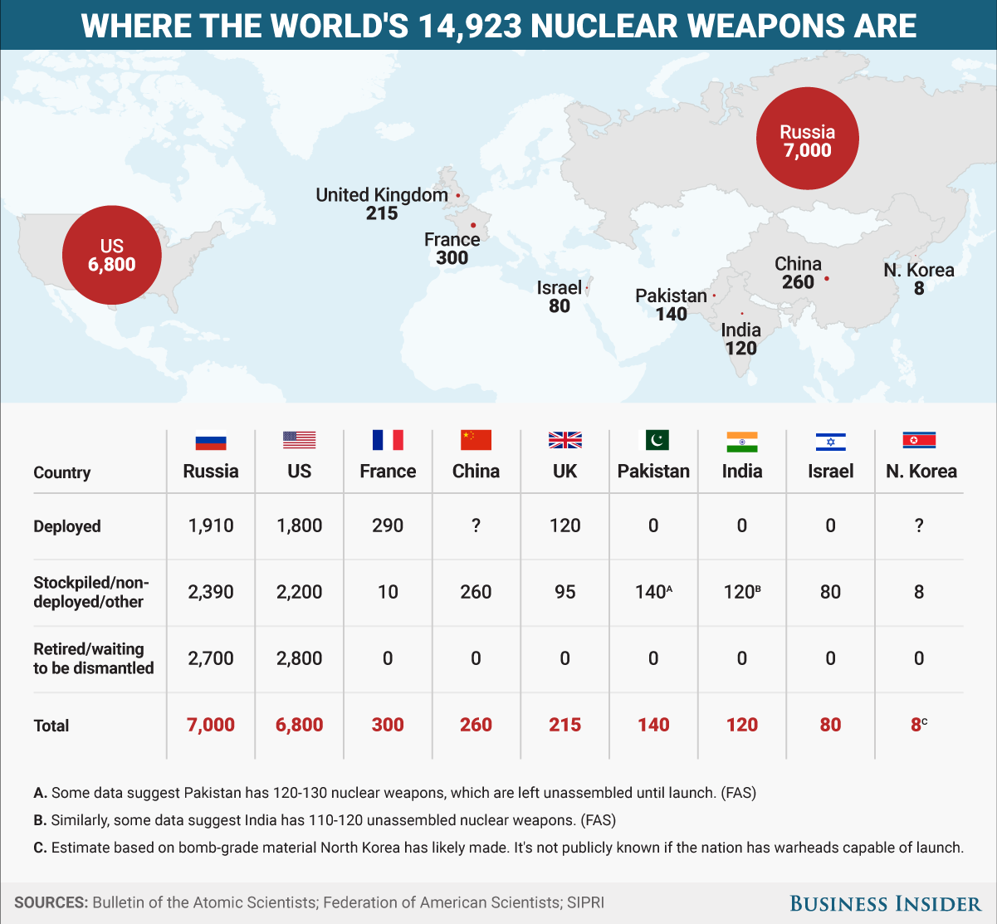
This animation shows how terrifyingly powerful nuclear weapons have become

Slide 15
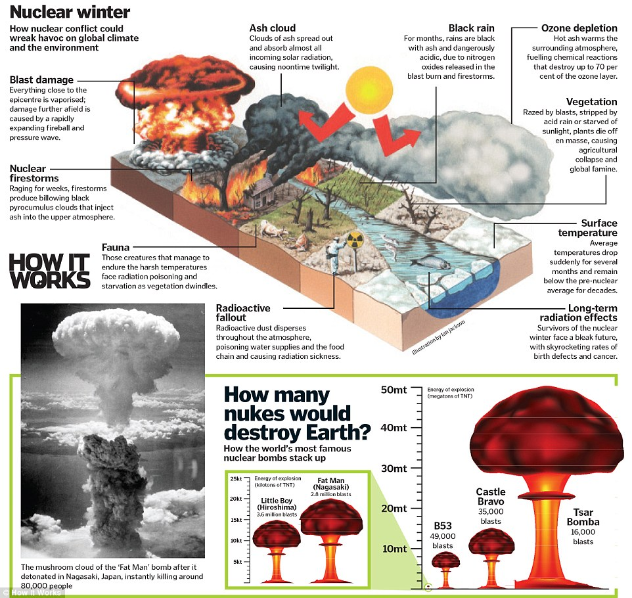
How it works magazine
Notes:
http://www.dailymail.co.uk/sciencetech/article-3409908/The-seven-biggest-threats-humanity-revealed-nuclear-winter-devastating-supervolcano-experts-explain-violent-ways-world-end.html

Slide 16
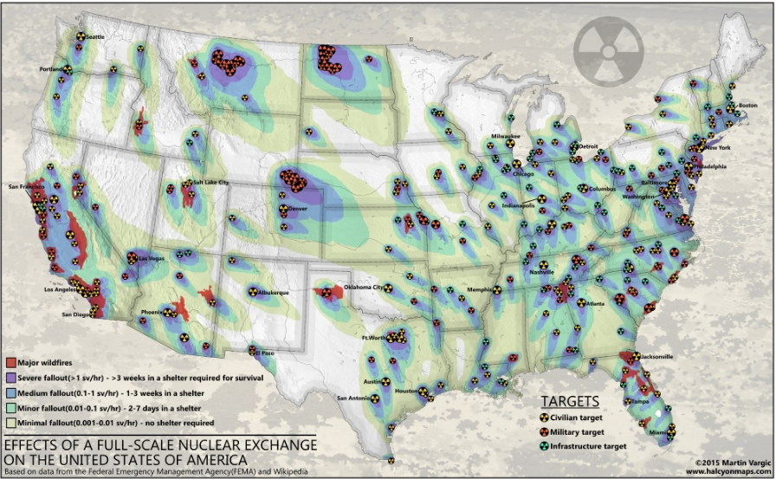
Fall-Scale Nuclear “Exchange”

Slide 17
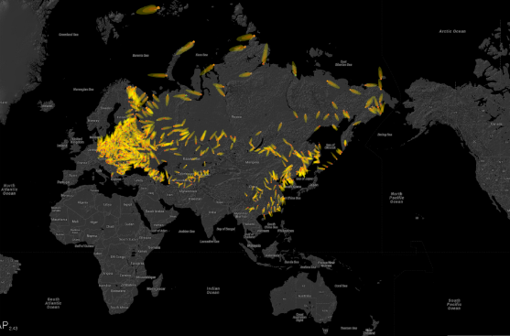
Future of Life Maps
https://futureoflife.org/background/us-nuclear-targets/#nukemap

Slide 18
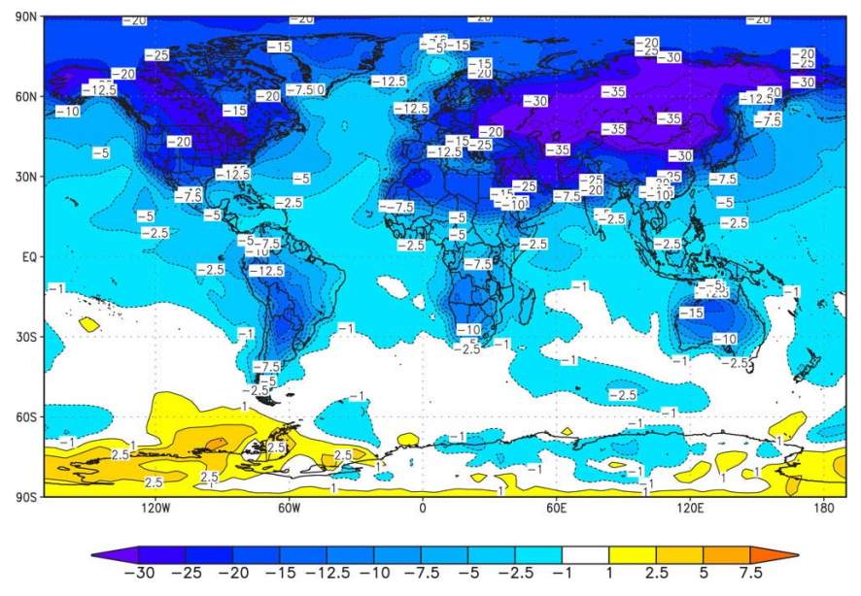
Surface Air Temperature (degree C) changes following a full-scale nuclear war averaged for June, July, and August of the year following the conflict.
The INESAP Bulletin 28, April 2008, by Steven Starr
Notes:
Isn’t this kind of nuts?

Slide 19
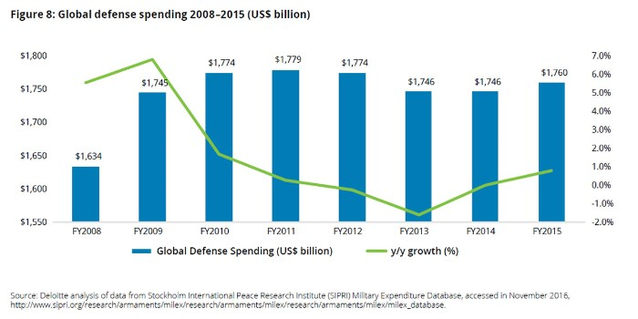
To Understand, You have to see it from their perspective
NASDAQ predictions for Boeing
2017 Global aerospace and defense industry outlook
  Growth prospects and trends remain upbeat
  You have to make profit or you can’t pay the shareholders
  If the shareholders sell, your company loses value
  If your company loses value it can become a take-over target

Slide 20
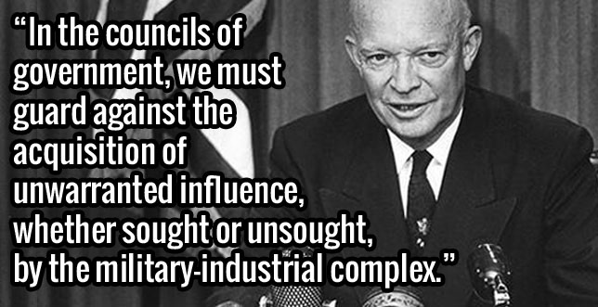
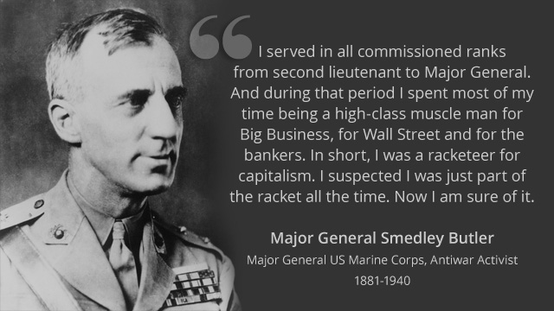
President Eisenhower’s
Final Address
“If you join the military now, you are not defending the United States of America. You are helping certain policy makers pursue an imperial agenda.”
- Lieutenant Colonel Karen Kwiatkowski

Slide 21
The Military Industrial Complex
Tax Payers
Congress
$2,600 Billion
Armed Services
Committees
Lobbyists
Staffers
Media
Employ
Defense Contractors
$700 Billion
DOD
Generals retire
Figures are annual approximations in billions
Notes:
80% of generals retire to defense contractors or consultants
http://archive.boston.com/news/nation/washington/articles/2010/12/26/defense_firms_lure_retired_generals/

Slide 22
In Summary
The US has developed a huge complex of military contractors, defense works, lobbyists, politicians and the Department of Defense that must have conflict to justify it’s existence.
The complex supports the rich through supporting resource extraction in other countries.
Tax payers are funding this to the detriment of the world.

Slide 23
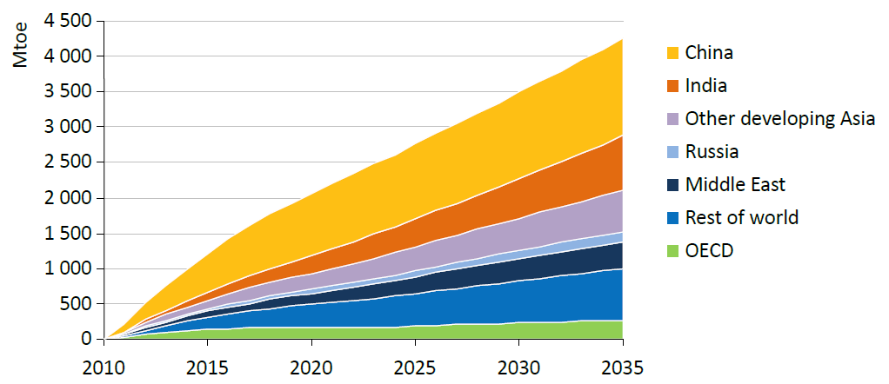
Increase in Energy Demand
International Energy Agency
Notes:
Demand for energy continues to grow.

Slide 24
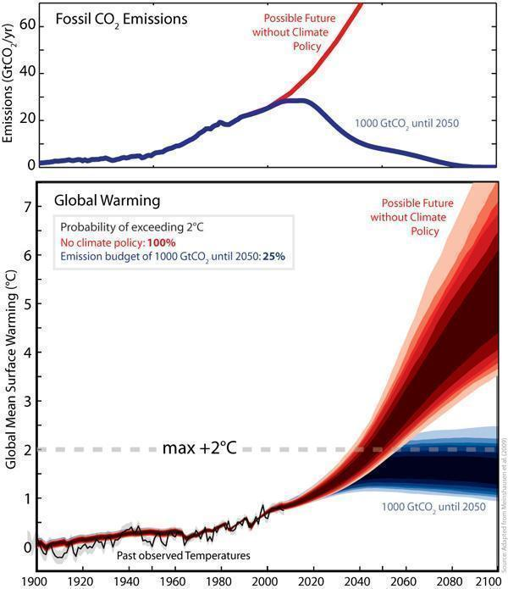
http://www.sciencedaily.com
Notes:
Global CO₂ emissions and warming compared to pre-industrial times for a scenario without climate policy (red) and a scenario in which the emissions are restricted to 1000 billion tonnes of CO₂ (blue) from 2000 to 2050. The intervention can limit the probability of exceeding the 2°C threshold to 25%. (Credit: Image courtesy of ETH Zurich)

Slide 25
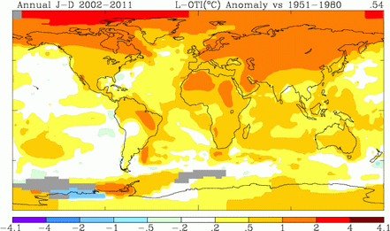
Global Warming
National Oceanic and Atmospheric Administration (NOAA)
Notes:
Global warming is happening primarily in the northern latitudes and is rapidly changing ecosystems in the arctic.

Slide 26
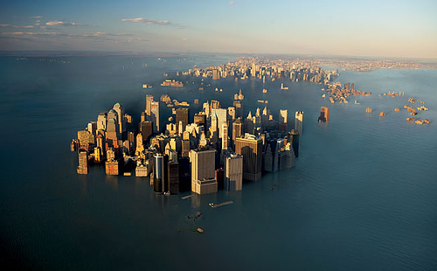
Sea Level Rise
If Greenland ice cap melts:
  7 meter sea level rise
If Antarctic ice cap melts:
  60 meter sea level rise (about 240 feet!)
See: http://geology.com/sea-level-rise/
wordpress.com
Notes:
It will probably take a long time for a 60 meter sea level rise to occur, potentially thousands of years.

Slide 27
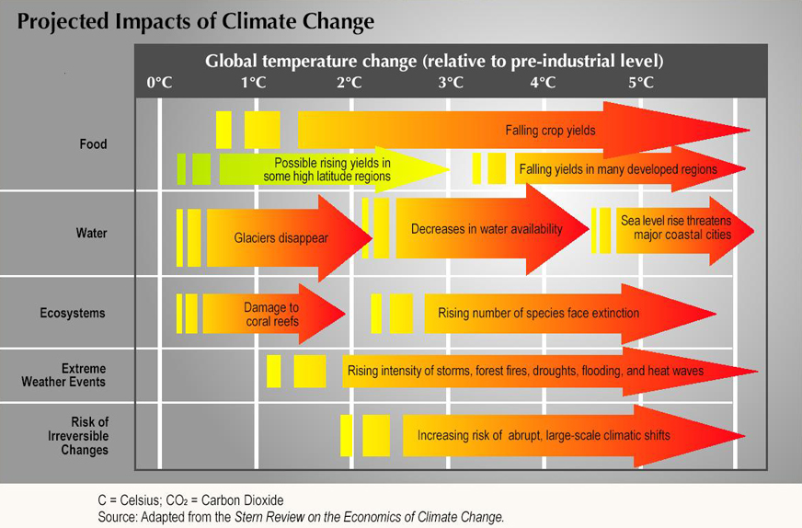
Notes:
Atlantic THC
The real concern with climate change is the increase in temperature causing decreases in food production and water availability.

Slide 28
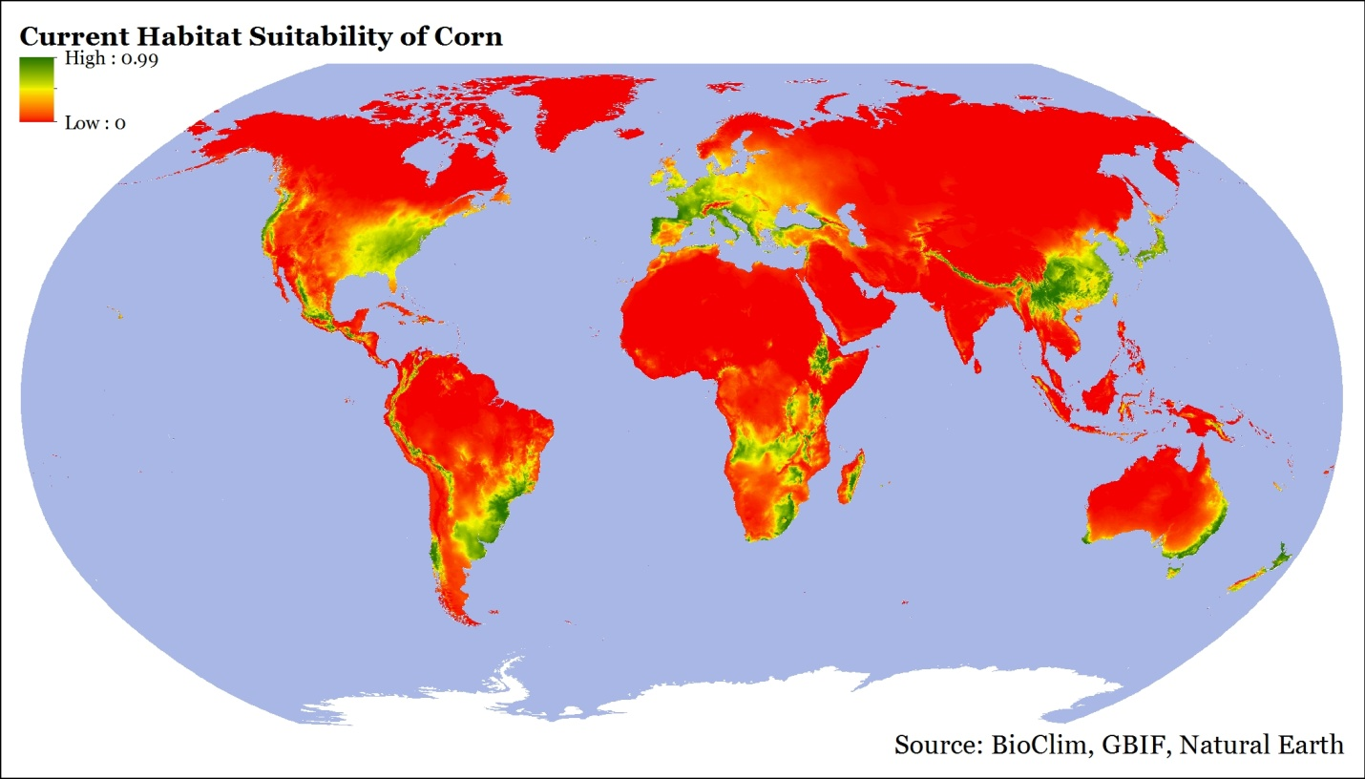
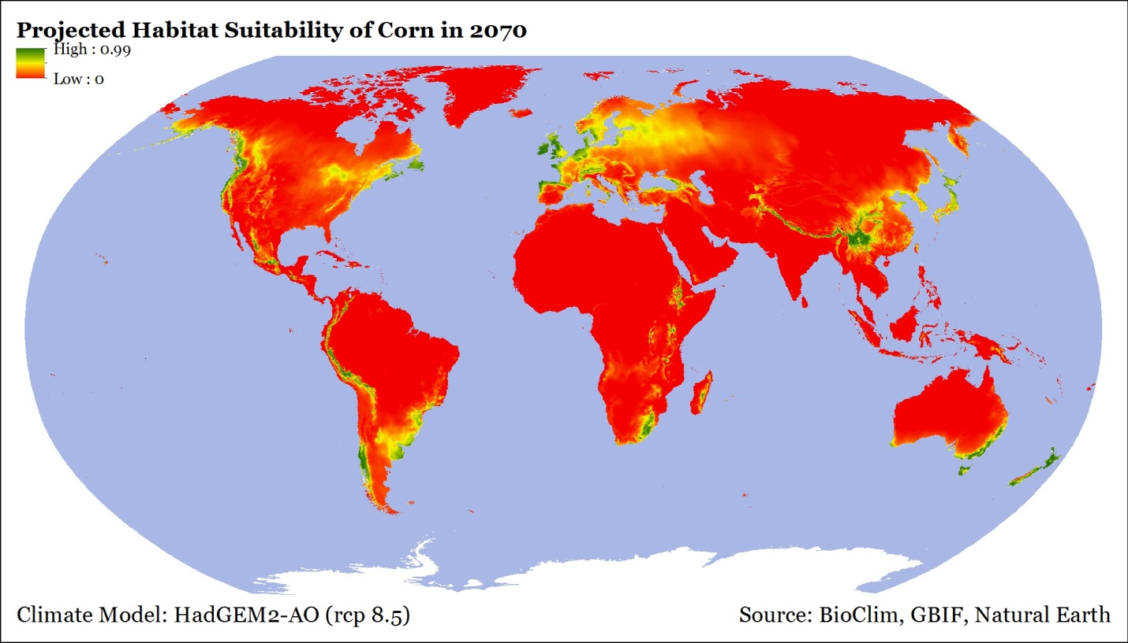
Corn
Habitat
Julia Clark 2015

Slide 29
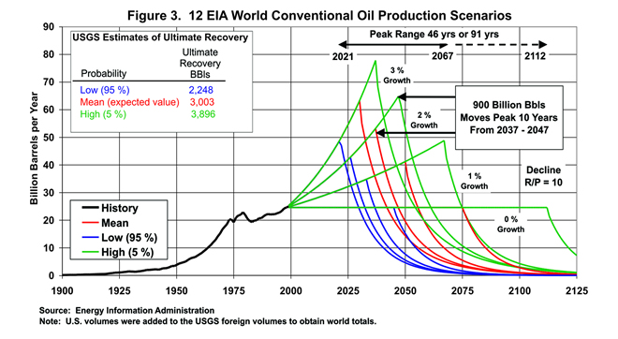
Oil Runs Out by 2100
Notes:
https://www.eia.gov/pub/oil_gas/petroleum/feature_articles/2004/worldoilsupply/oilsupply04.html

Slide 30
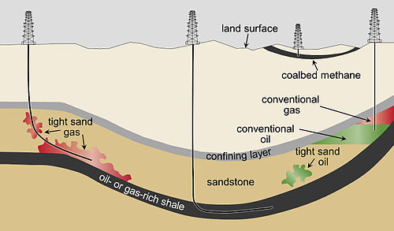
Tight Oil
Wikipedia

Slide 31
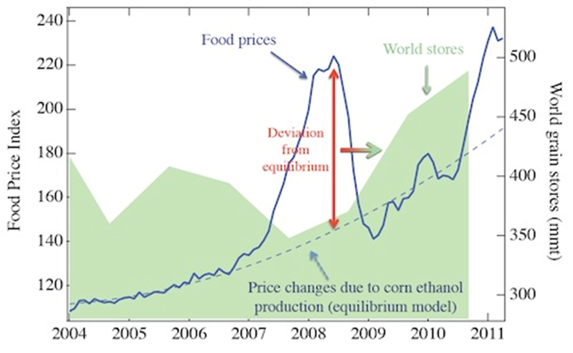
Ethanol Food Connection
2011, Johson, EM, Commodity Traitors: Financial Speculation on Commodities Fuels Global Insecurity,
Scientific American Blog.
Notes:
The price of oil is tied directly to food production because as soon as the price of gasoline reaches about $4 per gallon, farms switch swelling corn for food and large quantities are sold for ethanol production.

Slide 32
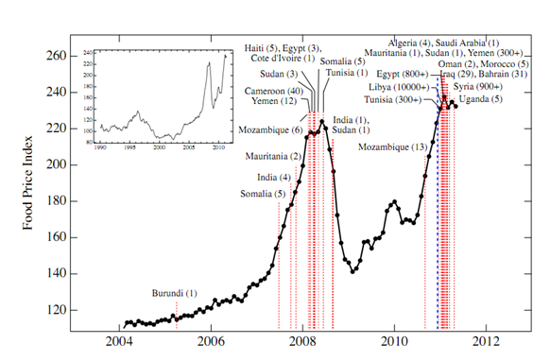
Food Riots
Technology Review, MIT, http://www.technologyreview.com/blog/arxiv/27083/
Notes:
This has caused food riots in areas far from the US.

Slide 33
Drought
Increasing
Population
Invasive
Species
Climate
Warming
Sea
Level Rise
Greenhouse
Gases
Marine
Acidification
Over-fishing
Decrease
in Food Availability
Pollution
Fertilizers
Reduced
Phosphorus
Shortage
Oil
“Scarcity”
Biofuels
Increase
Famine
Disease
Death

Slide 34
Drought
Climate
Warming
Sea
Level Rise
Greenhouse
Gases
Marine
Acidification
Decrease
in Food Availability
Burning Oil, Coal, and Natural Gas
Pollution
Oil
“Scarcity”
Biofuels
Increase
Famine
Disease
Death

Slide 35
Summary
US is arming ourselves, and the rest of the world, as if we are in a world war.
We are burning all the fossil fuels we can reach as fast as we can causing long-term damage to the earth, war, pollution, etc.
We have been told for decades that renewables are too expensive.

Slide 36
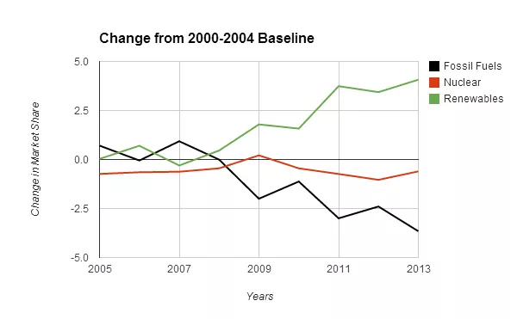
Renewable Energy Momentum Has Passed The Tipping Point
(cleantechnica.com)
Notes:
This is likely to accelerate over time because newly added renewables have a cumulative effect. This is to say that each new renewable installation will supplant the energy demand of the older model energy sources of oil, coal, gas and nuclear.

Slide 37
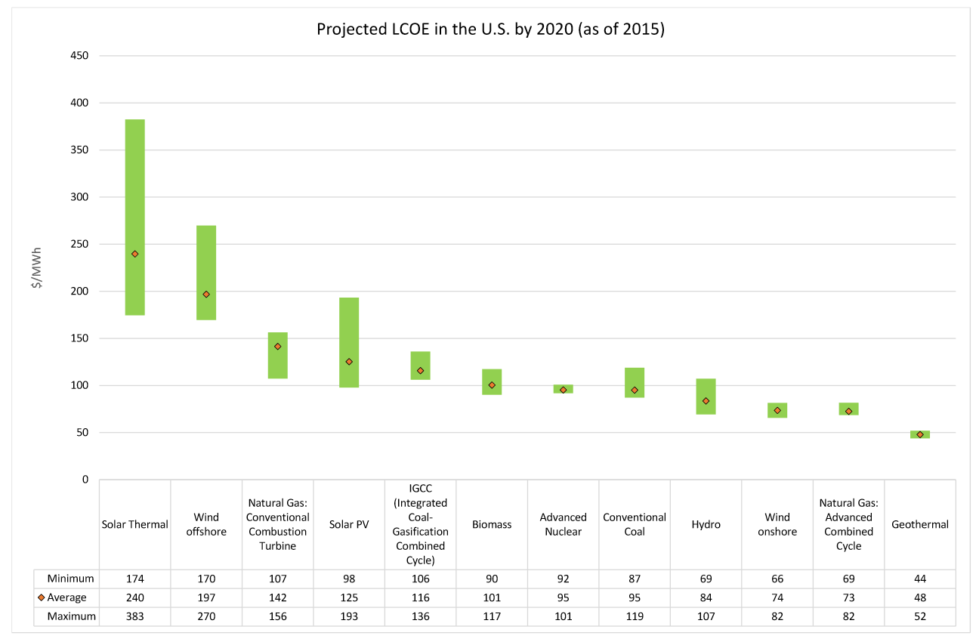
Renewables are Cost Effective
Wikipedia
Notes:
Levelized cost of energy, basically the cost of building and running a power plant divided by the electrical output.
This does not include taxes, consistency of power sources (i.e. solar and wind), difficulties in ramping power (coal and nuclear), and waste storage and disposal (nuclear).
From: https://en.wikipedia.org/wiki/Cost_of_electricity_by_source

Slide 38
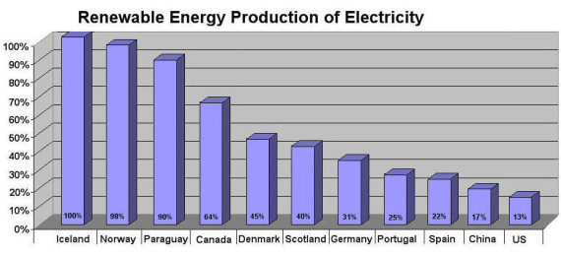
US is Falling Behind
https://cleantechnica.com
Notes:
Highest numbers are based on hydroelectric

Slide 39
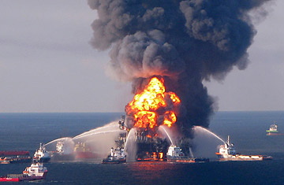
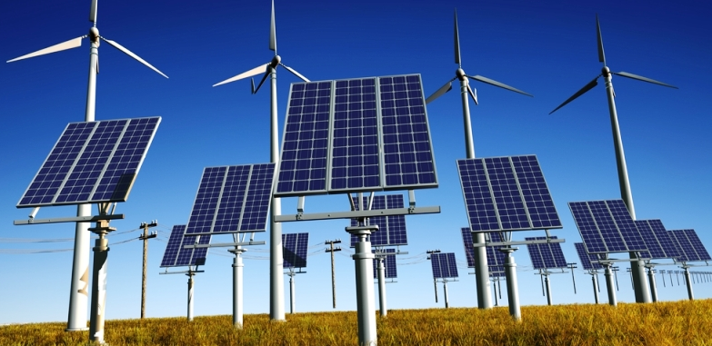
Fossil Fuels
Renewables
Running out
Pollute: CO2, etc.
Carcinogenic
Explosive
Toxic
Cause war, terrorism
Long-lasting
Wind: Impacts birds
Solar: Large installs impact birds
Geothermal?
http://solarcontech.com

Slide 40
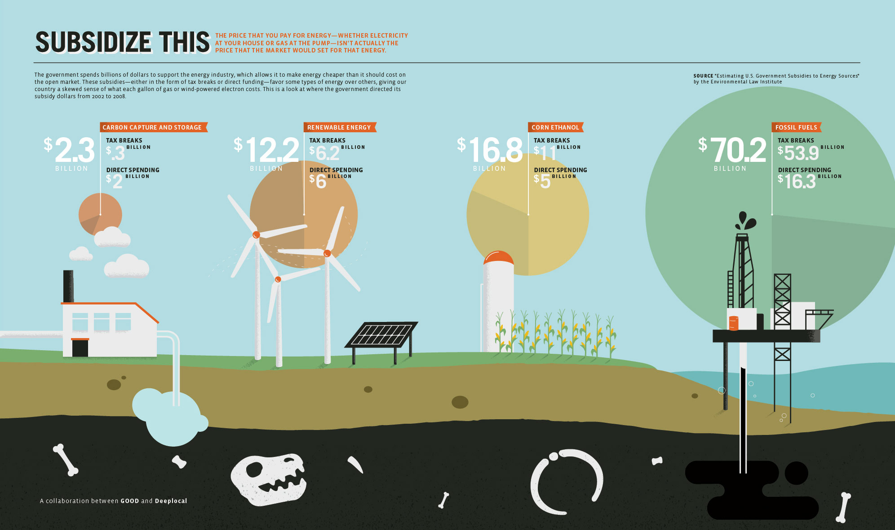
US Subsidies Favor Oil & Gas

Slide 41
New Military-Industrial-Oil Complex?
$1,500 Billion
Tax Payers
Lobbyists
Staffers
Congress
Armed Services
Committees
Media
Employ
Employ
$700 Billion
Oil Companies
Defense Contractors
Generals retire
DOD
$38.4 billion just from offshore

Slide 42
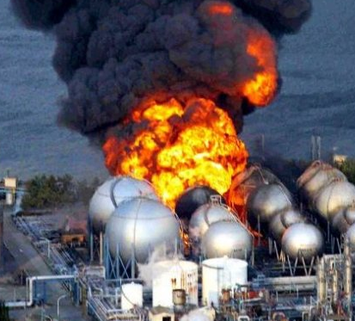
Why not Nuclear?
sites.suffolk.edu
Potential for disasters
Limited supply of fuel
No plan to store the waste
  Estimates for the time required to store nuclear waste range from 1000 to 100,000 years.
Oldest stable government in the world is Iceland at about 800 years.
  The US is second at about 230!
Notes:
Oldest stable government is Iceland

Slide 43
Providing all global energy with clean renewable power
3,800,000 5MW wind turbines,
49,000 300MW concentrated solar plants
40,000 300 Mw solar PV power plants
1.7 billion 3kW roof top PV systems
5350 100MW geothermal power plants
270 new 1300MW hydroelectric power plants
720,0000 75MW wave devices
490,000 1MW tidal turbines
Jacobson M. Z., M. A. Delucchi, 2011, Providing all global energy with wind, water, and solar power, Part I:
Technologies, energy resources, quantities and areas of infrastructure. Energy Policy
Notes:
By 2030

Slide 44
1.3 Trillion Dollars Buys
Every year, what we spend on the military could purchase:
  ~350,000 wind turbines
    10 years to meet global needs
  ~450 million residential PV systems
    4 years to meet global needs

Slide 45
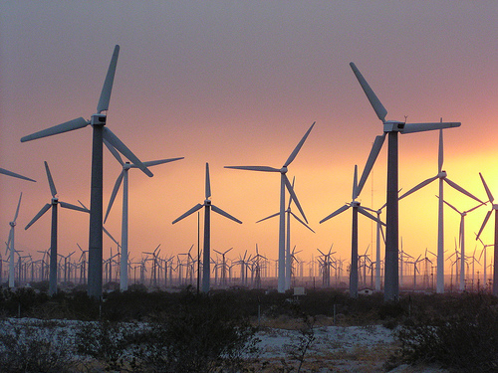
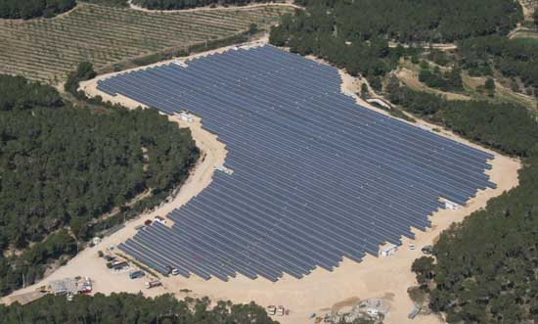
Pressure on Critical Land
Food
Energy
Biodiversity
Water

Slide 46
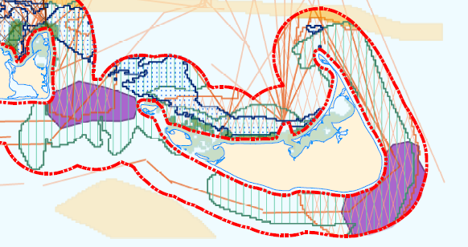
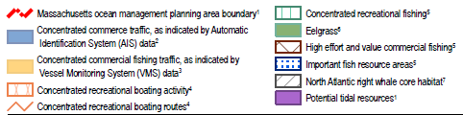
Nantucket Island

Slide 47

Short-Term Thinking Leads to Long-Term Disasters
The President is in control of our Nuclear Arsenal
Notes:
At no other point in history has a species had the knowledge to prevent it’s own demise, and continued on a path of destruction.

Slide 48
Trump’s Proposed Changes:
Defense: +10% ($54 billion)
EPA: -31%
State Department: -29%
Dept. of Ag.: -21%
Dept. of Health Services: -18%
Dept. of Commerce: -16%
  NOAA: -$250 in coastal research
Dept. of Education: -14%
Dept. of Energy: -6%

Slide 49
What can you do?
First, seek:
  The strength to change the things you can
  The serenity to accept the things you cannot
  The wisdom to know the difference
    Adapted from Reinhold Niebuhr
Be the change you want to see in the world - Ghandi
Use renewable energy:
  Walk & ride
  Purchase a house near work
  Build or remodel your house to be carbon neutral or positive

Slide 50

What you can do
Contract Your Elected Officials
  https://www.usa.gov/elected-officials
  Tell them not to support Trump’s increases to defense and cuts to agencies that provide services to us.
Push for tax credits on renewables, taxes on fossil fuels, regulations against further fossil fuel development
  Support petitions (see MoveOn.org)
govtrack.us

Slide 51
What about GIS Professionals?
Listen, then define and describe the issue
Collect and qualify data
Analyze, model, map, and write
Convey results, with uncertainties, to all interested parties
Learn and educate
Maps can make a difference, locally or globally

Slide 52
Additional Slides

Slide 53
Hypothesis
The United States has created a global empire backed by a huge military industrial complex
The US is funding this empire instead of investing in updating our infrastructure, including moving to renewable energy source
This will result in degrading our planet to where it cannot sustain our current population by the end of this century

Slide 54
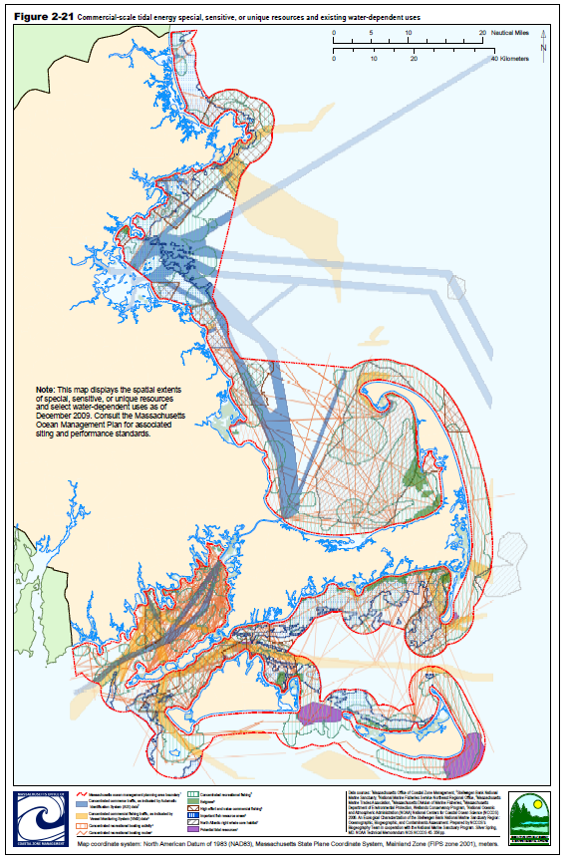
MSP
Marine Spatial Planning
Mass. Ocean Management Plan

Slide 55
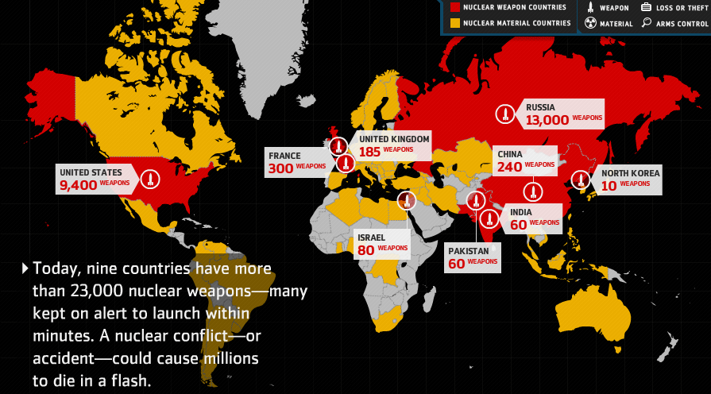
Nuclear Arsenal
$1,000 Billion to be spend in modernization in the next decade, Financial Times
Notes:
Nuclear arsenal has reduced from over 70,000 to under 20,000
We continue to maintain a huge number of nuclear weapons which most folks do not think about today but this is still a major threat to happiness.

Slide 56
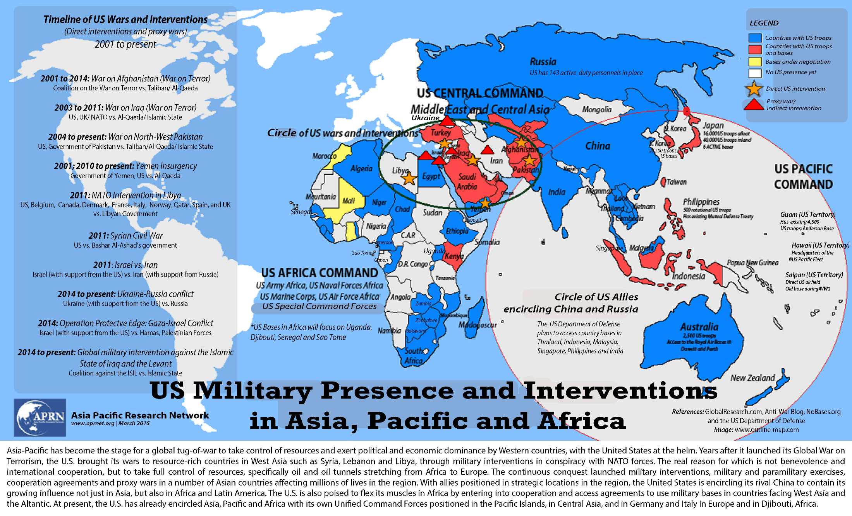

Slide 57
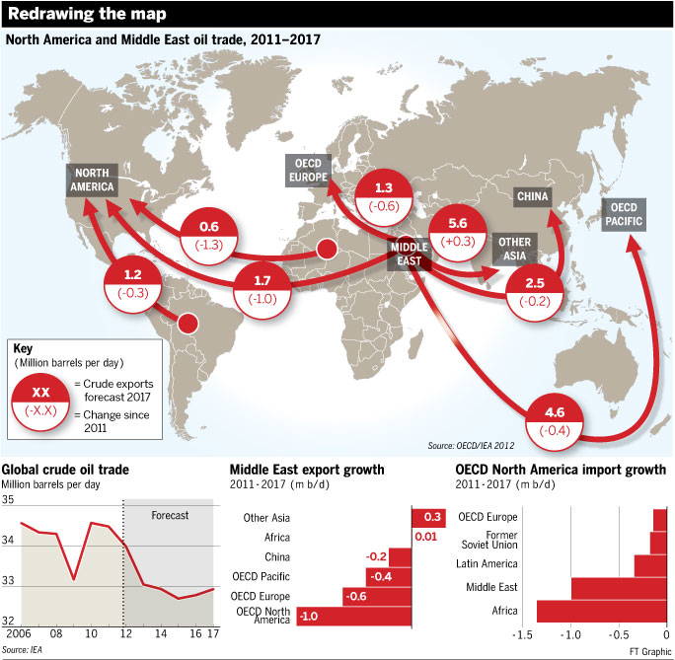
Notes:
Oil goes for btween 65 to 90 dollars a barrel, 1 million a day = 65 million to 90 million a day, 24 to 32 billion (about 30 billion a year)

Slide 58
All we have to do is:
Stop burning fossil fuels!
  Including uranium.
Switch to sustainable, clean solutions
Conserve energy
Have fewer children
It’s probably too late to avoid major problems but the sooner we get started, the less problems we will have

Slide 59
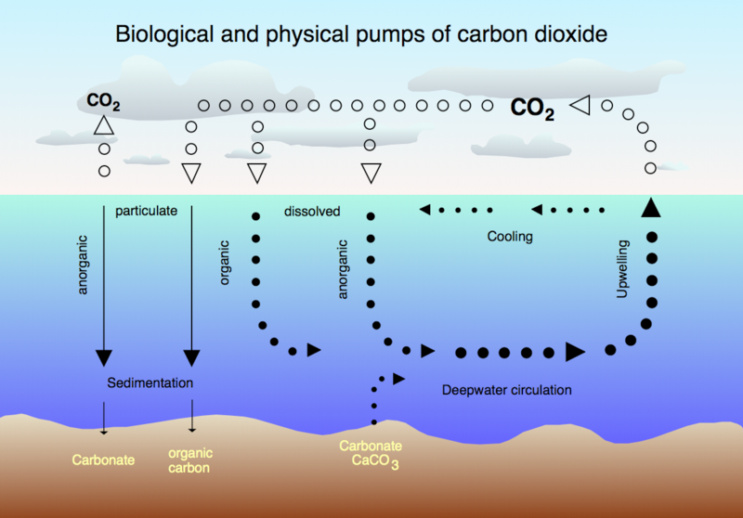
Ocean Acidification
Notes:
Another effect of atmospheric CO2 is that the ocean becomes more acidic as it absorbs CO2.

Slide 60

Increase in pH Since 1700s
Notes:
This has caused a global increase in pH and recently caused oyster failures because the small oysters could not form their shells. This has the potentially to cause collapses in major fisheries.

Slide 61


Slide 62

Fertility Rate: 2005
http://www.fooddeserts.org
Notes:
Fertility rates have dropped to near replacement for most of the world, except Africa.

Slide 63




Slide 64

Estimated World Population
WORLD POPULATION TO 2300 - United Nations
Notes:
The UN has esimated that world population may peak at about 2050.

Slide 65
The Risk
 | Do Nothing | Take Action
Global Change is not happening | No effect | Cleaner environment for everyone Economic impacts?
Global Change is happening | Billions starve Most major cities have to move Island cultures relocated Low-lying countries inundated 20-50% species lost | Less starve Less impact on cities Less impact on island cultures Less impact on low-lying countries Less species loss
Adapted from YouTube video: The most terrifying video you'll ever see
Notes:
How about we stop arguing about if and why and start taking action to mitigate the potential problems?

Slide 66


What does this have to do with GIS?
NASA
Wikipedia

Slide 67

US Renewable Energy
http://thinkprogress.org/climate/2011/11/03/360531/getting-clean-energy-economy-facts/?mobile=nc

Slide 68
Renewables are now cheaper than fossil fuels (including nuclear)

Slide 69

Solar Engery
http://www.exploregreenenergy.com

Slide 70

Mean Annual Wind Speed
http://myweb.unomaha.edu/~gpagett/CartGIS/gallery.htm

Slide 71

Geothermal

Slide 72

Biofuel

Slide 73

Food Production in Increasing
Notes:
At the same time, world food production has increased steadily but partly because of the use of fertilizers and industrial agricultural equipment.

Slide 74

Greenhouse Gasses
http://interculturalclimateaction.wordpress.com

Slide 75

Carbon Dioxide Output
U.S. Dept. Of Energy

Slide 76

Atmospheric CO2

Slide 77


Slide 78

Fertility Rate: 1970
http://www.fooddeserts.org
Notes:
Fertility rates used to be well above replacement (2) so there was rapid population growth.

Slide 79

sparkaction.org

Slide 80

Solar in the US

Slide 81

Peak Oil?
www.greatdreams.com
Notes:
Everyone agrees that we will run out of fossil fuels in the future but there is little agreement on when. This will cause oil to steadily increase in cost and eventually case oil scarcity.

Slide 82
Spatial-Tempral Planning
Disease Outbreaks
Safety/Emergency services
Recreation
Economics
Fish & Wildlife
Agriculture
Cultural Resources
Energy Production
Legal Issues
Ownership

Slide 83
Impacted by Ocean Acidification
Coccolithophores & Foraminifera: Plankton
  > ?
Corals:
  > huge variety of fish
Echinoderms: star fish, echinoderms
  > Mammals
Crustaceans: Shrimp, crabs, lobsters
  > birds, mammals, fish, and humans
Molluscs: Snails
  > birds, others

Slide 84


Australian Fire Storms
ksj.mit.edu

Slide 85


Slide 86
Food Security?
Demand for energy is increasing
  We will run out of fossil fuels
  Switch to biofuel will reduce food production
Population is increasing
  But the rate of increase is slowing
Food consumption is increasing
  Food production is increasing
  But we are running out of phosphorus

Slide 87

Interconnected World
http://www.pikeresearch.com/tag/biofuels

Slide 88



Slide 89

Climate Change
Caption: Figure 1. Rainfall deciles across Australia for 1 January 1997 to 31 December 2009; deciles based on climatology from 1900 to 2009 (Bureau of Meteorology)

Slide 90

Increasing Food Consumption

Slide 91


What will the world look like in 2100?
www.oxfam.ca
Chernobyl in Winter
thebluereview.org
Notes:
https://thebluereview.org/utopian-writers-american-west/

Slide 92
Three Threats
Nuclear War
Resource Exhaustion: Water, Oil, Food, Fertilizer, etc.
  Leads to famine, disease

Slide 93


Coral Reef Bleaching
http://www.duke.edu

Slide 94


Threats to Biodiversity
Biodiversity Threat: riverthreat.net

Slide 95

Human Water Security
Human Water Security Threat: riverthreat.net

Slide 96



Slide 97

Predicted Temperature Increase
Degrees F
Year
http://www.dailytemperaturecycle.com/fossilfuellifetime.htm

Slide 98


Slide 99

Food Stocks are Low

Slide 100

Peak Phosphorus
Figure 1: Peak phosphorus ‘Hubbert’ curve, indicating that production will eventually reach a maximum, after which it will decline (source: Cordell, Drangert and White, 2009) ^{i}

Slide 101

Ice Cover in Arctic

Slide 102
Grand Challenges
Eradicate extreme poverty and hunger
Achieve universal primary education
Promote gender equality
Reduce child mortality
Improve maternal health
Combat diseases
Ensure environmental stability
Develop Global Partnership for Development
United Nations Millennium Development Goals

Slide 103


sparkaction.org

Slide 104
“Renewable, Clean, Energy”
Solar: requires trace minerals
Wind: minerals and species impacts
Wave/tidal: minerals and species impacts
Geothermal: limited availability?
Hydroelectric: limited locations, sediment
Biofuel: Deforestation, food -> fuel, marginal in the US
Nuclear: impacts, danger, storage
Conservation?

Slide 105

US Energy Sources
http://www.instituteforenergyresearch.org

Slide 106

US Renewable Energy
http://www.instituteforenergyresearch.org
Notes:
- Biomass and hydro is down because of draughts, solar increasing but still small

Slide 107

Increased CO2 -> Warming

Slide 108



China Renewable Energy Center

Slide 109

Energy Emissions
Stern Review

Slide 110

Energy Usage In New York

Slide 111

Global Potential Energy

Slide 112


Military
Expenditures
Notes:
A the same time, military expenditures in the US remain high. The map on the bottom uses a special approach that makes a polygon the size of an attribute, either increasing or decreasing it based on the value. This map shows how the US dominates world military spending while the Russian Federation actually spends very little.

Slide 113
Nuclear Arsenal
Imagine, a room, awash in gasoline. And there are two implacable enemies in that room. One of them has 9,000 matches. The other has 7,000 matches. Each of them is concerned about who’s ahead, who’s stronger. Well, that's the kind of situation we are actually in.
  Carl Segan

Slide 114

Arctic Ice Extent 2010
Magenta line indicates median ice extent for 1979-2000, NOAA
Notes:
For the first time in human history, there is a “northwest passage” open during the summer.

Slide 115


Greenland Ice Melt
NASA
Notes:
The entire ice cap of Greenland was defrosting in July of 2012, this is unprecidented in at least 150 years

Slide 116

World Phosphorus Reserves
http://www.thebrokeronline.eu/en/Articles/Peak-phosphorus
Notes:
Another threat to food production is that we have a limited supply of phosphorus, an important fertilizer.

Slide 117

Notes:
Countries that have strong economies are also investing in other countries and purchasing land to produce food for export. This could reduce local production capacity.

Slide 118

Notes:
The highest number of undernourished people are in Africa.

Slide 119

Change in Cereal Production
Gornall, Implications of climate change for agricultural productivity in the early twenty-first century,
The Royal Society, Biological Sciences
Notes:
Shows the predicted change in cereal production yield based on climate change scenarios.
Notice that there is actually a potential increase at first in the northern latitudes but then a uniform negative trend in output.

Slide 120

World Happiness Map
The results of Columbia University's World Happiness Report, mapped. (Max Fisher/The Washington Post)
The United States ranks 17th of the 156 ranked countries, behind Mexico (16) and Panama (15).
Notes:
One of my goals is to help increase human happiness, now and in the future.

Slide 121




Risks to human happiness
Humans Need:
Risks:
Safe homes
Clean water
Good food
Socialization
Freedom
War/Armed Conflict
Natural Disasters
Totalitarian Governments
Disease
Famine
Drought
Clean water council
NPR

Slide 122


Slide 123


Slide 124


Slide 125

Global Armed Conflict
International Institute for Strategic Studies (IISS) Armed Conflict Database
Notes:
There are still armed conflicts but they are relegated to increasingly smaller areas of the globe.

