Slide 1
Not
visible
Viewshed
Not
Visible

Slide 2
Viewshed
Not
Visible
Not
visible

Slide 3
Not
visible
Viewshed
Not
Visible
Not
Visible

Slide 4
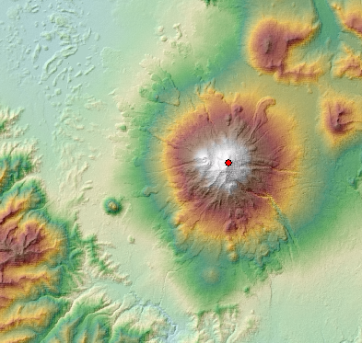
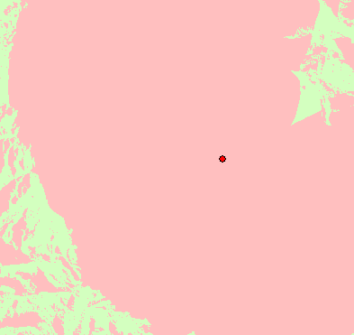

Slide 5
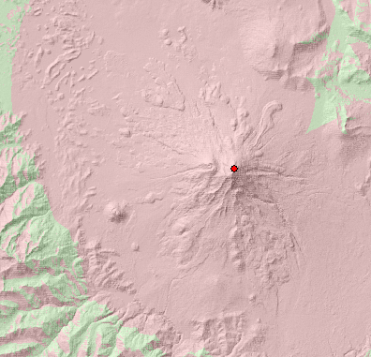
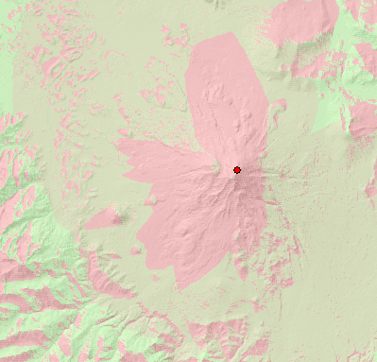

Slide 6
