Slide 1
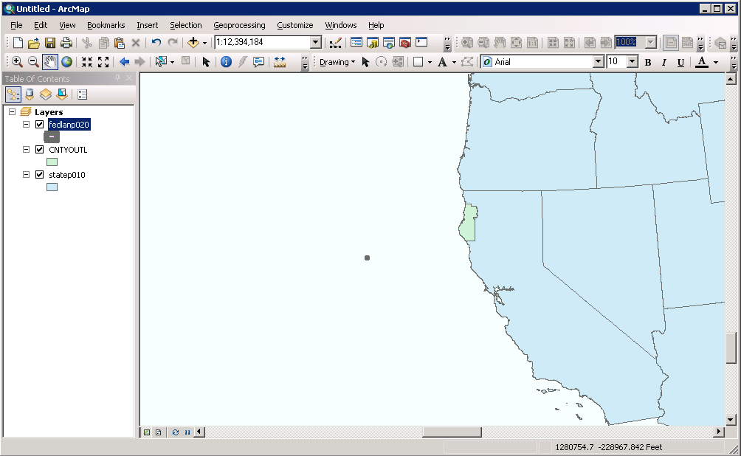
The entire federal land shapefile is here

Slide 2
