Slide 1
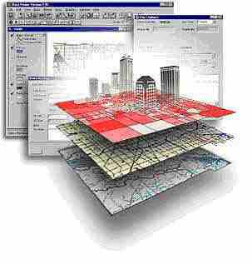
GSP 270
Definition of Spatial References

Slide 2
Spatial Reference System
Also referred to as a “Coordinate System”
  Geographic Coordinate System
  Projected Coordinate System
Try not to confuse this with the more general:
  Spherical Coordinate System
  Rectangular Coordinate System
Esri uses:
  Coordinate System
  Spatial Reference System
  Projection

Slide 3
Spatial Reference System
Is either:
  Geographic Coordinate System
Or:
  Projected Coordinate System

Slide 4
Geographic Coordinate System
Datum
  Ellipsoid
    Major Axis
    Inverse Flattening
  Primer Median (Greenwich)
Units (Degrees)

Slide 5
Projected Coordinate System
Geographic Coordinate System
Projection Method: Mercator, etc.
Parameters
  Number varies with the method
Units
  Always linear

