Slide 1
My Goals
All of you find careers that are truly satisfying
We have few regrets
We help make the world a better place for everyone
To do this, I feel we need to have a broader perspective

Slide 2
Dimensions of Perspective
Spatial: Local to global
Time: Past, present and future
Culture: Individual to global
I feel this is important to:
Find solutions that everyone involved feels are good solutions
Minimize the number of decisions we regret later in life

Slide 3
Definition of Culture
The definition varies
Culture is:
Learned
Dynamic
Complex
Includes:
Ways of viewing the world, making decisions, etc.
Includes:
Beliefs
Art
Law
Morals and values
Customs: ceremonies, holidays
Food
Language
Clothing
Religion/spirituality
Health care

Slide 4
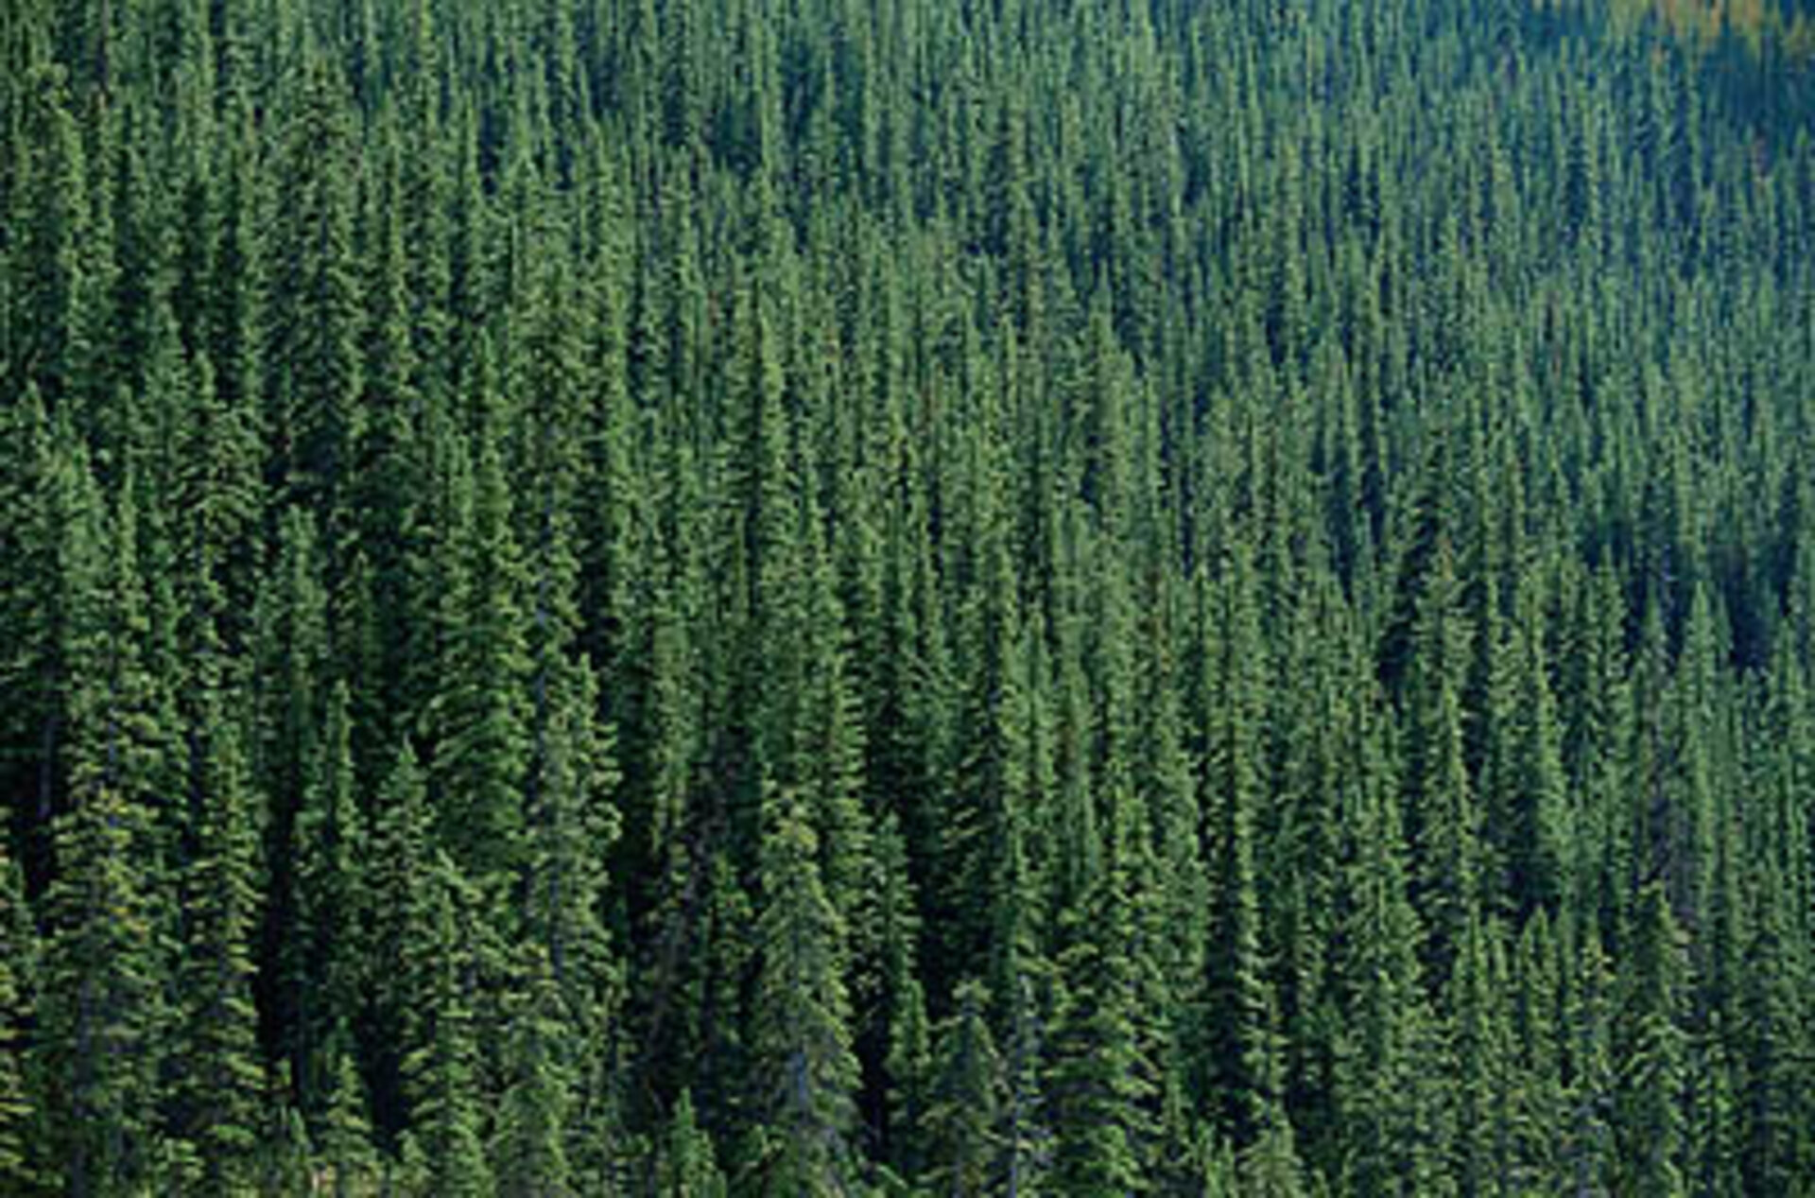
What do you see?

Slide 5
Origins of Western Culture
Emerged out of Greece about 300 BC
Valued:
Wealth, Political power, Fame
Achieved this through:
Technology, strategy, hierarchical organization
Included:
Extraction (i. e. mining)
Conquering other people and taking their land and resources
People working to death to serve a few

Slide 6
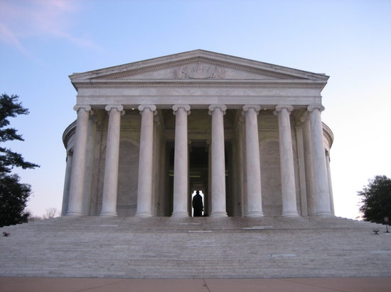
Greek Culture
Democracy
Philosophy: inquiry and logic
Mathematics, geometry, architecture
Women, immigrants and slaves could not be citizens
Gods were personified
Hero worship
Extracted copper, tin, gold
Weapons and wealth
Notes:
Copper and tin combined together create bronze which were the best weapons of the time and gave this age it’s name “The Bronze Age”

Slide 7
Other Cultures are Different
Values:
Having a healthy, satisfying life
Family, community
Church, religion, spirituality
Achieved through:
Learning locally
Working together, helping each other
Personal reflection, meditation

Slide 8
You have to know the past to understand the present. - Carl Sagan
We have everything we need to make the world a wonderful place for everyone
Yet, we continue to make decisions that cause disasters
Before asking what we can do, I feel we need some perspective on how we got here

Slide 9
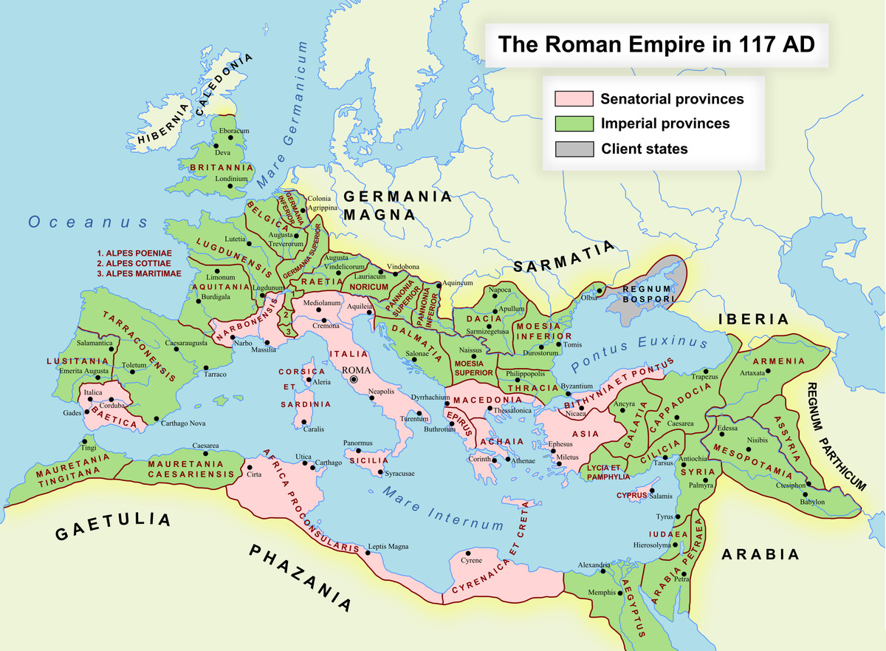
https://www.vox.com/world/2018/6/19/17469176/roman-empire-maps-history-explained

Slide 10
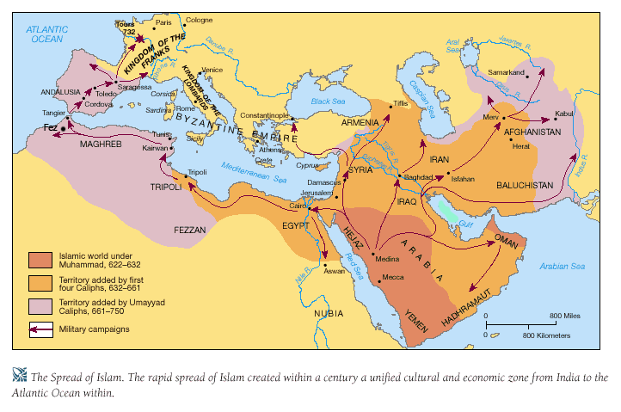
Arabian Expansion
worldmiddleages.blogspot.com
Notes:
worldmiddleages.blogspot.com

Slide 11
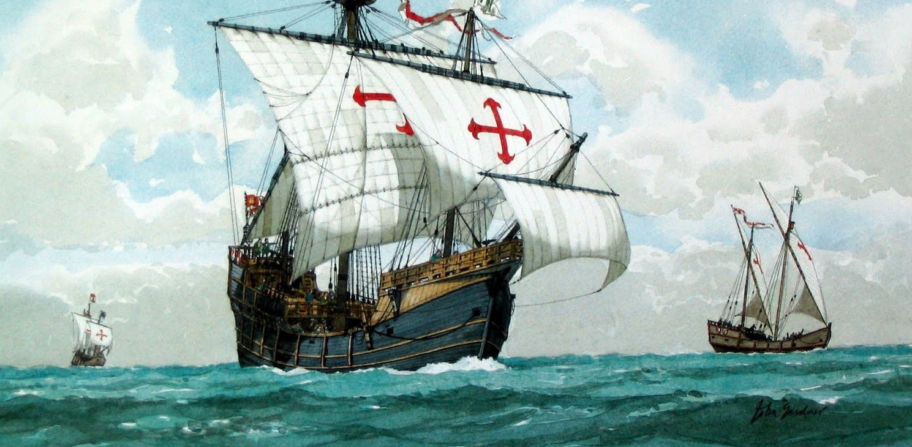
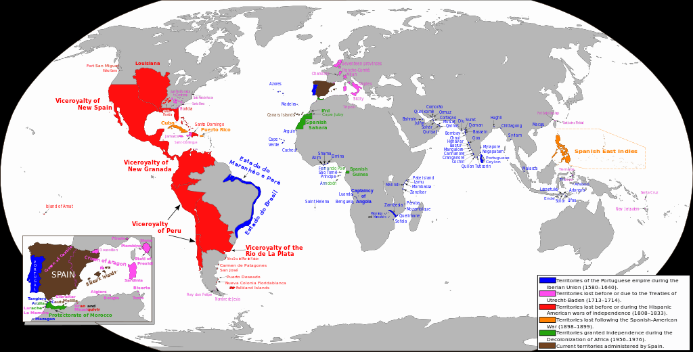
Spanish Empire
1492-1899
wikipedia.org

Slide 12
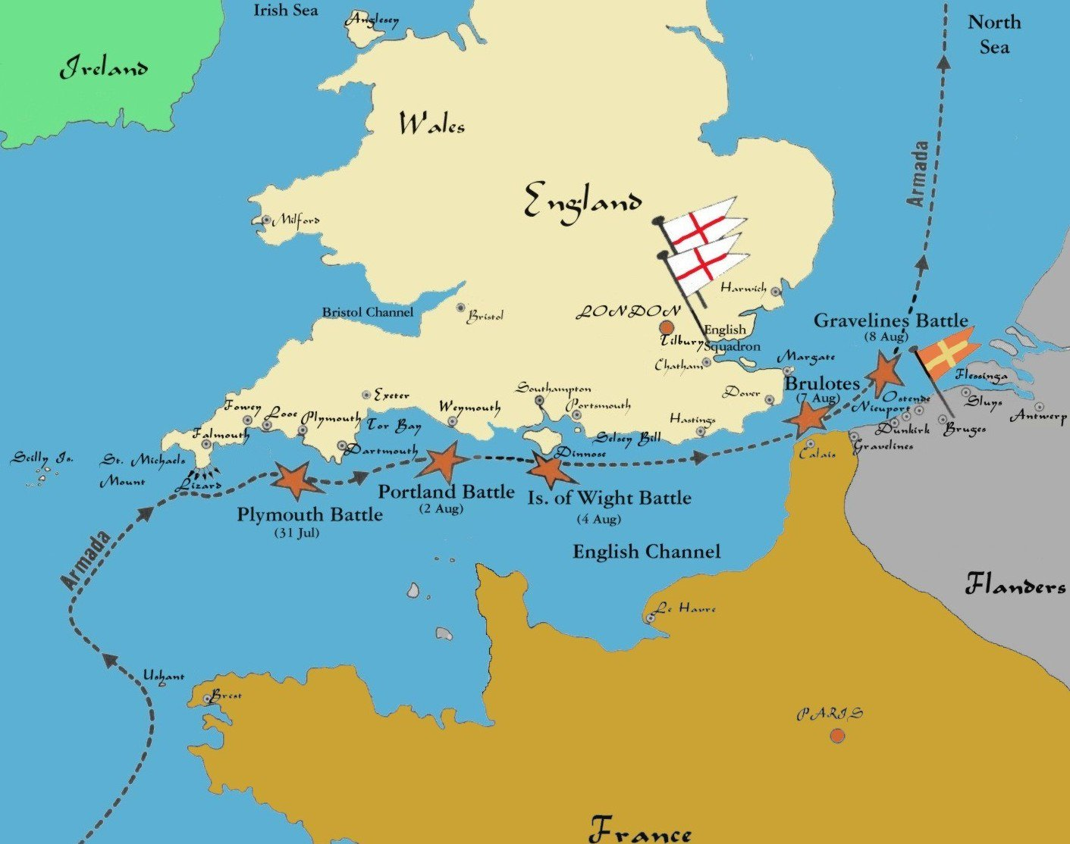
www.awesomestories.com
Notes:
1588

Slide 13
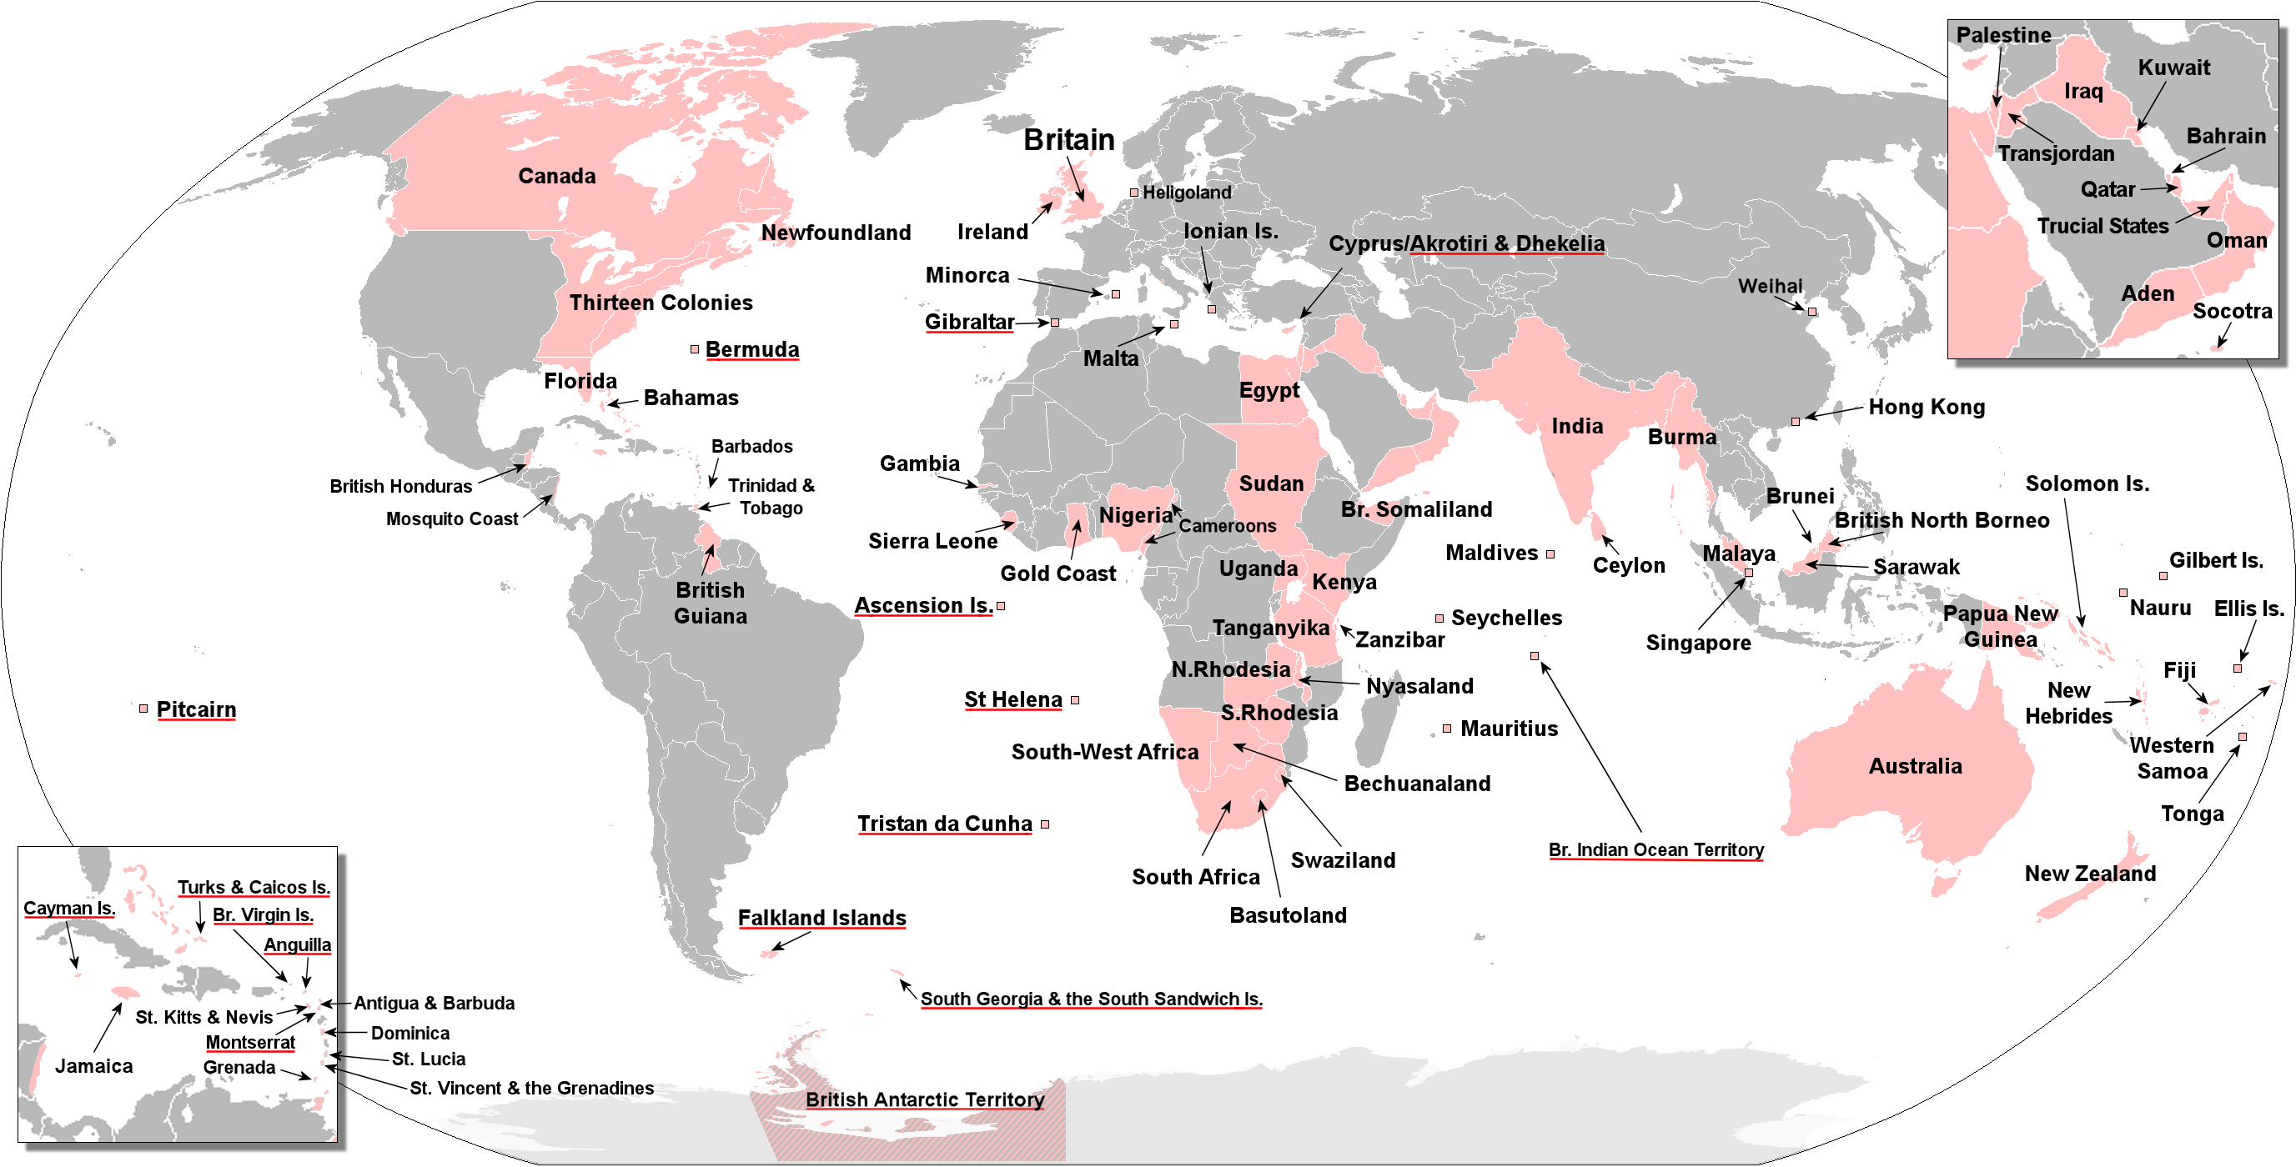
British Empire
In 1913, Britain held sway over 412 million people, 1/4 the earths population
https://en.wikipedia.org/wiki/Territorial_evolution_of_the_British_Empire
Notes:
http://www.basfeijen.nl/system/britishempire.htm
By 1922, Britain held sway over 450 million people, 1/5 the earths population

Slide 14
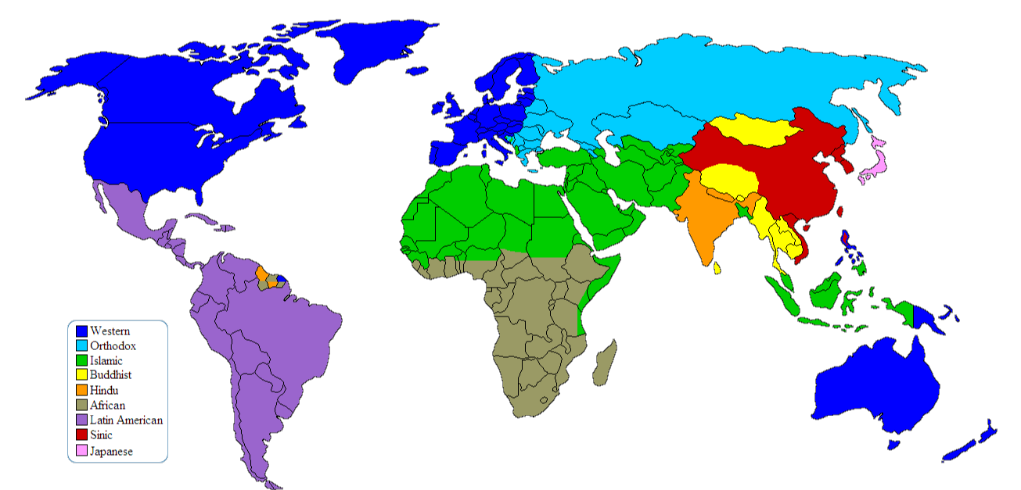
Dominant Cultures
en.wikipedia.org/wiki/Western_culture
Notes:
https://en.wikipedia.org/wiki/Western_culture

Slide 15
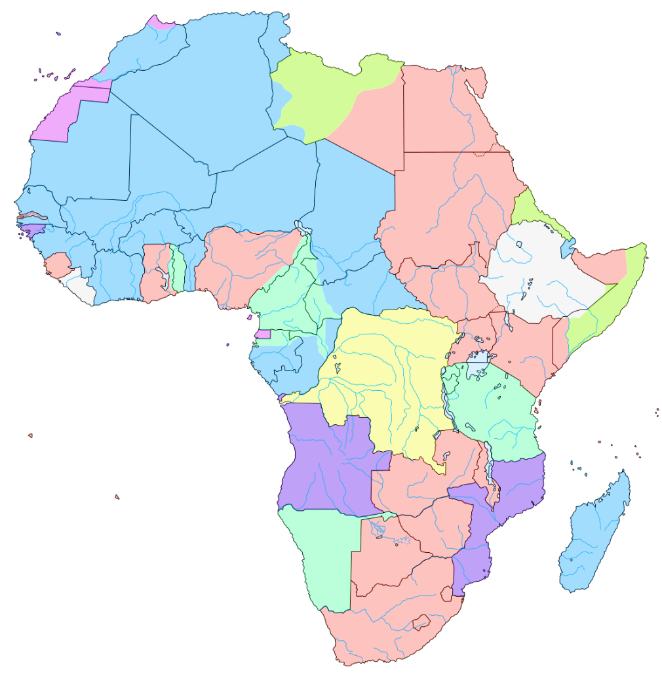
Africa 1883
The Berlin Conference of 1884–85
Organized by Otto von Bismarck, first Chancellor of Germany
"The Principle of Effective Occupation.“
US attended
Opened Up trade
en.wikipedia.org/wiki/Berlin_Conference

Slide 16
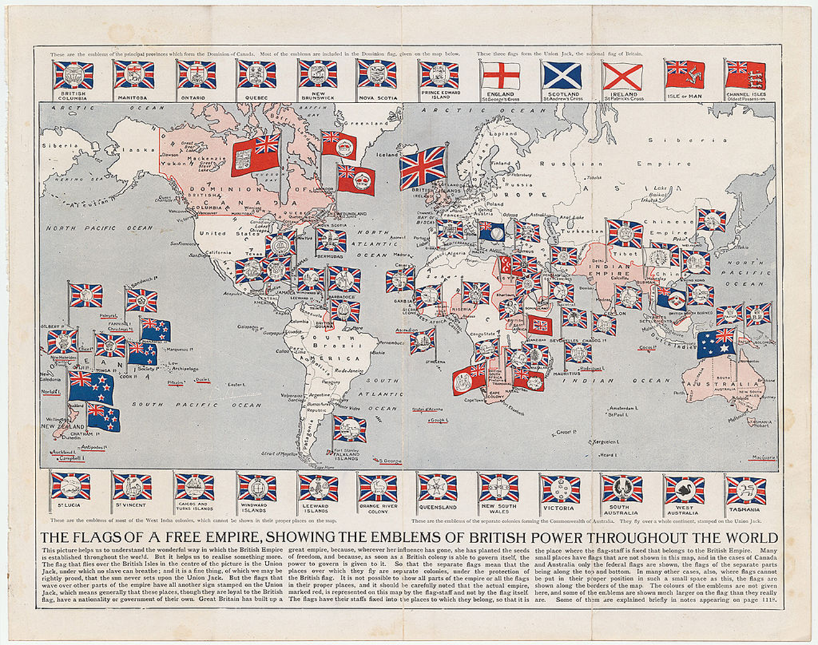
1910

Slide 17
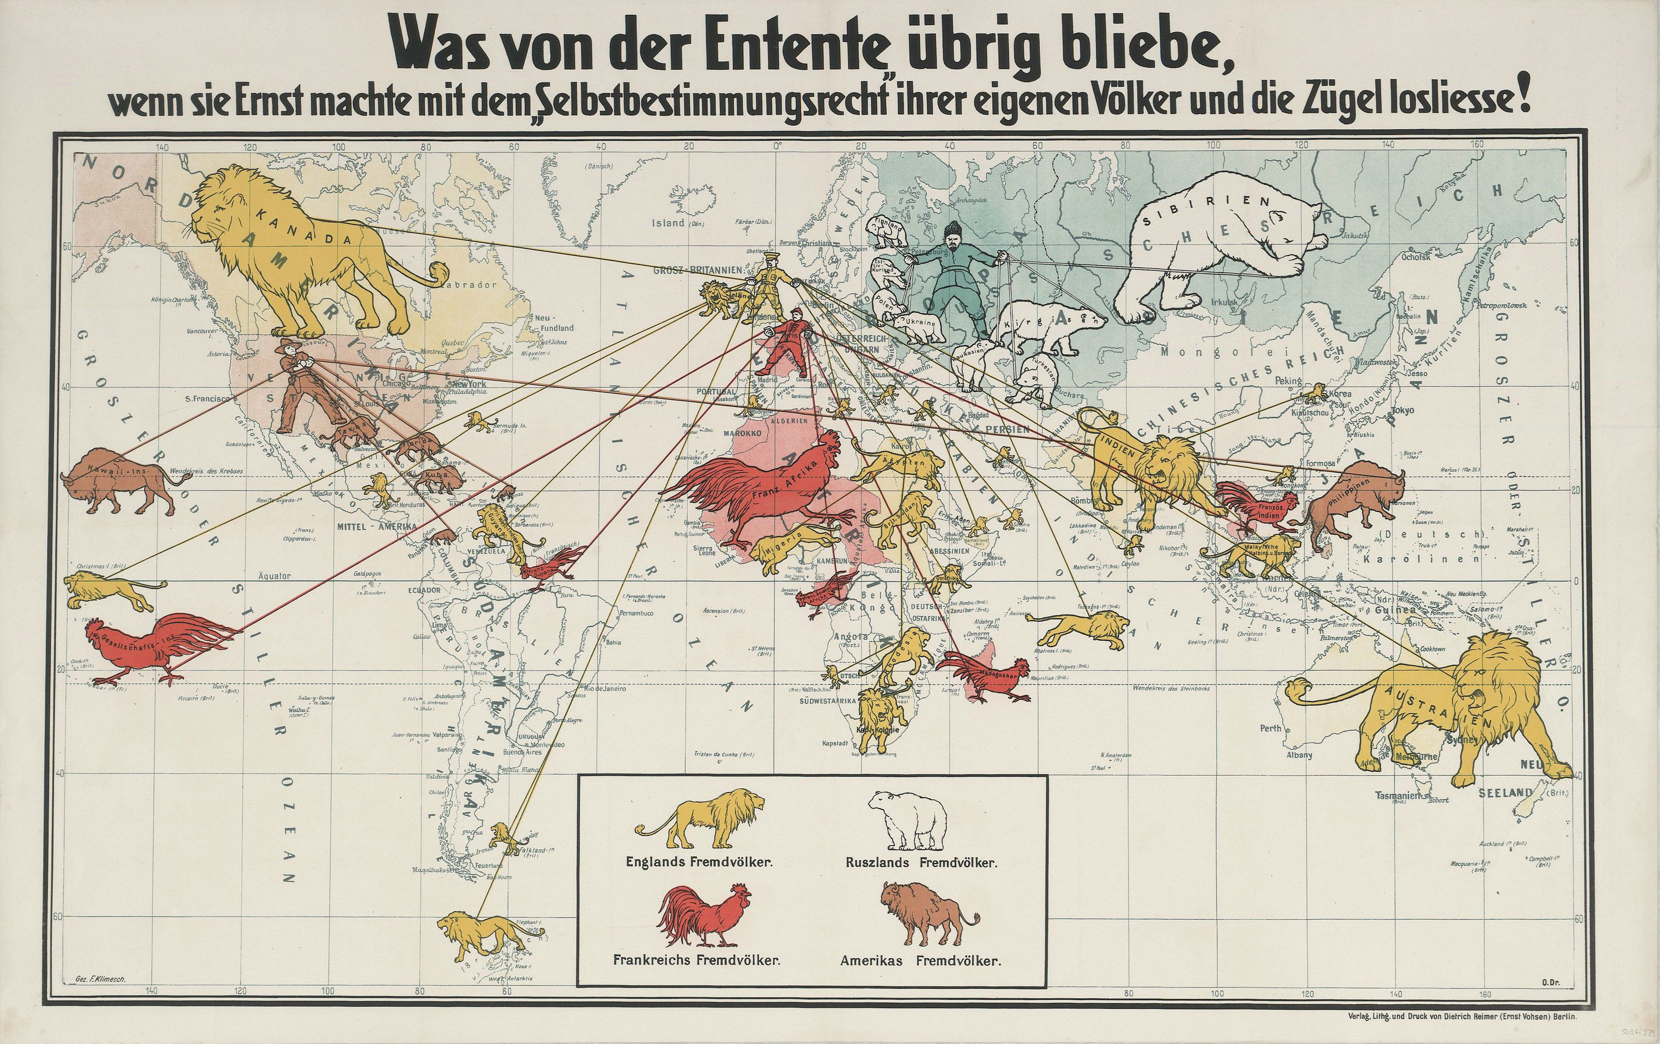
The German Perspective
1916
Notes:
German propaganda map of the Allies’ colonial empires, circa 1916
What would be left of the Entente (agreement) if they would be serious about the right of self-determination and loosen the reins.

Slide 18
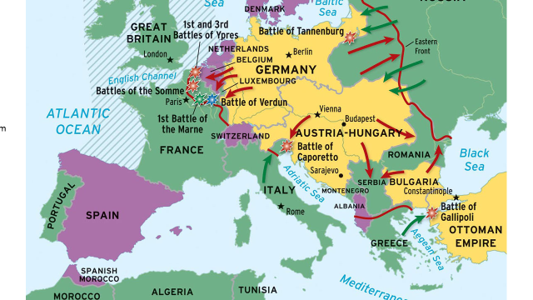
World War I

Slide 19
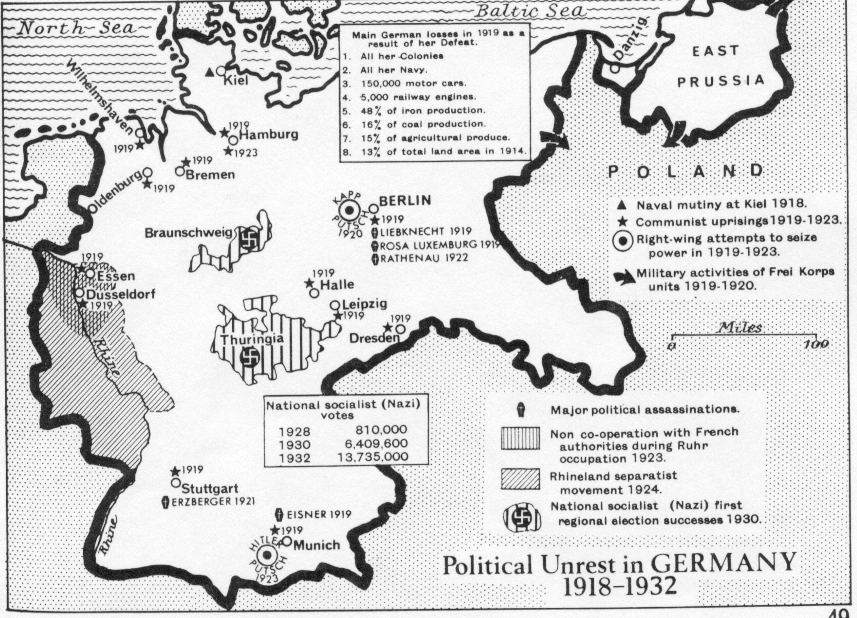

Slide 20
Germany, 1932
Reichstag (parliament):
National Socialist German Workers' Party (NAZI): 196 seats (33.09%)
The Social Democrats (SPD): 121 seats (20.43%)
Communists (KPD): 100 (16.86%).
President Hindenburg appoints Hitler chancellor to form majority government

Slide 21
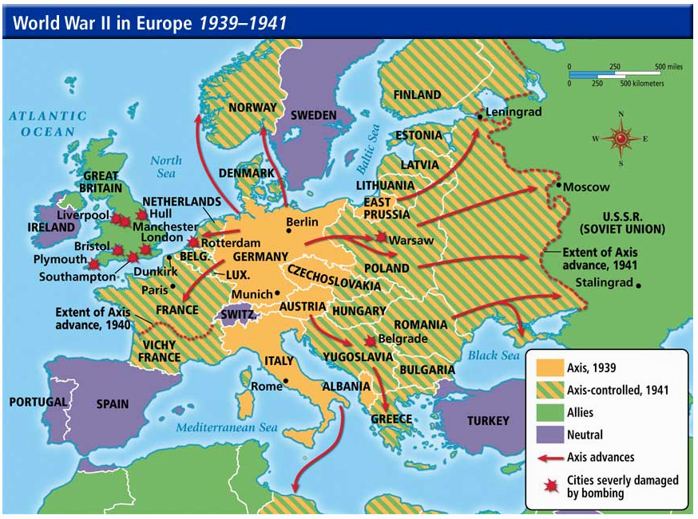
http://burkeen.me

Slide 22
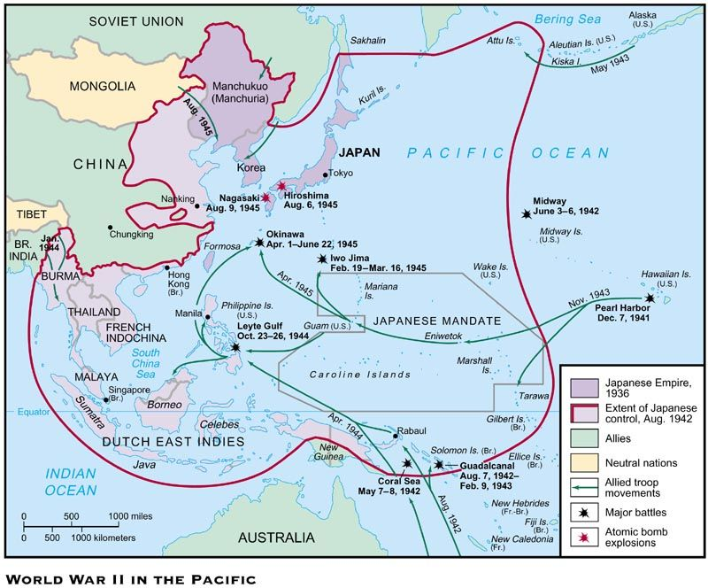
Learnourhistory.com
Notes:
1853 Admiral Perry forced Japan to open to western trade

Slide 23
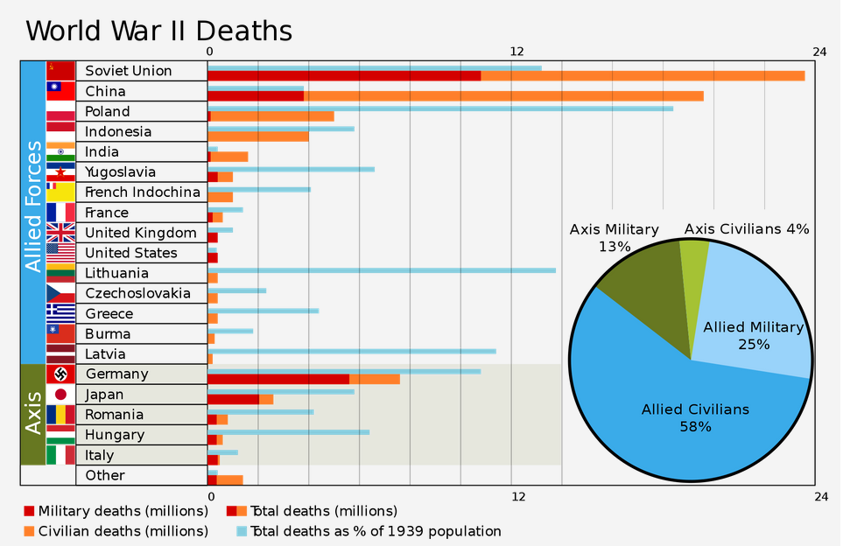
WW II
https://www.reddit.com/r/dataisbeautiful/comments/1bb3xv/world_war_ii_deaths/

Slide 24
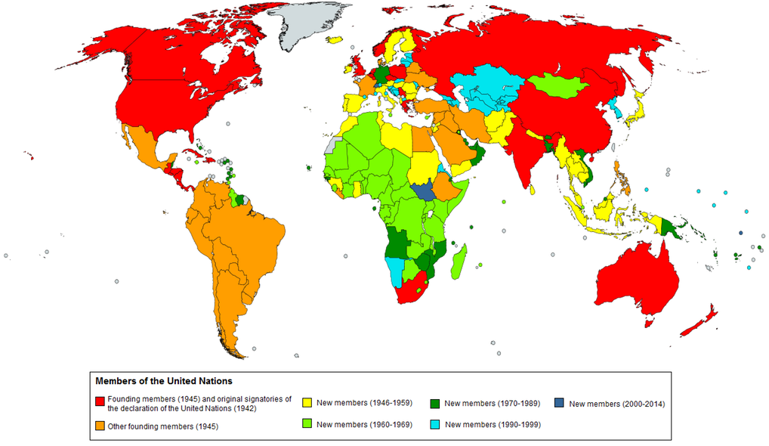
United Nations

Slide 25
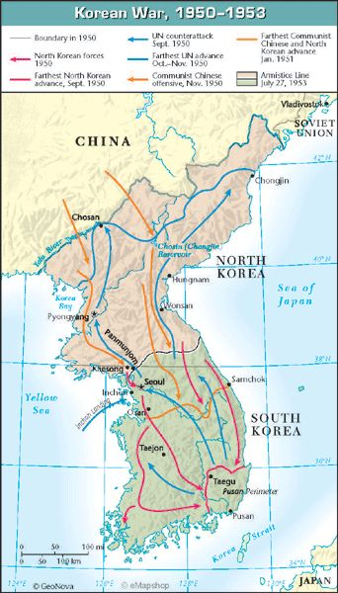
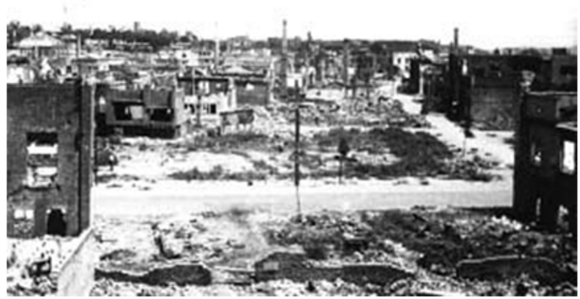
Population 1939: 24,326,000
1939 – 1941: 500,000 deaths, 5,400,000 conscripted
1950-1953: 3 million people died
American planes dropped 635,000 tons of bombs (503,000 tons of bombs dropped in the entire Pacific in World War II)
Destroyed 8,700 factories, 5,000 schools, 1,000 hospitals and 600,000 homes
Pyongyang, 1953
https://sites.tufts.edu
Notes:
https://apjjf.org/-Charles-K.-Armstrong/3460/article.html
http://www.bbc.com/news/world-asia-43921385?ocid=global_bbccom_email_27042018_top+news+stories
85,000 miles squared – California is 165,000!
Popuplatino of California: 40 million

Slide 26
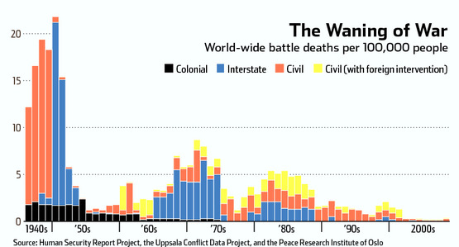
Armed Conflict
Notes:
The number of deaths from conflict have dramatically decreased in the last 70 years.

Slide 27
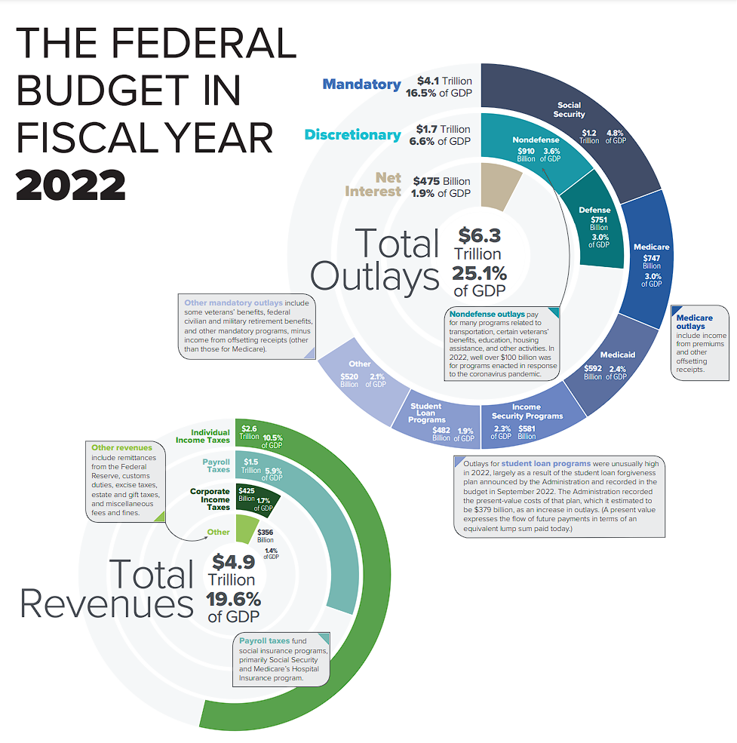
wiki2.org
Notes:
https://wiki2.org/en/United_States_federal_budget#/media/File:2018_Federal_Budget_Infographic.png

Slide 28
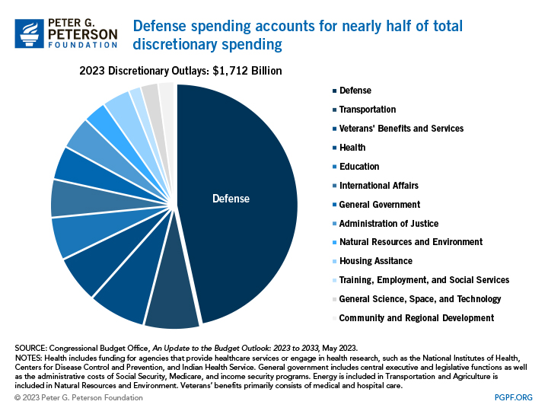

Slide 29
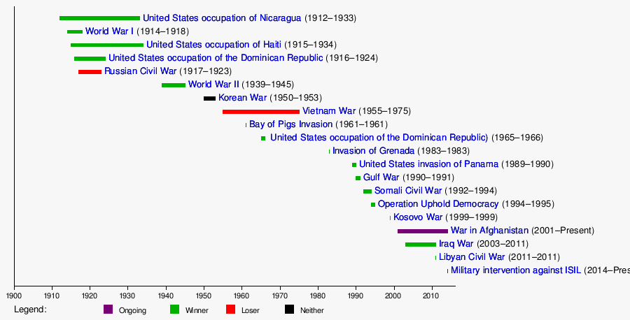
In 239 years, 222 years at war
https://www.quora.com/Why-has-America-waged-so-many-wars

Slide 30
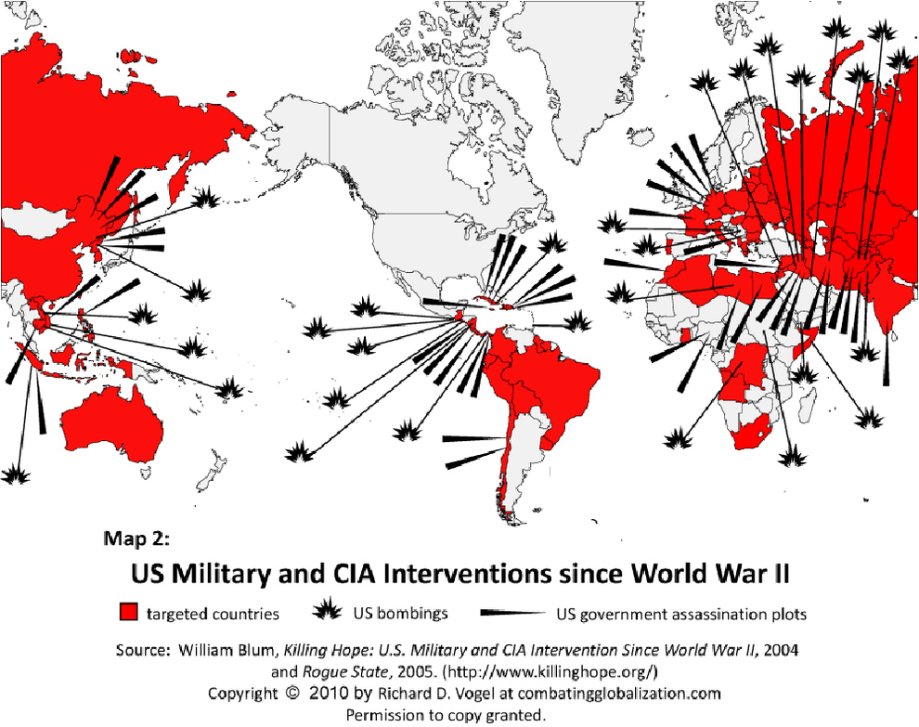
Notes:
US overturned a democratically elected government in Chile when they threatened to nationalize the mines. The government was replaced by a military dictatorship.
US overturned the government of Iran when they threatened to nationalize the oil fields, the government was replaced by the Shah, a ruthless dictator that tortured and willed 200,000 of his own people. Ayatollah Khomeini led a revolution against the Shah and today Iran's government is elected but our enemy.
https://www.youtube.com/watch?v=-2d-yXtm2ME

Slide 31
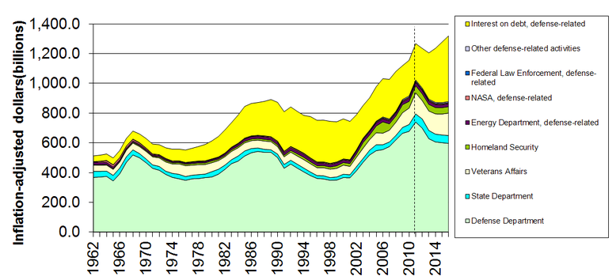
Military-Related Spending
https://en.wikipedia.org/wiki/Military_budget_of_the_United_States

Slide 32
Cost of Post-9/11 Wars
$8 trillion, $26,000 per US Citizen
Over 801,000 lives lost by direct violence
7,050 US Soldiers Killed
38 million people displaced
Revenue:
$7 trillion to defense contractors
https://tinyurl.com/7ka5e7pe
Notes:
https://watson.brown.edu/costsofwar/papers/summary

Slide 33
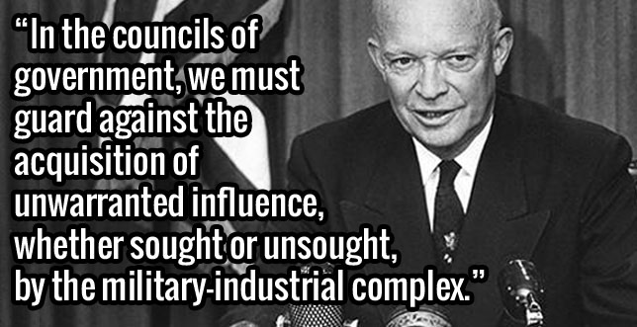
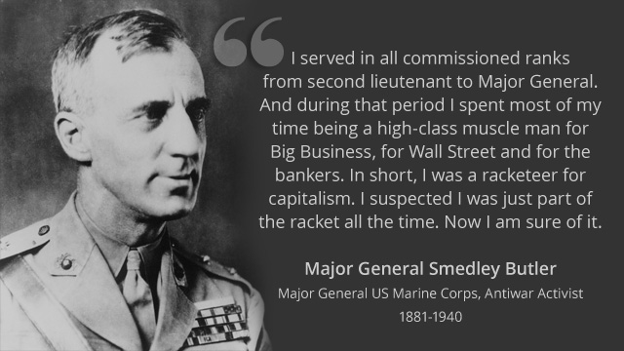
President Eisenhower’s
Final Address
“If you join the military now, you are not defending the United States of America. You are helping certain policy makers pursue an imperial agenda.”
- Lieutenant Colonel Karen Kwiatkowski

Slide 34
Military-Industrial Complex
$1,500 Billion
Tax Payers
Lobbyists
Staffers
Congress
Employ
Armed Services
Committees
Media
Employ
$700 Billion
Oil Companies
Defense Contractors
Generals retire
DOD
$38.4 billion just from offshore

Slide 35
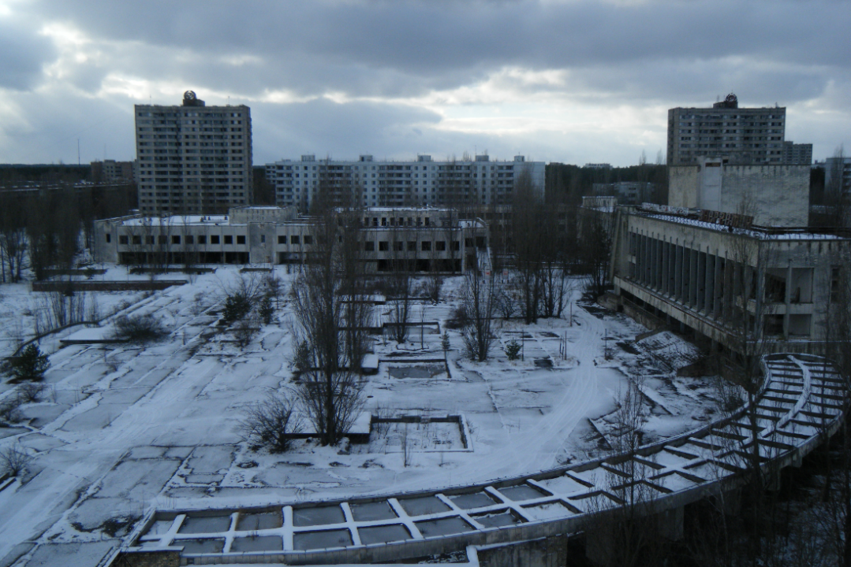
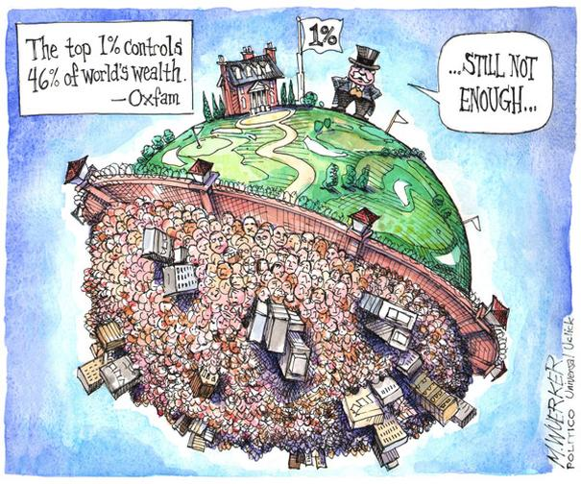
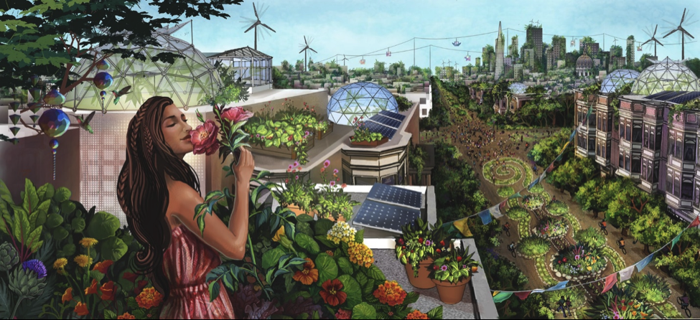
What will the world look like in 2100?
Nuclear Winter
Chernobyl in Winter
www.oxfam.ca
Orwell’s 1984
thebluereview.org
Ecotopia
Notes:
https://thebluereview.org/utopian-writers-american-west/

Slide 36
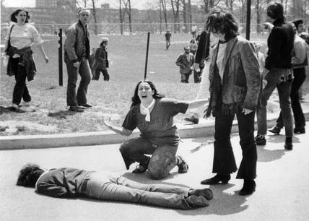
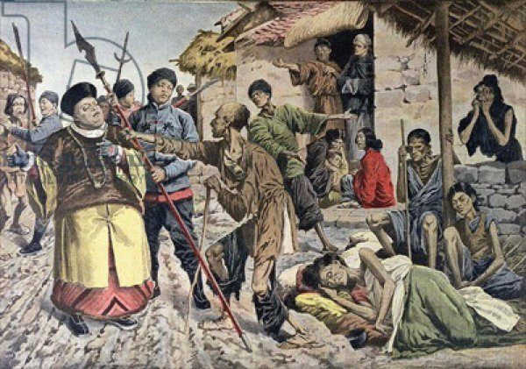
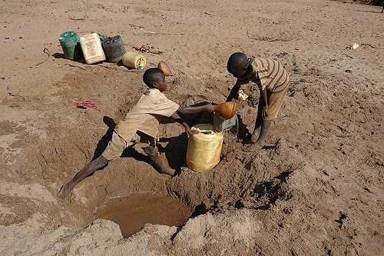
Threats
War
Famine
Water shortages
Etc.
Kent State Shooting, May 1970
Chinese famine of 1907, 25 million died
Drought in Kenya, 2009
Notes:
Kent State Shooting, May 1970
Chinese famine of 1907 (25 million died, later 43 million)
Drought in Kenya, 2009
https://listverse.com/2013/04/10/10-terrible-famines-in-history/

Slide 37
Drought
Increasing
Population
Invasive
Species
Climate
Warming
Sea
Level Rise
Greenhouse
Gases
Marine
Acidification
Over-fishing
Decrease
in Food Availability
Pollution
Fertilizers
Reduced
Phosphorus
Shortage
Oil
“Scarcity”
Biofuels
Increase
Famine
Disease
Death

Slide 38
Jim’s Theory
As of cultivation of crops and domestication of animals expanded, there was excess food all year around allowing a small number of people to rule over others.
Hierarchies formed around: politics, religion, and wealth/business
These hierarchies have expanded to a global level

Slide 39
Power Corrupts
Many leaders see their role as controlling those under them and are always nervous of losing control
So, they try to tighten control
After you are on top, you can only get higher by conquering others (self reinforcing)

Slide 40
Leads to
Big Business
Not so much
Technology
Commerce
War
Centralized energy
Drugs and surgery
Resource extraction
Fast food
Uniformity
Enlightenment
Exercise
Peace
Decentralized energy
Health
Reduce, reuse, recycle
Gardening
Diversity

Slide 41
What can we do?
Local to Global
Personal to Organizational
Now and in the Future

Slide 42
Additional Sources
NASA: https://climate.nasa.gov/
US EIA: https://tinyurl.com/y39wlws8
Canada.gov: https://tinyurl.com/t3olklw
IPCC: https://www.ipcc.ch/
BBC: https://tinyurl.com/w95pzaj
UN: https://tinyurl.com/y9ffrjv7
UK: https://tinyurl.com/sm35lx7

Slide 43
Additional Slides

Slide 44
Warming
Climate
Warming Reducing Farm and Timber Lands By 2100
Accumulating
GHG
Recycled
Education
Education, Regulation, Incentives
35 Gigatons/Year
~30% of Emissions
+1%/year
Population
7.7 billion
85%
10%
2.6%
Energy¹
Gone by 2100
Oceans
Fossil Fuels
Food
Bio
Fuel
Bio
Fuel
Forests
Farmland
Timberland
1. Missing 2% is nuclear. 2.3% of the renewables are hydro most of which is not sustainable.

Slide 45
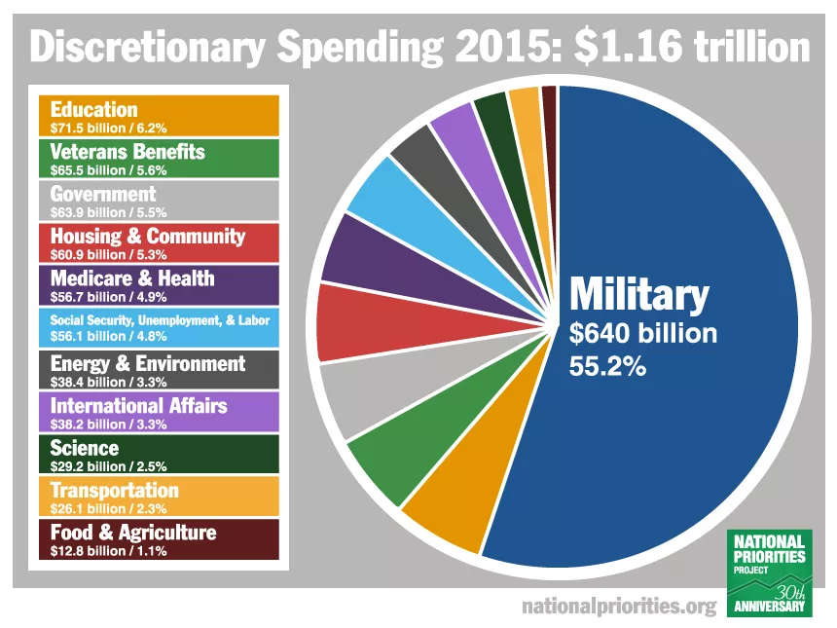

Slide 46
Hypothesis
The United States has created a global empire backed by a huge military industrial complex
The US is funding this empire instead of investing in updating our infrastructure, including moving to renewable energy source
This will result in degrading our planet to where it cannot sustain our current population by the end of this century

Slide 47
US Allies
US Enemies
E. U., Britain (democracy)
North Korea (dictatorship)
Saudi Arabia (monarchy)
Iran (constitutional monarchy)
1953
Iran (The Shah)
1979
Iran (Islamic democracy)
Iraq (Saddam Hussein)
1990
Iraq (Saddam Hussein)
2003
Iraq (Islamic democracy)
1973
Chile (Allende)
Chile (Pinochet)
Dictatorship
Democracy?
Representative Democracy
Notes:
A form of government in which power is explicitly vested in the people, who in turn exercise their power through elected representatives. Today, the terms republic and democracy are virtually interchangeable, but historically the two differed.
Iran became our enemy in 1941 when the prime minister nationalized the oil fields
Shah of Iran: https://en.wikipedia.org/wiki/Mohammad_Reza_Pahlavi

Slide 48
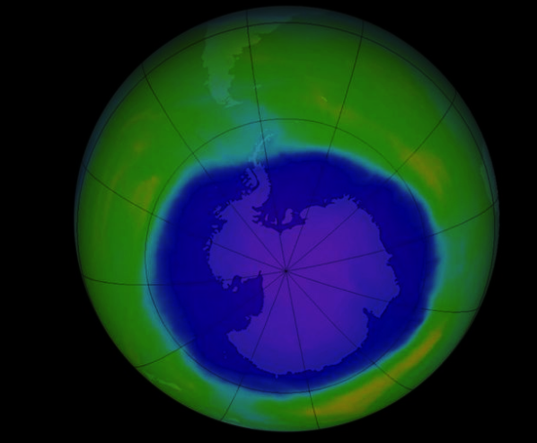
As GIS Professionals
Listen, then define and describe the issue
Collect and qualify data
Analyze, model, map, and write
Convey results, with uncertainties, to all interested parties
Learn and educate
Maps can make a difference, locally or globally

Slide 49
Global Change
Over-fishing
Pollution
Invasive
Species
Increasing
Population
Marine
Acidification
Biofuels
Increase
Less
Food
Drought
Famine
Sea
Level
Rise
Fertilizers
Reduced
Climate
Warming
Oil
“Scarcity”
Phosphorus
Shortage
Disease
Greenhouse
Gases
Notes:
My main concern is not for any one of these issues but for all of them combined. Particularly when we add over-fishing, pollution, invasive species, and an increasing population. I believe this will cause increased famine and then disease, particularly, in certain African countries.

Slide 50
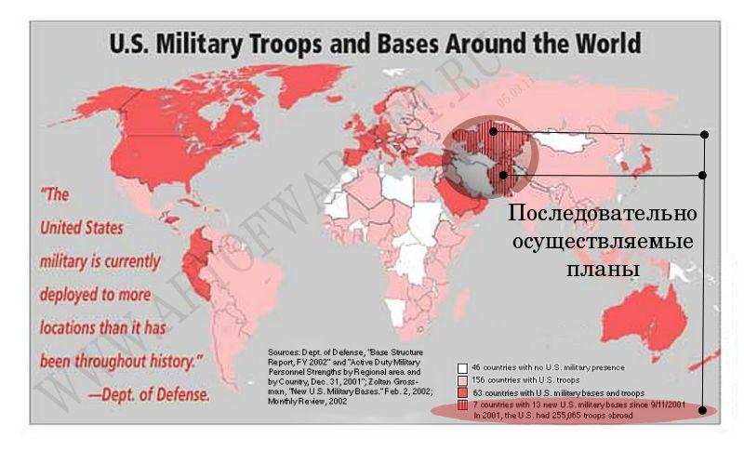
People wanted change, but few people then imagined that as a result of such "changes" Russia would lose industry and 15 million people, and economic and territorial losses would exceed the losses of the WWII times. In other Soviet republics, the US dictatorship was actually established. The plundered and humiliated Russia - the largest fragment of the USSR, almost 20 years was not able to answer even the most simple geopolitical challenges. As a result, NATO has come very close to Russia, and American bases are literally seizing the world of the Eurasian peoples they hate.
Notes:
People wanted change, but few people then imagined that as a result of such "changes" Russia would lose industry and 15 million people, and economic and territorial losses would exceed the losses of the WWII times. In other Soviet republics, the US dictatorship was actually established. The plundered and humiliated Russia - the largest fragment of the USSR, almost 20 years was not able to answer even the most simple geopolitical challenges. As a result, NATO has come very close to Russia, and American bases are literally seizing the world of the Eurasian peoples they hate.
http://geoclub.info/%D1%81%D0%B5%D0%BF%D0%B0%D1%80%D0%B0%D1%82%D0%B8%D0%B7%D0%BC-%D0%BA%D0%B8%D0%B5%D0%B2%D1%81%D0%BA%D0%BE%D0%B9-%D1%85%D1%83%D0%BD%D1%82%D1%8B/

Slide 51
Cost of Afghanistan War
$500 billion, $1600 per US Citizen
Notes:
Wikipedia and Congressional Budget Office

Slide 52
Cost of Iraq War
$1.9 trillion, $6,300 per US Citizen
$ 2 trillion in future veteran's benefits
460,000 Iraqi deaths
4,431 US Deaths
31,994 US Wounded in action
Notes:
PLOS Medicine survey

Slide 53
 | CO₂ (Carbon Dioxide) | CH₄ (Methane) | N₂O (Nitrous Oxide) | CFC-11 (Chlorofluoro-carbon-11) | HFC-23 (Hydrofluoro-carbon-23) | CF₄ (Perfluoro-methane)
Pre-industrial concentration | about 280 ppm | about 700 ppb | about 270 ppb | zero | zero | 40 ppt
Concentration in 1998 | 365 ppm | 1745 ppb | 314 ppb | 268 ppt | 14 ppt | 80 ppt
Rate of concentration change ^{b} | 1.5 ppm/yr ª | 7.0 ppb/yr ª | 0.8 ppb/yr | -1.4 ppt/yr | 0.55 ppt/yr | 1 ppt/yr
Atmospheric lifetime | 5 to 200 yr ^{c} | 12 yr ^{d} | 114 yr ^{d} | 45 yr | 260 yr | >50,000 y
https://archive.ipcc.ch/ipccreports/tar/wg1/016.htm

Slide 54
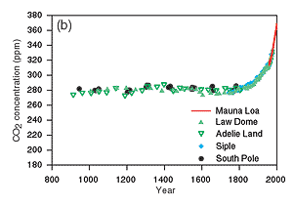
https://archive.ipcc.ch/ipccreports/tar/wg1/figts-10.htm

Slide 55
1.3 Trillion Dollars Buys
Every year, what we spend on the military could purchase:
~350,000 wind turbines
~216 million residential PV systems

Slide 56
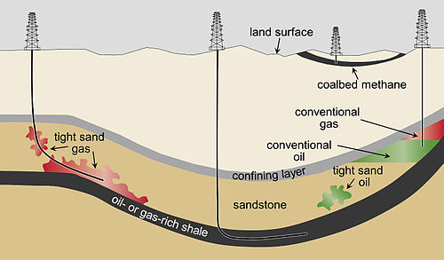
Tight Oil
Wikipedia

Slide 57
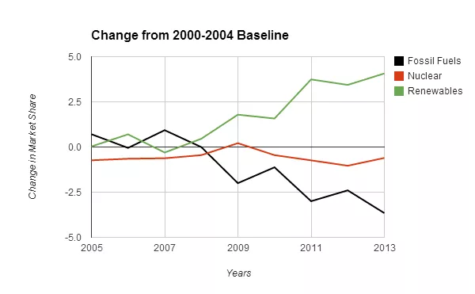
Renewable Energy Momentum Has Passed The Tipping Point
(cleantechnica.com)
Notes:
This is likely to accelerate over time because newly added renewables have a cumulative effect. This is to say that each new renewable installation will supplant the energy demand of the older model energy sources of oil, coal, gas and nuclear.

Slide 58
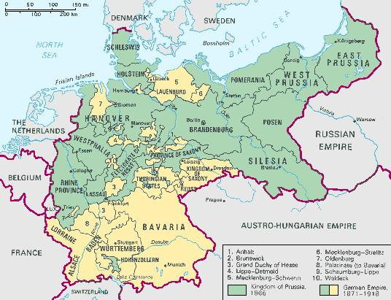
Notes:
www.britannica.com

Slide 59
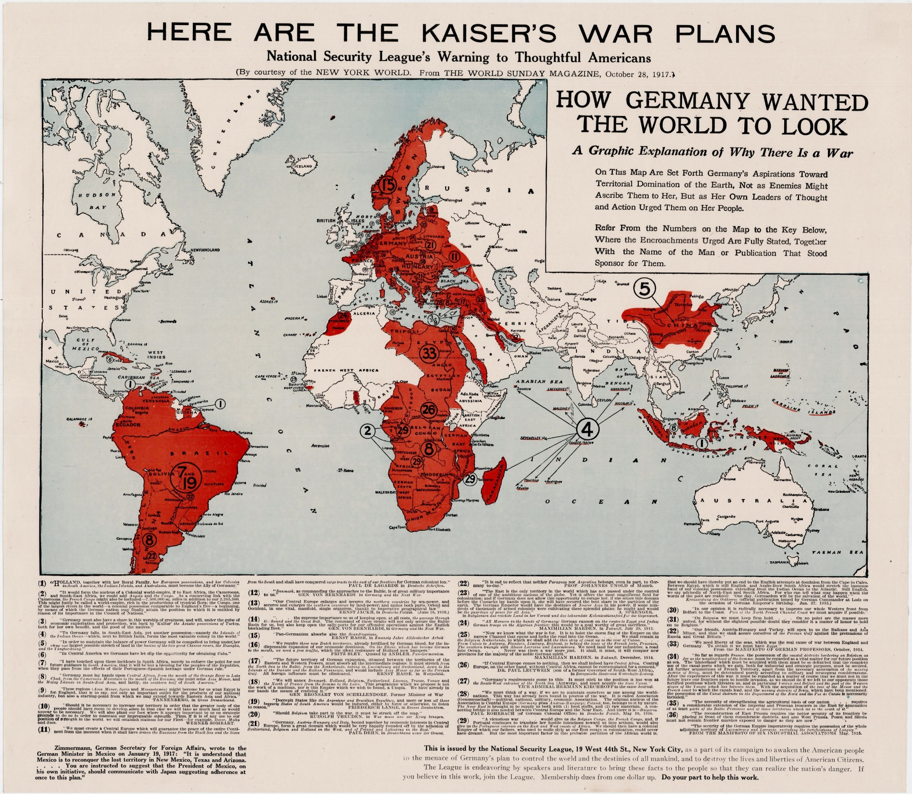
1917
Notes:
World War One propaganda map advocating American intervention

Slide 60
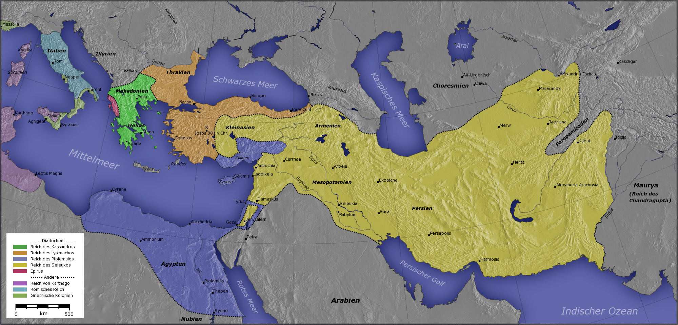
Macedonian Empire
Notes:
The Macedonian Empire, 336-323 B.C. AND Kingdoms of the Diadochi in 301 BC and 200 BC. Historical Atlas by William R. Shepherd, 1911. Courtesy of the University of Texas Libraries, The University of Texas at Austin., CC BY-SA 3.0, https://commons.wikimedia.org/w/index.php?curid=531504

Slide 61
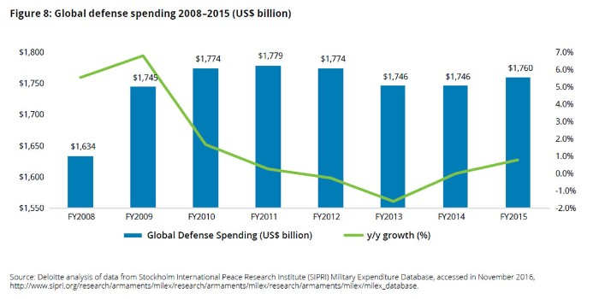
To Understand, You have to see it from their perspective
NASDAQ predictions for Boeing
2017 Global aerospace and defense industry outlook
Growth prospects and trends remain upbeat
You have to make profit or you can’t pay the shareholders
If the shareholders sell, your company loses value
If your company loses value it can become a take-over target

Slide 62
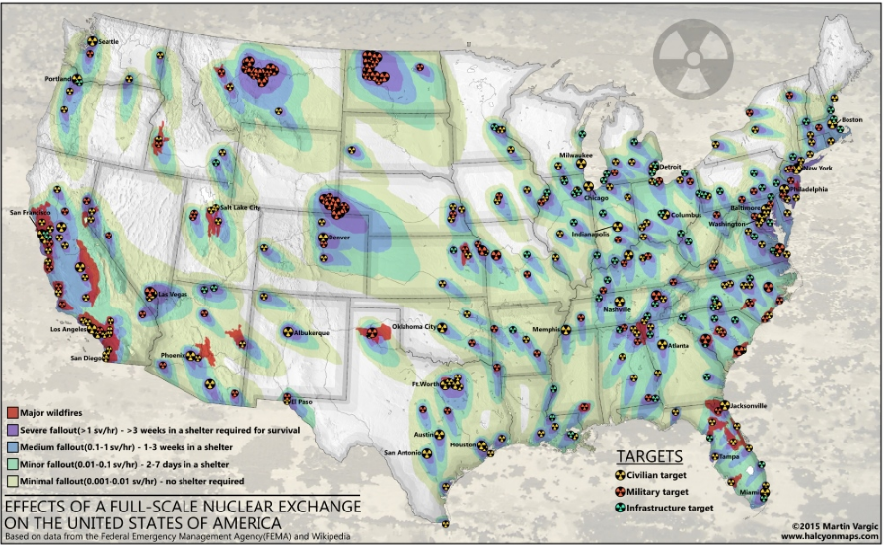
Fall-Scale Nuclear “Exchange”

Slide 63
In Summary
The US has developed a huge complex of military contractors, defense works, lobbyists, politicians and the Department of Defense that must have conflict to justify it’s existence.
The complex supports the rich through supporting resource extraction in other countries.
Tax payers are helping with funding to the detriment of the world.

Slide 64
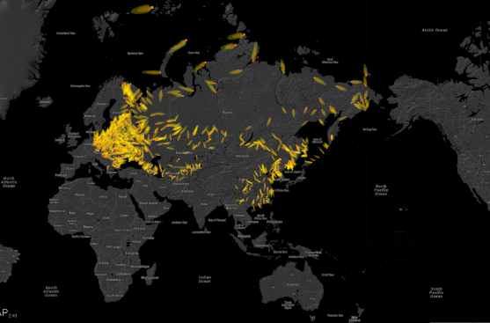
Future of Life Maps
https://futureoflife.org/background/us-nuclear-targets/#nukemap

Slide 65
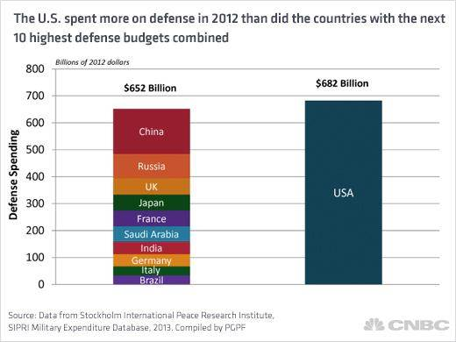

Slide 66
Military-Industrial-Oil Complex?
$1,500 Billion
Tax Payers
Lobbyists
Staffers
Congress
Armed Services
Committees
Media
Employ
Employ
$700 Billion
Oil Companies
Defense Contractors
Generals retire
DOD
$38.4 billion just from offshore

Slide 67
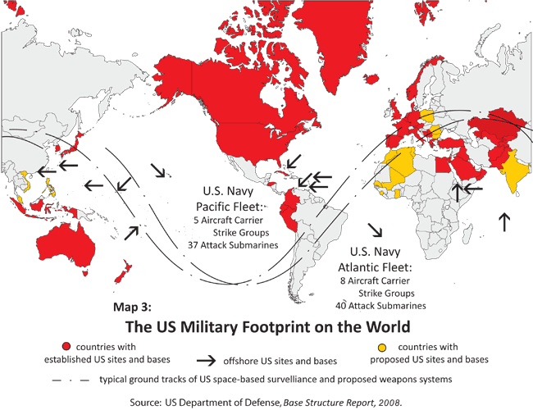

Slide 68
Trump’s Proposed Changes:
Defense: +10% ($54 billion)
EPA: -31%
State Department: -29%
Dept. of Ag.: -21%
Dept. of Health Services: -18%
Dept. of Commerce: -16%
NOAA: -$250 in coastal research
Dept. of Education: -14%
Dept. of Energy: -6%

Slide 69
Summary
US is arming ourselves, and the rest of the world, as if we are in a world war.
We are burning all the fossil fuels we can reach as fast as we can causing long-term damage to the earth, war, pollution, etc.
We have been told for decades that renewables are too expensive.

Slide 70
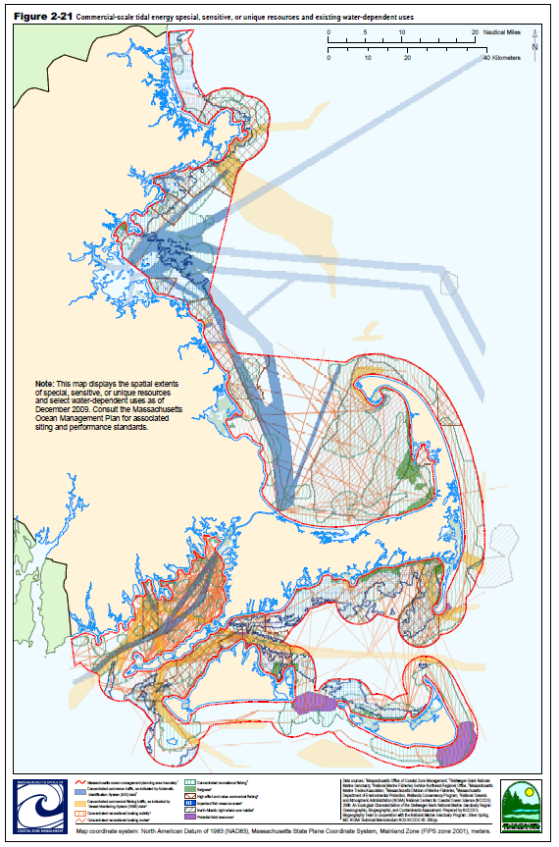
MSP
Marine Spatial Planning
Mass. Ocean Management Plan

Slide 71
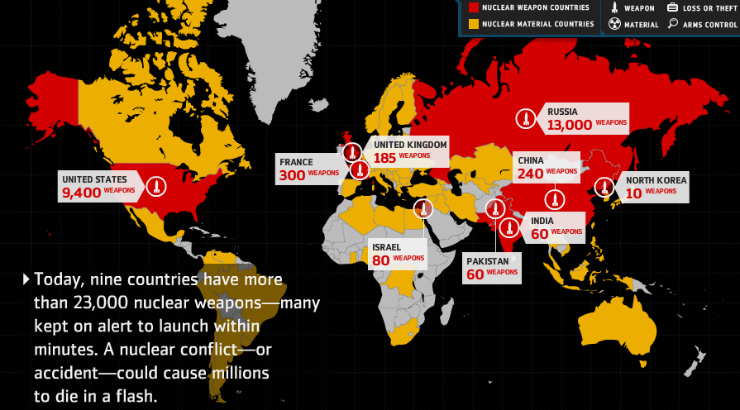
Nuclear Arsenal
$1,000 Billion to be spend in modernization in the next decade, Financial Times
Notes:
Nuclear arsenal has reduced from over 70,000 to under 20,000
We continue to maintain a huge number of nuclear weapons which most folks do not think about today but this is still a major threat to happiness.

Slide 72
The Military Industrial Complex
Tax Payers
Congress
$2,600 Billion
Armed Services
Committees
Lobbyists
Staffers
Media
Employ
Defense Contractors
$700 Billion
DOD
Generals retire
Figures are annual approximations
Notes:
80% of generals retire to defense contractors or consultants
http://archive.boston.com/news/nation/washington/articles/2010/12/26/defense_firms_lure_retired_generals/

Slide 74
Notes:
Oil goes for btween 65 to 90 dollars a barrel, 1 million a day = 65 million to 90 million a day, 24 to 32 billion (about 30 billion a year)

Slide 75
All we have to do is:
Stop burning fossil fuels!
Including uranium.
Switch to sustainable, clean solutions
Conserve energy
Have fewer children
It’s probably too late to avoid major problems but the sooner we get started, the less problems we will have

Slide 76
Ocean Acidification
Notes:
Another effect of atmospheric CO2 is that the ocean becomes more acidic as it absorbs CO2.

Slide 77
Increase in pH Since 1700s
Notes:
This has caused a global increase in pH and recently caused oyster failures because the small oysters could not form their shells. This has the potentially to cause collapses in major fisheries.

Slide 79
Fertility Rate: 2005
http://www.fooddeserts.org
Notes:
Fertility rates have dropped to near replacement for most of the world, except Africa.

Slide 81
Estimated World Population
WORLD POPULATION TO 2300 - United Nations
Notes:
The UN has esimated that world population may peak at about 2050.

Slide 82
The Risk
 | Do Nothing | Take Action
Global Change is not happening | No effect | Cleaner environment for everyone Economic impacts?
Global Change is happening | Billions starve Most major cities have to move Island cultures relocated Low-lying countries inundated 20-50% species lost | Less starve Less impact on cities Less impact on island cultures Less impact on low-lying countries Less species loss
Adapted from YouTube video: The most terrifying video you'll ever see
Notes:
How about we stop arguing about if and why and start taking action to mitigate the potential problems?

Slide 83
http://unit8juliahalexisp10.wikispaces.com
Korean War
1 Million People Killed

Slide 84
What does this have to do with GIS?
NASA
Wikipedia

Slide 85
US Renewable Energy
http://thinkprogress.org/climate/2011/11/03/360531/getting-clean-energy-economy-facts/?mobile=nc

Slide 86
Renewables are now cheaper than fossil fuels (including nuclear)

Slide 87
Solar Engery
http://www.exploregreenenergy.com

Slide 88
Mean Annual Wind Speed
http://myweb.unomaha.edu/~gpagett/CartGIS/gallery.htm

Slide 89
Geothermal

Slide 90
Biofuel

Slide 91
Food Production in Increasing
Notes:
At the same time, world food production has increased steadily but partly because of the use of fertilizers and industrial agricultural equipment.

Slide 92
Greenhouse Gasses
http://interculturalclimateaction.wordpress.com

Slide 93
Carbon Dioxide Output
U.S. Dept. Of Energy

Slide 94
Atmospheric CO2

Slide 96
Fertility Rate: 1970
http://www.fooddeserts.org
Notes:
Fertility rates used to be well above replacement (2) so there was rapid population growth.

Slide 97
sparkaction.org

Slide 98
Solar in the US

Slide 99
Peak Oil?
www.greatdreams.com
Notes:
Everyone agrees that we will run out of fossil fuels in the future but there is little agreement on when. This will cause oil to steadily increase in cost and eventually case oil scarcity.

Slide 100
Spatial-Tempral Planning
Disease Outbreaks
Safety/Emergency services
Recreation
Economics
Fish & Wildlife
Agriculture
Cultural Resources
Energy Production
Legal Issues
Ownership

Slide 101
Impacted by Ocean Acidification
Coccolithophores & Foraminifera: Plankton
> ?
Corals:
> huge variety of fish
Echinoderms: star fish, echinoderms
> Mammals
Crustaceans: Shrimp, crabs, lobsters
> birds, mammals, fish, and humans
Molluscs: Snails
> birds, others

Slide 102
Australian Fire Storms
ksj.mit.edu

Slide 104
Food Security?
Demand for energy is increasing
We will run out of fossil fuels
Switch to biofuel will reduce food production
Population is increasing
But the rate of increase is slowing
Food consumption is increasing
Food production is increasing
But we are running out of phosphorus

Slide 105
Interconnected World
http://www.pikeresearch.com/tag/biofuels

Slide 107
Climate Change
Caption: Figure 1. Rainfall deciles across Australia for 1 January 1997 to 31 December 2009; deciles based on climatology from 1900 to 2009 (Bureau of Meteorology)

Slide 108
Increasing Food Consumption

Slide 109
What will the world look like in 2100?
www.oxfam.ca
Chernobyl in Winter
thebluereview.org
Notes:
https://thebluereview.org/utopian-writers-american-west/

Slide 110
Three Threats
Nuclear War
Resource Exhaustion: Water, Oil, Food, Fertilizer, etc.
Leads to famine, disease

Slide 111
Coral Reef Bleaching
http://www.duke.edu

Slide 112
Threats to Biodiversity
Biodiversity Threat: riverthreat.net

Slide 113
Human Water Security
Human Water Security Threat: riverthreat.net

Slide 115
Predicted Temperature Increase
Degrees F
Year
http://www.dailytemperaturecycle.com/fossilfuellifetime.htm

Slide 117
Food Stocks are Low

Slide 118
Peak Phosphorus
Figure 1: Peak phosphorus ‘Hubbert’ curve, indicating that production will eventually reach a maximum, after which it will decline (source: Cordell, Drangert and White, 2009) ^{i}

Slide 119
Ice Cover in Arctic

Slide 120
Grand Challenges
Eradicate extreme poverty and hunger
Achieve universal primary education
Promote gender equality
Reduce child mortality
Improve maternal health
Combat diseases
Ensure environmental stability
Develop Global Partnership for Development
United Nations Millennium Development Goals

Slide 121
sparkaction.org

Slide 122
“Renewable, Clean, Energy”
Solar: requires trace minerals
Wind: minerals and species impacts
Wave/tidal: minerals and species impacts
Geothermal: limited availability?
Hydroelectric: limited locations, sediment
Biofuel: Deforestation, food -> fuel, marginal in the US
Nuclear: impacts, danger, storage
Conservation?

Slide 123
US Energy Sources
http://www.instituteforenergyresearch.org

Slide 124
US Renewable Energy
http://www.instituteforenergyresearch.org
Notes:
- Biomass and hydro is down because of draughts, solar increasing but still small

Slide 125
Increased CO2 -> Warming

Slide 126
The League of Nations

Slide 127
Global Potential Energy

Slide 128
Nuclear Arsenal
Imagine, a room, awash in gasoline. And there are two implacable enemies in that room. One of them has 9,000 matches. The other has 7,000 matches. Each of them is concerned about who’s ahead, who’s stronger. Well, that's the kind of situation we are actually in.
Carl Segan

Slide 129
Arctic Ice Extent 2010
Magenta line indicates median ice extent for 1979-2000, NOAA
Notes:
For the first time in human history, there is a “northwest passage” open during the summer.

Slide 130
Greenland Ice Melt
NASA
Notes:
The entire ice cap of Greenland was defrosting in July of 2012, this is unprecidented in at least 150 years

Slide 131
World Phosphorus Reserves
http://www.thebrokeronline.eu/en/Articles/Peak-phosphorus
Notes:
Another threat to food production is that we have a limited supply of phosphorus, an important fertilizer.

Slide 132
Notes:
Countries that have strong economies are also investing in other countries and purchasing land to produce food for export. This could reduce local production capacity.

Slide 133
Notes:
The highest number of undernourished people are in Africa.

Slide 134
Change in Cereal Production
Gornall, Implications of climate change for agricultural productivity in the early twenty-first century,
The Royal Society, Biological Sciences
Notes:
Shows the predicted change in cereal production yield based on climate change scenarios.
Notice that there is actually a potential increase at first in the northern latitudes but then a uniform negative trend in output.

Slide 135
World Happiness Map
The results of Columbia University's World Happiness Report, mapped. (Max Fisher/The Washington Post)
The United States ranks 17th of the 156 ranked countries, behind Mexico (16) and Panama (15).
Notes:
One of my goals is to help increase human happiness, now and in the future.

Slide 136
Risks to human happiness
Humans Need:
Risks:
Safe homes
Clean water
Good food
Socialization
Freedom
War/Armed Conflict
Natural Disasters
Totalitarian Governments
Disease
Famine
Drought
Clean water council
NPR

Slide 140
Global Armed Conflict
International Institute for Strategic Studies (IISS) Armed Conflict Database
Notes:
There are still armed conflicts but they are relegated to increasingly smaller areas of the globe.

Slide 141
Armed Conflict to Drop to 1 in 12 countries by 2050
Higher education, lower infant mortality and lower population growth are reasons why the world can expect a more peaceful future

