Slide 1
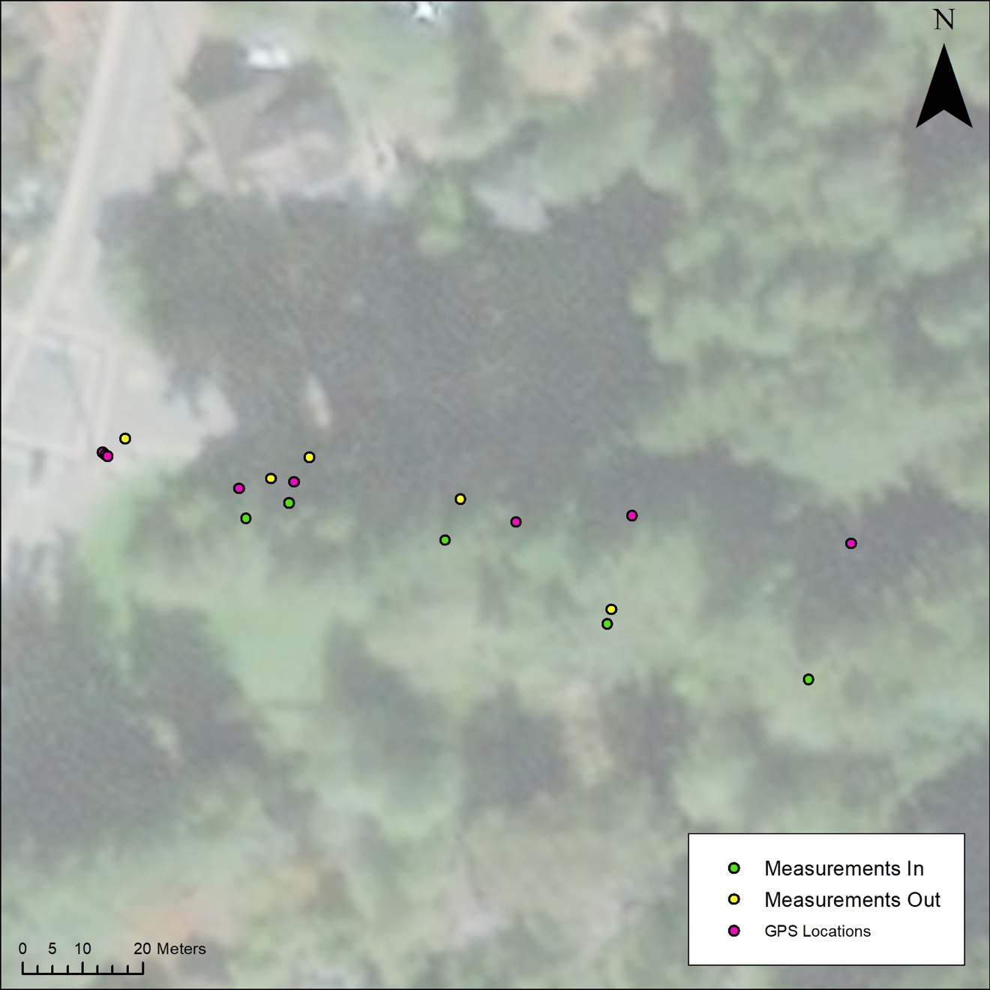
Notes:
From Anne

