Slide 1
Field Methods
Also known as “Survey Methods” refers to collecting data, “on the ground”.
Understanding field methods is critical for analysis even if you did not collect the data so you have an idea of what is possible (and what is not).
This is required even with modern remotely sensed data so we can “Ground Truth” the data

Slide 2
Existing Experience
What field work have you done?

Slide 3
Steps
Establish objectives
Select a site
Plan the visit (including protocol(s))
Collect the data
Qualify the data (estimate uncertainty)
Download data
Qualify the data again
Start Analysis
Go back and get more data as needed!

Slide 4
Common Mistakes
Run out of batteries
GPS breaks, is dropped overboard, lost, stolen, etc.
Notes get wet, dropped overboard, burned, used as TP.
Datum set to the wrong datum or worse, changed while collecting.
Assume what HDOP means.
Notes:
HDOP, or Horizontal Dilusion of Precision, is defined by the manufacturer.

Slide 5
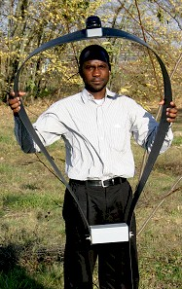

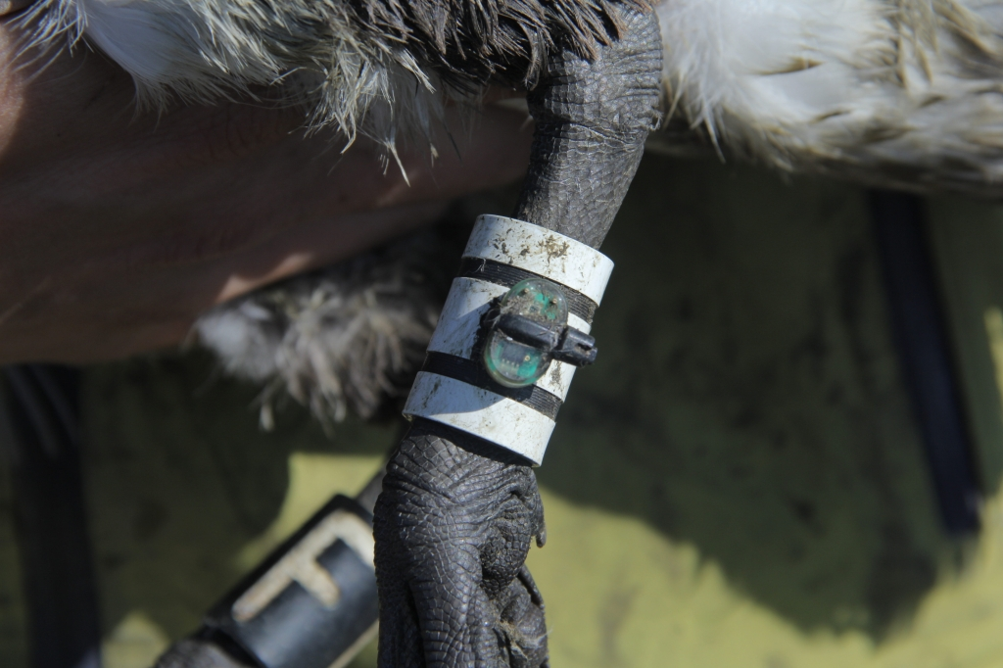
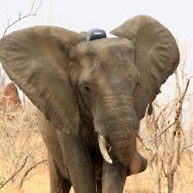
Collecting Data
Varies with the discipline:
  Wildlife: observe and/or capture
    Tags, cameras, GPS
  Fisheries: observe, tag
  Forestry: traditional surveys & GPS
  Range: GSP & traditional surveys
  Watershed: find a location and get wet!
http://www.microwavetelemetry.com
http://tobseda.com

Slide 6
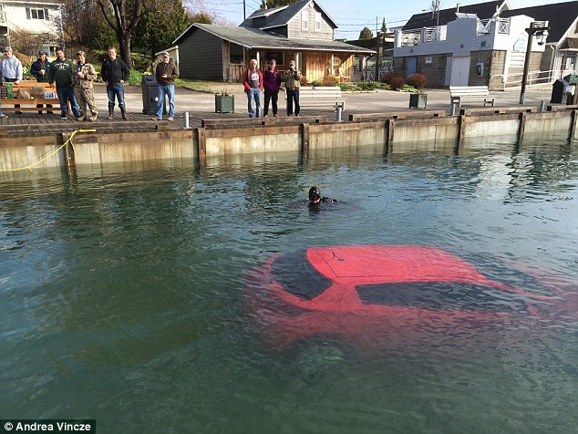
What is critical?
Must find our location with some degree of accuracy!
  Allows us to find it again (rebar is not good enough)
  Allows us to do spatial analysis:
    Migration
    Density/Abundance
    Habitat
    Distances

Slide 7
Tools
Maps!
Protocol
GPS, compass, range finder, etc.
Measuring equipment
ID books?
Notebook!
Tags, traps, other stuff?
Also:
  Food, water, first aid kit, bug spray, sun block, camera, etc.

Slide 8
Maps!
People have died because they trusted their GPS
  see WikiPedia: Death by GPS.
USGS Topographic maps (Topo Quads)
Are free to download and a bit of a pain to print.
The store, Adventures Edge, still has them for sale.

Slide 9
Map Use
Take a look at your USGS Topo Quad.
What spatial reference systems do you see?
What spatial reference system is the map printed in?
When was the map printed and does it include everything you would expect?
What is the declination?

Slide 10
GPS
GPS
  $100 to $1000: 1 meter accuracy
  >$1000: < 1 meter, 10 centimeters?
  Differential station: 1 centimeter?
“Traditional” Surveying
  Electronic “theodolites” and laser ranging has replaced mechanical tools
    Total Station
  < 10 centimeters
Cell phone triangulation is not an option!
  Typically only work in cities

Slide 11
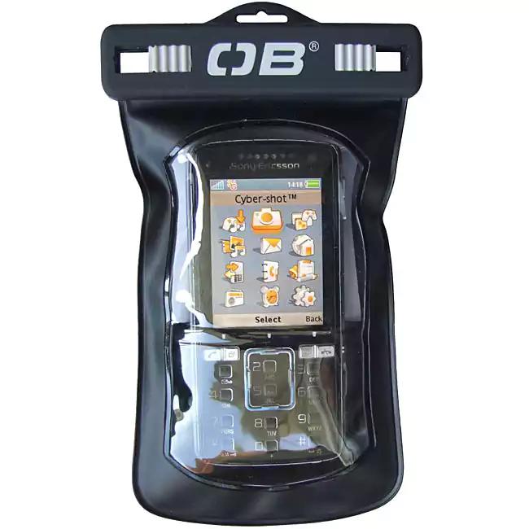
GPS Accessories
Overstock.com
Always carry:
  Spare batteries
  Baggies (in case it rains)
    GPS in a baggy will float, one without will sink!
  Pink surveying tape
    Tie it to everything so you don’t lose equipment!
  Spare GPS?

Slide 12
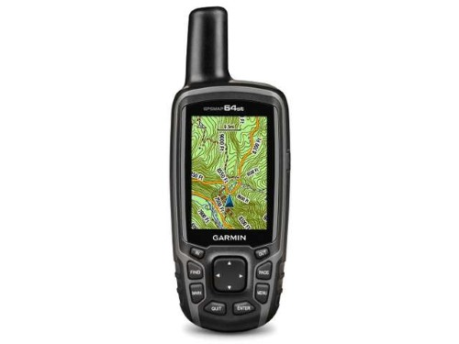
Garmin GPSMAP 64st
Owner’s Manual
Quick Start
Power
Change Menu Item
Mark Waypoint
Main Menu
Enter

Slide 13
Measuring Equipment
Tape measures
Yard sticks
Quadrats
Range Finders

Slide 14
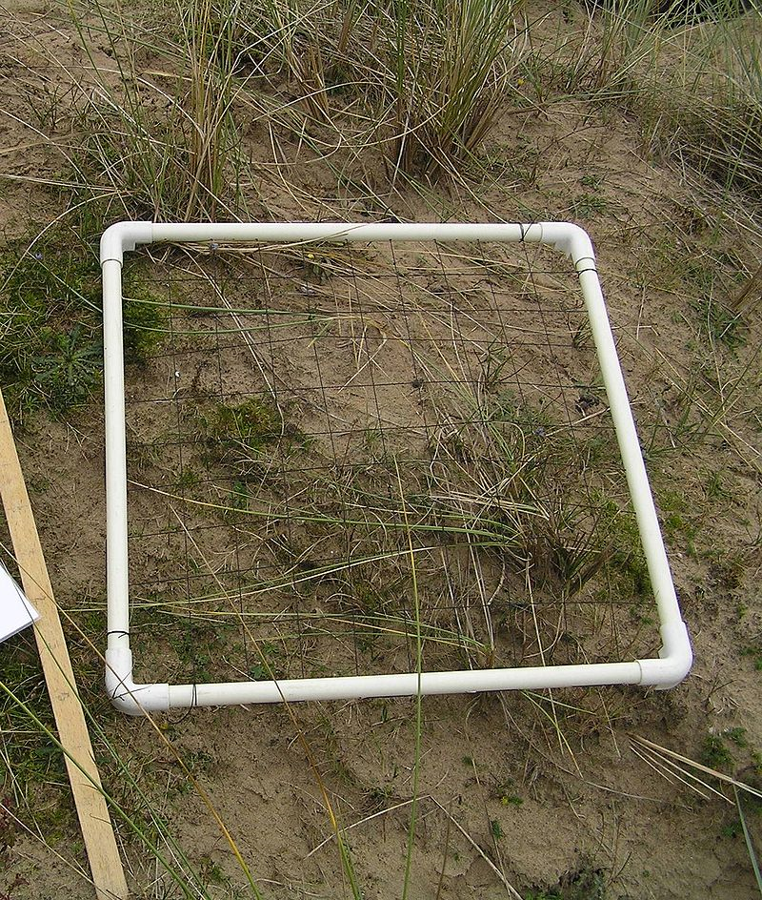
Quadrates
1 meter square
1 meter “hoop”
Wikipedia

Slide 15
Notebooks
Computers will replace paper when:
  You can fold up a computer and put it in your back pocket
  It costs 5 cents
  You can use it to start a fire or as TP
Paper is still fragile!
  Keep your notes and notebooks in a baggie

