Slide 1
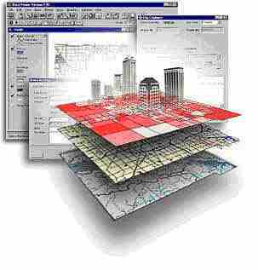
EMP 580
What you really need to do to be successful with GIS Data!

Slide 2
What you are going to see…
Data sets in many different spatial references, especially:
  Datums: NAD27, NAD83, WGS84, some WGS72
  Projections: UTM, State Plane, Geographic, Albers…
  Units: US Feet, Meters, Nautical Miles, a few others
Data sets with:
  Properly defined spatial references (80%?)
  Undefined spatial references (lots)
  Incorrect spatial references (a few)
Organizations with:
  A standard spatial reference
  No idea what a spatial reference is

Slide 3
Key Points
If a spatial data set does not have a defined Coordinate System (Spatial Reference System) then it’s relationship to the earth is not defined. These data sets should not be used until their Spatial Reference System is defined.
If a spatial data set has the wrong Coordinate System, it will be improperly referenced to the earth. These data sets should not be used until their Spatial Reference System is correctly defined.
Error will be reduced and performance increased if all datasets used together are in the same Spatial Reference System.

Slide 4
What you should do…
If your organization doesn’t have a standard spatial reference:
  Define one
I recommend:
  WGS84 for the Datum
  An appropriate projection based on the area
  Meters for the units
Also, setup a folder structure to keep the data organized

Slide 5
Suggested Folder Structure
1_Originals
  Humboldt_County
  California
2_Working
  WGS84_UTM_10_North_Meters
    California
    Humboldt_County
  WGS84_Geographic
  WGS84_Albers_Equal_Area_North_America
3_Final
  …

Slide 6
Process
Download data into “1_Originals”
Make sure the spatial reference is defined and correct
After all the spatial references are properly defined:
  “Project” the data sets into the spatial reference you want to work in
  Store them in “2_Working”
Now we’re ready to rumble!

