Slide 1
Key Points
To visualize spatial data on a 2d surface, it must be “Projected
We cannot project spatial data to 2d without some distortion
Common projected systems in the US include:
  Universal Transverse Mercator
  State Plane
  Albers
  Lambert
  Geographic on a 2d surface

Slide 2
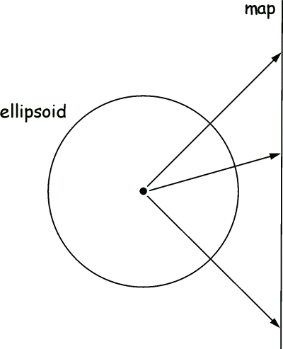
Map Projections
“Projects” spherical data onto a
2d (planar) surface

Slide 3
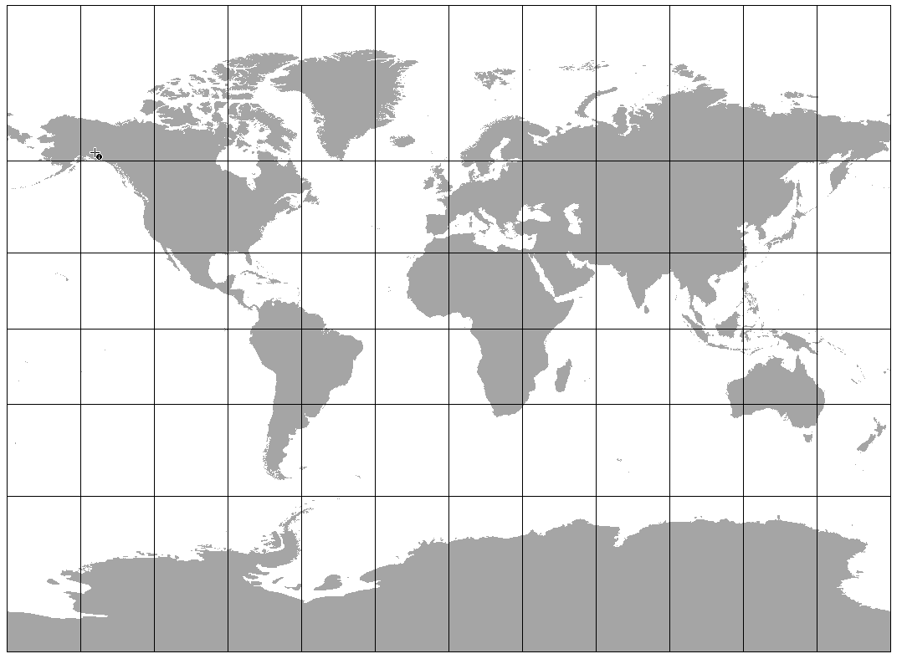
Map Projections

Slide 4
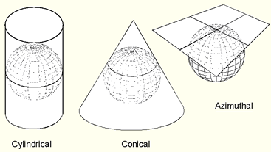
Projection Surface
Projection families:

Slide 5
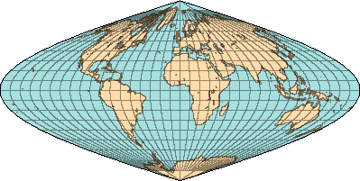
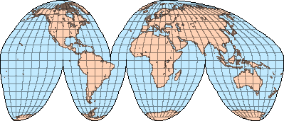
Projection Surface
Others
Pseudocylindrical
Mollweide
Sinusoidal
Goode Homolosine
Sinusoidal
Goode Homolosine

Slide 6
Map Projections
Distortion is unavoidable….
Shape
Area
Distance
Direction
Different map projections exist in order to preserve some properties of the geographic data

Slide 7

Visualizing distortion: what happens to Justin Bieber?
Notes:
Created by Chris Ringo

Slide 8
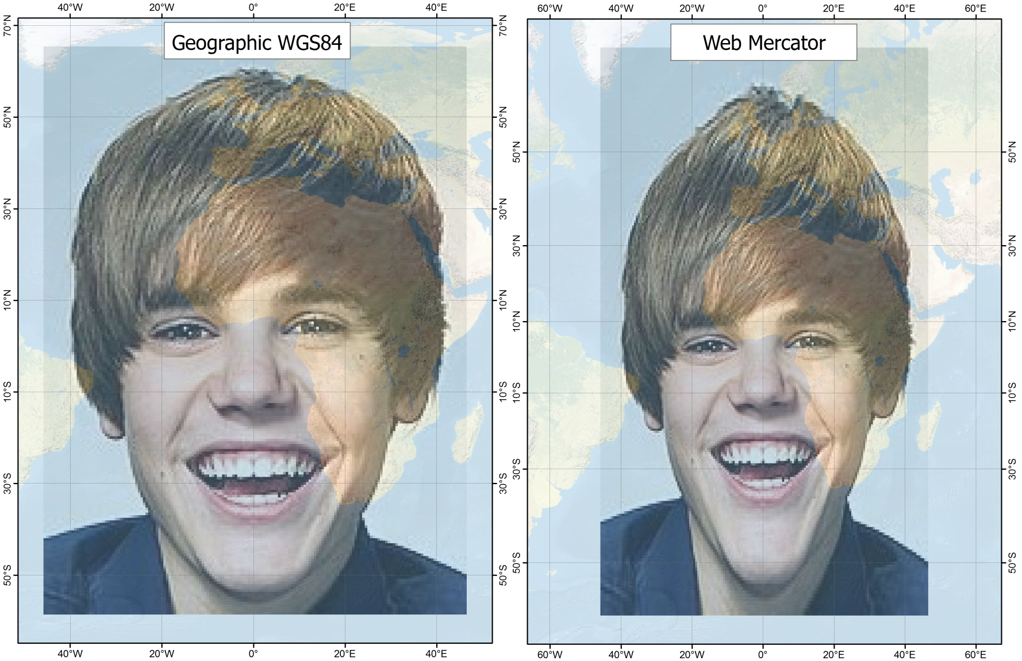
Visualizing distortion: what happens to Justin Bieber?
Notes:
Mercator is a conformal cylindrical projection, and stretches out higher latitudes

Slide 9
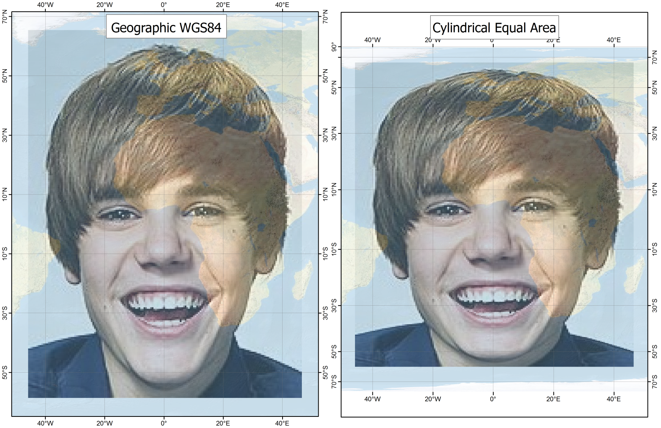
Visualizing distortion: what happens to Justin Bieber?

Slide 10
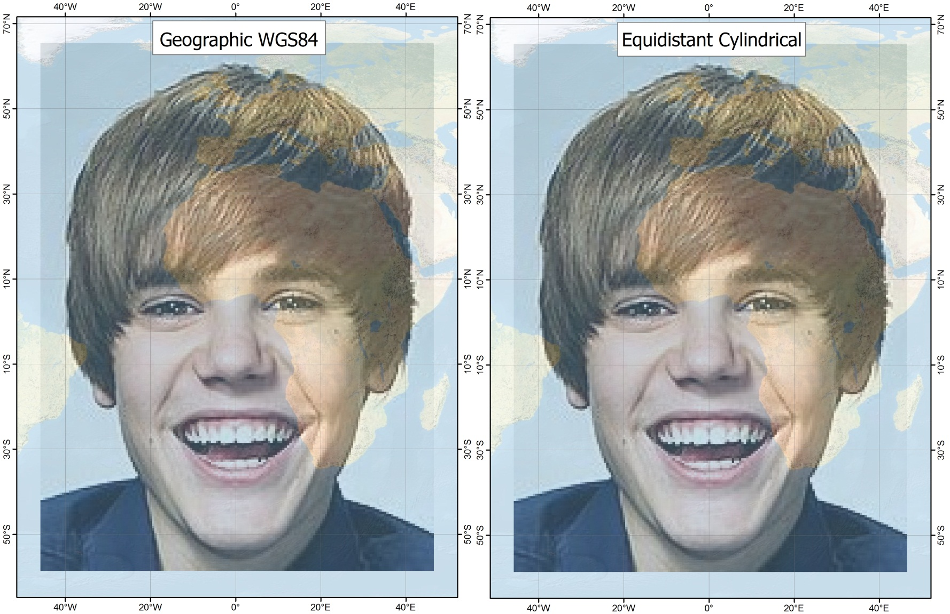
Visualizing distortion: what happens to Justin Bieber?
Notes:
Hey, they look the same!
ESRI uses this projection to display a geographic coordinate system

Slide 11
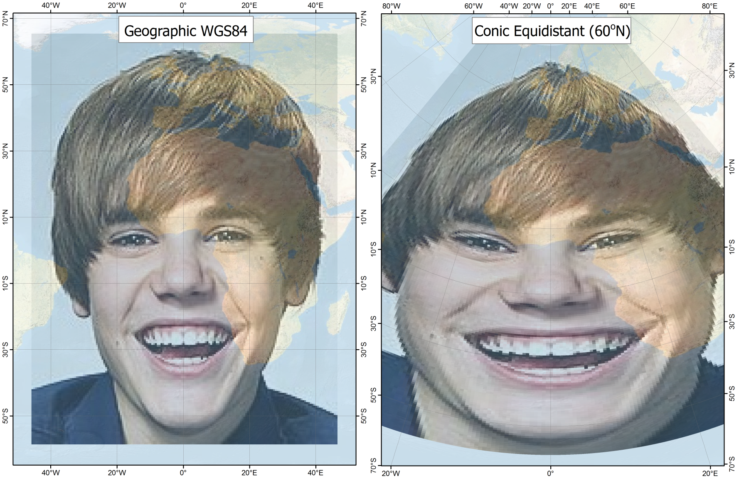
Visualizing distortion: what happens to Justin Bieber?

Slide 12
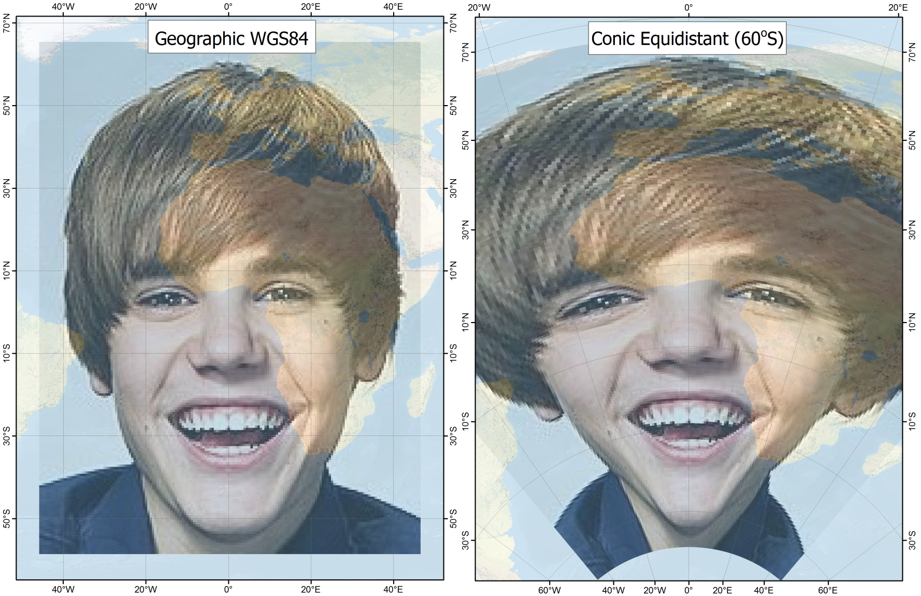
Visualizing distortion: what happens to Justin Bieber?

Slide 13
Map Projections
Types of projections:
Conformal projections
  Preserve shapes and angles
Equal area projection
Equidistant projections
True-direction projections

Slide 14
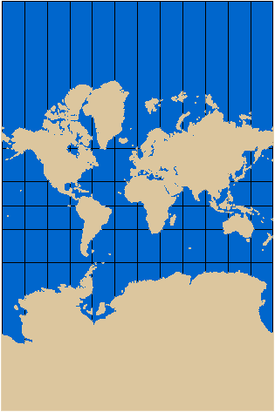
Map Projections
Mercator
Family: Cylindrical
Conformal and True-Direction.
Note the size of Greenland
Greenland: 0.8 million sq. miles
Africa: 11.6 million sq. miles

Slide 15
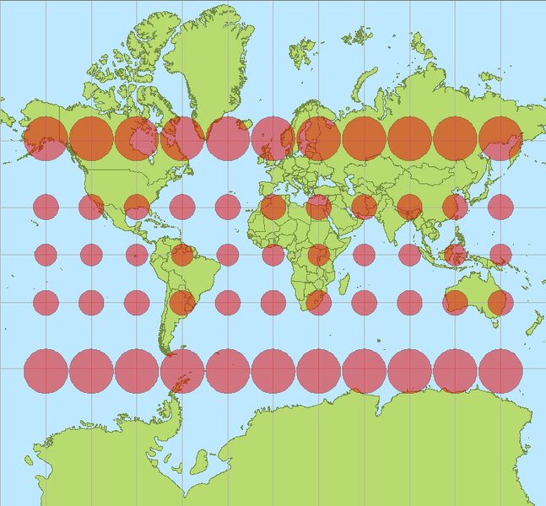
Mercator with Tissot Ellipses
Wikipedia
Notes:
Note that the shape is preserved, size is not

Slide 16
In Theory...

Slide 17
In Reality...
Projecting Latitude and Longitude to UTM:
y = northing = K1 + K2p2 + K3p4, where
K1 = Sk0,
K2 = k0sin21" nu sin(lat)cos(lat)/2
K3 = [k0sin41" nu sin(lat)cos3(lat)/24][(5 - tan2(lat) + 9e'2cos2(lat) + 4e'4cos4(lat)]
x = easting = K4p + K5p3, where
K4 = k0sin1" nu cos(lat)
K5 = (k0sin31" nu cos3(lat)/6)[1 - tan2(lat) + e'2cos2(lat)]

Slide 18
Web Mercator
LonInRadians=Longitude * 0.01745329252
LatInRadians=Latitude * 0.01745329252
Easting = LonInRadians * 6378137.0
  Multiply by the radius of the earth
Northing = 3189068.5 *
  Log((1+Sin(LatRadians))/(1-Sin(LatInRadians)))
  - This one is more complicated

Slide 19
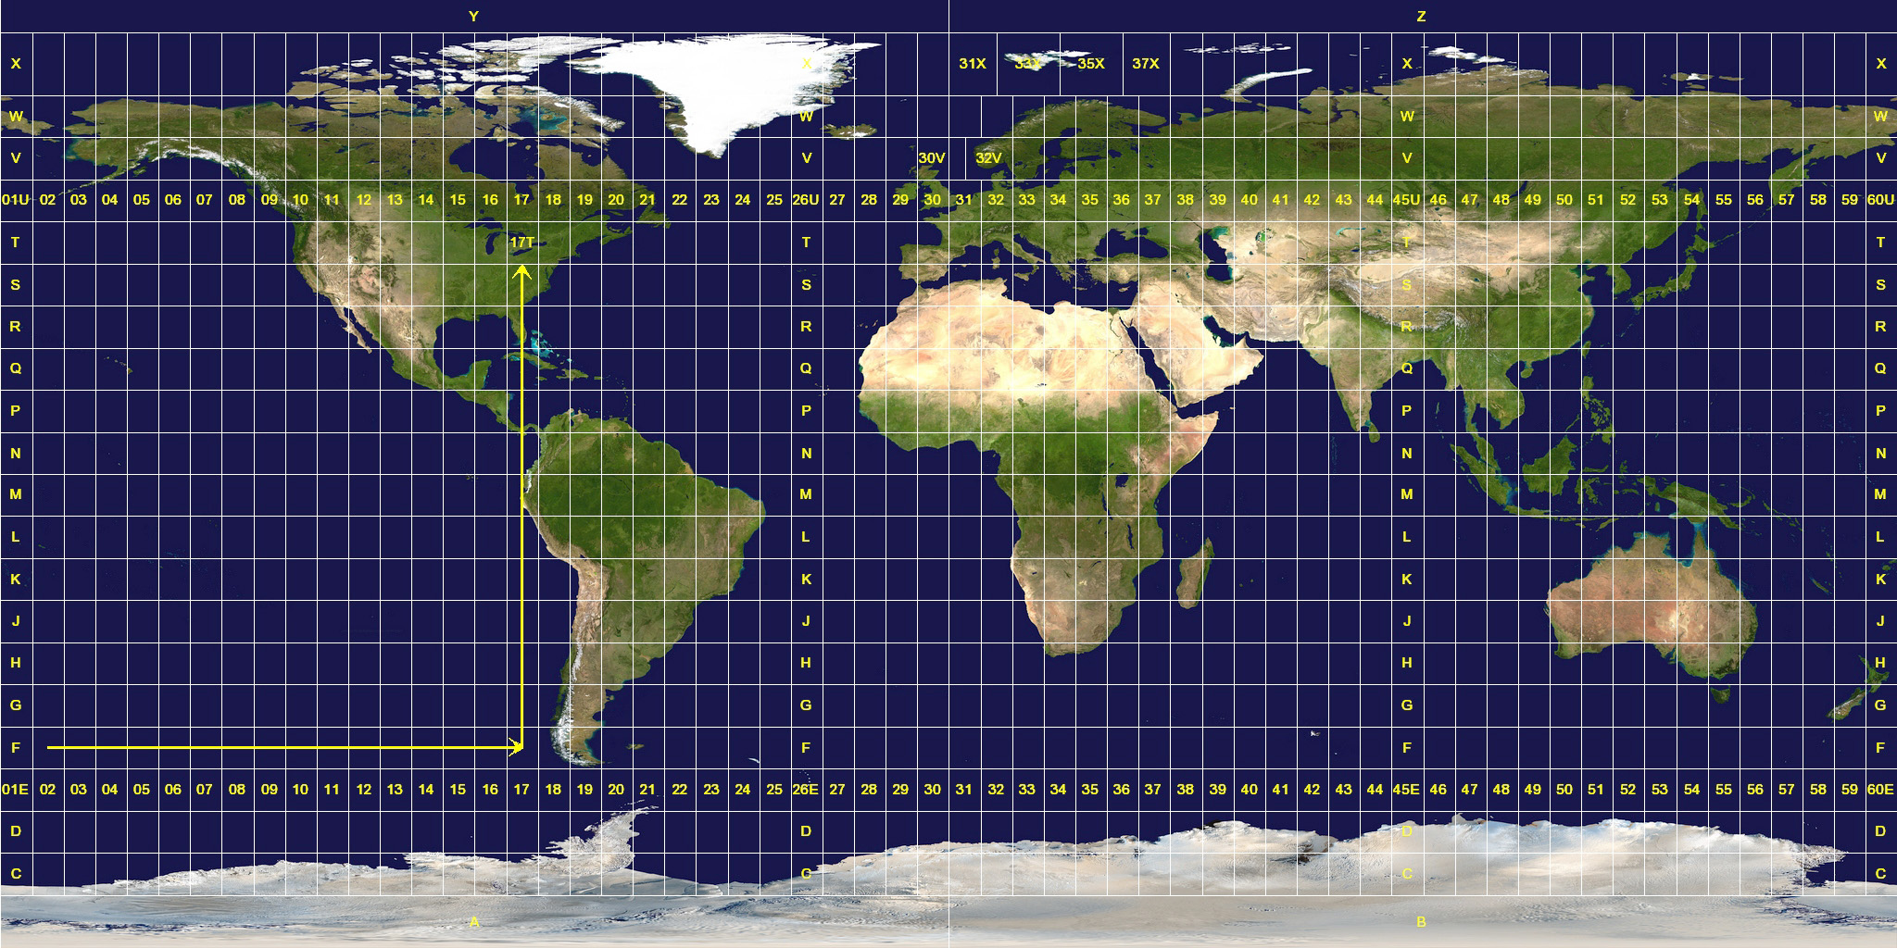
Universal Transverse Mercator
60, 6 degree zones
North
South
Notes:
Entire world is divided into northern and southern hemispheres and then broken up into 6 degree slices.

Slide 20
UTM Coordinates
84° N Latitude
X
500,000 Easting (X)‏
4,000,000 Northing (Y)‏
Y
Equator
500,000 meters

Slide 21
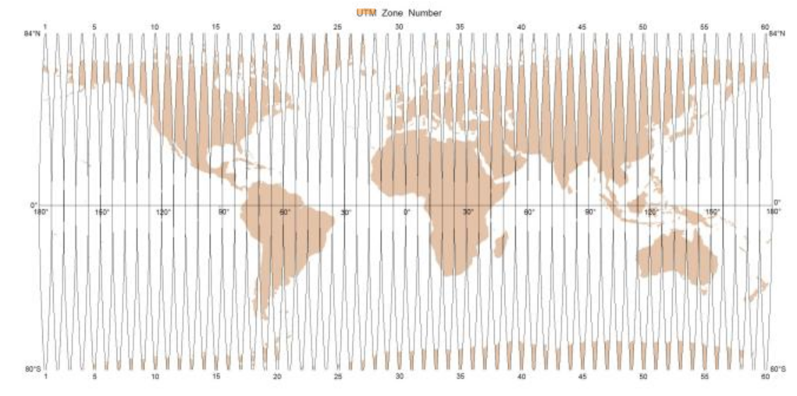
Projected Coordinate Systems
UTM Zone 10 North

Slide 22
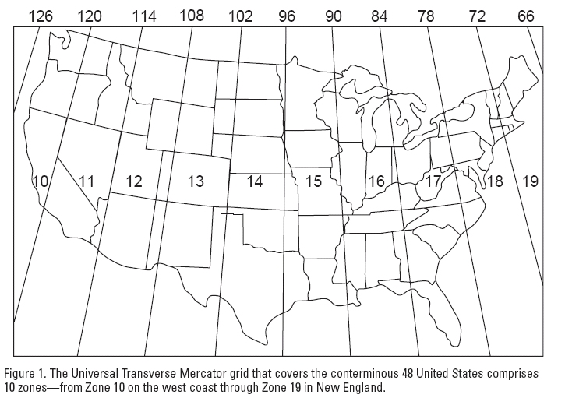
UTM Zones in the CONUS

Slide 23
Projected Coordinate Systems
Southern UTM Zones:
For southern zones the northing origin is 10,000,000 meters south of the equator and 500,000 meters west of Central Meridian.
10,000,000 meters south of the equator, Northings = 0
At the equator Northings = 10,000,000.
This ensures that only positive coordinate values are observed for southern UTM zones.

Slide 24
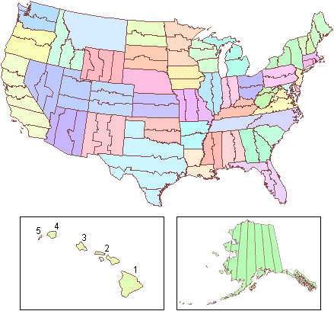
State Plane Coordinate System (SPS or SPCS):
Only applicable in the U.S.
Zones
  Defined by county or state lines.
  Different number of zones for each state.
  Sometimes identified by the Federal Information Processing
  System (FIPS) Codes.
Two basic types of map projections:
  The Lambert conformal Conic (for e – w oriented zones)
    Two standard parallels (secant).
  Transverse Mercator (for n – s oriented zones).
  (Alaska also uses oblique Mercator).
Units: Feet or Meters.
Distance distortions are kept below 1 part in 10,000

Slide 25
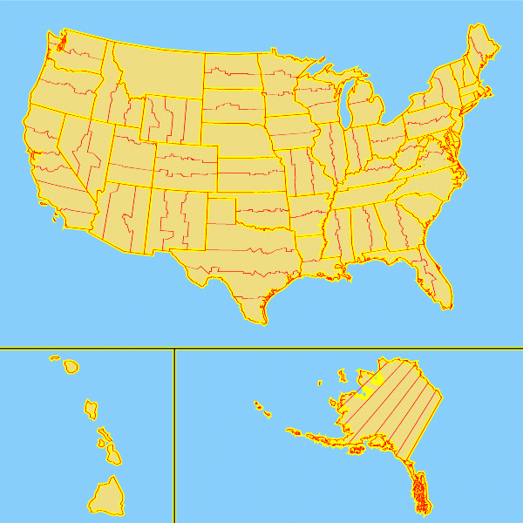
State Plane Zones By State

Slide 26
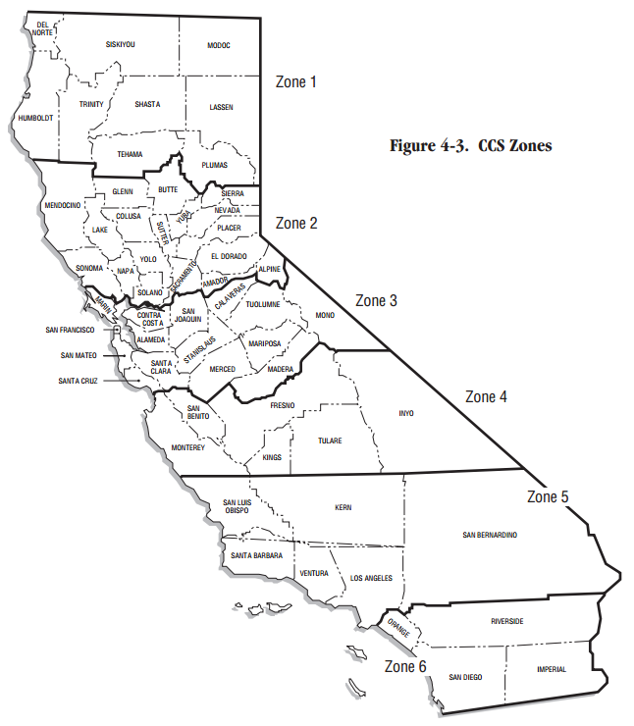
Ca
California State Plane Zones
http://www-group.slac.stanford.edu/

Slide 27
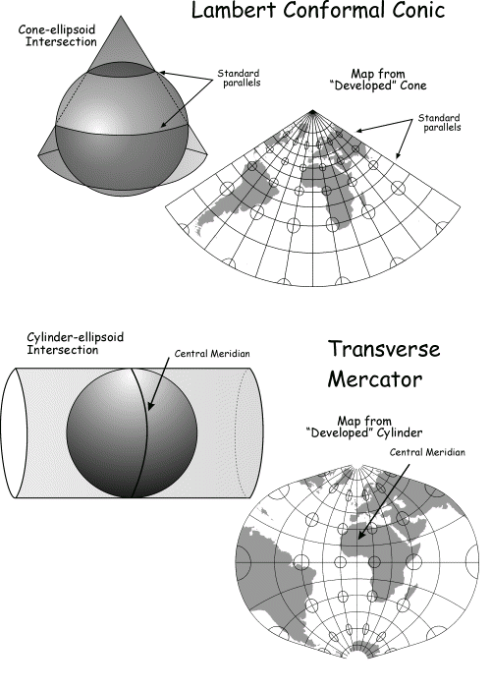
Projections used for State Plane

Slide 28
California State Plane I
Projection: Lambert_Conformal_Conic
False_Easting: 2000000.00000000
False_Northing: 0.00000000
Central_Meridian: -122.00000000
Standard_Parallel_1: 40.00000000
Standard_Parallel_2: 41.66666667
Latitude_Of_Origin: 39.33333333
Linear Unit: Foot_US

Slide 29
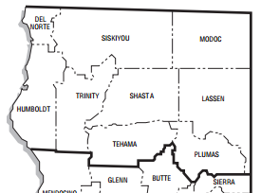
California State Plane Zone I
-122.000 Longitude
39.333
Latitude
0,0
2,000,000, 0

Slide 30
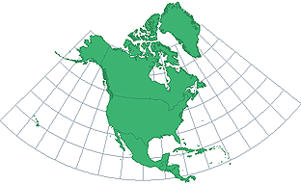
Lambert Conformal Conic
Popular for maps of North America.
Georeference.org

Slide 31
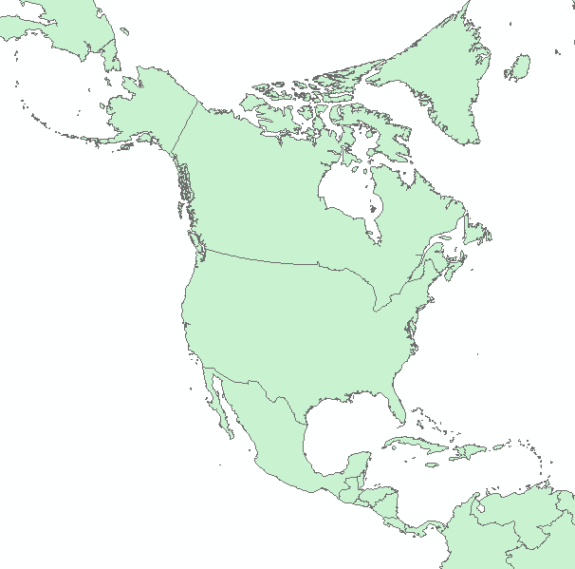
North American Albers Equal Area

Slide 32
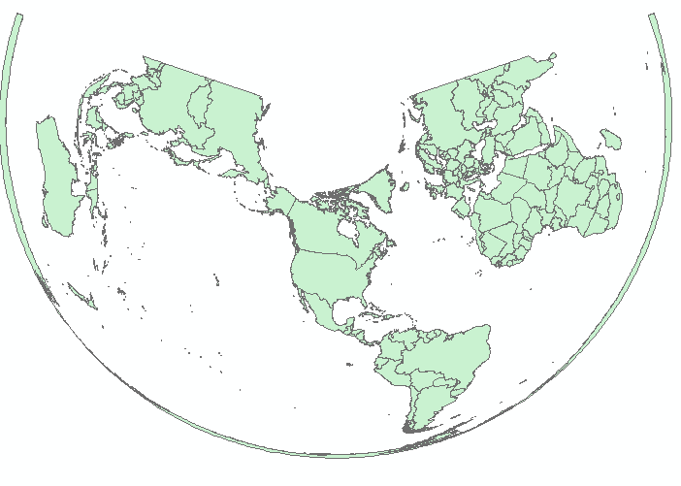
North American Albers Equal Area

Slide 33
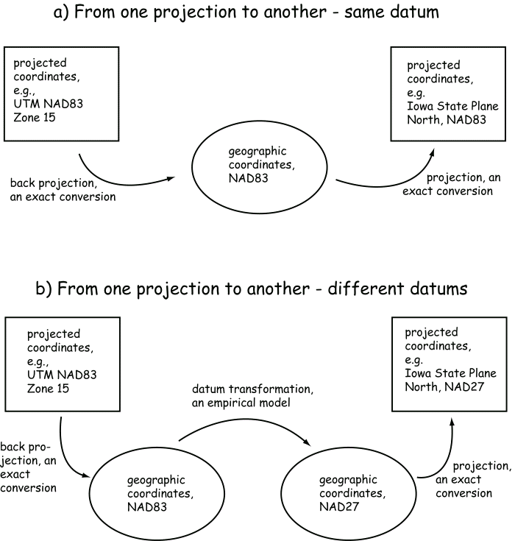
Projected Coordinate Systems
From one projected coordinate system to another (same datums)

Slide 34
Projected Coordinate Systems
From one projected coordinate system to another (different datums)
“Geographic” transformation

Slide 35
Spatial Precision Projected
Systems
Depends on the units:
  Meters: No fractional digits needed for 1 meter precision
  Feet: No fractional digits needed for 1 meter precision
  Miles:
    5280 feet in a mile ~ 1500 meters in a mile
    Need 4 digits after the decimal for 1 meter precision
  Kilometers:
    1000 meters in a kilometer
    Need 3 digits after the decimal for 1 meter precision

Slide 36
Finding Coordinates
Go to: http://geonames.usgs.gov/
Search for a name
What format are the coordinates in?
What is the accuracy of the data?

