Slide 1
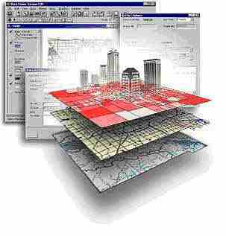
GSP 510
Topic:
What is a GIS?

Slide 2
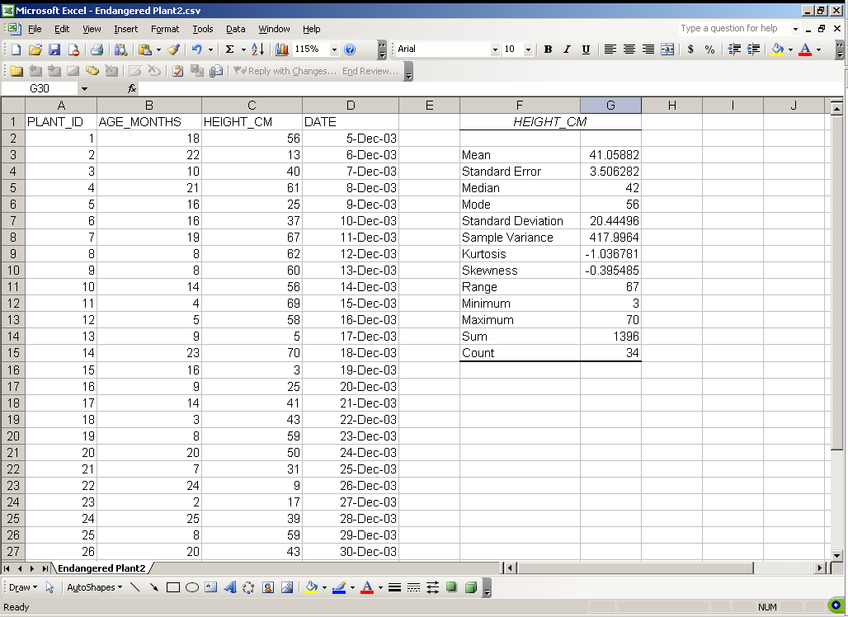
Aspatial Data

Slide 3
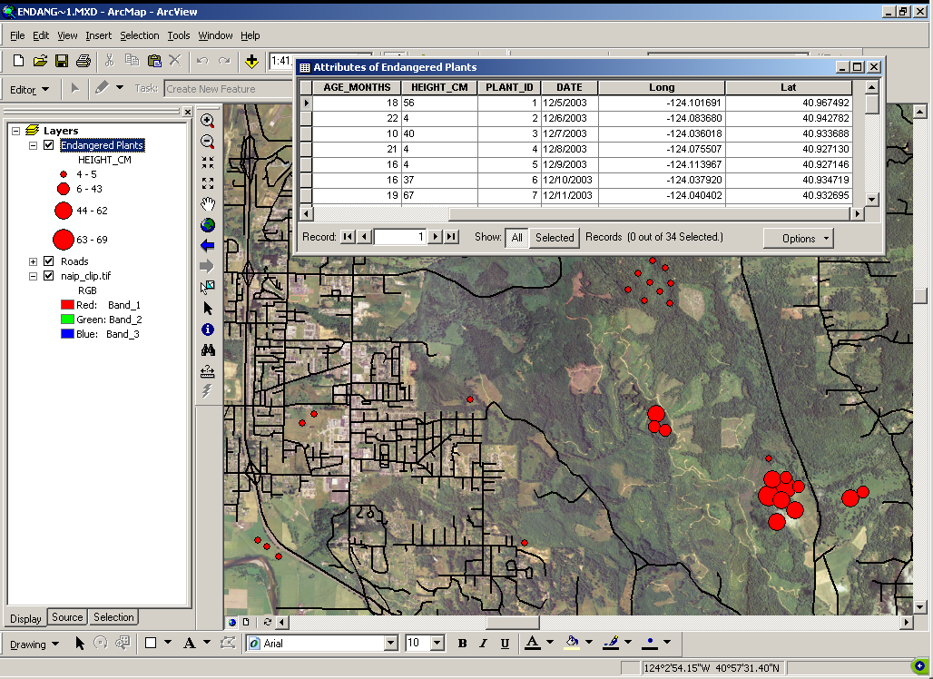
Spatial Data

Slide 4
What is a GIS?
Spatial Data:
  Data with a “spatial component” describing where something is located in on the earth.
Formal Definition of GIS:
  “A computer-based system to aid in the collection, maintenance, storage, analysis, output and distribution of spatial data and information (Bolstad, 2008)”

Slide 5
Elements of GIS
Collection: Internet, web services, GPS…
Maintenance: Quality control, metadata…
Storage: Files, folders, databases…
Analysis: Too many to list!
Output: Maps, tables, reports, pubs…
Distribution: Websites, web services…

Slide 6
Questions from Managers
When and where should we:
  Spray for weeds?
  Build roads?
  Patrol for poachers?
  Protect habitat?
  Reintroduce species?
  Harvest?
  Monitor?
  Allow off-roading?

Slide 7
What can I do with a GIS?
With a GIS and spatial data you can ask spatially related questions:
The spatial distribution of object(s) or theme(s)
    Where is x? How is x distributed?
The relationship between the spatial distribution of objects or themes
    Where is x in relationship to y?
The association of objects or themes in an area.
    Is there a correlation between the distribution of X and the distribution of Y? Could X be causing Y?
Spatial Analysis!

Slide 8
GIS Is About:
Acquiring Spatial Data – representing things on the earth
Evaluating – making sure data fits use
Analysis – turning data into information
Cartography – the creation of maps
Dissemination – distributing maps, data, and results
Documenting – ensures future use

Slide 9
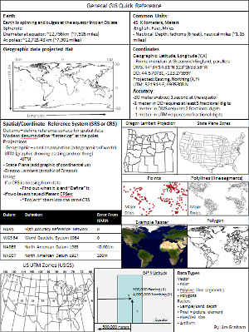
GIS Resources
There are many resources:
  The web, classes, books, organizations, individuals
See Jim’s professional website for more:
  (http://gsp.humboldt.edu/JimsProfessional/Resources.html)
  You’ll want to know everything on the quick reference

Slide 10
The Bigger Picture
Geospatial Sciences
GIS
Remote Sensing
GPS
Cartography
More…
Geodesy
Geospatial Sciences: The science and technology of gathering, analyzing, interpreting, distributing, and using geographic information.

Slide 11
GIS is almost everywhere
Wildlife
Forestry
Geology
Spatial Management
Navigation
Transportation
Security
Atmospheric Sci.
Oceanography
Anthropology
Biogeography
Environmental Sci.
Tourism
Economy
Policy
Social Science
And more…
General GIS:
Data acquisition, management, analysis, and representation
Basic concepts, skills, knowledge

Slide 12
Key Points
A GIS is not just a computer program for making maps.
It is, first and foremost, a powerful analytical tool with a spatial “awareness” that allows you to analyze spatial data and answer complex spatial questions.

Slide 13
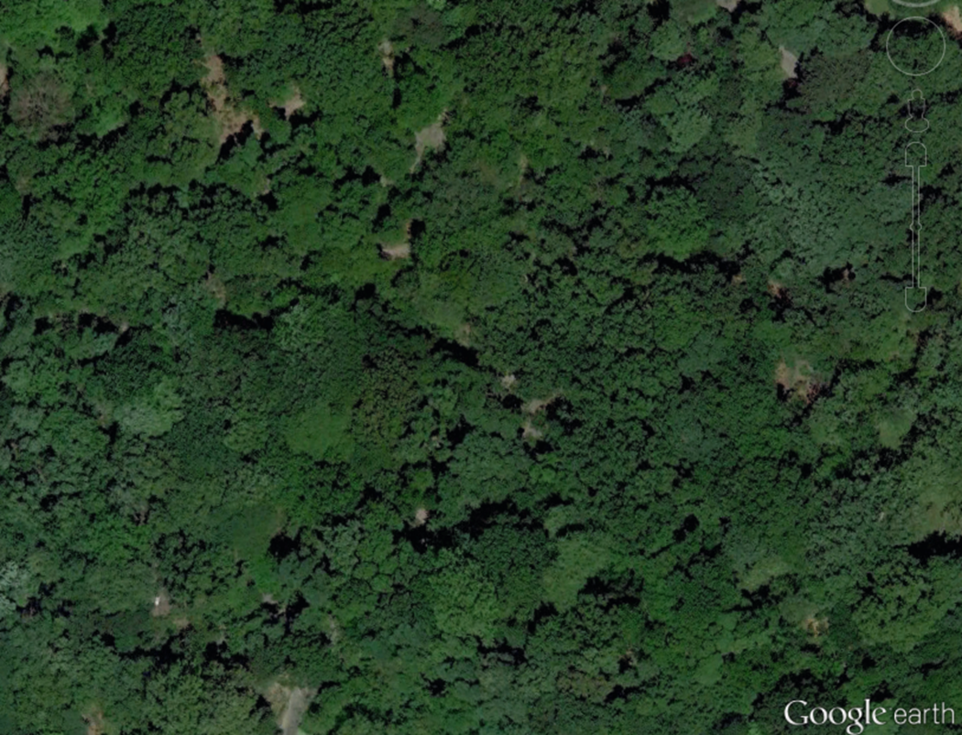
Where are we?

Slide 14
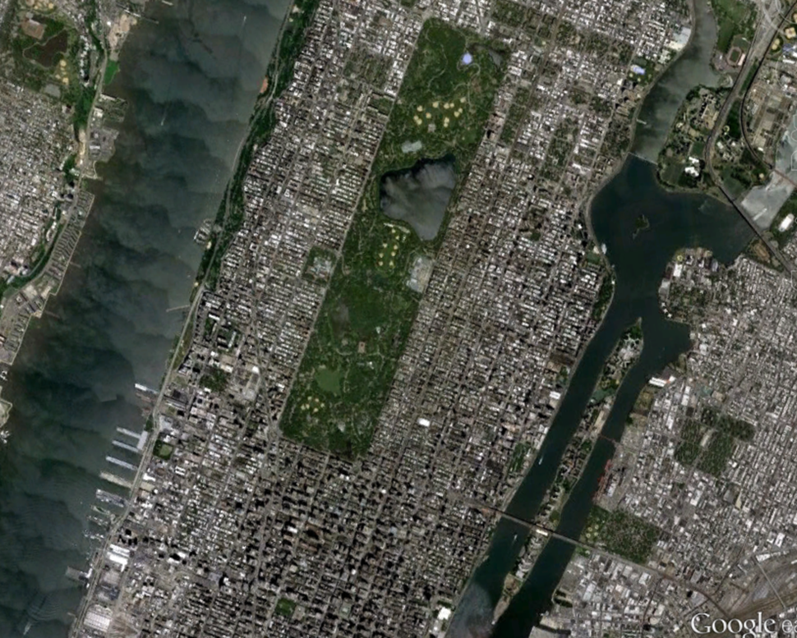
GIS can broaden your view!

