Slide 1
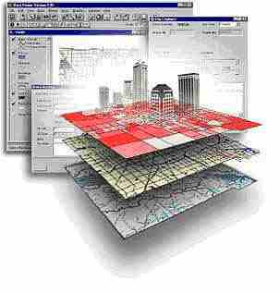
Geospatial Research Methods
GSP 510
Instructor: Jim Graham
E-mail: James.Graham@Humboldt.edu

Slide 2

HSU Sits on Traditional Wiyot Land
Please respect the traditions of our local tribal members
http://www.historicjusticealliance.org/

Slide 3
Everyone is Welcome Here
We all have unique backgrounds, skills, and knowledge
This makes each of us unique and valuable
We are in a room filled with individuals that you may do future research, publishing, and other activities together
We will also be helping each other along the way
Please take a monument to enjoy this space and relax!

Slide 4
About the class
This is an introduction to how to properly use geospatial data and methods in research
The class substitutes as a prereq for GSP 101 and GSP 270
The class is for graduate students and thus the amount of work will be much higher than either of the other classes!
This class will prepare you for GSP 216, GSP 316, GSP 370 and so on…

Slide 5
Jim Graham
Bachelors in CS and Math from Chico State
Over 20 years as a software engineer
  15 with HP as an engineer and manager
Owner of tecBugs and now SchoonerTurtles
PhD from Colorado State U. in Forestry/GIS
Eight years with the Natural Resource Ecology Laboratory at Colorado State
Two years with Oregon State U.
23 years doing GIS, 16 years teaching GIS
Research with: State Dept., USGS, USDA, DOE…

Slide 6
Introductions
Where do you come from?
What do you like to do outside academia?
Why are you here?
Where do you want to go?
How can this class help you go there?

Slide 7

Why are we here?
For me:
  Help you get the career you want
  Improve the world for all living things
From students:
  Learn
  Career prep
  Stay heathy
  Get their monies worth

Slide 8
This class is about Research with Spatial Data and Methods
We will not cover everything you need to know to be successful
We will cover the basics and how to learn what you need to know to be successful

Slide 9
Research Process
Products
Acquire/Create Data
Create
Products
QAQC
Data
Analysis
Prep
Data

Slide 10

What is a GIS?
Geographic Information System
Something (typically a computer) that provides information based on spatial data (locations of stuff)
Includes: ?

Slide 11
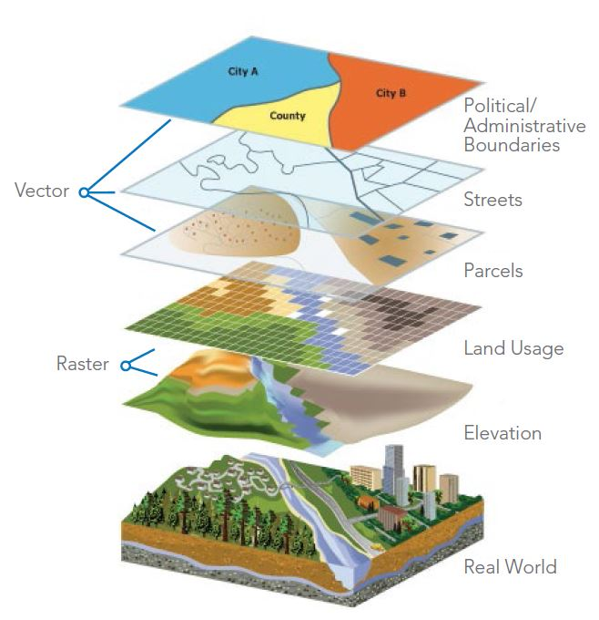
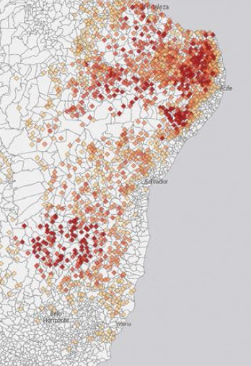
What is GIS?
A Geographic Information Science
Using spatial data and analysis to create new information
Some academics prefer this definition.
Better
Decisions
http://data-informed.com/how-spatial-analysis-leads-to-insight/

Slide 12
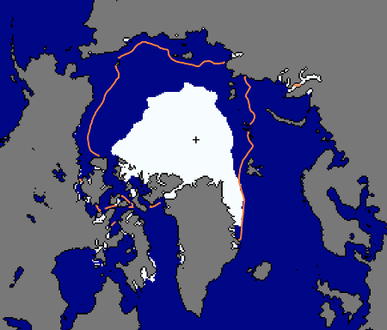
To Help Make Better Decisions
Sept. 24, 2012
National Snow and Ice Data Center, 2012

Slide 13

Antarctic Ozone Hole
Largest Antarctic Ozone Hole
September 2006

Slide 14
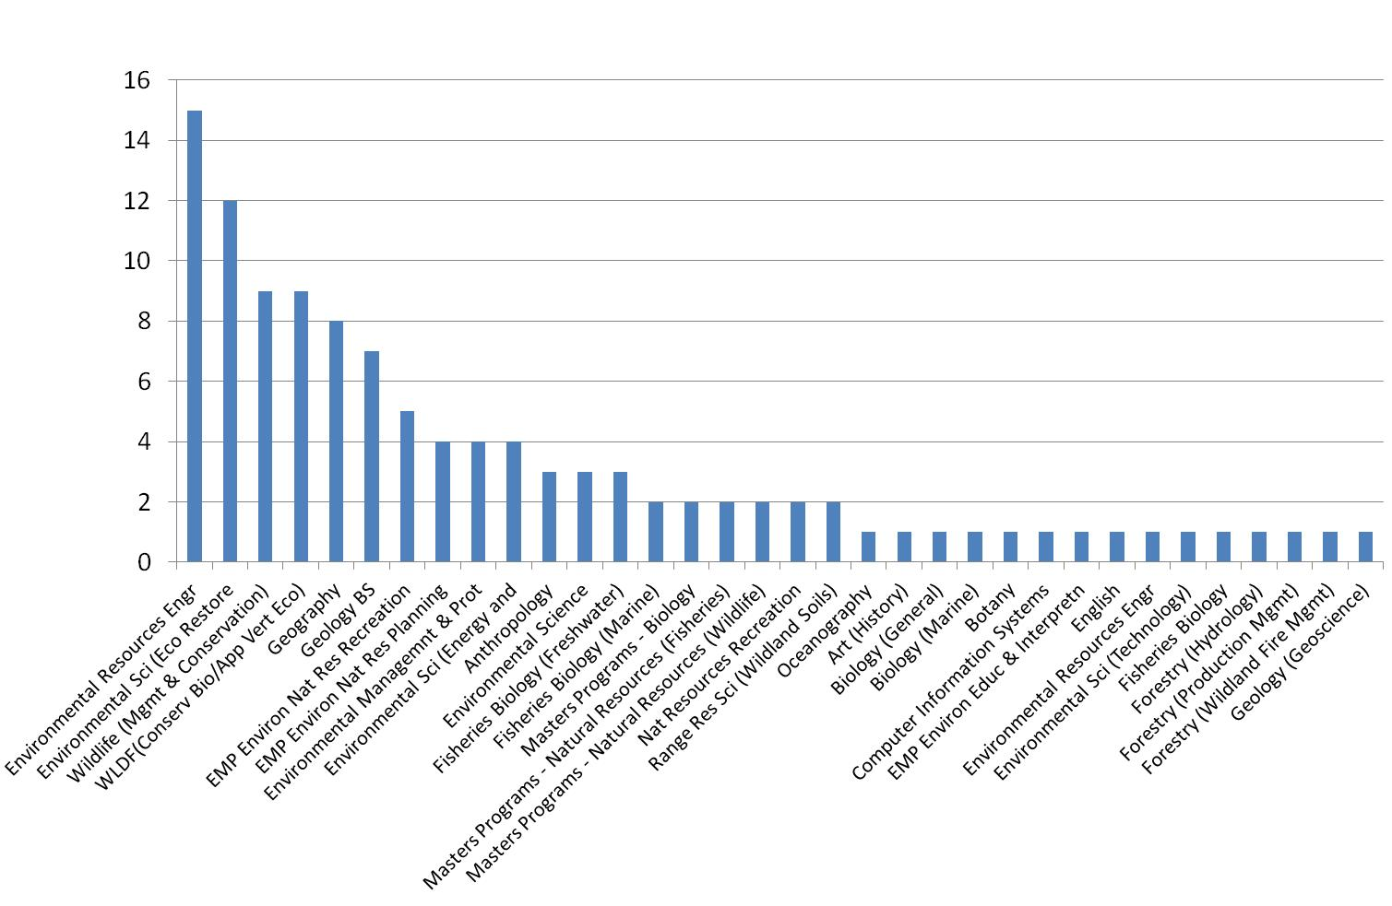
Who's using GIS?
“Bolstad: From Archeology to Zoology”

Slide 15
Anything else you need from me?
Visual resources
In-class demos (no death by ppt)
Non-critical learning environ.
Hands on
Clear expectations
Research examples
Repetition of key concepts
Interpret data
Feedback
Practical apps
Personal experiences
Organize data
Map mobile sediments, social science
GIS Software
Make maps
Assessable
Useful supplemental materials
GIS resources
Notes:
D

Slide 16
The Class Materials
Canvas is used for assignments and grades
  Home page has links for everything else
Class web site: All the content (except videos)
  gsp.humboldt.edu -> Academics -> Online Learning Materials -> GSP 510
YouTube has the videos
We will also share a GoogleDrive
I cannot cover all the material. You’ll need to read ahead, ask questions, and review the material again.

Slide 17
Class Organization
The schedule is organized by “Learning Modules” divided into weeks
Each week:
  Review the web site and do the indicated readings and activities
  Lectures and discussions
  Lab Sessions
  Start your lab on Friday and get it done by Tuesday!
  Turn it in the following Friday and so on
Quizzes “periodically” instead of tests
During the final time, you’ll be presenting projects

Slide 18
Hyflex Delivery
This is a face-to-face class with synchronous Zoom delivery if you cannot attend a class
  Please let me know when and why you’re missing class
I will endeavor to record the lectures and discussions, but the process is a bit rough
To be successful, you’ll want to catch up ASAP and get help when needed!

Slide 19
Using Zoom
When using Zoom, please:
  Mute your microphone when not talking
  Don't turn off your video in participatory meetings unless you are having Internet issues
  Only chat to the group, or the teacher during group meetings
  If folks are talking, just raise your hand and I'll call on you (unless it is one of those long pauses where I’m looking for students to answer questions and no one wants to ;-)

Slide 20
Homework
Recommendation is 3 hours of study time per week for each unit (i.e. 4 units * 3 hours = 12 hours)
You will need to spend time outside of class to:
  Complete labs, take read material and take online quizzes, prepare discussions, complete final project
I recommend using an online calendar to plan blocks of study time
Having study groups can help as well

Slide 21
Learning Styles
Everyone has different strengths and weaknesses
  Working with spatial data and computers are strengths for me while English is a weakness
If you struggle with spatial concepts and/or computers, you’ll need to spend additional time and get help
  Being able to ask for help is a strength!
Also, those who struggle tend to retain material better and often have unique perspectives that help solve problems and improve instruction
What is your learning style?

Slide 22
To be successful
Turn in lab assignments on time!
Attend class, do the readings, etc.
Ask questions on confusing topics
Make good decisions
Follow the 20 minute rule:
  If you’re stuck more than 20 minutes, get help

Slide 23
Working Together
Technology is moving really fast
However, society is not keeping up
We need “norms” so we can work together constructively
Respecting everyone is key
To communicate effectively, you have to communicate from the other persons perspective
Remember, you’re sitting in a room of potential collaborators

Slide 24
Communication
I communicate primarily through email and in person
Please write professional emails, not:
  Yo, what’s up with my assignment?
  Sent from iPhone
Feel free to stop by my office hours
Email me to setup a time if office hours do not work
We can also have Zoom meetings

Slide 25
Emails
Proper subject line
Provide context so the reader understands the message
Provide a formal signature
For important emails, I write them and then re-read them later
  For emotionally-charged emails, I write them, re-write them, have someone review them, and then don’t send some of them.
  Instead, I’ll go out to lunch with the person

Slide 26

Bottom Line
The more time you spend working with a GIS, the better you will do
If you work hard and do the assignments on time
  Me (and others) will be there to help you when needed
  You just need to ask!
Be ready to help others as well

Slide 27

A few other things…
There will be a lab assigned this week and due next week!
Don’t forget to do the readings, videos, & quizzes for this week

