Slide 1
Geo 118/318 – Introduction to GIS Programming
Dr. Jim Graham

Slide 2
Class Goals
Focus: Programming in GIS
  How computers work
  How to program & debug code
  How to tackle GIS programming tasks
With Python
  By itself
  With ArcGIS
  With other packages
Software development
  Documentation
  Management/Phases
  Meeting users NEEDS

Slide 3
About This Class
Moving from Toolbox to Python
Programming in Python
Putting Python and ArcGIS Together
Other libraries
GIS Software development
Special topics:
  What would you like to see here?

Slide 4
We are not learning…
Everything about Python
  It’s a huge language that is growing all the time!
  You only need a fraction of what is out there
  The challenge is to find that fraction and get good at it!
Everything about programming ArcGIS
  You will learn how to find anything available in programming ArcGIS
Everything about programming GIS
  More on this later…

Slide 5
We are learning…
Everything you need to figure out how to solve any programming problem in GIS that can be solved!
  Programming
  Debugging
  Finding answers
  Getting help
  Intro to the larger world of software development

Slide 6
Resources for Help
ArcGIS help – best for Arc libraries
The web – search for answers
ListServs – including Moodle blogs
Other students – make friends in this class
Me and the TA
Others?
  Anyone you can find who might have dealt with the same problem!

Slide 7
Other Stuff…
The website:
  See Moodle
  Will be updated before class
  Please send corrections and suggestions!
Office hours:
  When is best?

Slide 8
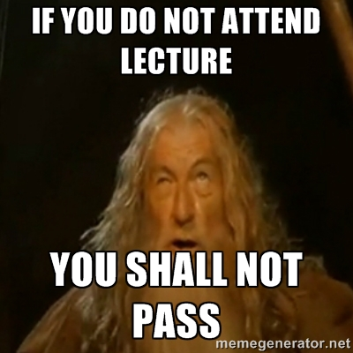
Last Semester 10% did not pass!
If you fall behind in this class you will not pass!
  Each week we learn concepts that are used the next week
  We move together as a whole group
Attendance is mandatory
  If you miss a class, make sure you catch up and get assignments in
Assignments must be in on time
  If you fall behind you’ll be working on the wrong assignment

Slide 9
Keep Up with the Pack!
This class moves!
  I’ll introduce a new topic and then you’ll have time to practice and work on the assignment
  This is a skills class, not everything you need to know is online – you’ll need to attend classes
Turn in labs each week
  Complete assignments outside of class and then turn in whatever you have when it is due
Get help when you need it!
  If you get stuck for 20 minutes, get help!

Slide 10
Final Projects
GIS Programming Problem
Must include some code you have written
Must apply to a GIS application
Class is 15 weeks – don’t build a biomass model for the earth!
Start getting the data now!

Slide 11
Examples
Harvest tree ring data to create a map in GoogleEarth with growth charts
Program to compute likely camping sites in wilderness areas
Program to mosaic LandSat scenes for anywhere in US
Simulation of werewolves chasing people

Slide 12
About Me
Programming for over 30 years!
Developer, Manager, CEO, Research Scientist, Professor
Operating systems: CPM, Apple, DOS, Mac, Windows, and others
Languages: Machine code, assembly, Pascal, Fortran, C/C++, VBA, Visual Basic, Forth…
Most recently: PHP, JavaScript, Java, SQL, Python

Slide 13
Me and ArcGIS
Worked on ArcGIS 8 beta
  Helped improve performance of raster transforms 10x
  Visual Basic
Lots of VBA, some C/C++, now Python
And I teach classes on using GIS and applying it to natural resource problems

Slide 14
About You!
Name
Department & Degree
Programming Experience
GIS Experience
What you want to get out of the class
Other comments, questions, concerns?

Slide 15
Why Program?
Automate tasks
  Repeated over and over again
Speed up tasks
  Computers can run 24/7
Allows for “exact” replication of processes
  Except that the libraries you call will change!
“Encapsulate” functionality and expertise
  You and everyone else can use it

Slide 16

Ready to become a NERD?
Learn a bunch of new terms (mostly TLAs)
Think like a computer
Amaze (and confuse) your friends!
Get a whole new wardrobe!

Slide 17
Definitions
Code – Instructions for a computer
Programming/Coding – writing, documenting, and testing code
Program – A file with instructions for a computer to execute to complete a task
Application – A program with a graphic user interface (as opposed to a command line interface)
Library – A file with code for a computer to be used by other programs

Slide 18
GIS Library/Package
A library with code to complete GIS tasks
  Spatially referenced data
  Tasks specific to GIS
    Union, intersect, mosaic, project, and lots more!
Options
  ArcGIS – arcpy, etc.
  GeoTools – Open source
  GDAL, ORG, Proj – Open source
  BlueSpray – SchoonerTurtles

Slide 19
Big Picture
ArcGIS Desktop
Wing IDE
Other Programs
Model Builder
Python Scripts
ArcGIS Libraries
Other Libraries
Data
Data includes GIS (spatially referenced) and non-spatially reference

Slide 20
Why Python?
ESRI’s primary scripting language (for now)
Very popular in GIS (Arc and OpenSource)
Very flexible (can solve lots of problems)
Well supported (with Wing IDE)
Easy to learn (relative to complied languages)
Portable
But it is not the fastest language
  Compiled (C/C++, Java, C#) are faster

