Slide 1
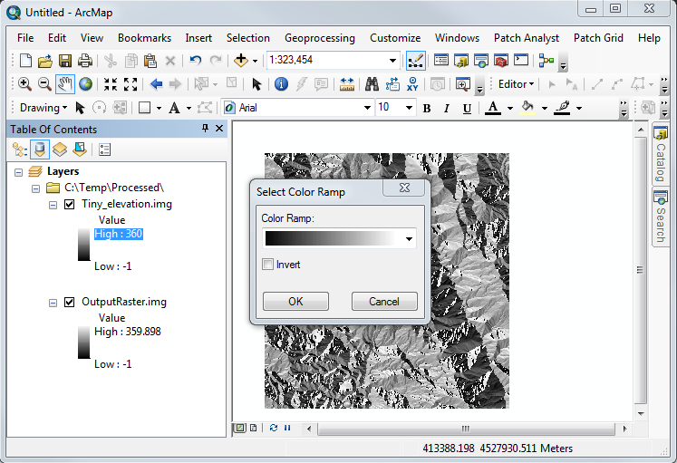
Window
Button
Menu
Popup
Menu
Checkbox
Button
Dialog Box

Slide 2


