Slide 1
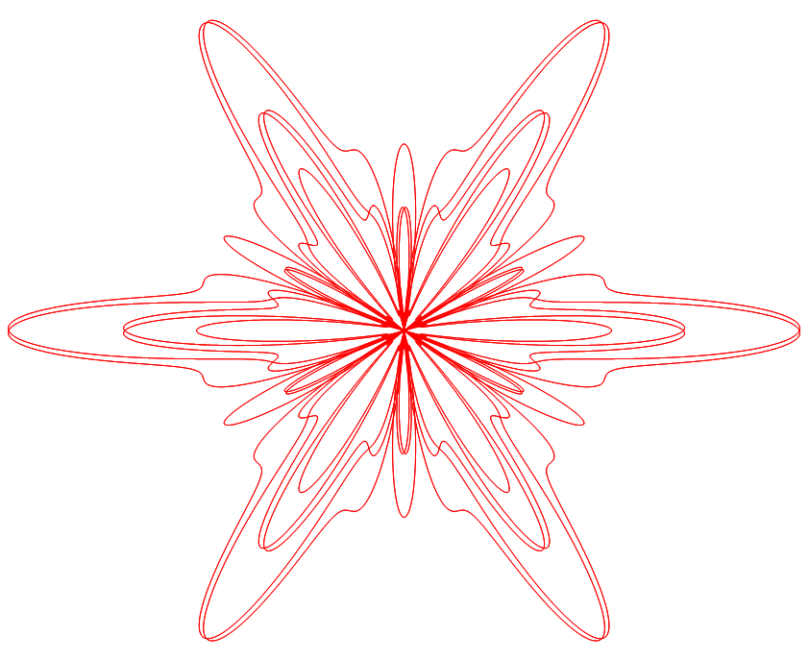

Slide 2
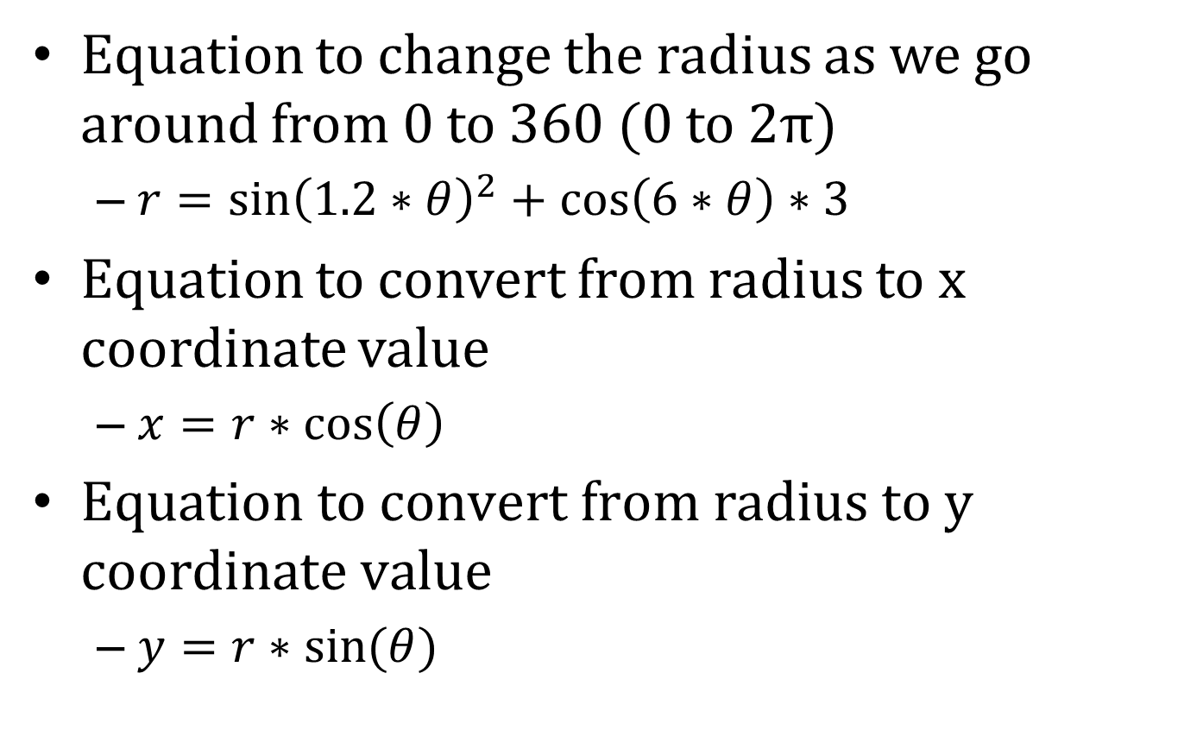
Equations
Equation to change the radius as we go around from 0 to 360 (0 to 2π)
  $r={\sin\left(1.2∗θ\right)}^{2}+\cos\left(6∗θ\right)∗3$
Equation to convert from radius to x coordinate value
  $x=r∗\cos\left(θ\right)$
$\text{Equation} \text{to} \text{convert} \text{from} \text{radius} \text{to} \text{y} \text{coordinate} \text{value}$
  $y=r∗sin⁡(θ)$

Slide 3


Slide 4
What is the maximum value an 8-bit unsigned integer can hold?
65536
32767
255
256
8
7

Slide 5
What will x be after the following code is executed: x=4 x=x*2+1
4
8
9
1
Something else

Slide 6
G_E_N_I_H
R W C E
M D O Y
V F W I
V E Y L

Slide 7
What is the approximate circumference of the earth at the equator?
40,000 km
6,300 km
25,000 miles
12,300 km
A and C
B and D

Slide 8
What is a datum (in GIS)?
The plural of data
Converts 3D data to 2D
References geographic data to the earth
A file format

