Slide 1
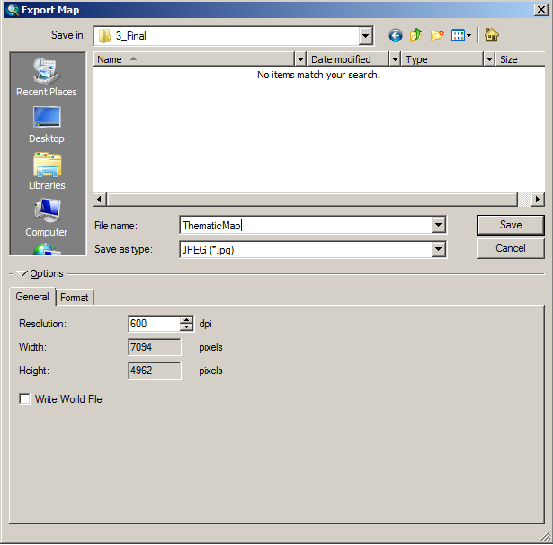
Make sure quality is “Max”
Set to at least 300dpi

Slide 2
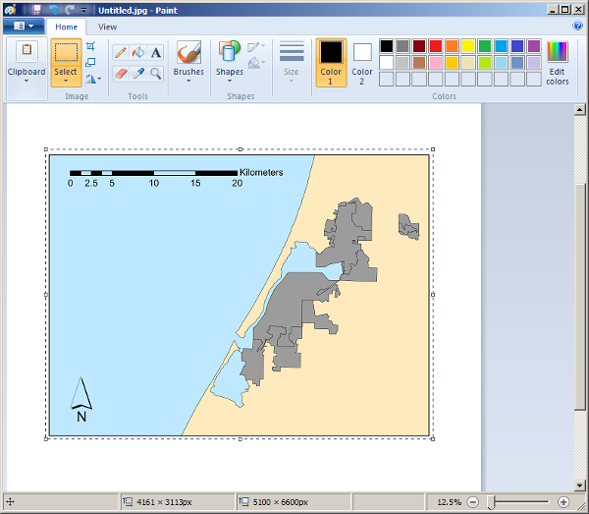
Select Just the Map

