Slide 1
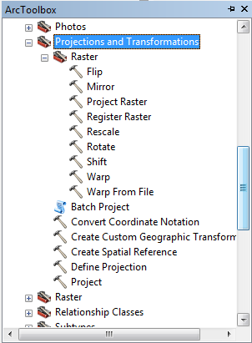
Project (Change the Spatial Reference) for raster data
Define (Define the Spatial Reference) for raster and vector data
Project (Change the Spatial Reference) for vector data

