Slide 1
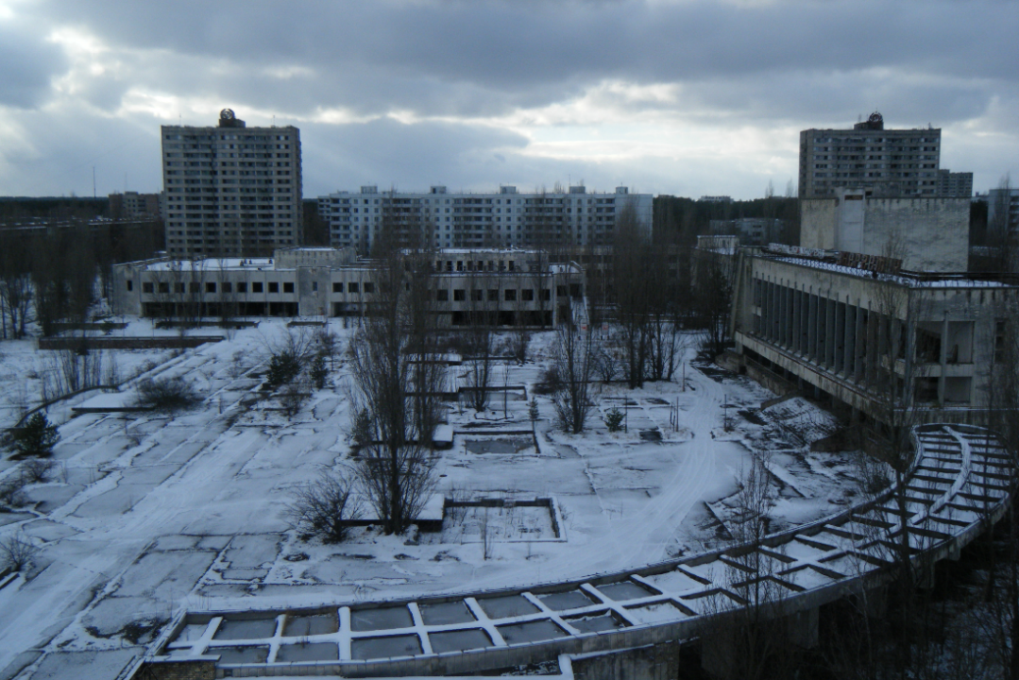
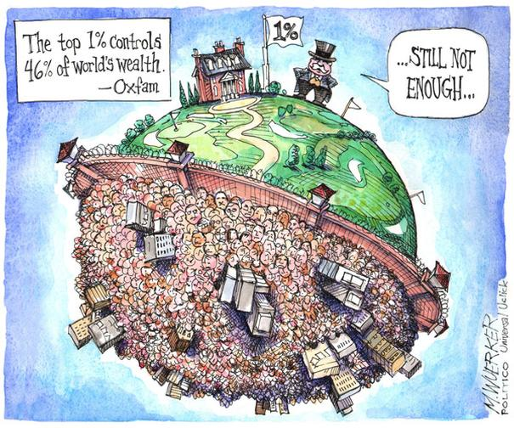

What will the world look like in 2100?
Nuclear Winter
Chernobyl in Winter
www.oxfam.ca
Orwell’s 1984
thebluereview.org
Ecotopia
Notes:
https://thebluereview.org/utopian-writers-american-west/

Slide 2
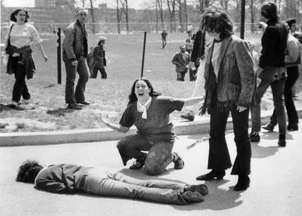
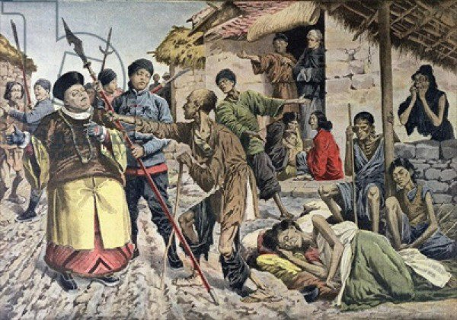
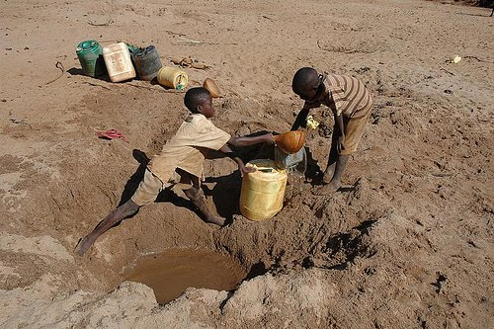
Threats
War
Famine
Water shortages
Etc.
Kent State Shooting, May 1970
Chinese famine of 1907, 25 million died
Drought in Kenya, 2009
Notes:
Kent State Shooting, May 1970
Chinese famine of 1907 (25 million died, later 43 million)
Drought in Kenya, 2009
https://listverse.com/2013/04/10/10-terrible-famines-in-history/

Slide 3
You have to know the past to understand the present.
- Carl Sagan
We have everything we need to make the world a wonderful place for everyone
Yet, we continue to make decisions that move us closer to disaster
Before asking what we can do, I feel we need some perspective on how we got here

Slide 4
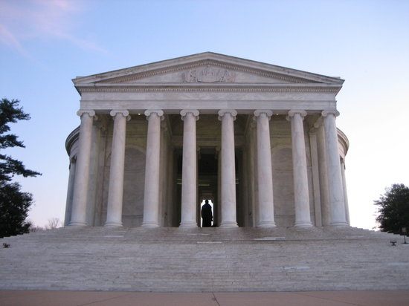
Greek Culture
Democracy
Philosophy: reason and inquiry
Mathematics, geometry, architecture
Sought personal wealth, status and fame
Women, immigrants and slaves could not be citizens
Gods were personified
  Hero worship
Extracted copper, tin, gold
  Weapons and wealth

Slide 5
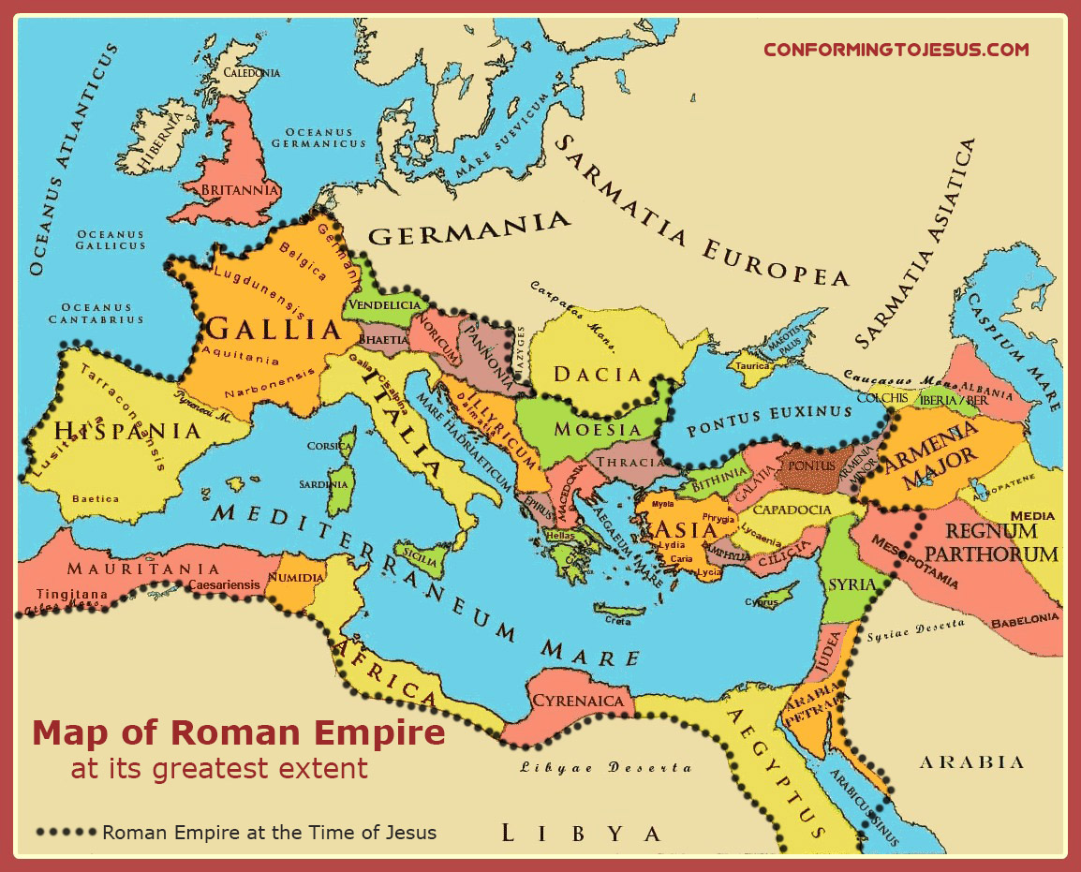

Slide 6
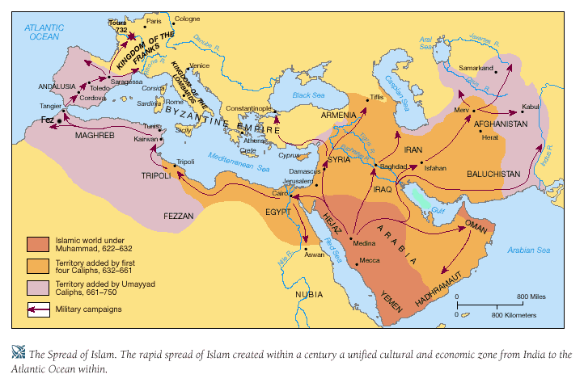
Arabian Expansion
worldmiddleages.blogspot.com
Notes:
worldmiddleages.blogspot.com

Slide 7
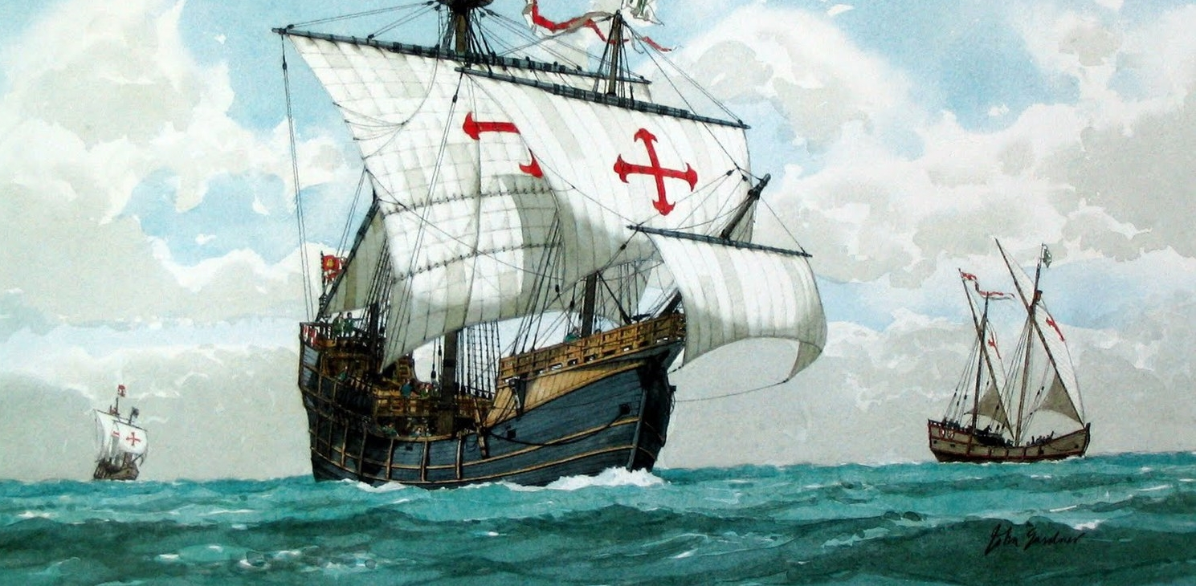
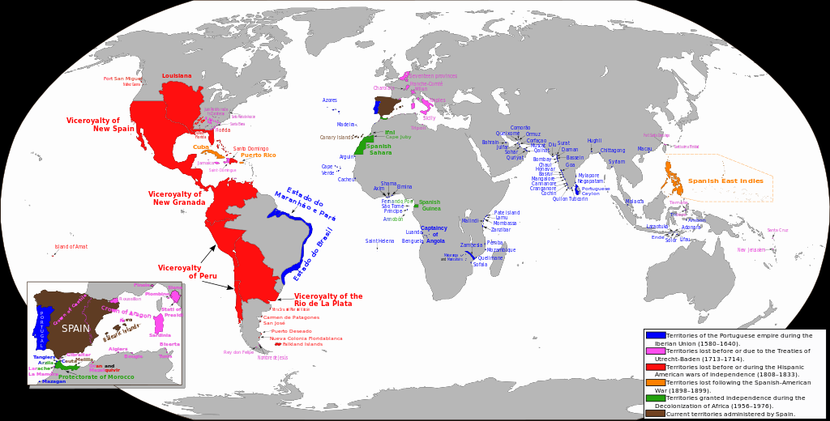
Spanish Empire
1492-1899
wikipedia.org

Slide 8
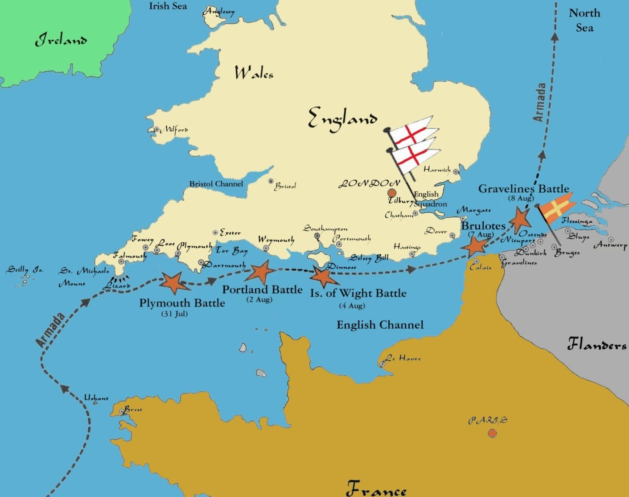
www.awesomestories.com
Notes:
1588

Slide 9

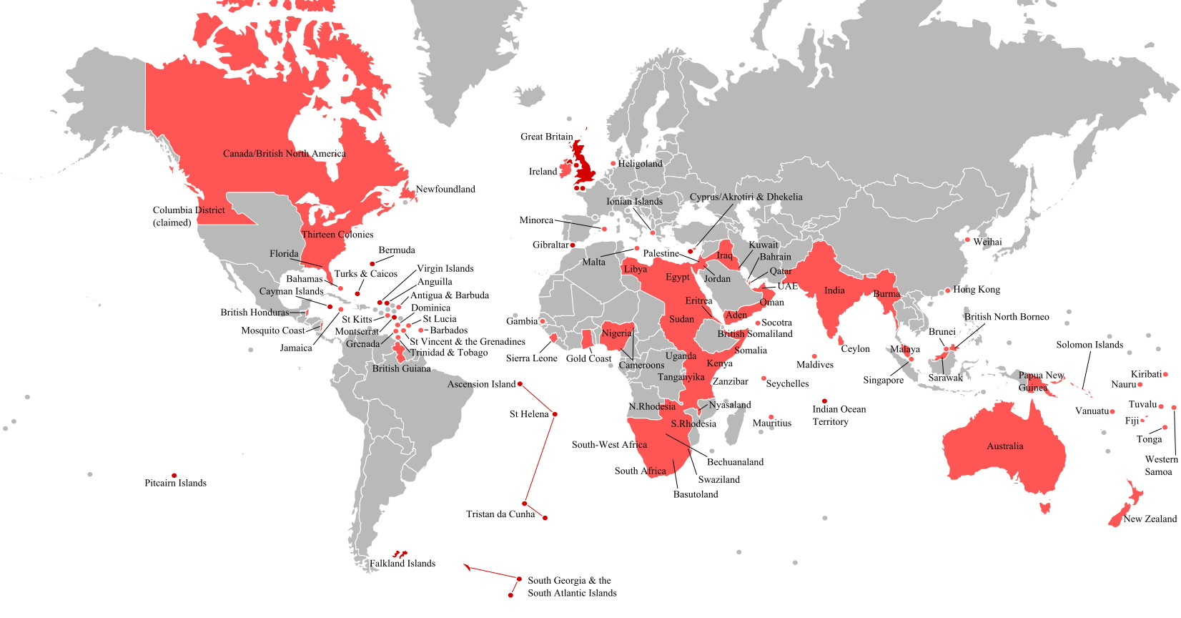
British Empire
By 1922, Britain held sway over 450 million people, 1/5 the earths population
http://www.basfeijen.nl/system/britishempire.htm
Notes:
http://www.basfeijen.nl/system/britishempire.htm
By 1922, Britain held sway over 450 million people, 1/5 the earths population

Slide 10
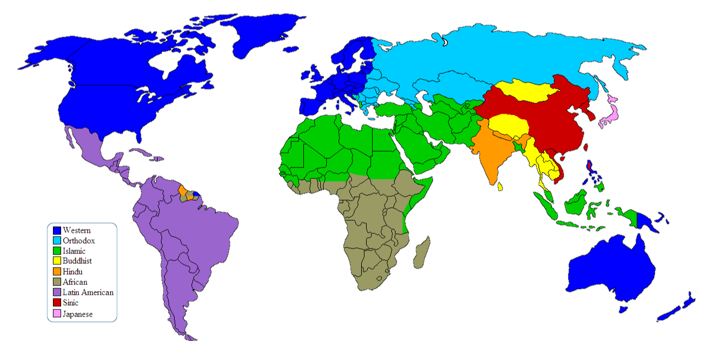
Dominant Cultures
en.wikipedia.org/wiki/Western_culture
Notes:
https://en.wikipedia.org/wiki/Western_culture

Slide 11
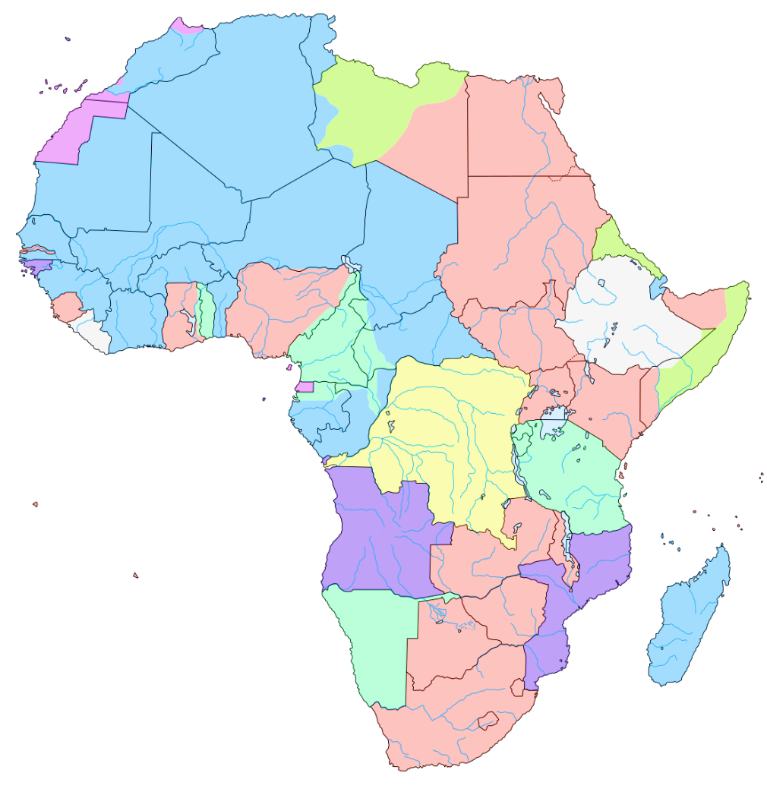
Africa 1883
The Berlin Conference of 1884–85
Organized by Otto von Bismarck, first Chancellor of Germany
"The Principle of Effective Occupation.“
US attended
Opened up trade
en.wikipedia.org/wiki/Berlin_Conference

Slide 12
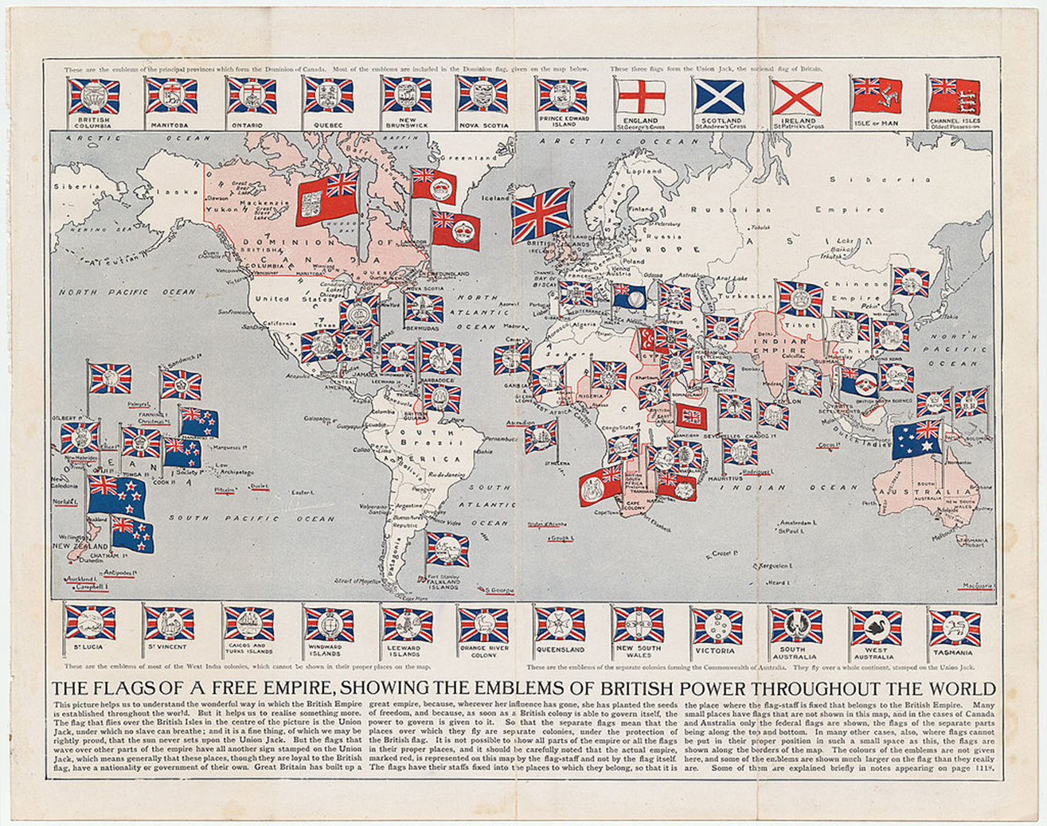
1910

Slide 13
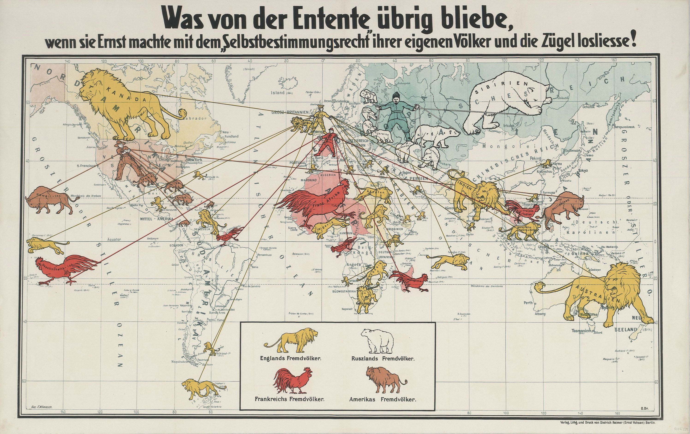
The German Perspective
1916
Notes:
German propaganda map of the Allies’ colonial empires, circa 1916
What would be left of the Entente (agreement) if they would be serious about the right of self-determination and loosen the reins.

Slide 14
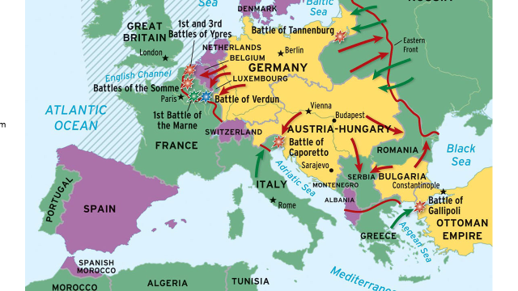
World War I

Slide 15
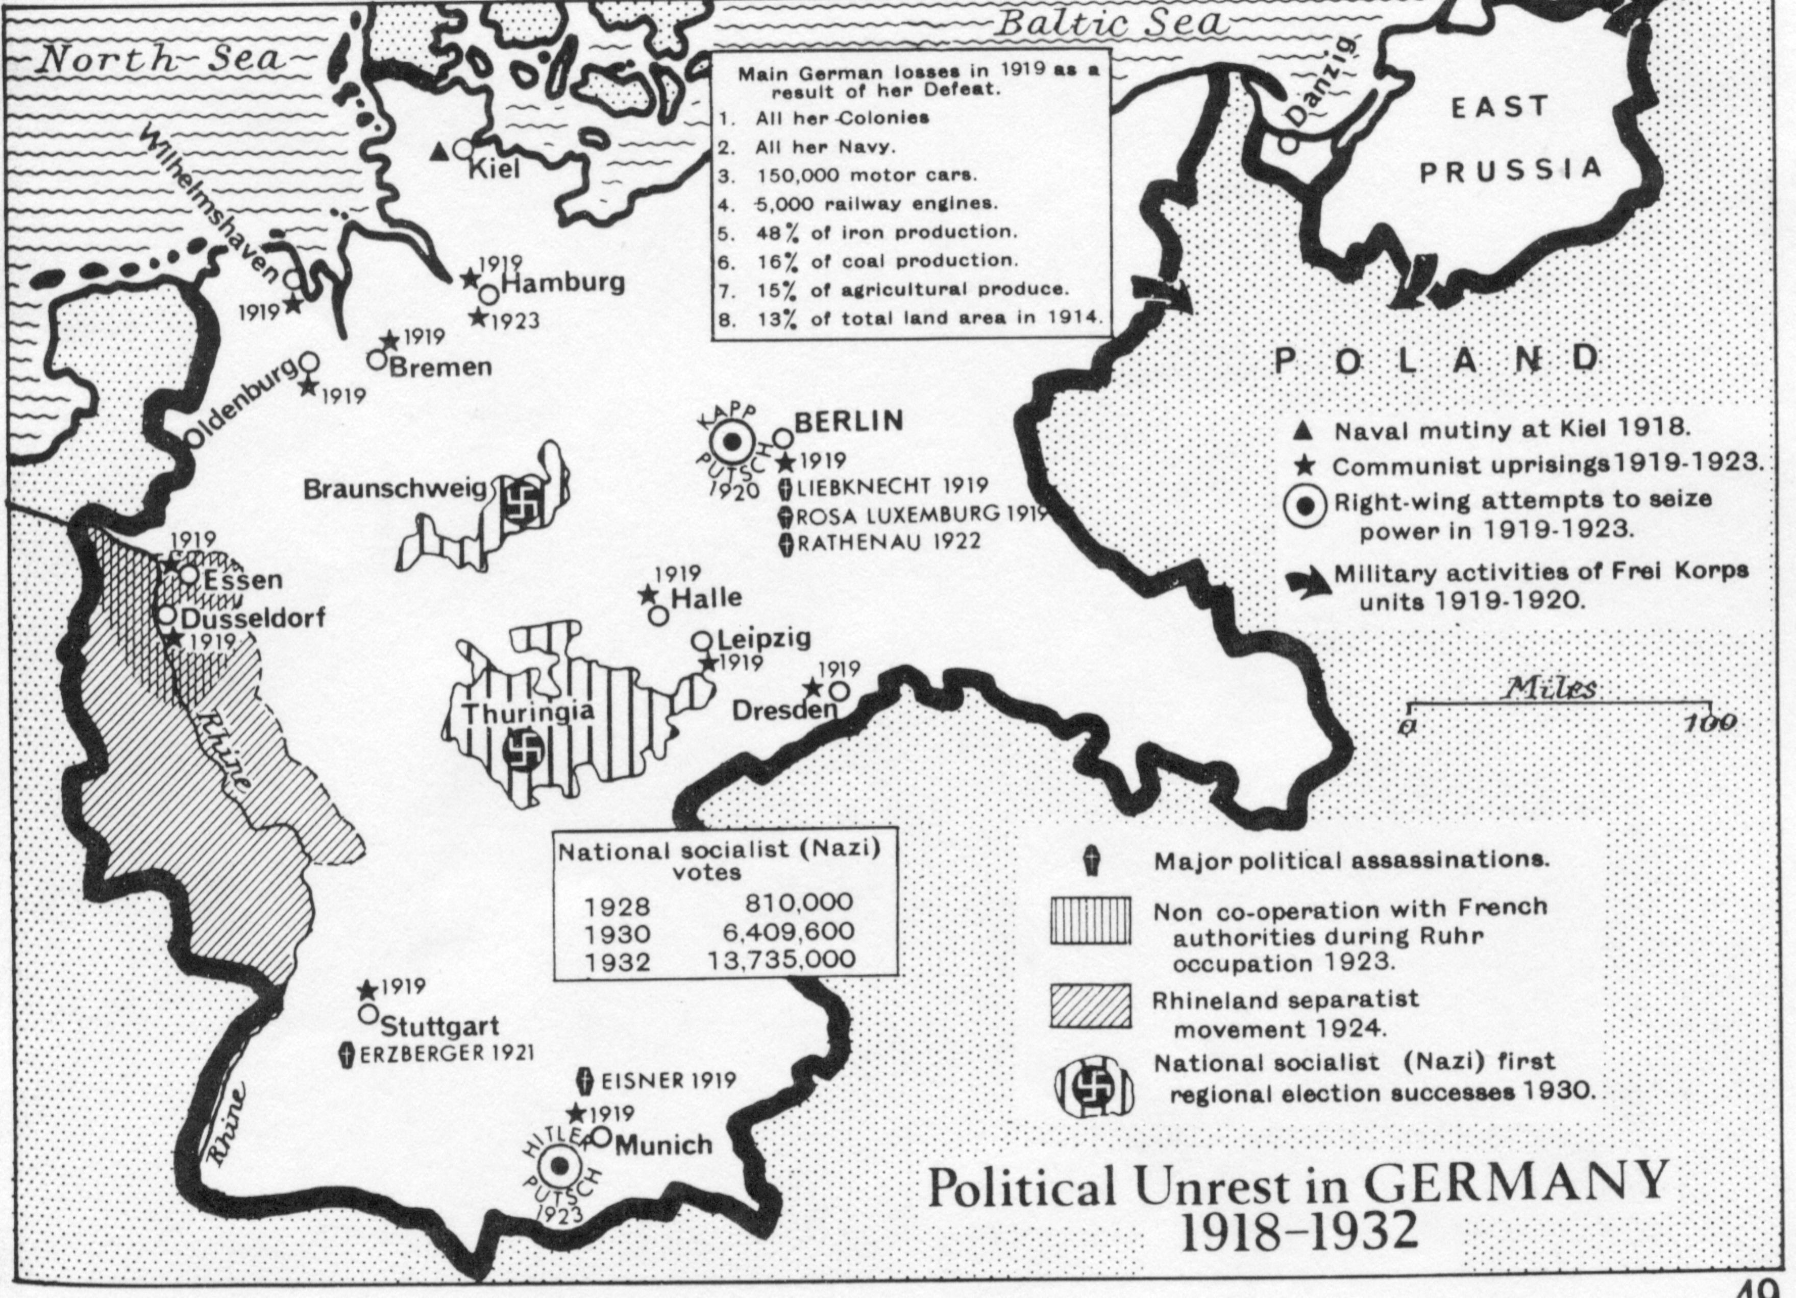

Slide 16
Germany, 1932
Reichstag (parliament):
  National Socialist German Workers' Party (NAZI): 196 seats (33.09%)
  The Social Democrats (SPD): 121 seats (20.43%)
  Communists (KPD): 100 (16.86%).
President Hindenburg appoints Hitler chancellor to form majority government

Slide 17
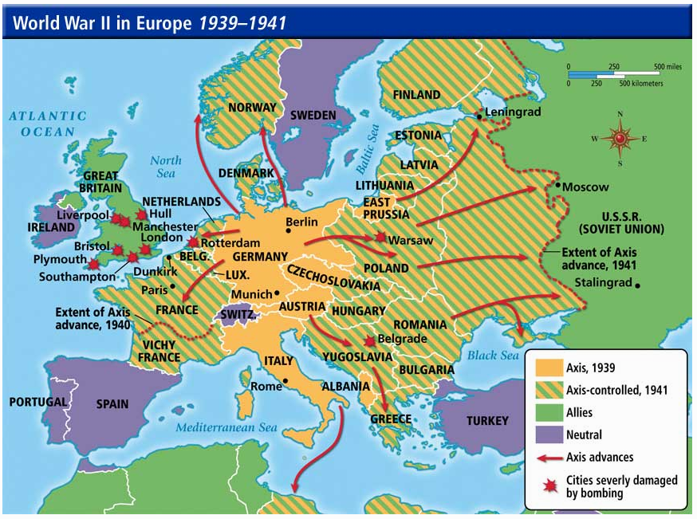
http://burkeen.me

Slide 18
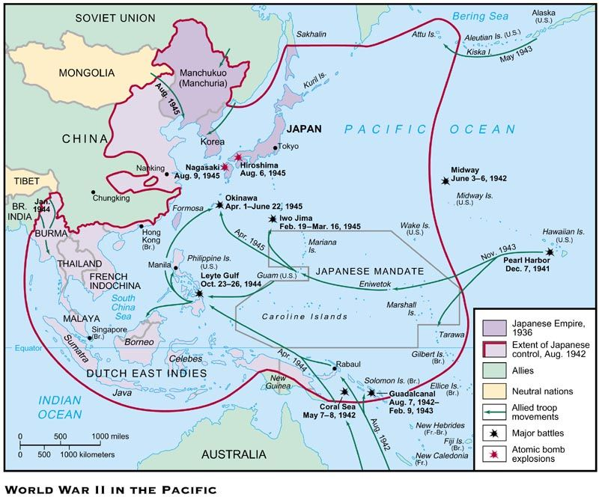
Learnourhistory.com
Notes:
1853 Admiral Perry forced Japan to open to western trade

Slide 19
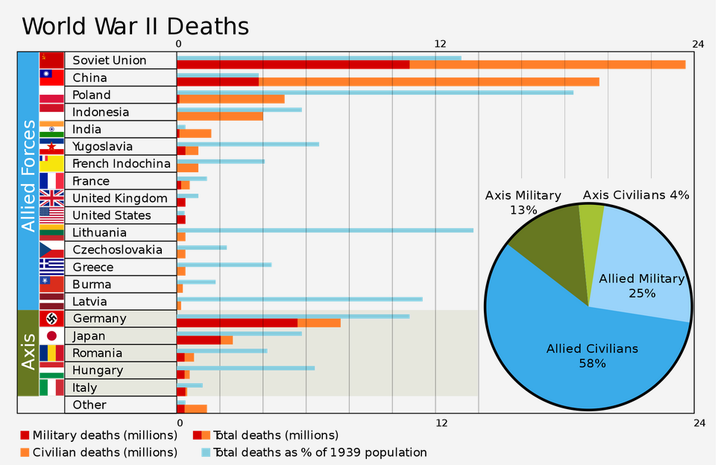
WW II
https://www.reddit.com/r/dataisbeautiful/comments/1bb3xv/world_war_ii_deaths/

Slide 20
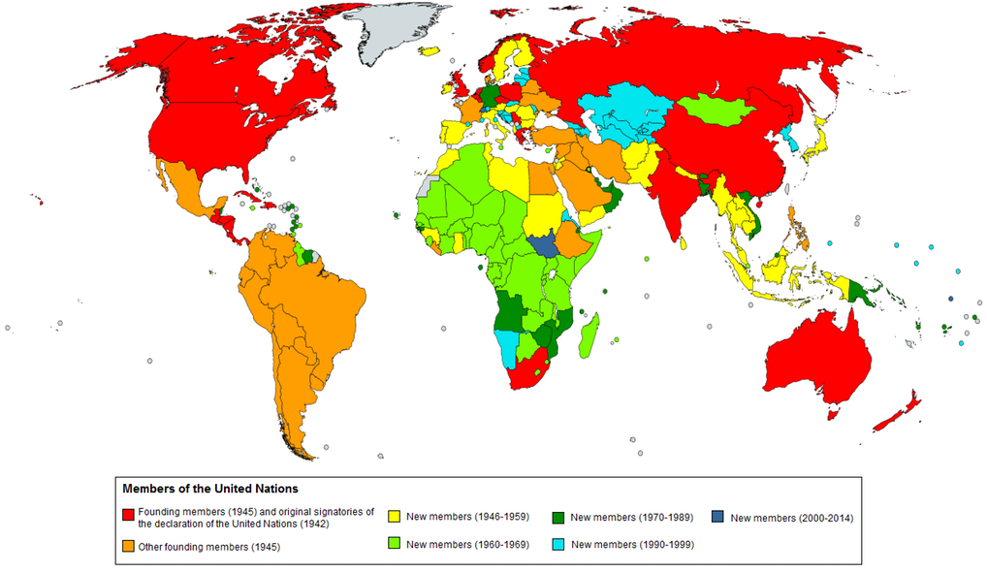
United Nations

Slide 21
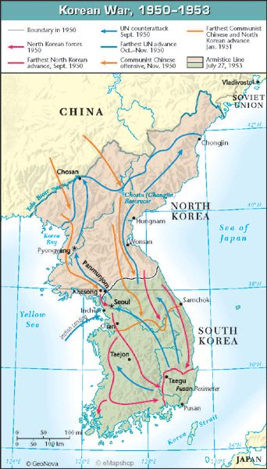
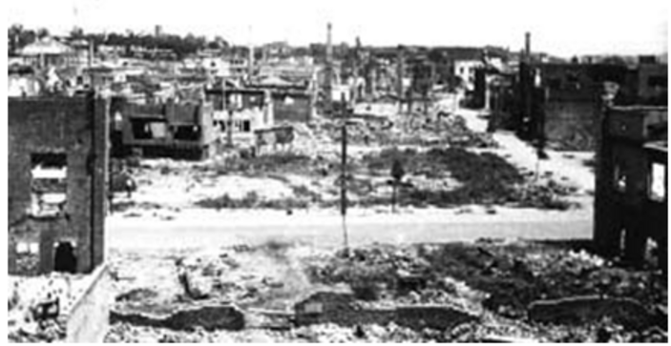
Population 1939: 24,326,000
1939 – 1941: 500,000 deaths, 5,400,000 conscripted
1950-1953: 3 million people died
American planes dropped 635,000 tons of bombs (503,000 tons of bombs dropped in the entire Pacific in World War II)
Destroyed 8,700 factories, 5,000 schools, 1,000 hospitals and 600,000 homes
Pyongyang, 1953
https://sites.tufts.edu
Notes:
https://apjjf.org/-Charles-K.-Armstrong/3460/article.html
http://www.bbc.com/news/world-asia-43921385?ocid=global_bbccom_email_27042018_top+news+stories
85,000 miles squared – California is 165,000!
Popuplatino of California: 40 million

Slide 22
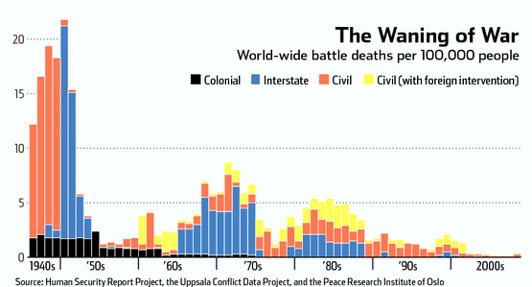
Armed Conflict
Notes:
The number of deaths from conflict have dramatically decreased in the last 70 years.

Slide 23
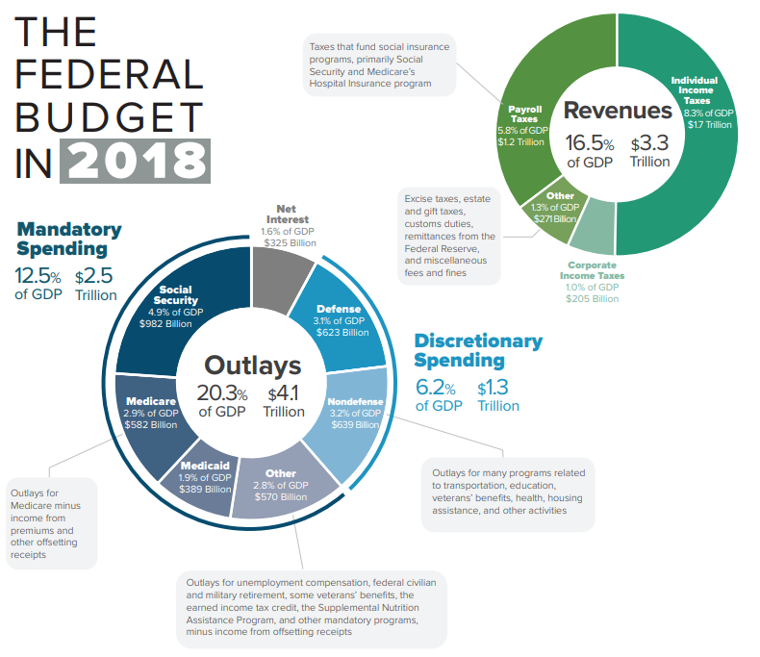
wiki2.org
Notes:
https://wiki2.org/en/United_States_federal_budget#/media/File:2018_Federal_Budget_Infographic.png

Slide 24
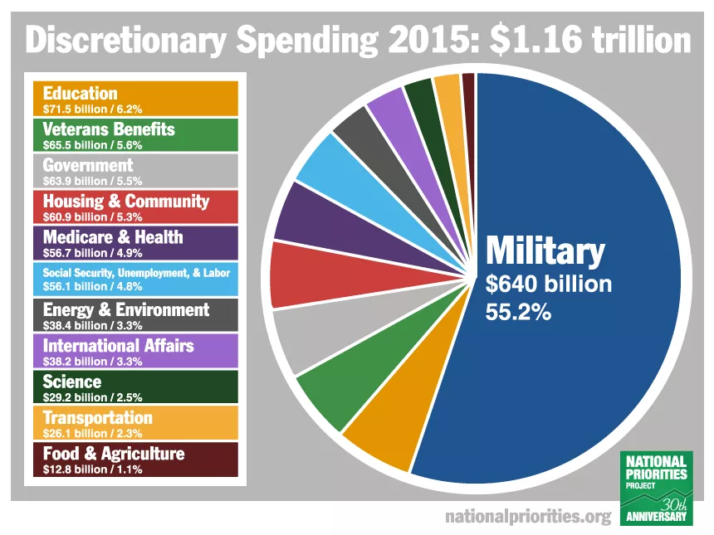

Slide 25
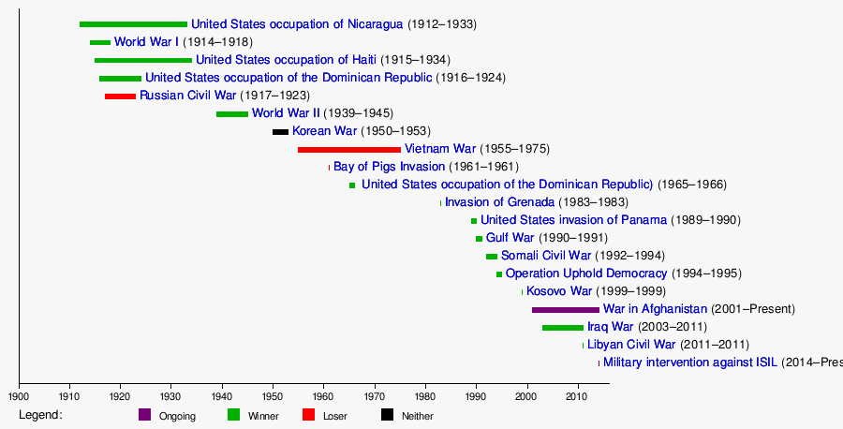
In 239 years, 222 years at war
https://www.quora.com/Why-has-America-waged-so-many-wars

Slide 26
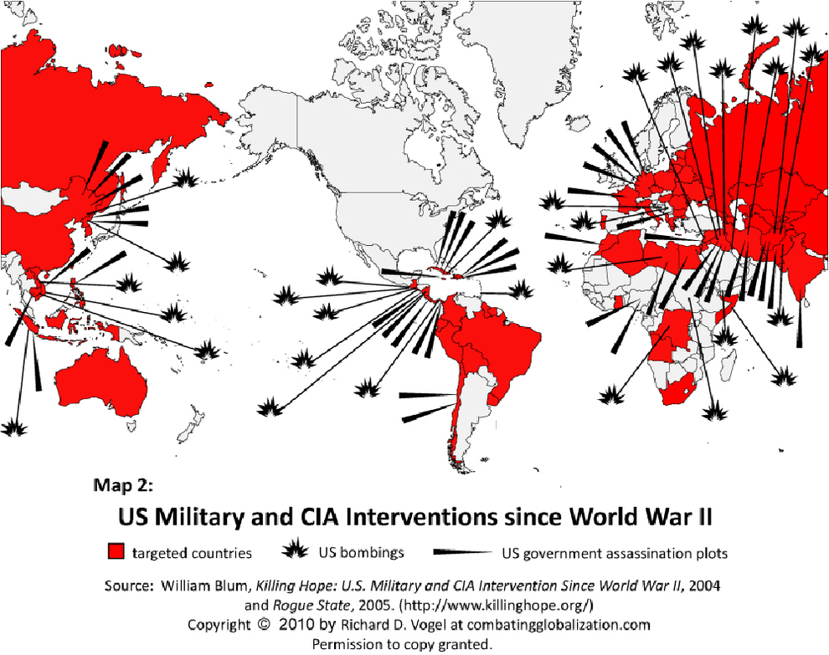
Notes:
US overturned a democratically elected government in Chile when they threatened to nationalize the mines. The government was replaced by a military dictatorship.
US overturned the government of Iran when they threatened to nationalize the oil fields, the government was replaced by the Shah, a ruthless dictator that tortured and willed 200,000 of his own people. Ayatollah Khomeini led a revolution against the Shah and today Iran's government is elected but our enemy.
https://www.youtube.com/watch?v=-2d-yXtm2ME

Slide 27
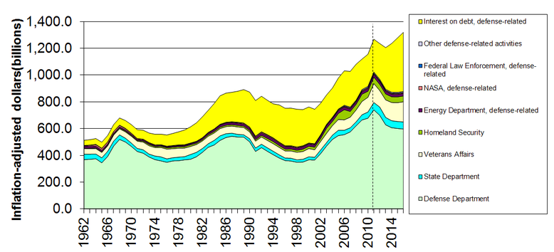
Military-Related Spending
https://en.wikipedia.org/wiki/Military_budget_of_the_United_States

Slide 28
Cost of Post-9/11 Wars
$8 trillion, $26,000 per US Citizen
Over 801,000 lives lost by direct violence
7,050 US Soldiers Killed
38 million people displaced
Revenue:
  $7 trillion to defense contractors
Notes:
https://watson.brown.edu/costsofwar/papers/summary

Slide 29
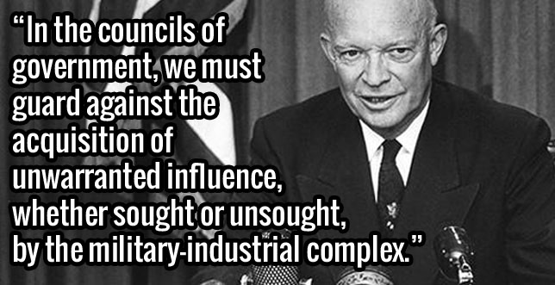
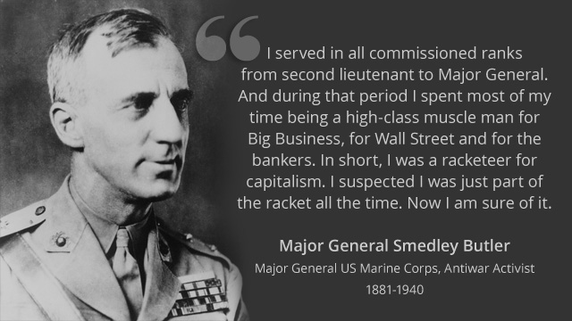
President Eisenhower’s
Final Address
“If you join the military now, you are not defending the United States of America. You are helping certain policy makers pursue an imperial agenda.”
- Lieutenant Colonel Karen Kwiatkowski

Slide 30
Military-Industrial Complex
$1,500 Billion
Tax Payers
Lobbyists
Staffers
Congress
Employ
Armed Services
Committees
Media
Employ
$700 Billion
Oil Companies
Defense Contractors
Generals retire
DOD
$38.4 billion just from offshore

Slide 31
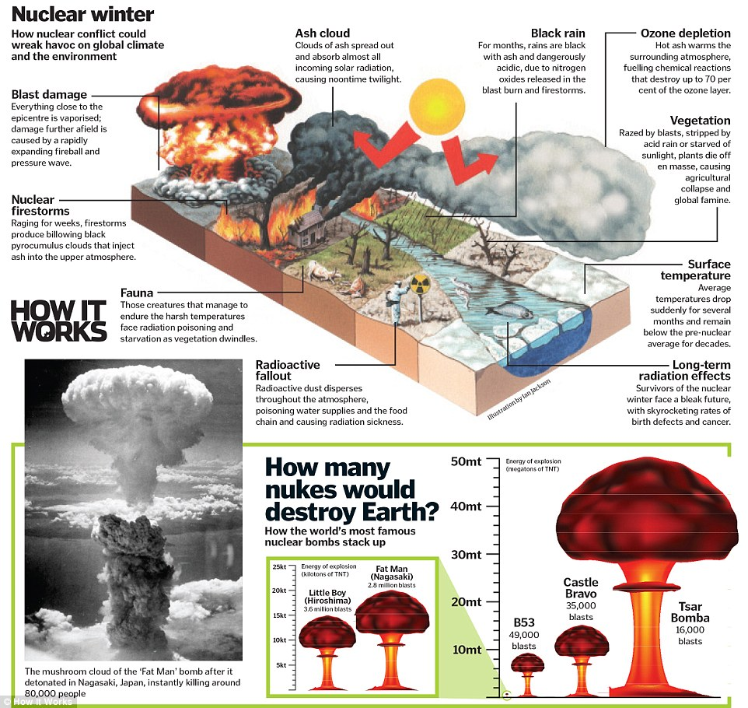
How it works magazine
Notes:
http://www.dailymail.co.uk/sciencetech/article-3409908/The-seven-biggest-threats-humanity-revealed-nuclear-winter-devastating-supervolcano-experts-explain-violent-ways-world-end.html

Slide 32

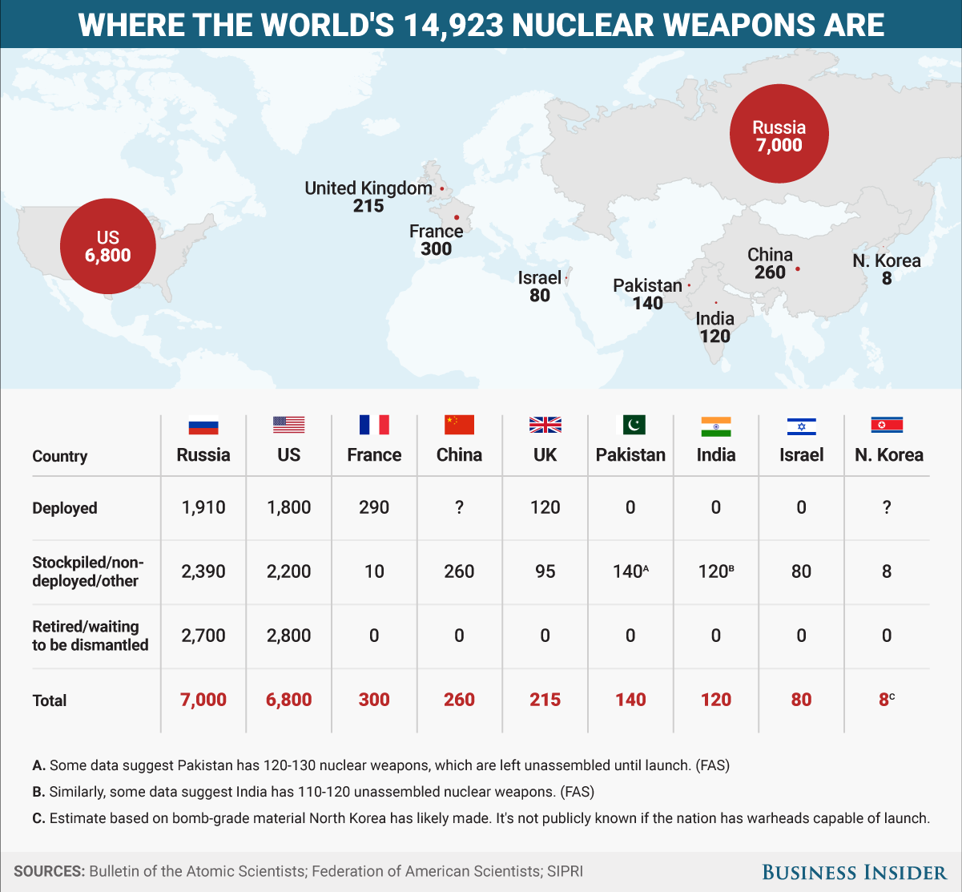
This animation shows how terrifyingly powerful nuclear weapons have become

Slide 33
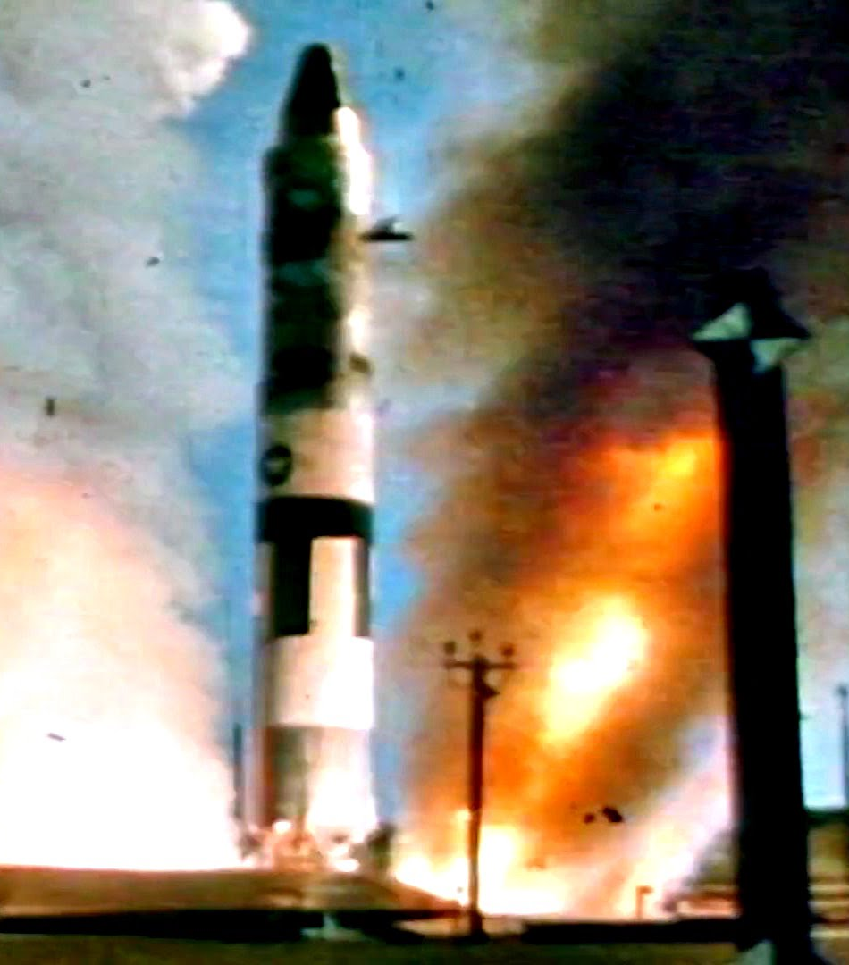
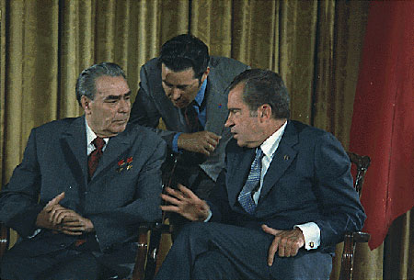
Strategic arms limitation treaty
SALT I froze numbers of: nuclear missile launchers
START I: ~2,000 launchers, ~10,000 warheads, ~4,000Megatons
Nixon and Brezhnev during the latter’s visit to the U.S. in 1973.

Slide 34
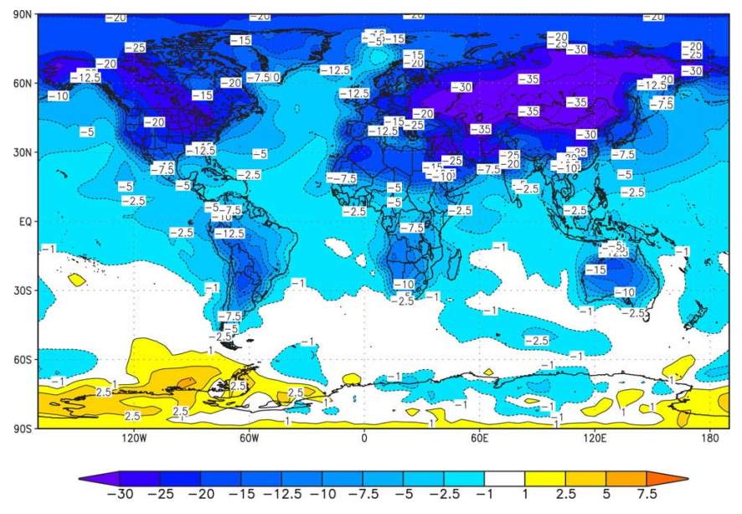
Surface Air Temperature (degree C) changes following a full-scale nuclear war averaged for June, July, and August of the year following the conflict.
The INESAP Bulletin 28, April 2008, by Steven Starr
Notes:
Isn’t this kind of nuts?

Slide 35
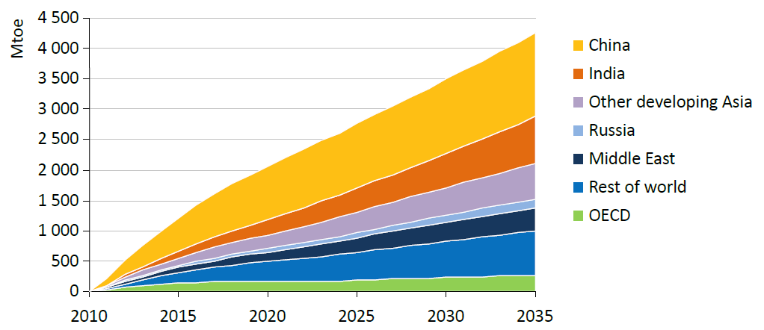
Increase in Energy Demand
International Energy Agency
Notes:
Demand for energy continues to grow.

Slide 36
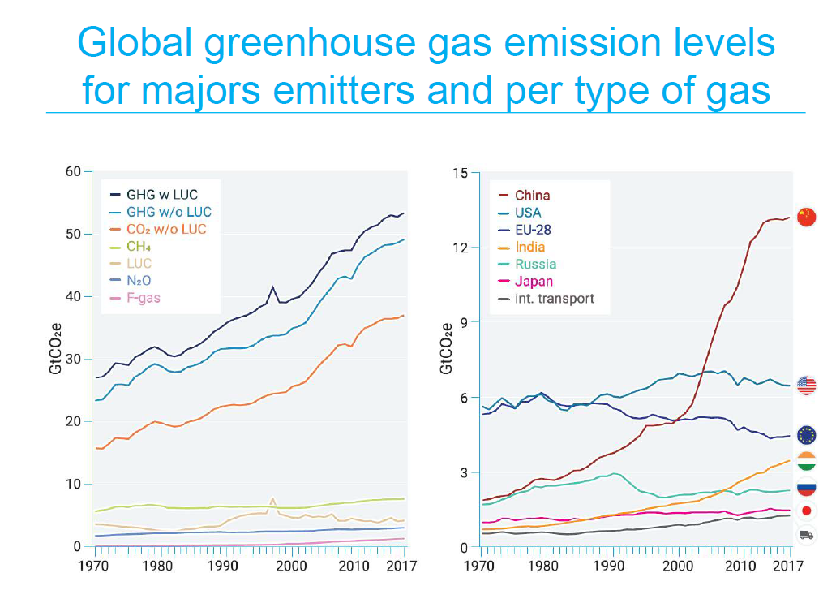
CO₂: Carbon Dioxide, CH₄: Methane, N₂O: Nitrous Oxide, F-gas: Fluorinated gases, LUC: Land use change (UN)

Slide 37
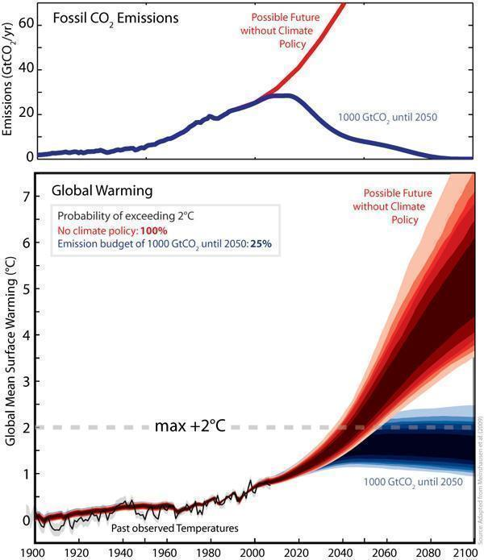
http://www.sciencedaily.com
Notes:
Global CO₂ emissions and warming compared to pre-industrial times for a scenario without climate policy (red) and a scenario in which the emissions are restricted to 1000 billion tonnes of CO₂ (blue) from 2000 to 2050. The intervention can limit the probability of exceeding the 2°C threshold to 25%. (Credit: Image courtesy of ETH Zurich)

Slide 38
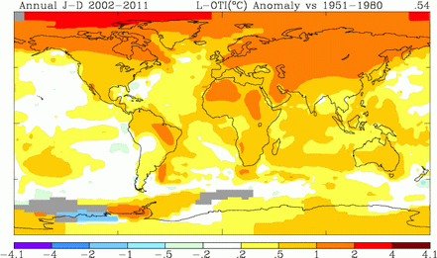
Global Warming
National Oceanic and Atmospheric Administration (NOAA)
Notes:
Global warming is happening primarily in the northern latitudes and is rapidly changing ecosystems in the arctic.

Slide 39
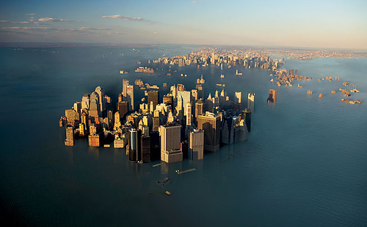
Sea Level Rise
If Greenland ice cap melts:
  7 meter sea level rise
If Antarctic ice cap melts:
  60 meter sea level rise (about 240 feet!)
See: http://geology.com/sea-level-rise/
wordpress.com
Notes:
It will probably take a long time for a 60 meter sea level rise to occur, potentially thousands of years.

Slide 40
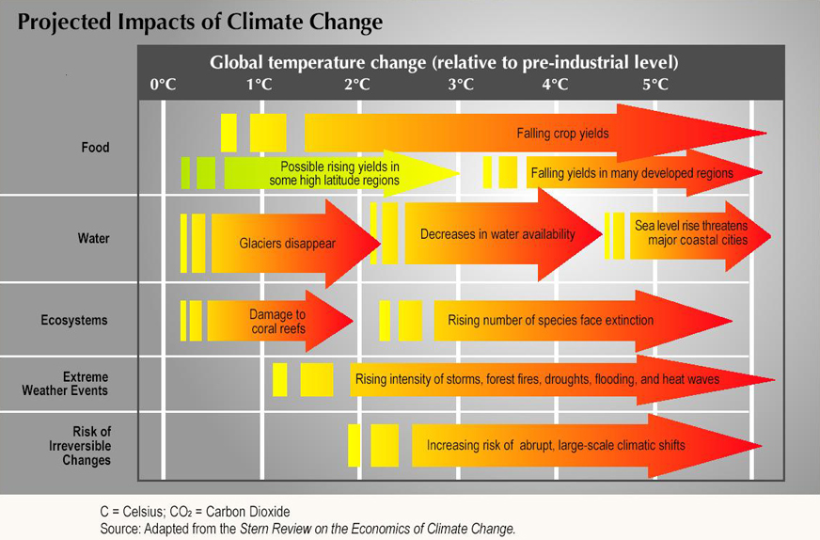
Notes:
Atlantic THC
The real concern with climate change is the increase in temperature causing decreases in food production and water availability.

Slide 41
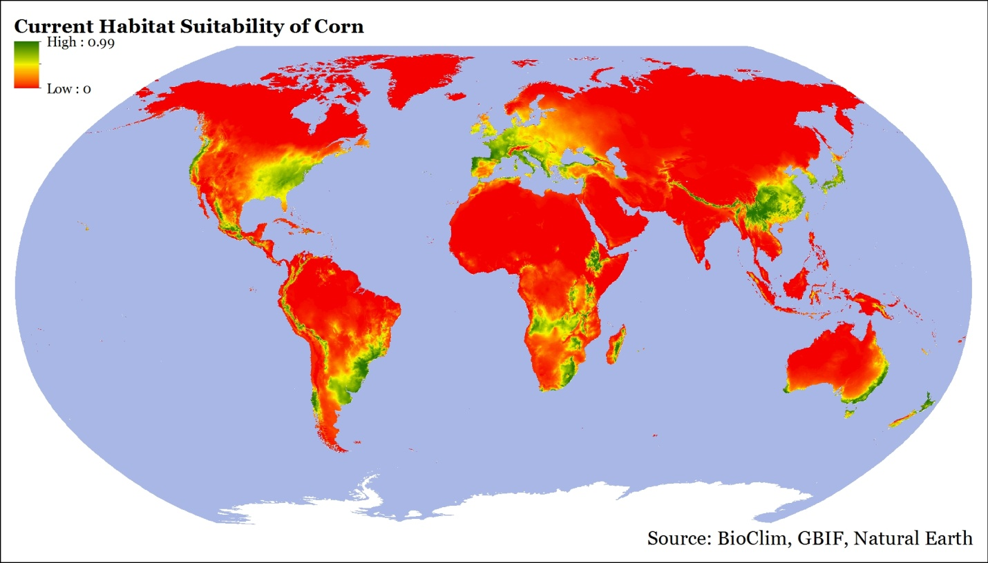
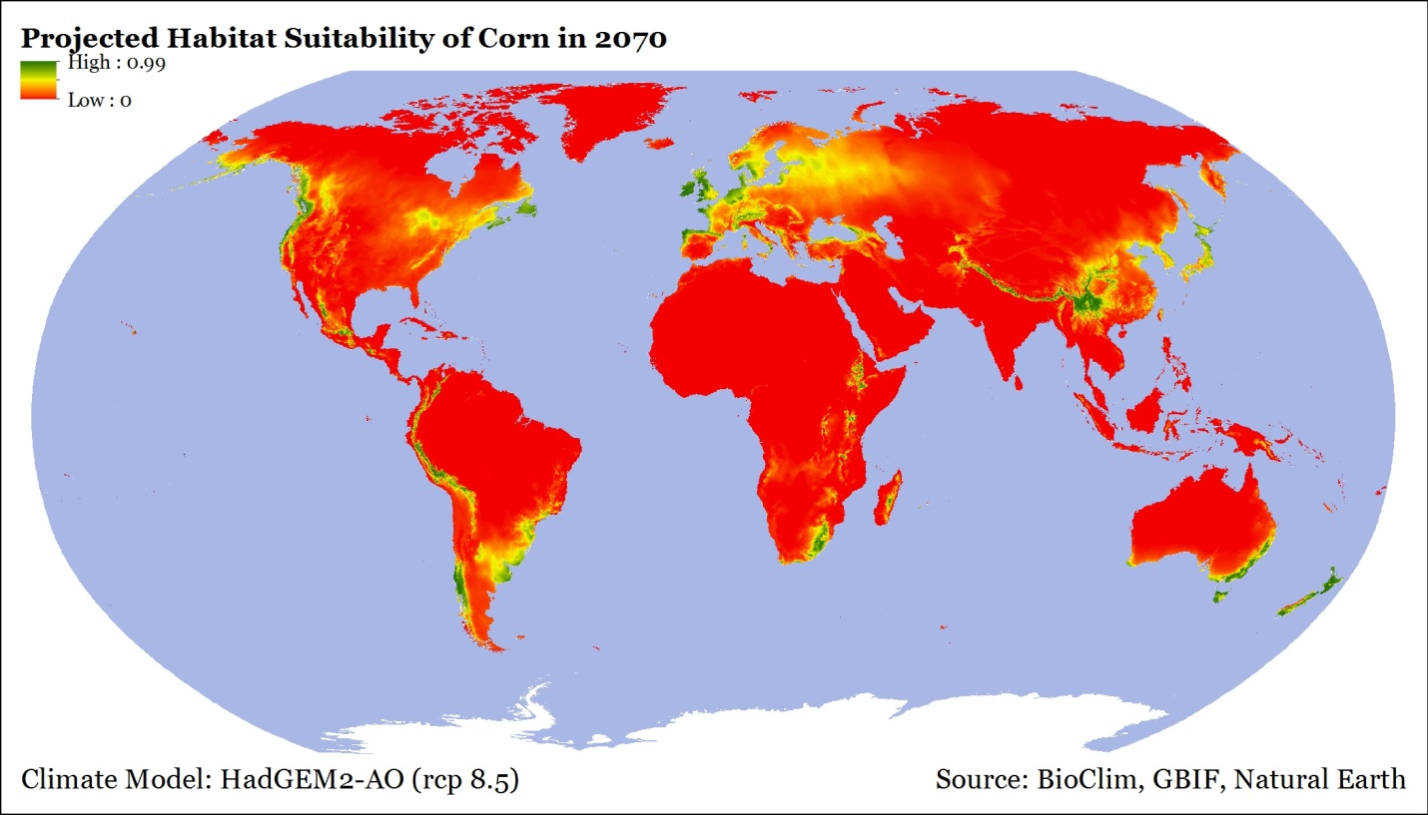
Corn
Habitat
Julia Clark 2015

Slide 42
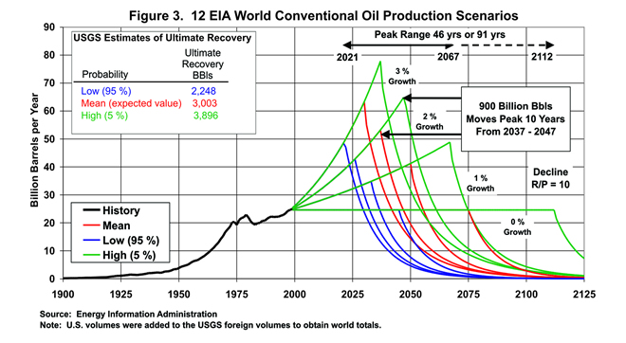
Oil Will Be Rare by 2100
Notes:
https://www.eia.gov/pub/oil_gas/petroleum/feature_articles/2004/worldoilsupply/oilsupply04.html

Slide 43
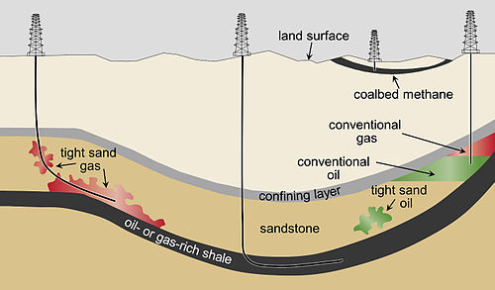
Tight Oil
Wikipedia

Slide 44
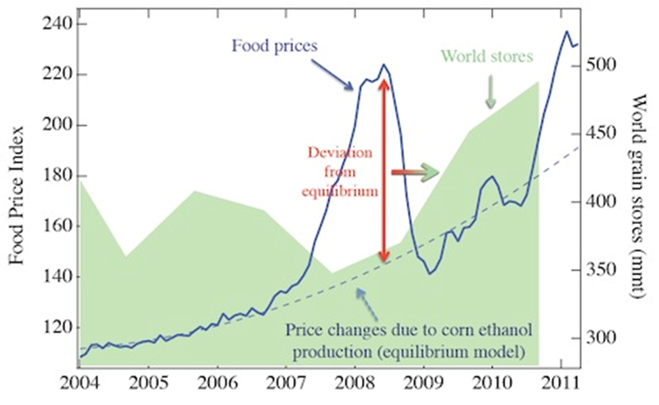
Ethanol Food Connection
2011, Johson, EM, Commodity Traitors: Financial Speculation on Commodities Fuels Global Insecurity,
Scientific American Blog.
Notes:
The price of oil is tied directly to food production because as soon as the price of gasoline reaches about $4 per gallon, farms switch swelling corn for food and large quantities are sold for ethanol production.

Slide 45
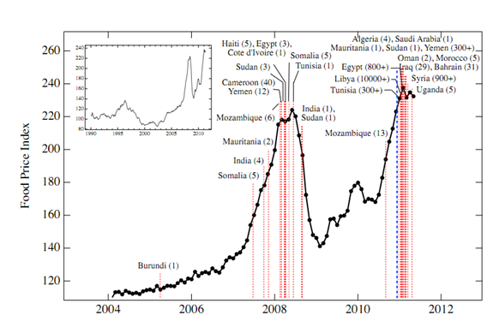
Food Riots
Technology Review, MIT, http://www.technologyreview.com/blog/arxiv/27083/
Notes:
This has caused food riots in areas far from the US.

Slide 46
Drought
Increasing
Population
Invasive
Species
Climate
Warming
Sea
Level Rise
Greenhouse
Gases
Marine
Acidification
Over-fishing
Decrease
in Food Availability
Pollution
Fertilizers
Reduced
Phosphorus
Shortage
Oil
“Scarcity”
Biofuels
Increase
Famine
Disease
Death

Slide 47
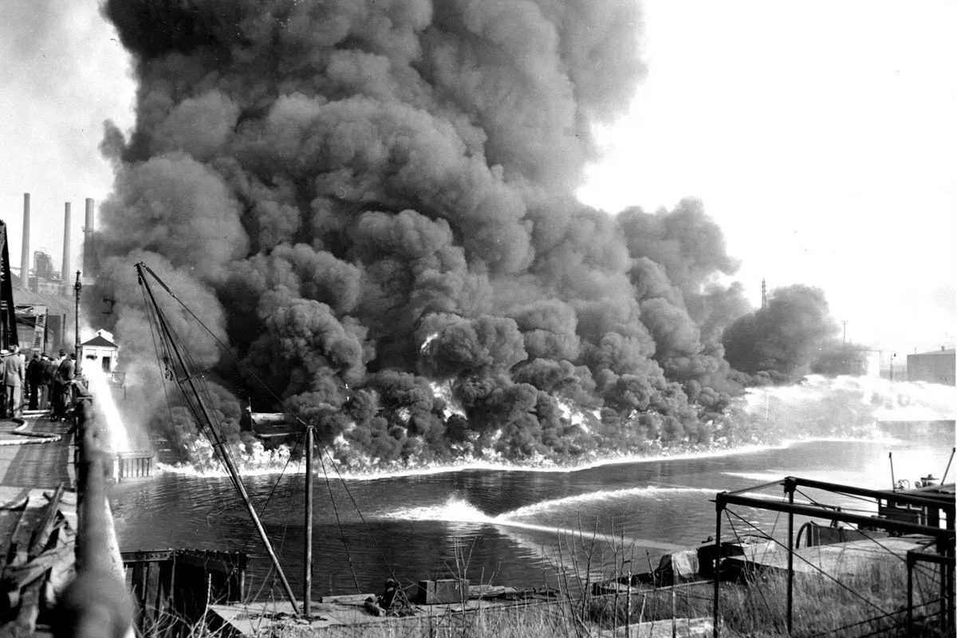
HOW A BURNING RIVER HELPED CREATE THE CLEAN WATER ACT
https://www.alleghenyfront.org/how-a-burning-river-helped-create-the-clean-water-act/
Notes:
The Cuyahoga (kai·uh·how·guh) River was once one of the most polluted rivers in the United States. It has caught fire a total of 13 times dating back to 1868, including this blaze in 1952 which caused over $1.3 million in damages.

Slide 48


Riparian stream buffers
Lewis County, WA —Weyerhaeuser clear cuts on Little Mill Creek
USDA
Notes:
https://www.seattletimes.com/seattle-news/logging-and-landslides-what-went-wrong/

Slide 49


After a 1976 report by the United States National Academy of Sciences concluded that credible scientific evidence supported the ozone depletion hypothesis
Notes:
National Academy of Sciences (1976). Halocarbons, effects on stratospheric ozone. Washington, DC. Retrieved May 28, 2016.

Slide 50

Renewables are Cost Effective
Wikipedia
Notes:
Levelized cost of energy, basically the cost of building and running a power plant divided by the electrical output.
This does not include taxes, consistency of power sources (i.e. solar and wind), difficulties in ramping power (coal and nuclear), and waste storage and disposal (nuclear).
From: https://en.wikipedia.org/wiki/Cost_of_electricity_by_source

Slide 51

US is Falling Behind
https://cleantechnica.com
Notes:
Highest numbers are based on hydroelectric

Slide 52

Notes:
Sinopec – oil and gas
State Grid – Chinas electric company

Slide 53

Millions of barrels of crude oil per day
Source: IEA Medium Term Oil Market Report May 2013
Notes:
Organisation for EconomicCo-operation and Development

Slide 54
Climate Talks
2015: 200 countries: Paris agreement:
  Limit temperature increase to 2° C
  Limit to 1.5 ° C requires zero net carbon emissions by 2050
68 countries want to do more (8% of emissions)
UN Climate Change Conference (COP 25)
  US is attending but we’re out in 2020
Countries with largest CO2 emissions
  https://www.youtube.com/watch?v=jx85qK1ztAc

Slide 55


Fossil Fuels
Renewables
Running out
Pollute: CO², etc.
Carcinogenic
Explosive
Toxic
Cause war, terrorism
Wind: Impacts birds, space
Solar: Large installs impact birds, space
Geothermal: see ground loops
http://solarcontech.com

Slide 56

US Subsidies Favor Oil & Gas

Slide 57

Why not Nuclear?
sites.suffolk.edu
Potential for disasters
Limited supply of fuel
No plan to store the waste
  Estimates for the time required to store nuclear waste range from 1000 to 100,000 years.
Oldest stable government in the world is Iceland at about 800 years.
  The US is second at about 230!
Notes:
Oldest stable government is Iceland

Slide 58

Providing all global energy with clean renewable power
3,800,000 5MW wind turbines,
49,000 300MW concentrated solar plants
40,000 300 Mw solar PV power plants
1.7 billion 3kW roof top PV systems
5350 100MW geothermal power plants
270 new 1300MW hydroelectric plants
720,0000 75MW wave devices
490,000 1MW tidal turbines
MidAmerican Energy
Jacobson M. Z., M. A. Delucchi, 2011, Providing all global energy with wind, water, and solar power, Part I:
Technologies, energy resources, quantities and areas of infrastructure. Energy Policy
Notes:
By 2030
MidAmerican Energy created largest land-based turbine

Slide 59
1.3 Trillion Dollars Buys
Every year, what we spend on the military could purchase:
  ~350,000 wind turbines
    10 years to meet global needs
  ~450 million residential PV systems
    4 years to meet global needs

Slide 60
What can you do?
First, seek:
  The strength to change the things you can
  The serenity to accept the things you cannot
  The wisdom to know the difference
    Adapted from Reinhold Niebuhr
Be the change you want to see in the world - Ghandi
Use renewable energy:
  Walk, bike, & ride
  Purchase a house near work
  Build or remodel your house to be carbon neutral

Slide 61

What you can do
Contact Your Elected Officials
  https://www.usa.gov/elected-officials
  Tell them not to support Trump’s increases to defense and cuts to agencies that provide services to us.
Push for tax credits on renewables, taxes on fossil fuels, regulations against further fossil fuel development
  Support petitions (see MoveOn.org)
govtrack.us

Slide 62


Pressure on Critical Land
Food
Energy
Biodiversity
Water

Slide 63


Nantucket Island

Slide 64

As GIS Professionals
Listen, then define and describe the issue
Collect and qualify data
Analyze, model, map, and write
Convey results, with uncertainties, to all interested parties
Learn and educate
Maps can make a difference, locally or globally

Slide 65
Additional Sources
NASA: https://climate.nasa.gov/
US EIA: https://tinyurl.com/y39wlws8
Canada.gov: https://tinyurl.com/t3olklw
IPCC: https://www.ipcc.ch/
BBC: https://tinyurl.com/w95pzaj
UN: https://tinyurl.com/y9ffrjv7
UK: https://tinyurl.com/sm35lx7

Slide 66
Additional Slides

Slide 67



Warming
Climate
Warming Reducing Farm and Timber Lands By 2100
Accumulating
GHG
Recycled
Education
Education, Regulation, Incentives
35 Gigatons/Year
~30% of Emissions
+1%/year
Population
7.7 billion
85%
10%
2.6%
Energy¹
Gone by 2100
Oceans
Fossil Fuels
Food
Bio
Fuel
Bio
Fuel
Forests
Farmland
Timberland
1. Missing 2% is nuclear. 2.3% of the renewables are hydro most of which is not sustainable.

Slide 68
Hypothesis
The United States has created a global empire backed by a huge military industrial complex
The US is funding this empire instead of investing in updating our infrastructure, including moving to renewable energy source
This will result in degrading our planet to where it cannot sustain our current population by the end of this century

Slide 69
US Allies
US Enemies
E. U., Britain (democracy)
North Korea (dictatorship)
Saudi Arabia (monarchy)
Iran (constitutional monarchy)
1953
Iran (The Shah)
1979
Iran (Islamic democracy)
Iraq (Saddam Hussein)
1990
Iraq (Saddam Hussein)
2003
Iraq (Islamic democracy)
1973
Chile (Allende)
Chile (Pinochet)
Dictatorship
Democracy?
Representative Democracy
Notes:
A form of government in which power is explicitly vested in the people, who in turn exercise their power through elected representatives. Today, the terms republic and democracy are virtually interchangeable, but historically the two differed.
Iran became our enemy in 1941 when the prime minister nationalized the oil fields
Shah of Iran: https://en.wikipedia.org/wiki/Mohammad_Reza_Pahlavi

Slide 70
Global Change
Over-fishing
Pollution
Invasive
Species
Increasing
Population
Marine
Acidification
Biofuels
Increase
Less
Food
Drought
Famine
Sea
Level
Rise
Fertilizers
Reduced
Climate
Warming
Oil
“Scarcity”
Phosphorus
Shortage
Disease
Greenhouse
Gases
Notes:
My main concern is not for any one of these issues but for all of them combined. Particularly when we add over-fishing, pollution, invasive species, and an increasing population. I believe this will cause increased famine and then disease, particularly, in certain African countries.

Slide 71

People wanted change, but few people then imagined that as a result of such "changes" Russia would lose industry and 15 million people, and economic and territorial losses would exceed the losses of the WWII times. In other Soviet republics, the US dictatorship was actually established. The plundered and humiliated Russia - the largest fragment of the USSR, almost 20 years was not able to answer even the most simple geopolitical challenges. As a result, NATO has come very close to Russia, and American bases are literally seizing the world of the Eurasian peoples they hate.
Notes:
People wanted change, but few people then imagined that as a result of such "changes" Russia would lose industry and 15 million people, and economic and territorial losses would exceed the losses of the WWII times. In other Soviet republics, the US dictatorship was actually established. The plundered and humiliated Russia - the largest fragment of the USSR, almost 20 years was not able to answer even the most simple geopolitical challenges. As a result, NATO has come very close to Russia, and American bases are literally seizing the world of the Eurasian peoples they hate.
http://geoclub.info/%D1%81%D0%B5%D0%BF%D0%B0%D1%80%D0%B0%D1%82%D0%B8%D0%B7%D0%BC-%D0%BA%D0%B8%D0%B5%D0%B2%D1%81%D0%BA%D0%BE%D0%B9-%D1%85%D1%83%D0%BD%D1%82%D1%8B/

Slide 72
Cost of Afghanistan War
$500 billion, $1600 per US Citizen
Notes:
Wikipedia and Congressional Budget Office

Slide 73
Cost of Iraq War
$1.9 trillion, $6,300 per US Citizen
$ 2 trillion in future veteran's benefits
460,000 Iraqi deaths
4,431 US Deaths
31,994 US Wounded in action
Notes:
PLOS Medicine survey

Slide 74
 | CO₂ (Carbon Dioxide) | CH₄ (Methane) | N₂O (Nitrous Oxide) | CFC-11 (Chlorofluoro-carbon-11) | HFC-23 (Hydrofluoro-carbon-23) | CF₄ (Perfluoro-methane)
Pre-industrial concentration | about 280 ppm | about 700 ppb | about 270 ppb | zero | zero | 40 ppt
Concentration in 1998 | 365 ppm | 1745 ppb | 314 ppb | 268 ppt | 14 ppt | 80 ppt
Rate of concentration change ^{b} | 1.5 ppm/yr ª | 7.0 ppb/yr ª | 0.8 ppb/yr | -1.4 ppt/yr | 0.55 ppt/yr | 1 ppt/yr
Atmospheric lifetime | 5 to 200 yr ^{c} | 12 yr ^{d} | 114 yr ^{d} | 45 yr | 260 yr | >50,000 y
https://archive.ipcc.ch/ipccreports/tar/wg1/016.htm

Slide 75

https://archive.ipcc.ch/ipccreports/tar/wg1/figts-10.htm

Slide 76
1.3 Trillion Dollars Buys
Every year, what we spend on the military could purchase:
  ~350,000 wind turbines
  ~216 million residential PV systems

Slide 77
Tight Oil
Wikipedia

Slide 78

Renewable Energy Momentum Has Passed The Tipping Point
(cleantechnica.com)
Notes:
This is likely to accelerate over time because newly added renewables have a cumulative effect. This is to say that each new renewable installation will supplant the energy demand of the older model energy sources of oil, coal, gas and nuclear.

Slide 79

Notes:
www.britannica.com

Slide 80

1917
Notes:
World War One propaganda map advocating American intervention

Slide 81

Macedonian Empire
Notes:
The Macedonian Empire, 336-323 B.C. AND Kingdoms of the Diadochi in 301 BC and 200 BC. Historical Atlas by William R. Shepherd, 1911. Courtesy of the University of Texas Libraries, The University of Texas at Austin., CC BY-SA 3.0, https://commons.wikimedia.org/w/index.php?curid=531504

Slide 82

To Understand, You have to see it from their perspective
NASDAQ predictions for Boeing
2017 Global aerospace and defense industry outlook
  Growth prospects and trends remain upbeat
  You have to make profit or you can’t pay the shareholders
  If the shareholders sell, your company loses value
  If your company loses value it can become a take-over target

Slide 83

Fall-Scale Nuclear “Exchange”

Slide 84
In Summary
The US has developed a huge complex of military contractors, defense works, lobbyists, politicians and the Department of Defense that must have conflict to justify it’s existence.
The complex supports the rich through supporting resource extraction in other countries.
Tax payers are helping with funding to the detriment of the world.

Slide 85

Future of Life Maps
https://futureoflife.org/background/us-nuclear-targets/#nukemap

Slide 86


Slide 87
Military-Industrial-Oil Complex?
$1,500 Billion
Tax Payers
Lobbyists
Staffers
Congress
Armed Services
Committees
Media
Employ
Employ
$700 Billion
Oil Companies
Defense Contractors
Generals retire
DOD
$38.4 billion just from offshore

Slide 88


Slide 89
Trump’s Proposed Changes:
Defense: +10% ($54 billion)
EPA: -31%
State Department: -29%
Dept. of Ag.: -21%
Dept. of Health Services: -18%
Dept. of Commerce: -16%
  NOAA: -$250 in coastal research
Dept. of Education: -14%
Dept. of Energy: -6%

Slide 90
Summary
US is arming ourselves, and the rest of the world, as if we are in a world war.
We are burning all the fossil fuels we can reach as fast as we can causing long-term damage to the earth, war, pollution, etc.
We have been told for decades that renewables are too expensive.

Slide 91

MSP
Marine Spatial Planning
Mass. Ocean Management Plan

Slide 92

Nuclear Arsenal
$1,000 Billion to be spend in modernization in the next decade, Financial Times
Notes:
Nuclear arsenal has reduced from over 70,000 to under 20,000
We continue to maintain a huge number of nuclear weapons which most folks do not think about today but this is still a major threat to happiness.

Slide 93
The Military Industrial Complex
Tax Payers
Congress
$2,600 Billion
Armed Services
Committees
Lobbyists
Staffers
Media
Employ
Defense Contractors
$700 Billion
DOD
Generals retire
Figures are annual approximations
Notes:
80% of generals retire to defense contractors or consultants
http://archive.boston.com/news/nation/washington/articles/2010/12/26/defense_firms_lure_retired_generals/

Slide 94


Slide 95

Notes:
Oil goes for btween 65 to 90 dollars a barrel, 1 million a day = 65 million to 90 million a day, 24 to 32 billion (about 30 billion a year)

Slide 96
All we have to do is:
Stop burning fossil fuels!
  Including uranium.
Switch to sustainable, clean solutions
Conserve energy
Have fewer children
It’s probably too late to avoid major problems but the sooner we get started, the less problems we will have

Slide 97

Ocean Acidification
Notes:
Another effect of atmospheric CO2 is that the ocean becomes more acidic as it absorbs CO2.

Slide 98

Increase in pH Since 1700s
Notes:
This has caused a global increase in pH and recently caused oyster failures because the small oysters could not form their shells. This has the potentially to cause collapses in major fisheries.

Slide 99


Slide 100

Fertility Rate: 2005
http://www.fooddeserts.org
Notes:
Fertility rates have dropped to near replacement for most of the world, except Africa.

Slide 101




Slide 102

Estimated World Population
WORLD POPULATION TO 2300 - United Nations
Notes:
The UN has esimated that world population may peak at about 2050.

Slide 103
The Risk
 | Do Nothing | Take Action
Global Change is not happening | No effect | Cleaner environment for everyone Economic impacts?
Global Change is happening | Billions starve Most major cities have to move Island cultures relocated Low-lying countries inundated 20-50% species lost | Less starve Less impact on cities Less impact on island cultures Less impact on low-lying countries Less species loss
Adapted from YouTube video: The most terrifying video you'll ever see
Notes:
How about we stop arguing about if and why and start taking action to mitigate the potential problems?

Slide 104


http://unit8juliahalexisp10.wikispaces.com
Korean War
1 Million People Killed

Slide 105


What does this have to do with GIS?
NASA
Wikipedia

Slide 106

US Renewable Energy
http://thinkprogress.org/climate/2011/11/03/360531/getting-clean-energy-economy-facts/?mobile=nc

Slide 107
Renewables are now cheaper than fossil fuels (including nuclear)

Slide 108

Solar Engery
http://www.exploregreenenergy.com

Slide 109

Mean Annual Wind Speed
http://myweb.unomaha.edu/~gpagett/CartGIS/gallery.htm

Slide 110

Geothermal

Slide 111

Biofuel

Slide 112

Food Production in Increasing
Notes:
At the same time, world food production has increased steadily but partly because of the use of fertilizers and industrial agricultural equipment.

Slide 113

Greenhouse Gasses
http://interculturalclimateaction.wordpress.com

Slide 114

Carbon Dioxide Output
U.S. Dept. Of Energy

Slide 115

Atmospheric CO2

Slide 116


Slide 117

Fertility Rate: 1970
http://www.fooddeserts.org
Notes:
Fertility rates used to be well above replacement (2) so there was rapid population growth.

Slide 118

sparkaction.org

Slide 119

Solar in the US

Slide 120

Peak Oil?
www.greatdreams.com
Notes:
Everyone agrees that we will run out of fossil fuels in the future but there is little agreement on when. This will cause oil to steadily increase in cost and eventually case oil scarcity.

Slide 121
Spatial-Tempral Planning
Disease Outbreaks
Safety/Emergency services
Recreation
Economics
Fish & Wildlife
Agriculture
Cultural Resources
Energy Production
Legal Issues
Ownership

Slide 122
Impacted by Ocean Acidification
Coccolithophores & Foraminifera: Plankton
  > ?
Corals:
  > huge variety of fish
Echinoderms: star fish, echinoderms
  > Mammals
Crustaceans: Shrimp, crabs, lobsters
  > birds, mammals, fish, and humans
Molluscs: Snails
  > birds, others

Slide 123


Australian Fire Storms
ksj.mit.edu

Slide 124


Slide 125
Food Security?
Demand for energy is increasing
  We will run out of fossil fuels
  Switch to biofuel will reduce food production
Population is increasing
  But the rate of increase is slowing
Food consumption is increasing
  Food production is increasing
  But we are running out of phosphorus

Slide 126

Interconnected World
http://www.pikeresearch.com/tag/biofuels

Slide 127



Slide 128

Climate Change
Caption: Figure 1. Rainfall deciles across Australia for 1 January 1997 to 31 December 2009; deciles based on climatology from 1900 to 2009 (Bureau of Meteorology)

Slide 129

Increasing Food Consumption

Slide 130


What will the world look like in 2100?
www.oxfam.ca
Chernobyl in Winter
thebluereview.org
Notes:
https://thebluereview.org/utopian-writers-american-west/

Slide 131
Three Threats
Nuclear War
Resource Exhaustion: Water, Oil, Food, Fertilizer, etc.
  Leads to famine, disease

Slide 132


Coral Reef Bleaching
http://www.duke.edu

Slide 133


Threats to Biodiversity
Biodiversity Threat: riverthreat.net

Slide 134

Human Water Security
Human Water Security Threat: riverthreat.net

Slide 135



Slide 136

Predicted Temperature Increase
Degrees F
Year
http://www.dailytemperaturecycle.com/fossilfuellifetime.htm

Slide 137


Slide 138

Food Stocks are Low

Slide 139

Peak Phosphorus
Figure 1: Peak phosphorus ‘Hubbert’ curve, indicating that production will eventually reach a maximum, after which it will decline (source: Cordell, Drangert and White, 2009) ^{i}

Slide 140

Ice Cover in Arctic

Slide 141
Grand Challenges
Eradicate extreme poverty and hunger
Achieve universal primary education
Promote gender equality
Reduce child mortality
Improve maternal health
Combat diseases
Ensure environmental stability
Develop Global Partnership for Development
United Nations Millennium Development Goals

Slide 142


sparkaction.org

Slide 143
“Renewable, Clean, Energy”
Solar: requires trace minerals
Wind: minerals and species impacts
Wave/tidal: minerals and species impacts
Geothermal: limited availability?
Hydroelectric: limited locations, sediment
Biofuel: Deforestation, food -> fuel, marginal in the US
Nuclear: impacts, danger, storage
Conservation?

Slide 144

US Energy Sources
http://www.instituteforenergyresearch.org

Slide 145

US Renewable Energy
http://www.instituteforenergyresearch.org
Notes:
- Biomass and hydro is down because of draughts, solar increasing but still small

Slide 146

Increased CO2 -> Warming

Slide 147

The League of Nations

Slide 148

Global Potential Energy

Slide 149
Nuclear Arsenal
Imagine, a room, awash in gasoline. And there are two implacable enemies in that room. One of them has 9,000 matches. The other has 7,000 matches. Each of them is concerned about who’s ahead, who’s stronger. Well, that's the kind of situation we are actually in.
  Carl Segan

Slide 150

Arctic Ice Extent 2010
Magenta line indicates median ice extent for 1979-2000, NOAA
Notes:
For the first time in human history, there is a “northwest passage” open during the summer.

Slide 151


Greenland Ice Melt
NASA
Notes:
The entire ice cap of Greenland was defrosting in July of 2012, this is unprecidented in at least 150 years

Slide 152

World Phosphorus Reserves
http://www.thebrokeronline.eu/en/Articles/Peak-phosphorus
Notes:
Another threat to food production is that we have a limited supply of phosphorus, an important fertilizer.

Slide 153

Notes:
Countries that have strong economies are also investing in other countries and purchasing land to produce food for export. This could reduce local production capacity.

Slide 154

Notes:
The highest number of undernourished people are in Africa.

Slide 155

Change in Cereal Production
Gornall, Implications of climate change for agricultural productivity in the early twenty-first century,
The Royal Society, Biological Sciences
Notes:
Shows the predicted change in cereal production yield based on climate change scenarios.
Notice that there is actually a potential increase at first in the northern latitudes but then a uniform negative trend in output.

Slide 156

World Happiness Map
The results of Columbia University's World Happiness Report, mapped. (Max Fisher/The Washington Post)
The United States ranks 17th of the 156 ranked countries, behind Mexico (16) and Panama (15).
Notes:
One of my goals is to help increase human happiness, now and in the future.

Slide 157




Risks to human happiness
Humans Need:
Risks:
Safe homes
Clean water
Good food
Socialization
Freedom
War/Armed Conflict
Natural Disasters
Totalitarian Governments
Disease
Famine
Drought
Clean water council
NPR

Slide 158


Slide 159


Slide 160


Slide 161

Global Armed Conflict
International Institute for Strategic Studies (IISS) Armed Conflict Database
Notes:
There are still armed conflicts but they are relegated to increasingly smaller areas of the globe.

Slide 162

Armed Conflict to Drop to 1 in 12 countries by 2050
Higher education, lower infant mortality and lower population growth are reasons why the world can expect a more peaceful future

