Slide 1
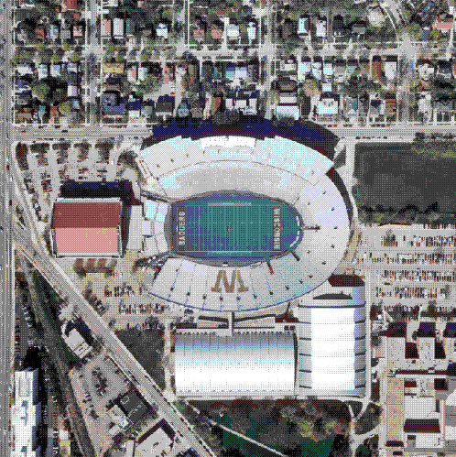
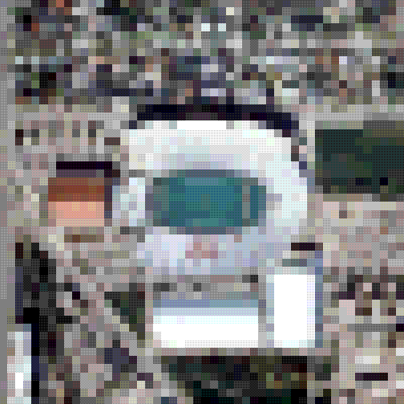

Spatial Resolution in Digital Images
Digital Images
  “Size” can change easily (zoom, subset, mosaic)
  Pixel size is assumed not to change within an image
  Scale is referenced to physical size of the pixel
        1 pixel = 30 meters (Landsat 7)
1 m
10 m
30 m

Slide 2
4 Resolutions of Rasters
Spatial:
  X and Y resolution (10 cm to 1 km)
Spectral:
  3 for photos, 7 Landsat, 256 MODIS
Temporal:
  Daily for MODIS, 15 days for Landsat, every few years for SRTM
Radiometric:
  8 bits=0 to 255 (256 shades)

Slide 3
4 Resolutions of Rasters
Radiometric
Resolution
+ Temporal

Slide 4
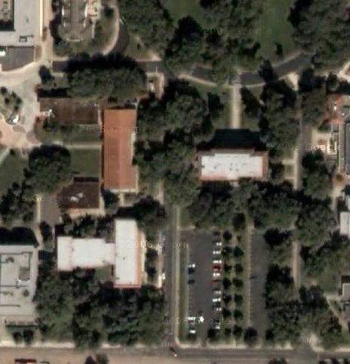
Geo-Referenced Raster
Known Projection and Datum
(X1,Y1)
(X4,Y4)
(X2,Y2)
(X3,Y3)

Slide 5
Geo-Referenced Raster
Known Projection and Datum
Width and height of a pixel in map units
(X1,Y1)
Height in pixels
Width in Pixels

Slide 6
Geo-Referenced Raster
Known Projection and Datum
(X1,Y1)
(X3,Y3)

Slide 7

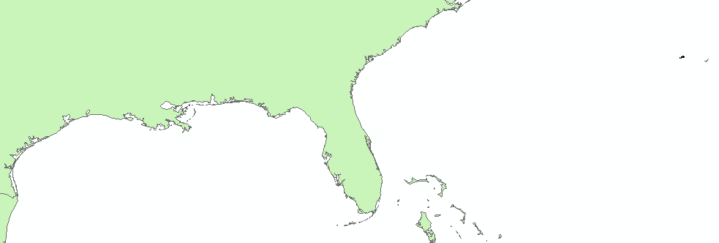
What’s Wrong with this Picture?
Elevation data for the intertidal zone of the Gulf of Mexico
Notes:
The spatial reference appears to be wrong!

Slide 8
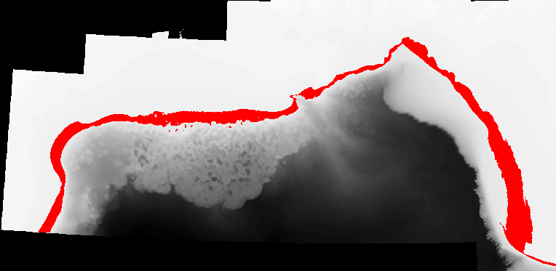
“No-Data” or NULL Values
Rasters are always rectangular
No-Data values are “transparent” and are not used for calcualations

Slide 9
NoData
Background: Bathymetry (depth) of the Gulf (black areas are NoData)
Red is adult shrimp habitat with all other areas “masked” out as “NoData”

Slide 10
Continuous vs. Categorized
Continuous:
  Like photographs
  Satellite and aerial photos
  Best for analysis
Categorized or discrete
  Land Cover
  Eco-regions
  Limited analysis
  Careful on precision and accuracy

Slide 11
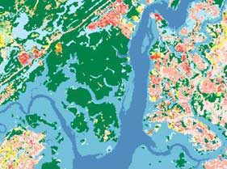
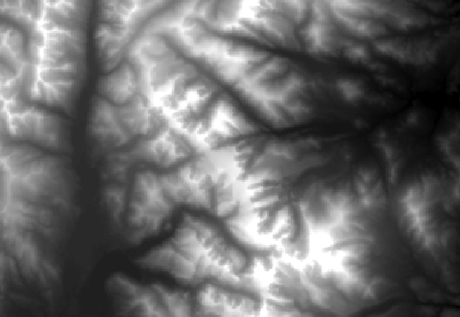
Categorical vs. Continuous
Land cover
Digital Elevation
Model (DEM)

Slide 12
Raster Sources
Scanned
  Topos
Remotely Sensed
  Aerial Photos
  Satellite Photos
  Digital Elevation Models (DEM)
Derived Rasters
  Hill shade
  Slope
  Aspect
  Statistical Spatial Analysis

Slide 13
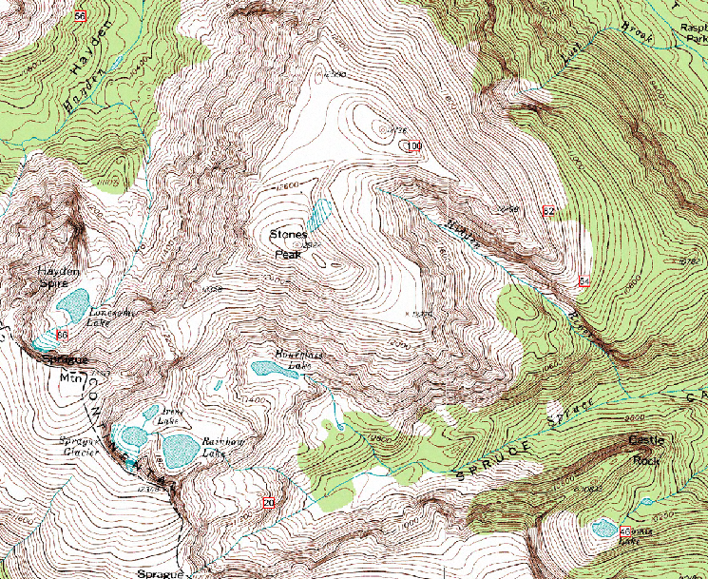
Digital Raster Graphic

Slide 14
Digital Elevation Model (DEM)
Each pixel value is an elevation

Slide 15
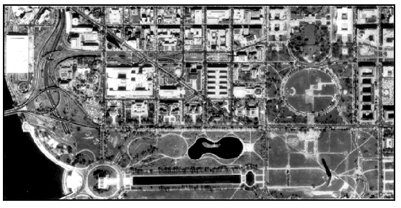
Digital Orthophoto Quadrangles (DOQ)
Digial Orthophoto Quarter Quad (DOQQ)
1 meter aerial photos
http://egsc.usgs.gov/isb/pubs/factsheets/fs05701.html

Slide 16
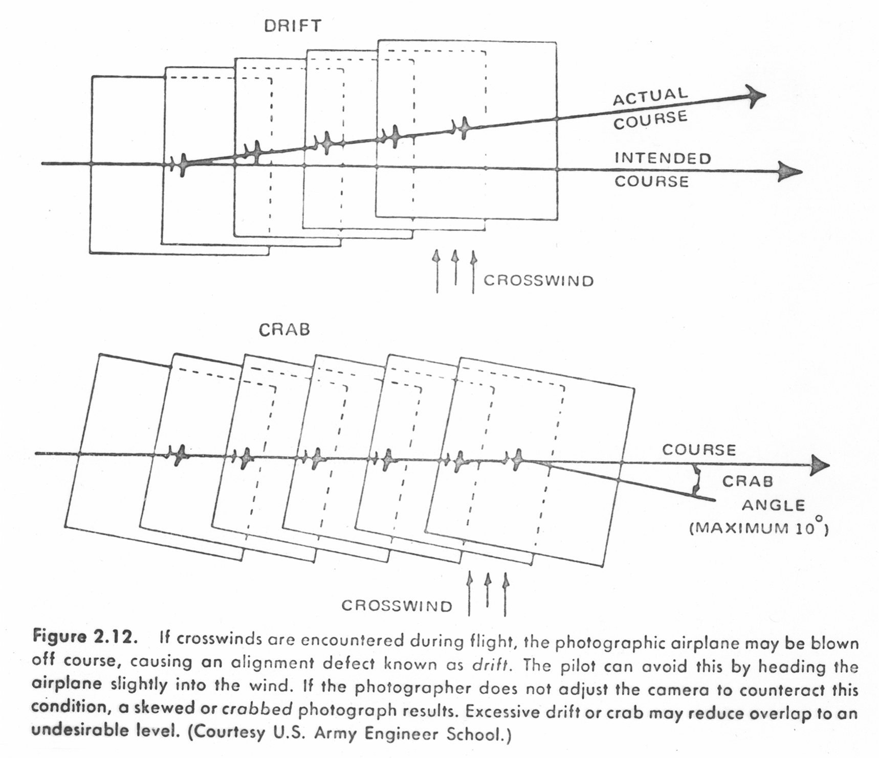
Flight Characteristics
Notes:
The flight characteristics also apply to satellites and cause the images to be rather strange shapes within a rectangular raster grid
The good news is that preprocessed, orthorectified images have all the distortion removed

Slide 17
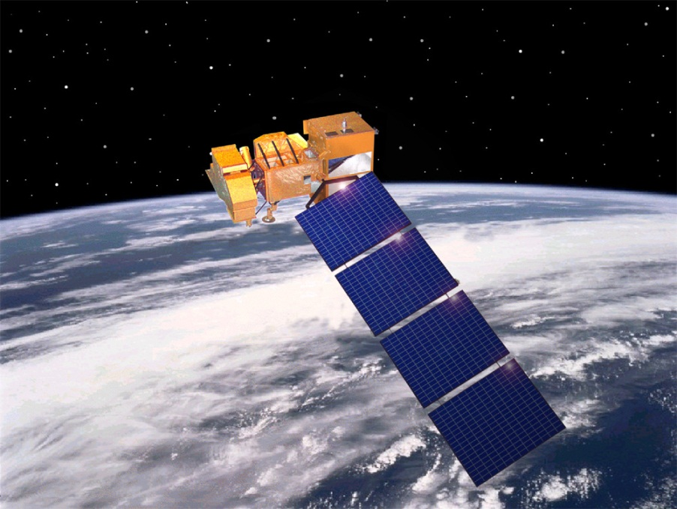
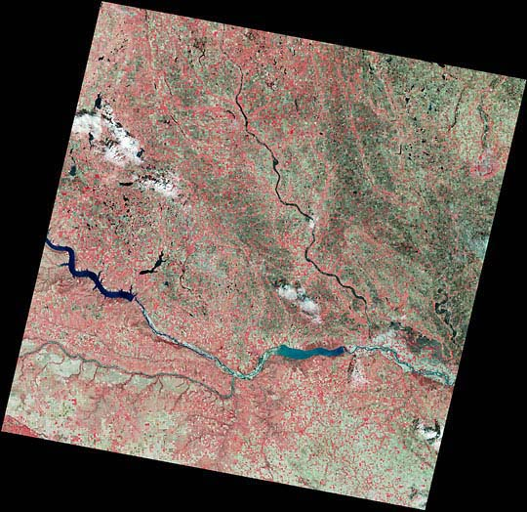
LandSat
7 Bands
30m, 15m bw
Entire earth
Twice a month
26 years of coverage
“Free”
EROS Data Center
NASA.gov

Slide 18
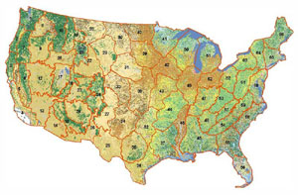
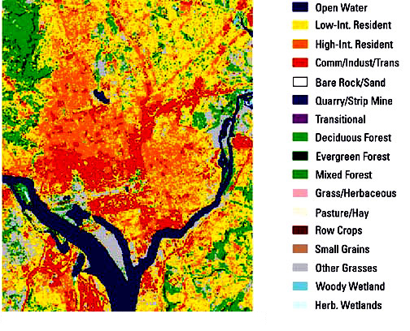
National Land Cover Dataset (NLCD)
Based on Landsat Imagery
21 Classes based on cover type
NLCD for Washington DC

Slide 19
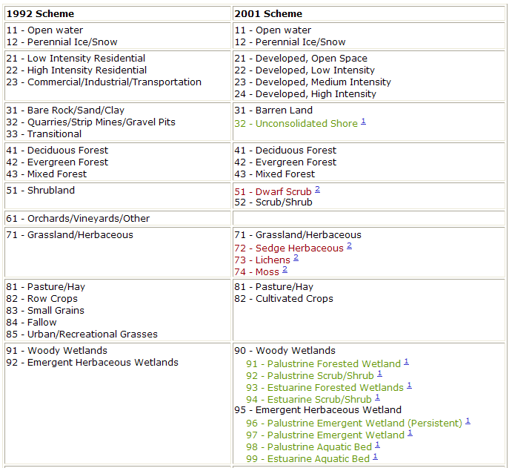
NLCD Coding Scheme
11 - Open water
12 - Perennial Ice/Snow
21 - Low Intensity Residential
22 - High Intensity Residential
23 - Commercial/Industrial/Transportation
31 - Bare Rock/Sand/Clay
32 - Quarries/Strip Mines/Gravel Pits
33 - Transitional
41 - Deciduous Forest
42 - Evergreen Forest
43 - Mixed Forest
51 - Shrubland
61 - Orchards/Vineyards/Other
71 - Grassland/Herbaceous
81 - Pasture/Hay
82 - Row Crops
83 - Small Grains
84 - Fallow
85 - Urban/Recreational Grasses
91 - Woody Wetlands
92 - Emergent Herbaceous Wetlands

Slide 20
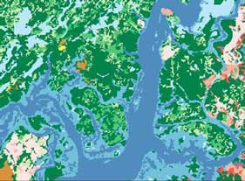
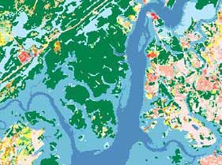
Change over time
1992
2006
2001

Slide 21
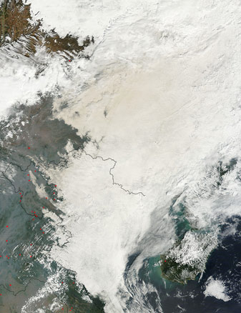
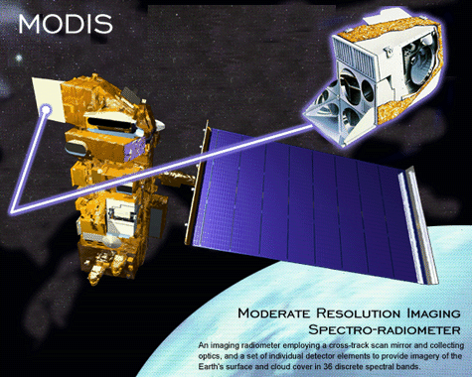
MODIS
Fires smoke and haze over China
256 Bands
250m
Entire earth
Twice a day
NASA.gov

Slide 22
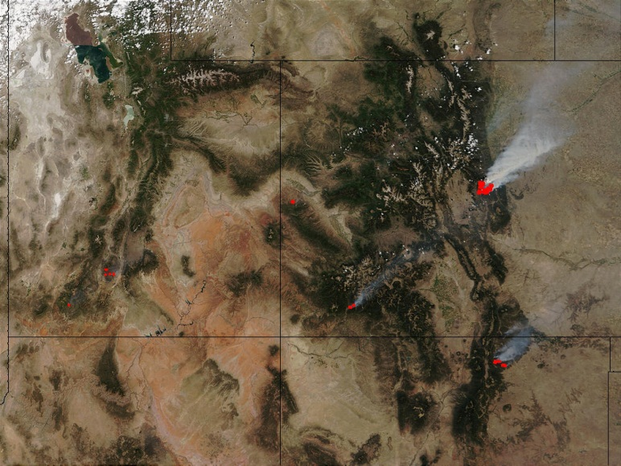
MODIS

Slide 23
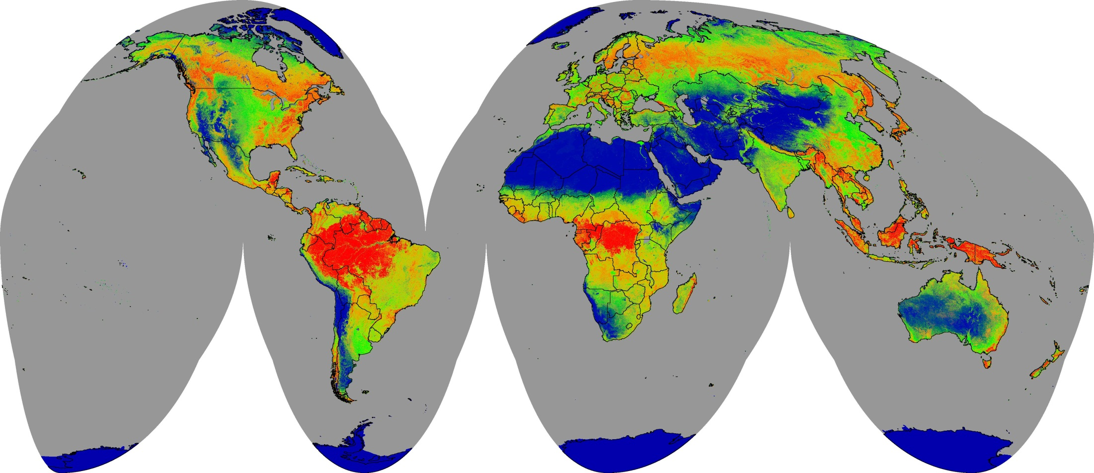
MODIS Vegetation Continuous Fields, Collection 3
Bare ground
Grass/shrubs/moss
Percent cover
0%
100%
Trees

Slide 24
Derived Rasters
Land Cover from satellite and aerial
Topography: Slope, aspect, hillshade
Ecoregions
Suitable Habitat
Flood plains
Geological Regions

Slide 25
GeoReferenced File Formats
GRID: ESRI’s format
GeoTIFF: Excellent support
MrSID: LizardTech
IMG: ERDAS
ECW: ERMapper
BIL, BIP, BSQ: See header
“ASCII” or “GRID ASCII” (asc)
Lots of others…
See: http://www.gdal.org/formats_list.html
http://webhelp.esri.com/arcgisdesktop/9.3/index.cfm?topicname=Technical_specifications_for_raster_dataset_formats

Slide 26
World Files
Contains:
  X-dimension Pixel size in map units
  Y-axis rotation
  X-axis rotation
  Y- dimension Pixel size in map units (negative)
  X-coordinate of upper-left pixel
  Y-coordinate of upper-left pixel
Image file contains width and height
TIFF World File: “.tfw”
JPEG World File: “jfw”

Slide 27
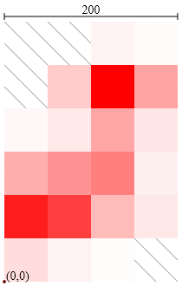
ASCII format (asc)
ncols 4
nrows 6
xllcorner 0.0
yllcorner 0.0
cellsize 50.0
NODATA_value -9999
-9999 -9999 5 2
-9999 20 100 36
3 8 35 10
32 42 50 6
88 75 27 9
13 5 1 -9999
See:
http://en.wikipedia.org/wiki/Esri_grid

Slide 28
Tagged Image File Format
TIFF
Can be georeferenced (GeoTIFF)
  Can tell in ArcCatalog or ArcMap
TIFF w/world file
  Also need Projection and Datum (prj?)
Can be compressed
  Run-length – Categorical data
  LZW – Categorical data
  Huffman encoding – Categorical data
  JPEG- Continuous data (don’t used on Categorical data!)

Slide 29
JPEG
Joint Photographic Experts Group
Widest used photo format
Can be Georeferened with a world file and a “prj” file
JPEG2000
  Completely new format!
  Can be georeferenced
  Not really adopted

Slide 30
GRIDS
ESRI’s native raster format
Pyramids
Not an exchange format!
Lots of files, easy to corrupt by moving part of the files (always use ArcCatalog to move these)
Being replaced by “IMG” files?

Slide 31
IMG – ERDAS Imagine
Esri’s new default
Internal geo-referencing
Recommended over Grids

