Slide 1
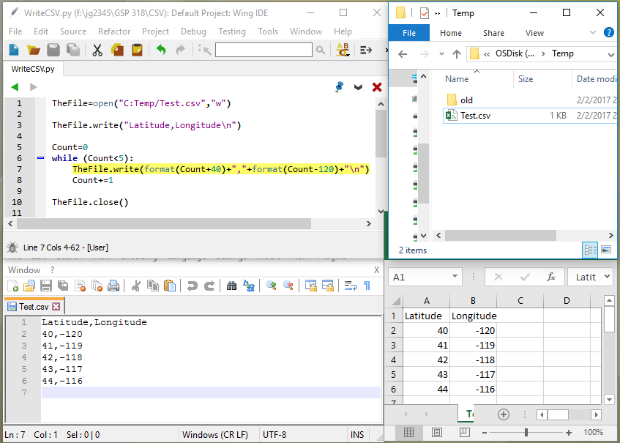
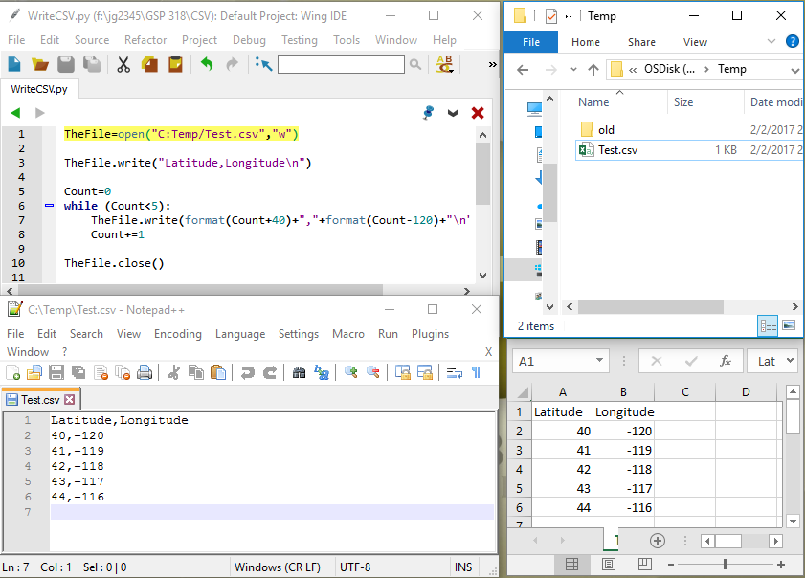
Creates the file on disk and opens it for writing
Creates the file and opens for writing

Slide 2
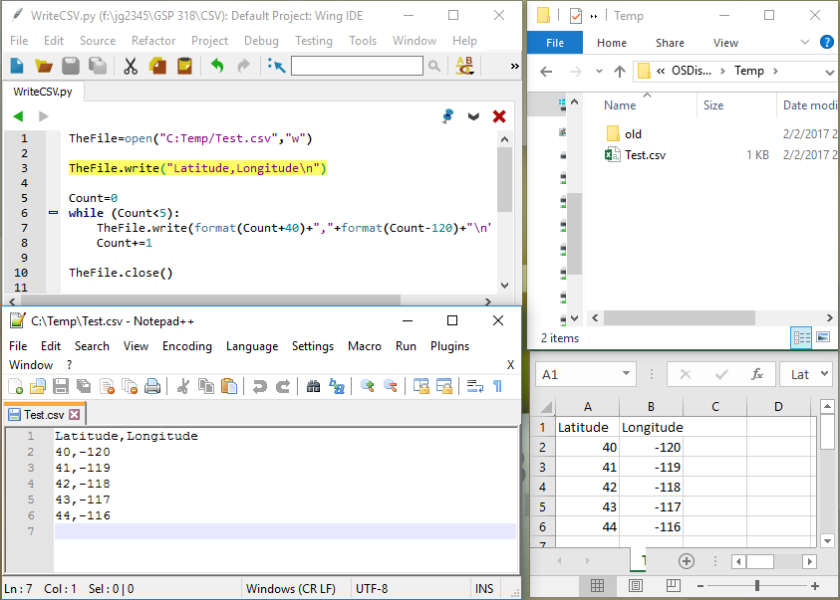
Adds the header to the file
Header appears in the first line
In Notepad and Excel

Slide 3
Comma appears
in Notepad
Comma separates values in rows in Excel

Slide 4
“/n” is hidden and moves Notepad to a new line
“\n” starts a new row in Excel

Slide 5
Adds a line to the file
Appears as a line in Notepad
Appears as a row in Excel

Slide 6
Format() converts a number to a string (i.e. text)
First number in the line in Notepad
First cell in row 2 in Excel

Slide 7
Comma appears
in Notepad
Comma separates values in rows in Excel

Slide 8
Format() converts a number to a string (i.e. text)
Second number in the line in Notepad
Second cell in row 2 in Excel

Slide 9
“/n” is hidden and moves Notepad to a new line
“\n” starts a new row in Excel

Slide 10
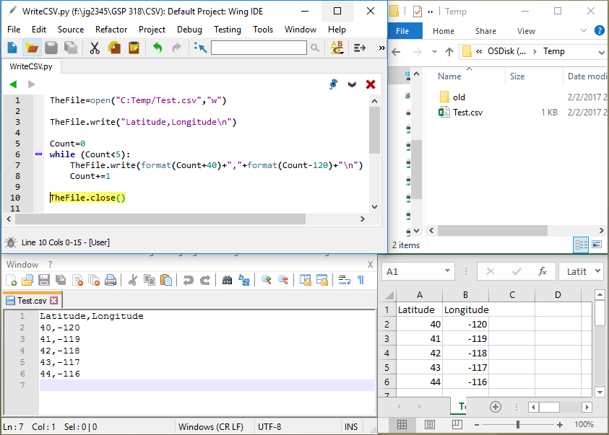
Closes the file so we can open it in Notepad, Excel, ArcMap, etc.

