Slide 1
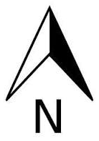
Δ Easting
Easting2
Northing2
Δ Northing
Bearing
Distance
Easting1
Northing1

Slide 2
Opposite
Adjacent
Angle
Hypotenuse

